Slide 1
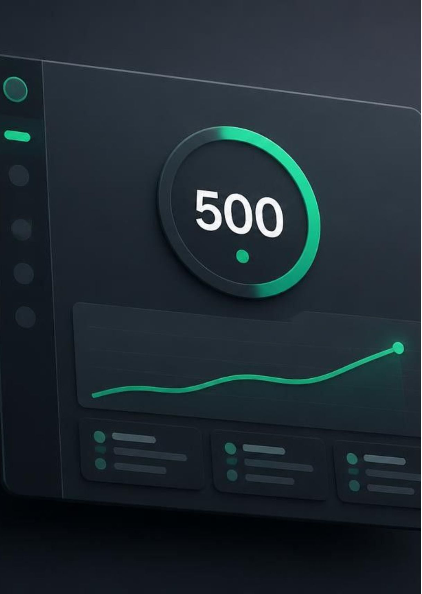
CAMPUS GROWTH SIMULATION · 7-DAY SPRINT
500 registrations in 7 days
Build Your First AI Project in 60 Minutes is a proposed campus growth architecture designed for final-year engineering students across key technical institutes.
Challenge: 500 final-year engineering student registrations target
Budget: ₹2,000 simulated campaign operating allocation
Status: Simulation only — evaluative model, no executed campaign results claimed
Notes:
Introduce the sprint challenge: 500 engineering student registrations in 7 days on a simulated ₹2,000 budget. Note upfront that all metrics are proposed models within our growth simulation environment.

Slide 2

Make the funnel visible before spending
Turn every acquisition touch into a measurable path from campus reach to registration, referral and workshop intent.
Reach
Convert
Compound
Campus communities, ambassadors and targeted retargeting.
Registration page with source and campaign attribution.
Referral code, leaderboard and student dashboard.
Simulation boundary: All numbers on this slide are Proposed or Simulated Target inputs, not observed performance.
Notes:
Walk through the three-stage path: campus reach, attributed registration, then referral and workshop intent.

Slide 3
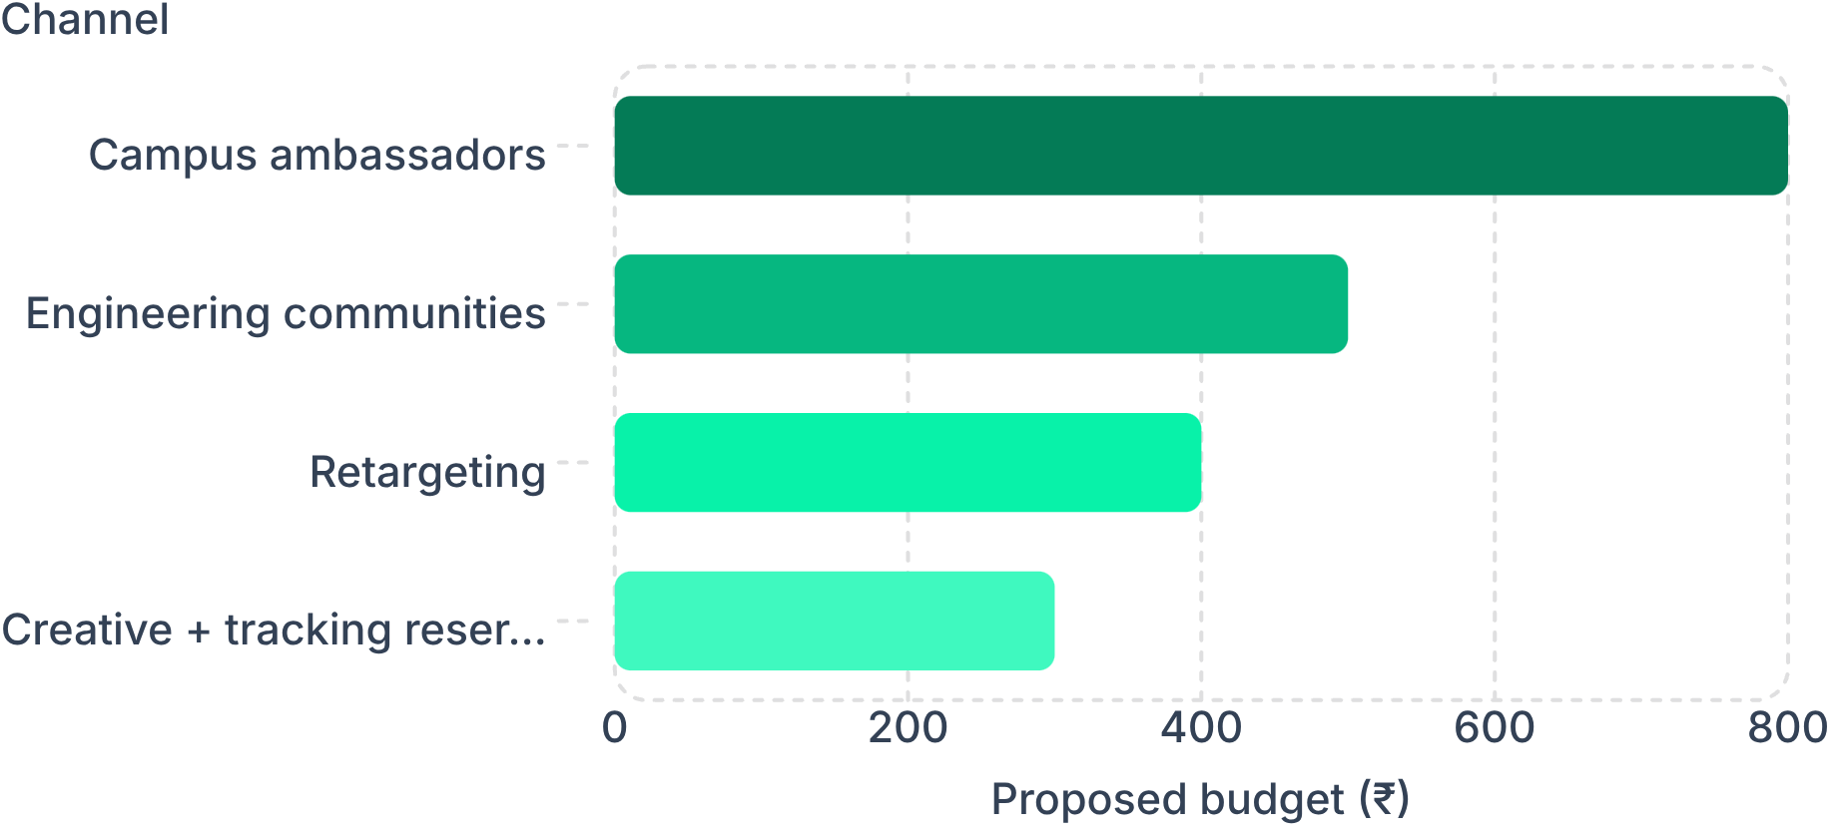
CAPITAL ALLOCATION · ₹2,000 SIMULATED BUDGET
Spend ₹2,000 where intent compounds
₹800 Proposed: campus ambassador prompts and peer distribution
₹500 Proposed: engineering community and WhatsApp placements
₹400 Proposed: retargeting visitors who reached the registration page
₹300 Proposed: creative, tracking and contingency
Simulated Target mix: 220 ambassador, 140 community, 100 referral, 40 retargeting registrations.
Notes:
Present the ₹2,000 simulated budget breakdown. The primary driver is peer-to-peer distribution (₹800 for 220 signups), supported by community seeding and retargeting, netting a simulated 500 total registrations.

Slide 4




PRODUCT MECHANISM · RETENTION & VIRALITY
Turn one student into a campus loop
The working product makes the growth loop tangible, trackable and easy to simulate.
Invite
Compete
Build
Return
Student registers and receives a referral link or code.
Campus leaderboard makes progress visible by college.
AI Project Playground gives the 60-minute workshop a concrete payoff.
WhatsApp reminders and the student dashboard pull students back into the journey.
Instrument referral tracking, college performance and campaign attribution at every step.
Notes:
Detail the 4-phase virality mechanism: Invite (peer referral), Compete (inter-college leaderboard), Build (immediate interactive AI playground), and Return (lifecycle retention nudges).

Slide 5
DECISION GOVERNANCE · SIMULATION CONTROL SURFACE
Judge the plan inside the simulation
Growth Admin acts as the evaluative console, verifying attribution and capital efficiency before launch.
TARGET BENCHMARK
Operating Telemetry & Controls
500
Readout | Operating Function
Source Attribution | Live channel mix monitoring to detect CPA divergence
Campus Board | Tracking registrations per college for targeted ambassador payouts
Referral Lift | Measuring organic multiplication factor from peer invites
Workshop Flow | Monitoring progress from signup to Playground completion
Simulated Target registrations within a 7-day execution window.
Core Decision Rule: Reallocate budget within 48 hours to whichever ambassador clusters yield a simulated referral k-factor > 0.25.
Notes:
Summarize the simulation operating model: the Growth Admin console enables real-time budget reallocation, channel pruning, and verification against the 500-registration target before deploying actual capital.

