Slide 1
Movie Recommendation System and Movie Data Visualizer Siva Ram Praneeth Vemulapalli (800966497) Vivekananda Adepu (800967951) Rohith Kumar Addagalla (800970444)

Slide 2
What is R?
R is influenced by S programming language
R and its libraries implement a wide variety of statistical and graphical techniques, including linear and nonlinear modeling, classical statistical tests, time-series analysis, classification, clustering, and others.

Slide 3
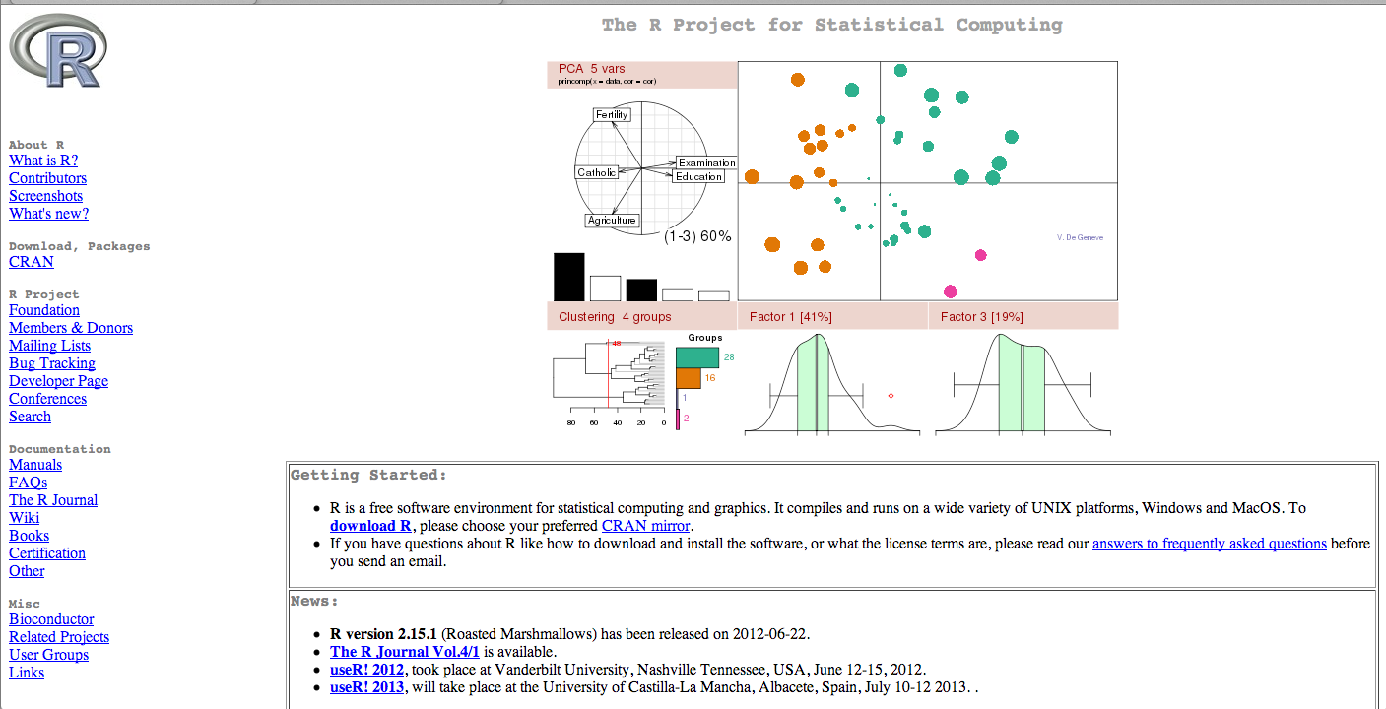
Getting Started:
To install R on your MAC or PC you first need to go to
http://www.r-project.org/.

Slide 4
Elements in R:
Keywords:
if, else
repeat
while , for
function
NULL, Inf, NaN, NA
in
next, break
TRUE, FALSE
R Data Types:
Vectors
Lists
Arrays
Data Frames

Slide 5
Operators in R:
Arithmetic Operators:
Operator Description
+ addition
- subtraction
* multiplication
/ division
^ or ** exponentiation
x %% y modulus (5%%2 is 1)
x %/% y integer division 5%/%2=2
Logical operators:
Operator Description
< less than
<= less than or equal to
> greater than
>= greater than or equal to
== exactly equal to
!= not equal to
!x not x
x | y x OR y

Slide 6
Matrices:
Matrices are the R objects in which the elements are arranged in a two-dimensional rectangular layout. They contain elements of the same types. A matrix is created using matrix() function. >a = matrix(c(3:14), nrow = 4, byrow = TRUE) # Matrix is created
>a
[,1] [,2] [,3] [1,] 3 4 5 [2,] 6 7 8 [3,] 9 10 11 [4,] 12 13 14
Elements of matrix can be accessed by using row and column index of the element. >a[3,3]
Various mathematical operations are performed on the matrices using the R operators of the same dimensions. The result of the operation is also a matrix.

Slide 7
Arrays:
Arrays are the R data objects which can store data in more than two dimensions. An array is created using the array() function. It takes vectors as input and uses the values in the dim parameter to create an array.
>arr = array(c(c(5,9,3), c(10,11,12,13,14,15)),dim = c(3,3,2)) # Array is created
>arr
, , 1 [,1] [,2] [,3] [1,] 5 10 13 [2,] 9 11 14 [3,] 3 12 15 , , 2 [,1] [,2] [,3] [1,] 5 10 13 [2,] 9 11 14 [3,] 3 12 15
Array elements can be accessed and manipulated in similar to accessing and manipulating matrix elements.

Slide 8
Built in Functions
R has many built in functions that compute different statistical procedures.
Functions in R are followed by ( ).
Inside the parenthesis we write the object (vector, matrix, array, dataframe) to which we want to apply the function.

Slide 9
Movie Recommendation System and Movie Data Visualizer
Collaborative filtering is the process of filtering for information or patterns using techniques involving collaboration among multiple agents, viewpoints, data sources, etc.
The basic idea of CFR systems is that, if two users share the same interests in the past, e.g. they liked the same book or the same movie, they will also have similar tastes in the future.
In this project, to recommend movies, we are going use a large set of users preferences towards the movies from a publicly available movie rating dataset.

Slide 10
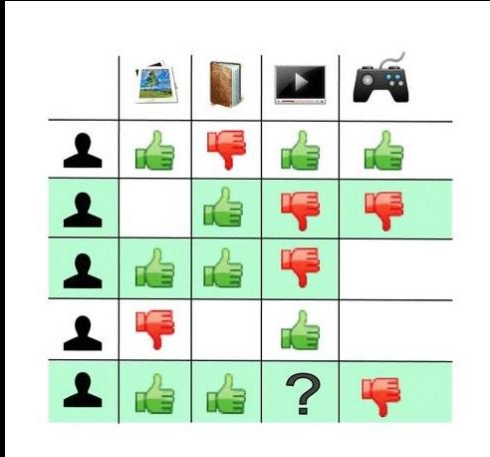
User based collaborative filter

Slide 11
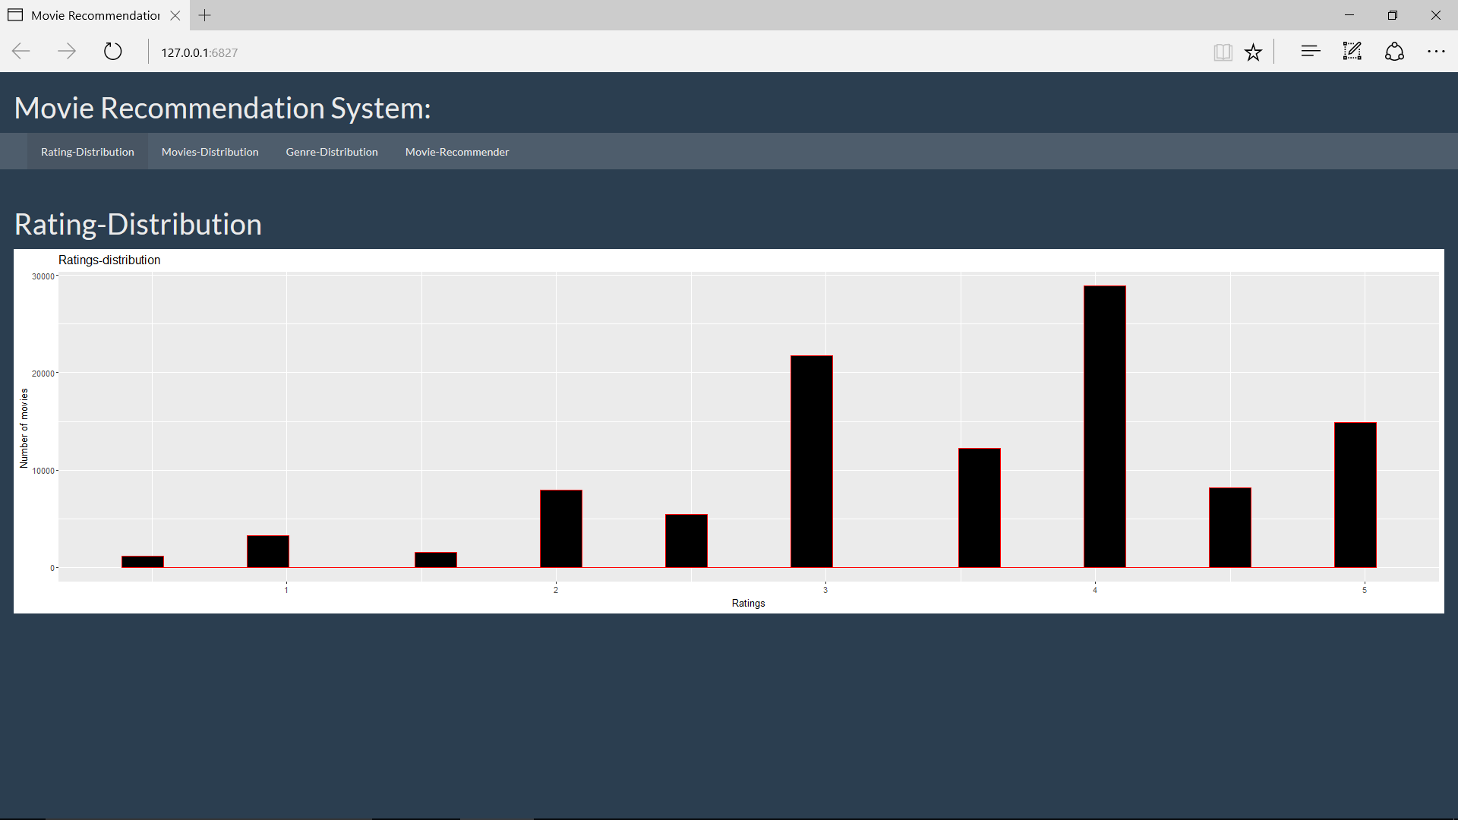
Rating-Distribution

Slide 12
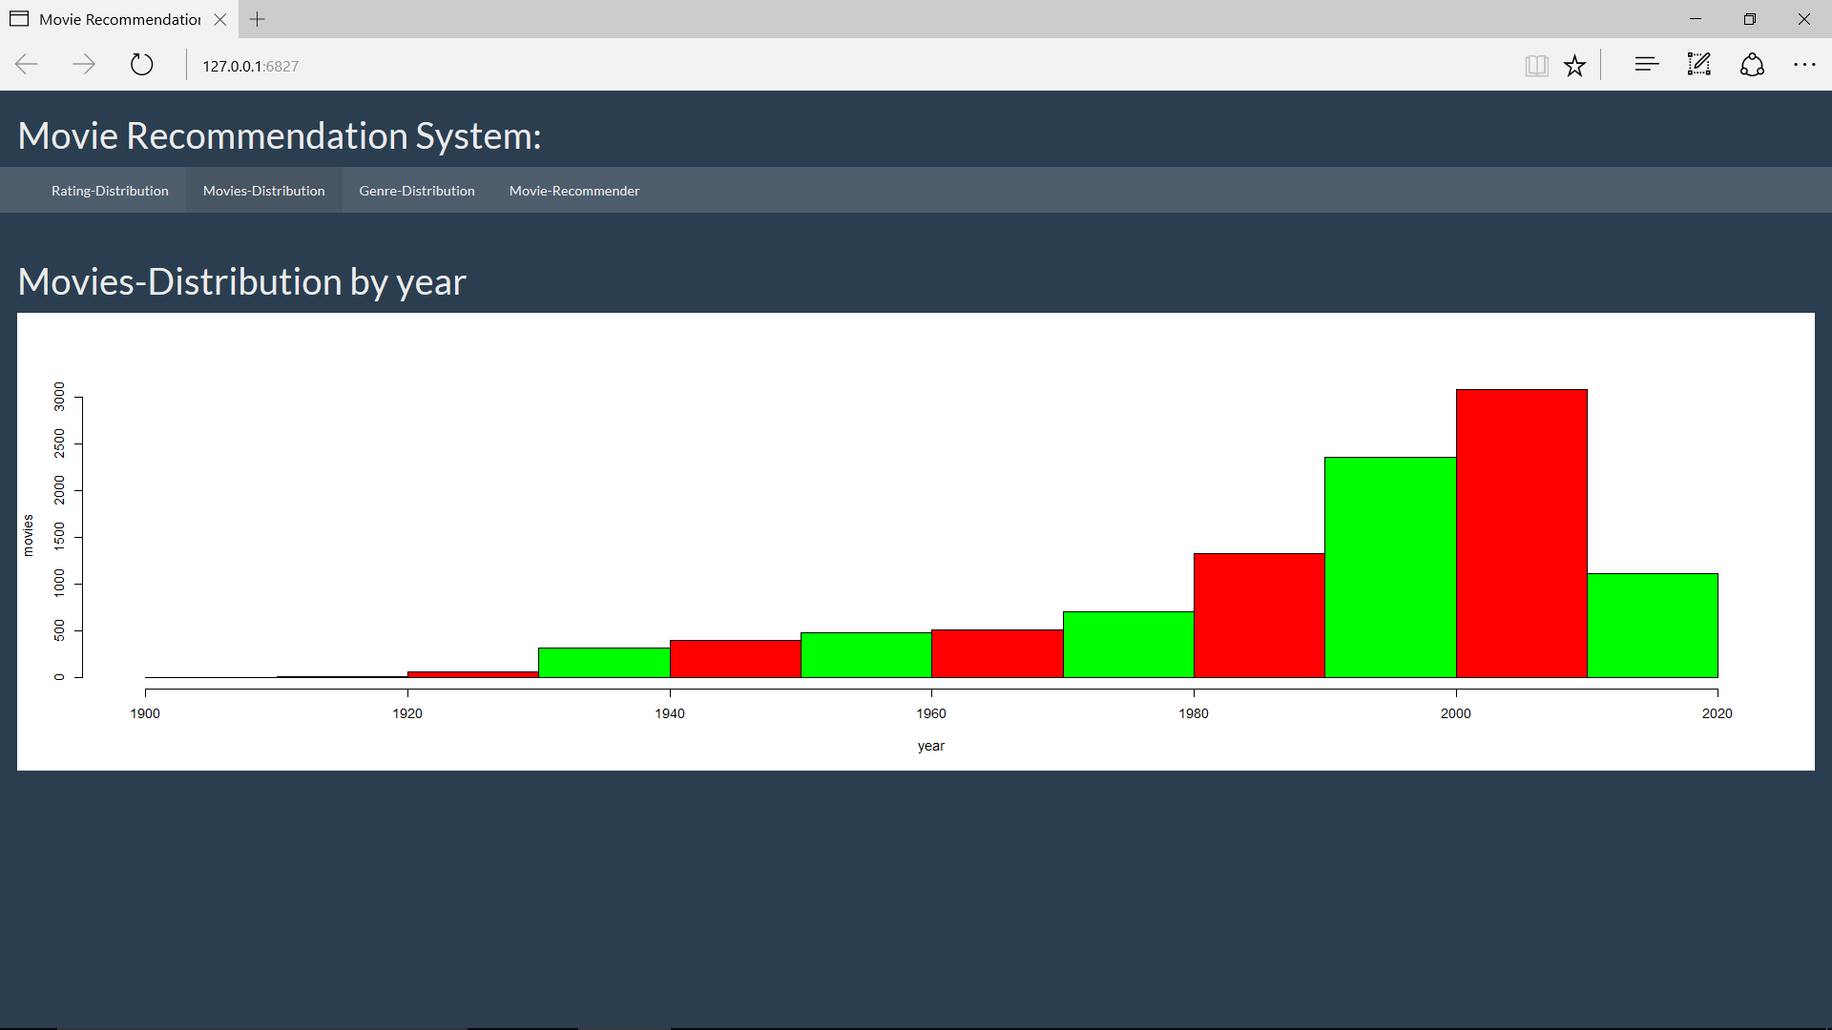
Movies-Distribution

Slide 13
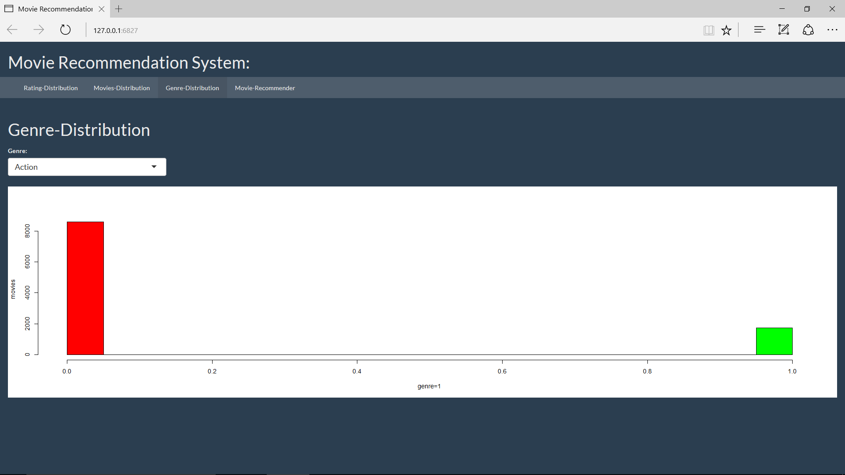
Genre-Distribution

Slide 14
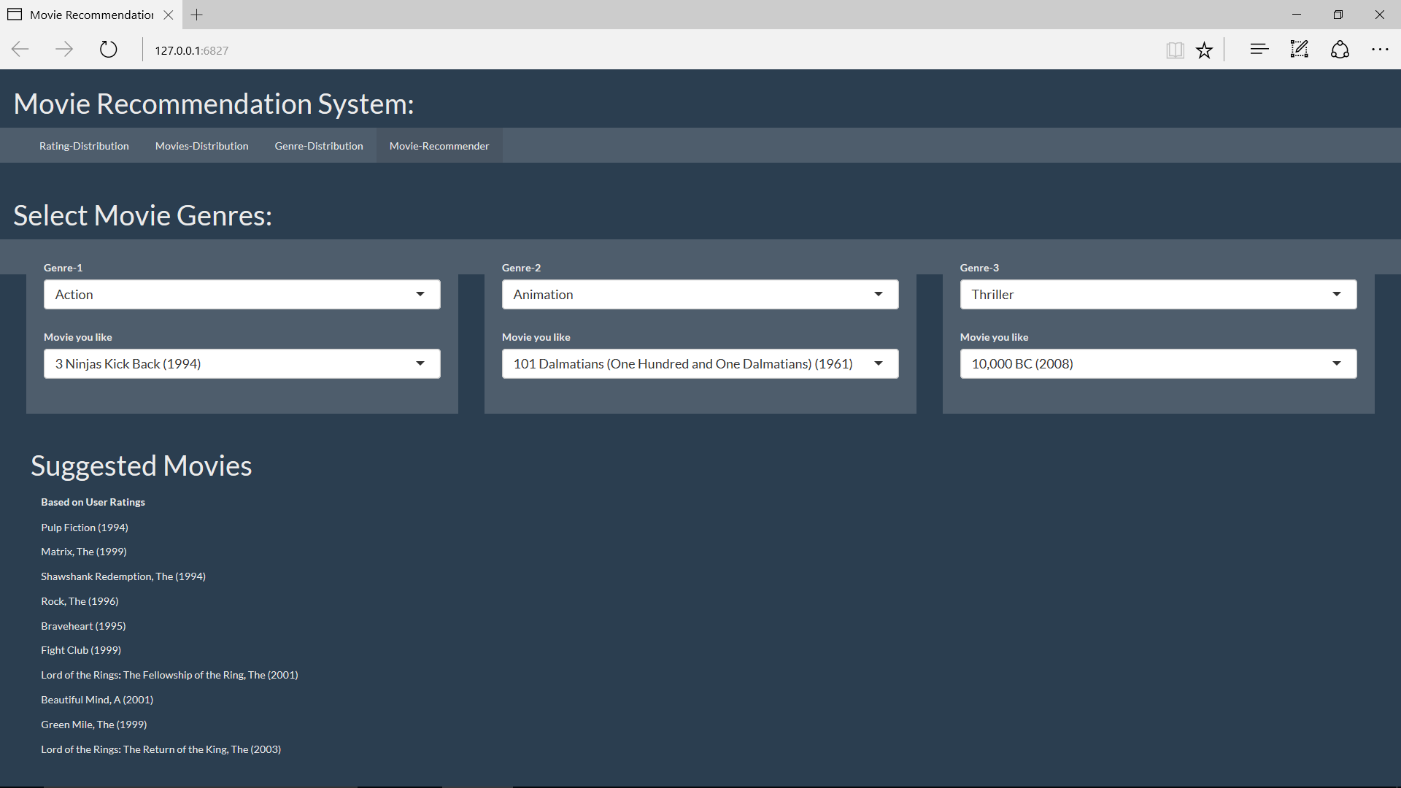
Movie-Recommender

