Slide 1

AI Powered Decentralized Healthcare Record Exchange, Intelligent Clinical Decision Support and Blockchain Enabled Organ Donation Network
Presented by:
PERAM VIVEKANANDA REDDY(192372330)
B RAMA KRISHNA(192311277)
S.KARTHIKEYAN (192419048)
Supervised By:
DR . VEERAMANI

Slide 2


introduction
An AI-powered decentralized healthcare platform enables secure sharing of patient medical records across hospitals using blockchain technology.
The system uses Artificial Intelligence to analyze patient history, laboratory reports, medical images, and symptoms to assist doctors in making accurate clinical decisions.
Blockchain ensures that healthcare records remain tamper-proof, transparent, and accessible only to authorized users while maintaining complete patient privacy.

Slide 3
Objectives
To develop a decentralized healthcare record exchange system using blockchain for secure medical data sharing.
To provide AI-powered clinical decision support for accurate disease diagnosis and treatment recommendations.
To ensure patient privacy, transparency, and data integrity through decentralized blockchain architecture.

Slide 4
Problem-Statement
Healthcare records are stored in isolated hospital databases, making information sharing difficult.
Patients often undergo repeated medical tests because hospitals cannot access previous records.
Medical data is vulnerable to unauthorized access, modification, and cyber-attacks.

Slide 5
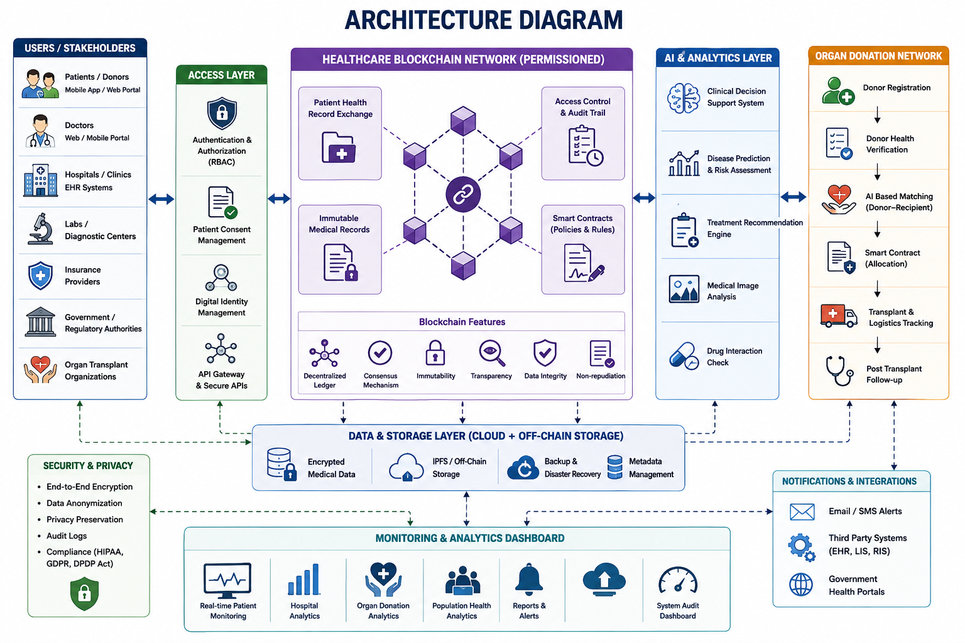

Slide 6
Module 1:Decentralized Healthcare Record Exchange Module
Stores patient medical records securely on a blockchain-based decentralized network.
Enables authorized hospitals and doctors to access patient records instantly with patient consent.
Eliminates duplicate medical records and repeated diagnostic tests.

Slide 7
Module 2: AI Clinical Decision Support Module
Uses Artificial Intelligence and Machine Learning algorithms to analyze patient symptoms, medical history, and laboratory reports.
Assists doctors in disease prediction, diagnosis, and treatment planning.
Provides personalized medication recommendations and risk assessment.
Detects chronic diseases at early stages using predictive analytics.

Slide 8
Module 3: Blockchain Enabled Organ Donation Network
Maintains secure donor and recipient registration using blockchain.
Matches organ donors and recipients using AI-based compatibility analysis.
Uses smart contracts to automate verification and approval processes.
Ensures transparent organ allocation without human manipulation.
Maintains complete traceability of organ transportation and transplantation

Slide 9
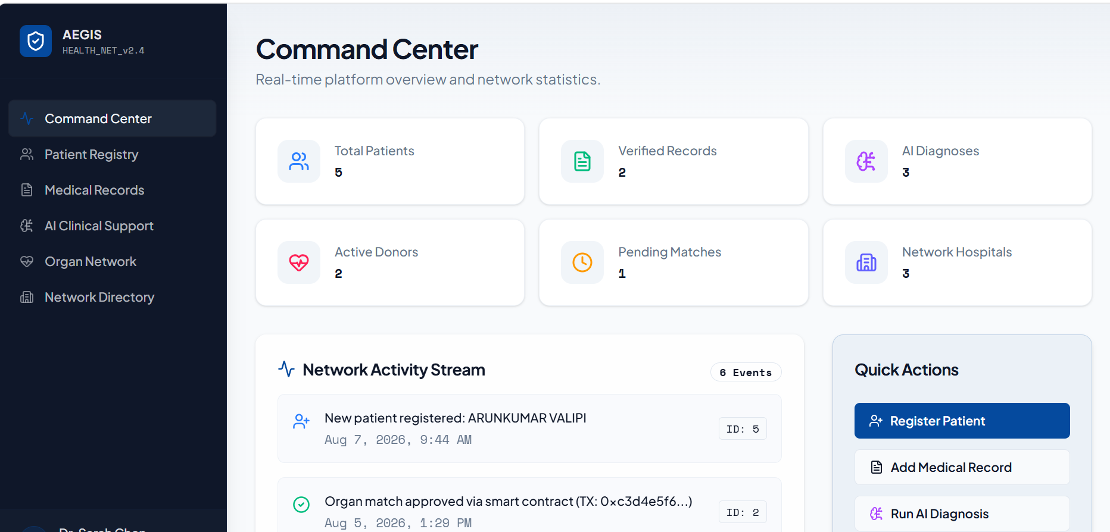
INTERFACE

Slide 10
TECHNOLOGIES
Frontend: React.js / Flutter
Backend : Python (Flask/Django) or Node.js
Database: MongoDB / PostgreSQL
AI: TensorFlow / Scikit-learn
Blockchain: Ethereum / Hyperledger Fabric / Polygon
Storage: IPFS(Interplanetary File System)

Slide 11
Conclusion and Future Enhancement
Successfully integrates Artificial Intelligence, Blockchain, and Cloud Computing to provide a secure and decentralized healthcare ecosystem.
Enables secure healthcare record exchange, intelligent clinical decision support, and transparent organ donation management.
Improves patient privacy, reduces medical errors, and enhances treatment accuracy through AI-driven healthcare analytics.

Slide 12
REFERENCES
Azaria, A., Ekblaw, A., Vieira, T., & Lippman, A. (2016). MedRec: Using Blockchain for Medical Data Access and Permission Management. 2nd International Conference on Open and Big Data (OBD), IEEE.
Kuo, T.-T., Kim, H.-E., & Ohno-Machado, L. (2017). Blockchain Distributed Ledger Technologies for Biomedical and Health Care Applications. Journal of the American Medical Informatics Association (JAMIA), 24(6), 1211–1220.
Kourou, K., Exarchos, T. P., Karamouzis, M. V., & Fotiadis, D. I. (2015). Machine Learning Applications in Cancer Prognosis and Prediction. Computational and Structural Biotechnology Journal, 13, 8–17.
Griggs, W. M., Ossipova, O., Bebbington, J., et al. (2018). A Blockchain-Enabled Model for Organ Donation and Transplantation. IEEE/ACM International Conference on Connected Health: Applications, Systems and Engineering Technologies.

Slide 13
Thank You

