Slide 1

IOT BASED HOME AUTOMATION
Guided by
Prof Senthil Kumar N
Vivekananthan S (21BCS0078)
Dhanush K (21BCS0166)

Slide 2

Abstract
This project explores the design and implementation of a smart home system that helps you in remotely access to the home appliances which is connected on a network. IOT (Internet of Things) gives access to your devices whenever and wherever you are in the world with an internet access. Assume that a physically challenged people who cannot move by his own or else people with busy schedule and forgets to turn off light, fan, etc. So, for people like them can now have their control over the home appliances remotely. Here we’ll be implementing the IOT based home automation system which helps in turn off/on lights, fan also according to the room temperature the fan will adjust the speed and gives alert if it senses any fire or smoke. Utilizing an ESP32 microcontroller, sensors, and a mobile application platform, the system aims to enhance the comfort, security, and energy efficiency within the home.

Slide 3
HARDWARE Used
ESP32
(MICRO-CONTROLLER)
Arduino UNO
MQ5 (Gas Sensor)
Relay
Motion Sensor
Temperature Sensor(ds18b20)
Current Sensor(ACS712 – 20A)
Servo Motor
Photoresistor
Buzzer
Led
5v Fan
Bulb

Slide 4

software Used
Flutter
Firebase
Arduino IDE
Mosquitto MQTT
YOLO v8(Pre-trained AI Model)
Yawcam

Slide 5
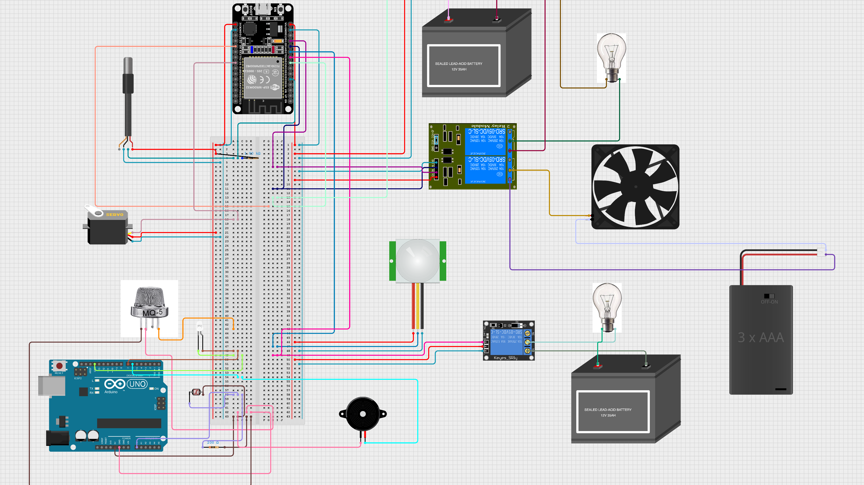
CIRCUIT DIAGRAM

Slide 6




Data Exchange
Data
Data
Firebase Database
Flutter App
ESP 32

Slide 7

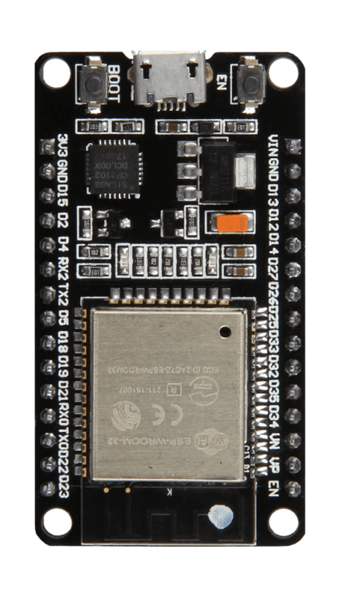


AI Data Exchange
WEB CAM
Reply
Request
Reply
Request
0,1
Server
MQTT Broker
Micro controller

Slide 8
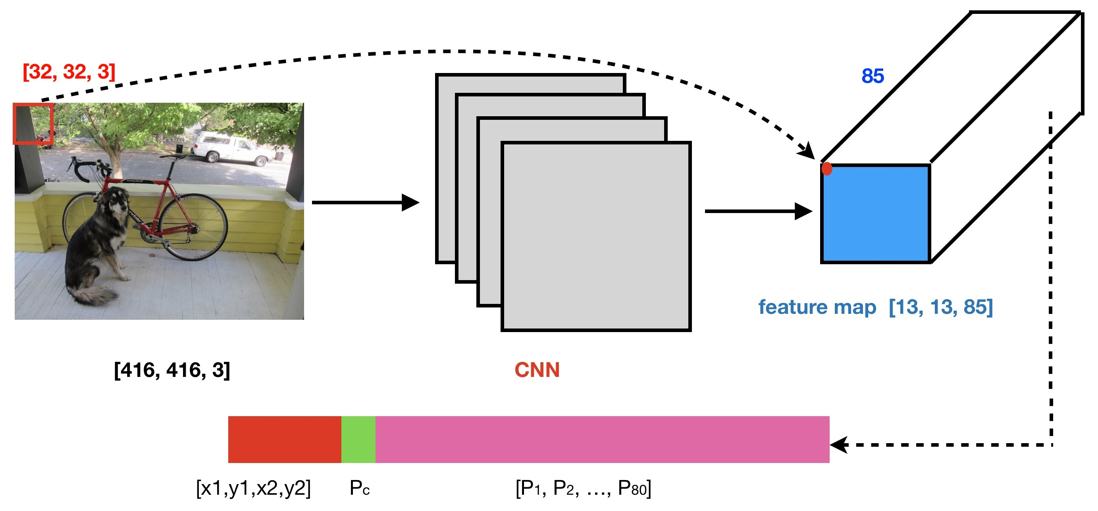

Slide 9


