Slide 1
Employee Data Analysis using Excel
STUDENT NAME: Viveka.V
REGISTER NO: 122203116 & [unm14512022h57]
DEPARTMENT:B.com(Corporate Secretaryship)
COLLEGE: Mahalashmi Women's College of Arts and Science

Slide 2
PROJECT TITLE
Employee Performance Analysis using Excel

Slide 3


AGENDA
Problem Statement
Project Overview
End Users
Our Solution and Proposition
Dataset Description
Modelling Approach
Results and Discussion
Conclusion
3/21/2024 Annual Review

Slide 4

PROBLEM STATEMENT
1. The organization is experiencing challenges in effectively assessing and improving employee performance. 2. Current performance evaluation methods are inconsistent, subjective, and fail to identify key areas where employees require development.
3. This leads to suboptimal productivity, unaddressed skill gaps, and decreased employee morale.

Slide 5

PROJECT OVERVIEW
1. Evaluate Performance: Measure individual and team performance against predefined metrics. 2. Identify Strengths and Weaknesses: Determine areas where employees excel and where improvement is needed. 3. Support Career Development: Provide data-driven insights to support employee growth, training, and development plans.
.

Slide 6

WHO ARE THE END USERS?
1. IT COMPANIES
2. BANKS
3. INDUTRIES
4. HUMAN RESOURCE DEPARTMENT

Slide 7

OUR SOLUTION AND ITS VALUE PROPOSITION
1. Conditional Formatting
2.Filtering
3.Employee data
4.Formula used to identify performance level
5.Pivotal table for summarising
6.Bar graph
7.Pie chart

Slide 8
Dataset Description
1. Employee data downloaded from Edunet dashboard
2. Features:
Totally 26 features are available in that 11 considered

Slide 9

THE "WOW" IN OUR SOLUTION
Performance level =IFS(Z8>=5,"VERY HIGH",Z8>=4,"HIGH",Z8>=3,"MED",TRUE,"LOW")
3/21/2024 Annual Review
9

Slide 10
MODELLING
1. Data Collection: Downloaded the data from edunet student's dashboard. 2. Feature Collection: Highlighted data which is required using the fill option. 3. Data Cleaning: Identified the missing values using conditional formatting. Removed/Filtered the missing data using filter-filter by colour. 4. Performance level: Performance Analysis is based on Department type is filtered by gender (Male employees)
10

Slide 11
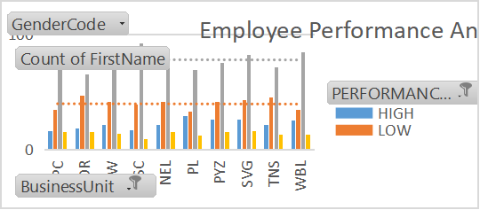
RESULTS
11

Slide 12
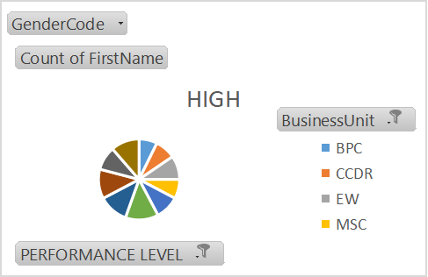
RESULTS

Slide 13
conclusion
Overall, the employee's contributions have been valuable, and with focused development, they have the potential to further enhance their performance and impact on the team.
The performance analysis indicates that the employee has consistently met or exceeded expectations in several key areas, including [mention specific areas such as project management, customer relations, etc.].
A conclusion for an employee performance analysis should succinctly summarize the key findings, highlight areas of strength, and identify opportunities

