Slide 1
WELCOME
OUR TEAM MEMBERS
A. DEVI LIKITHA (Y24ST20002)
B. ARUN KUMAR(Y24ST20003)
B. VIVEK(Y24ST20005)
CH. HARITHA(Y24ST20006)
G. SRAVANI(Y24ST20012)
G. CHAMUMDESWARI(Y24ST20013)
PROJECT SUPERVISOR
DR.A.VASUDEVA RAO
HONORARY PROFESSOR
DEPARTMENT OF STATISTICS
ACHARYA NAGARJUNA UNIVERSITY
NAGARJUNA NAGAR

Slide 2

PREDICTION OF LUNG CANCER USING LOGISTIC REGRESSION ANALYSIS

Slide 3
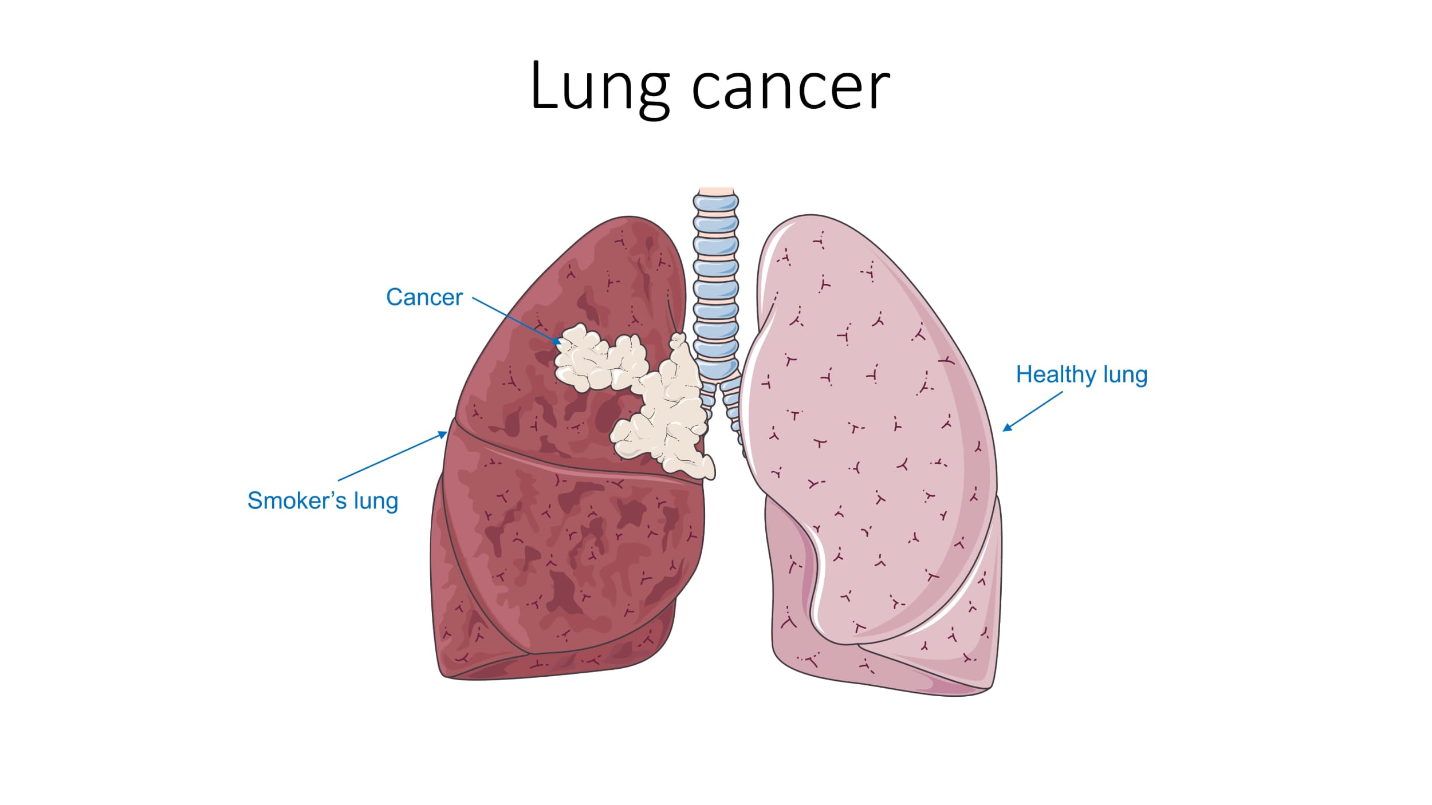
CHAPTER-1
INTRODUCTION TO LUNG CANCER
DEFINITION
2. CAUSES AND RISK FACTORS
3. ADVANCEMENTS IN TECHNOLOGY & TREATMENT
4. CONCLUSION

Slide 4
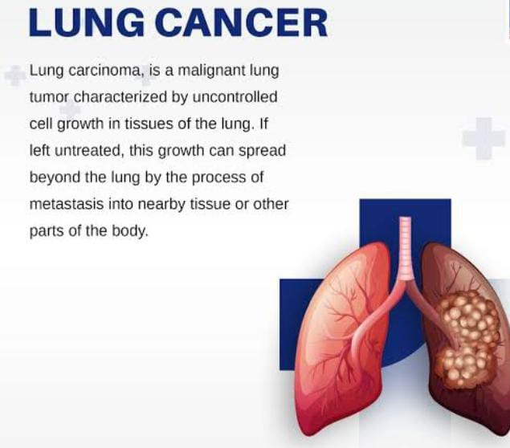
1. DEFINITION

Slide 5
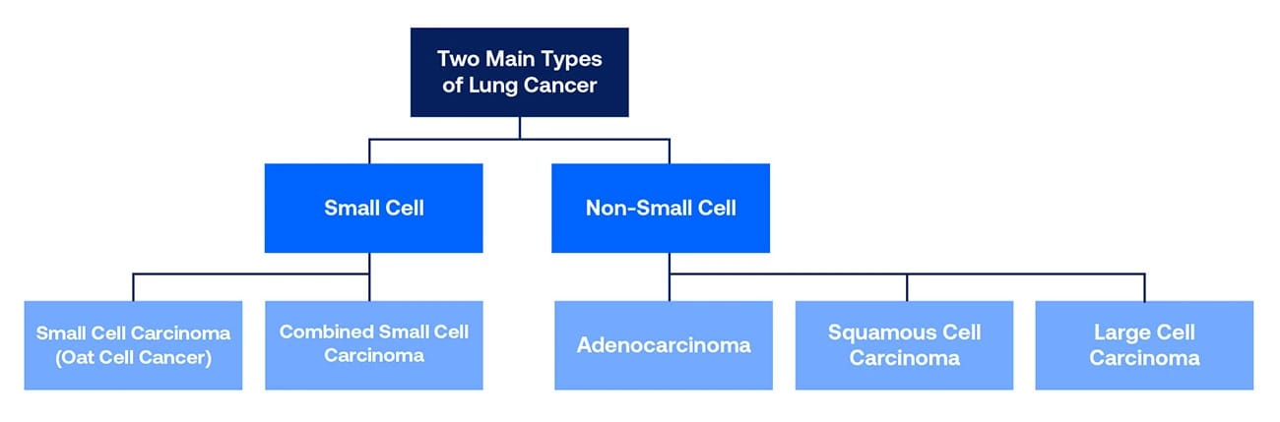

Slide 6
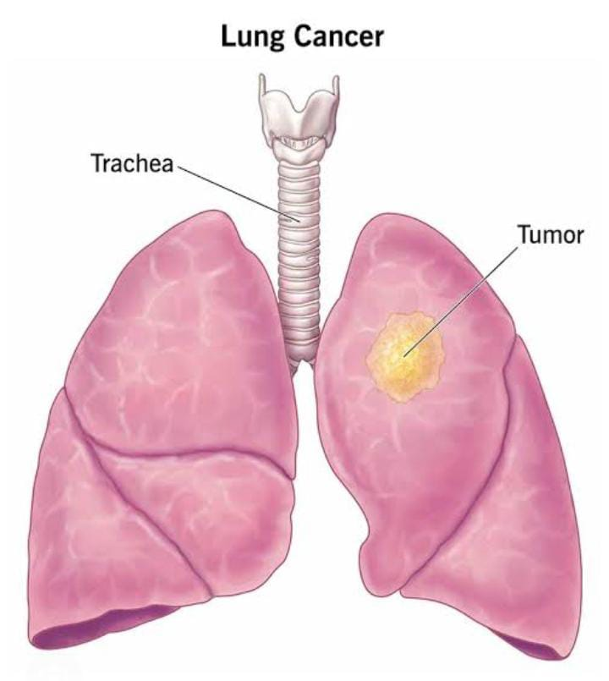
Overview of Lung Cancer
Lung cancer primarily originates in the cells lining the bronchi and other parts of the lung. There are two main types: non-small cell lung cancer (NSCLC), which accounts for about 85% of all cases, and small cell lung cancer (SCLC), which is more aggressive but less common. NSCLC includes subtypes like adenocarcinoma, squamous cell carcinoma, and large cell carcinoma. SCLC, on the other hand, tends to spread more quickly and is often diagnosed at an advanced stage.

Slide 7

2.Causes and Risk Factors
The primary cause of lung cancer is smoking, responsible for nearly 85% of all cases. However, non-smokers are also at risk due to factors like air pollution, genetic mutations, and exposure to harmful chemicals such as asbestos and radon. Early detection is crucial, as it dramatically improves survival rates, but this is often difficult because symptoms can remain hidden until the disease reaches an advanced stage.

Slide 8

Lung cancer is one of the most serious and widespread forms of cancer, accounting for a significant portion of global cancer-related deaths. It arises from the uncontrolled growth of abnormal cells in the lung tissues, which can spread to other parts of the body if left untreated. Despite major advancements in cancer research, lung cancer remains a critical challenge due to its aggressive nature, late-stage diagnosis, and complex treatment options.
One of the biggest challenges in lung cancer treatment is early detection. Most lung cancers are diagnosed at an advanced stage, when the prognosis is poor. This is partly due to the lungs' large size and capacity to compensate for impaired function, which allows tumors to grow undetected for months or even years. Additionally, the lack of effective screening programs in many countries further complicates early diagnosis.

Slide 9

3.Advancements in Technology and Treatment
Given the high mortality rate of lung cancer, prevention and early detection are critical. Public health campaigns focusing on smoking cessation, reducing exposure to air pollution, and promoting regular health check-ups can significantly reduce the incidence of lung cancer. Additionally, raising awareness about early symptoms and risk factors can encourage at-risk populations to seek medical advice sooner, potentially improving survival rates.
Symptoms
Common symptoms of lung cancer include:
1. Persistent Coughing: A cough that doesn't go away or gets worse over time.
2. Chest Pain or Discomfort: Pain or discomfort in the chest, shoulder, or back.
3. Coughing up Blood or Rust-Colored Mucus: Coughing up blood or rust-colored mucus can be a sign of lung cancer.
4. Shortness of Breath: Feeling short of breath or experiencing wheezing.
5. Fatigue: Feeling tired or weak.
6. Weight Loss: Unexplained weight loss.

Slide 10

Diagnosis
Diagnosing lung cancer typically involves:
1. Imaging Tests: X-rays, CT scans, MRI scans, or PET scans can help detect tumors.
2. Biopsies: A biopsy involves removing a sample of tissue from the lungs for examination.
Treatment Options
Treatment options for lung cancer depend on the stage and type of cancer, as well as overall health. Options may include:
1. Surgery: Surgery can be used to remove tumors or affected lung tissue.
2. Chemotherapy: Chemotherapy uses medications to kill cancer cells.
3. Radiation Therapy: Radiation therapy uses high-energy rays to kill cancer cells.
4. Targeted Therapy: Targeted therapy uses medications that target specific cancer cells.
5. Immunotherapy: Immunotherapy uses medications that stimulate the immune system to fight cancer.

Slide 11

Prevention
Preventing lung cancer involves:
1. Quitting Smoking: Quitting smoking can significantly reduce the risk of lung cancer.
2. Avoiding Exposure to Carcinogens: Avoiding exposure to radon, asbestos, and other carcinogens can reduce the risk.
3. Maintaining a Healthy Lifestyle: Eating a healthy diet, exercising regularly, and maintaining a healthy weight can help reduce the risk.

Slide 12
4.Conclusion
In summary, lung cancer is a complex and challenging disease with high mortality rates, primarily due to its aggressive nature and late-stage diagnosis. However, advancements in technology, personalized medicine, and early detection hold promise for improving patient outcomes. Continued research, public awareness, and early screening programs are essential in the global fight against lung cancer.
Using the patient's various cardiac characteristics and the R language approach of logistic regression on a publicly accessible dataset from Kaggle, we developed and examined models for predicting lung cancer disease in this project.
This study aims to establish the most significant heart disease risk factors and estimate the overall risk using logistic regression.
To overcome difficulties with classification, we employ logistic regression. Instead of using linear regression, which denotes continuous progress, it does this by forecasting categorical outcomes. An example of a binomial, which has two possible results in the most straightforward instance, is the prediction of heart disease, which has been steadily rising in prevalence worldwide. The primary goal of developing this approach was to forecast the likelihood of developing heart disease ten years from now. The Kaggle dataset, which has 800 observations, forecasts the likelihood that a patient in a specific location will develop heart disease. In this study, we used R software to predict heart disease using the patient data provided.

Slide 13
CHAPTER-2
METHODOLOGY
1.STUDY DESIGN
2. LOGISTIC REGRESSION
1. Study Design
The study adopts a quantitative, observational research design to develop a predictive model for lung cancer diagnosis using logistic regression, implemented in the R programming language. Logistic regression is a well-established statistical method ideally suited for binary classification tasks, such as predicting the presence or absence of lung cancer (1 = cancer, 0 = no cancer). Its strengths include interpretability, computational efficiency, and the ability to model relationships between a binary outcome and multiple predictor variables, making it a preferred choice in medical research.
The observational nature of the study leverages secondary data from a publicly available dataset or clinical database, ensuring ethical data collection and accessibility for research purposes. This approach eliminates the need for primary data collection, reducing time and resource constraints while maintaining data quality. The data is processed, analyzed, and modeled using R, a powerful open-source statistical computing environment widely used for data analysis, visualization, and machine learning.

Slide 14
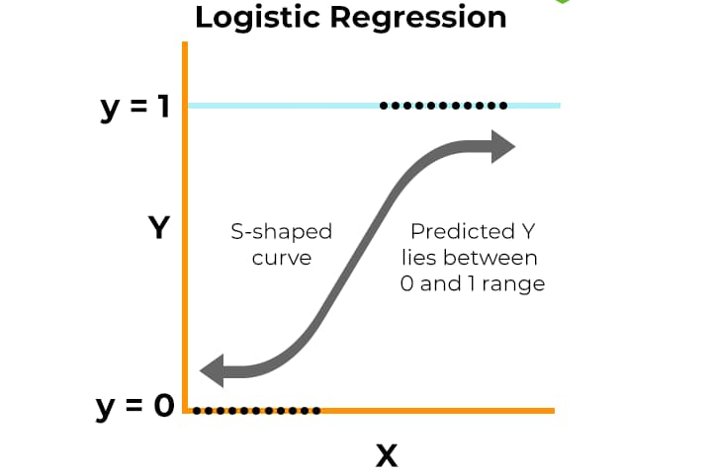


2. LOGISTIC REGRESSION
Logistic regression ( also known as Binomial logistics regression) in R programming is a classification algorithm used to find the probability of event success and event failure. It is used when the dependent variable is binary (0/1, True/False, Yes/No) in nature.
we use the sigmoid function where the input will be z and we find the probability between 0 and 1. i.e. predicted y.
σ(z)=
σ(z) tends towards 1 as z→∞
σ(z) tends towards 0 as z→−∞
σ(z) is always bounded between 0 and 1
An OR of 1 indicates equal probability of success and failure.
An OR of 2 means success is twice as likely as failure.
An OR of 0.5 implies failure is twice as likely as success.

Slide 15
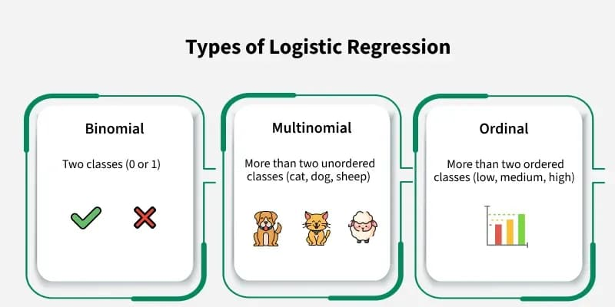
Types of Logistic Regression
On the basis of the categories, Logistic Regression can be classified into three types:
Binomial: In binomial Logistic regression, there can be only two possible types of the dependent variables, such as 0 or 1, Pass or Fail, etc.
Multinomial: In multinomial Logistic regression, there can be 3 or more possible unordered types of the dependent variable, such as “cat”, “dogs”, or “sheep”
Ordinal: In ordinal Logistic regression, there can be 3 or more possible ordered types of dependent variables, such as “low”, “Medium”, or “High”.

Slide 16
Properties of logit model
As P goes from 0 to 1 (i.e., as Z varies from −∞ to +∞),the logit L goes from −∞ to +∞.
Although L is linear in X, the probabilities themselves are not. This property is in contrast with the LPM model where the probabilities increase linearly with X.
Although we have included only a single X variable, or regressor, in the preceding model, one can add as many regressors as may be dictated by the underlying theory.
The logit becomes negative and increasingly large in magnitude as the odds ratio decreases from 1 to 0 and becomes increasingly large and positive as the odds ratio increases from 1 to infinity.
The interpretation of the logit model is as follows: β2, the slope, measures the change in L for a unit change in X, that is, it tells how the log-odds in favor of owning a house change as income changes by a unit,say,Rs.1000.The intercept β1 is the value of the logodds in favor of owning a house if income is zero. Like most interpretations of intercepts, this interpretation may not have any physical meaning.
Whereas the LPM assumes that Pi is linearly related to Xi, the logit model assumes that the log of the odds ratio is linearly related to Xi.

Slide 17
CHAPTER-3
INSTRUMENTS
SOFTWARE DESCRIPTIPON
REVERSION
3. RSTUDIO APPLICATION FOR WINDOWS
4. PACKAGE IN R PROGRAMMING
1.SOFTWARE DESCRIPTION
R is not solely entrusted by academics, however many massive firms and MNC’s additionally use R programming language, including Uber, Google, Airbnb, Facebook, and then on. Data analysis with R is finished in an exceedingly series of steps: programming, transforming, discovering, modelling, and communicating the results.
1.1 EVOLUTION OF R
R was initially written by Ross Ihaka and Robert Gentleman at the Department of Statistics of the University of Auckland in Auckland, New Zealand. R made it’s first appearance in 1993.
A large group of individuals has contributed to R by sending code and bug reports.
Since mid-1997 there has been a core group (the "R Core Team") who can modify the R source code archive.

Slide 18
2.R VERSION
R is free software and comes with ABSOLUTELY NO WARRANTY. You are welcome to redistribute it under certain conditions. Type 'license()' or 'licence()' for distribution details. Natural language support but running in an English locale
R is a collaborative project with many contributors. Type 'contributors()' for more information and 'citation()' on how to cite R or R packages in publications.
Type 'demo()' for some demos, 'help()' for on-line help, or 'help.start()' for an HTML browser interface to help. Type 'q()' to quit R.
USAGE OF R PROGRAMMING
R language is in much demand in real-world applications because of the following reasons:
IMPORTANT FOR DATA SCIENCE: As R is an interpreted language, we can run code without any compiler which is most important in data science. R is a vector language and hence powerful and faster than another language. R is used in biology, genetics as well as in statistics. Hence, it can perform any type of task.
OPEN-SOURCE: R language is an open-source language. It is also maintained by a large number of the programmers as a community across the world. Since R is issued under the General Public License (GNU), and hence there is no restriction on its usage.
USED TO DEVELOP WEB APPS: R provides the ability to build web applications. Using the R package, we can create develop interactive applications using the console of your R IDE.
PLATFORM INDEPENDENT: R language is a platform-independent language. It can work on any system irrespective of whether it is Windows, Linux, and Mac.
USED IN MACHINE LEARNING IN R LANGUAGE: Most important
advantage of R programming is that it helps to carry out Machine Learning in R language operations like classification, regression and also provides features for artificial intelligence and neural networks.

Slide 19
3.RSTUDIO APPLICATION FOR WINDOWS
RStudio is free, open-source integrated development environment for R programming language. It is designed for the use of data scientists, statisticians, data miners, business intelligence developers. App is designed for the use by data science project teams. Software is powerful and popular IDE for R language. Application is cross-platform product, which is available for Windows, macOS, Ubuntu. Product RStudio app has a simple and intuitive interface that is easy to learn and makes it a good place to start for beginners. Interface has a lot of functionality, and it is great tool for analysing and visualizing data. Application provides a lot of support in form of a built-in help system.
INTERFACE
Software RStudio download is well-designed, intuitive, user-friendly application. Design is minimalistic and clean. Interface is clean and user can easily navigate through the menus. Application provides a wide range of features that are mainly categorized into Data Science, Visualization, Administration. Interface is very user-friendly and has a clean design. It is based on "scratchpad" principle, where the user can create their own projects, or start with one of many templates that are available. Application provides code completion, which makes it easier to write code.

Slide 20
4.PACKAGES IN R PROGRAMMING
Packages in R Programming language are a set of R functions, compiled code, and sample data. These are stored under a directory called “library” within the R environment. By default, R installs a group of packages during installation. Once we start the R console, only the default packages are available by default. Other packages that are already installed need to be loaded explicitly to be utilized by the R program that’s getting to use them.
FUNCTION USED
glm()
Fitting Generalized Linear Models
Description
glm is used to fit generalized linear models, specified by giving a symbolic description of the linear predictor and a description of the error distribution.
Usage
glm(formula, family = gaussian, data, weights, subset,
na.action, start = NULL, etastart, mustart, offset,
control = list(...), model = TRUE, method = "glm.fit",
x = FALSE, y = TRUE, singular.ok = TRUE, contrasts = NULL, ...)
glm.fit(x, y, weights = rep.int(1, nobs),
start = NULL, etastart = NULL, mustart = NULL,
offset = rep.int(0, nobs), family = gaussian(),
control = list(), intercept = TRUE, singular.ok = TRUE)
## S3 method for class 'glm'
weights(object, type = c("prior", "working"), ...)

Slide 21
CHAPTER-4
PREDICTION OF LUNG CANCER USING LOGISTIC
REGRESSION ANALYSIS
1.DATA SOURCE AND DESCRIPTION
2. DATA PROCESSING
3. LOAD THE DATA
LOAD THE TEST DATA
5. MAKE PRIDICTIONS OF NEW DATA
CONVERT PROBABILITIES TO CLASS LABELS
CALCULATE ACCURACY
EVALUTE MODEL PERFORMANCE
INTERPRETATION

Slide 22
1.Data Source
The dataset for this study is sourced from a publicly available clinical database ‘Kaggle’ The dataset was selected based on its relevance to lung cancer prediction, availability of key variables, and ethical considerations (e.g., de-identified data to protect patient privacy). The use of secondary data ensures that the study adheres to ethical standards without requiring direct patient interaction or institutional review board (IRB) approval for data collection.
Variables
The dataset comprises a diverse set of demographic and clinical variables identified in the literature as significant predictors of lung cancer risk. These variables provide a comprehensive representation of factors influencing lung cancer diagnosis, enabling the model to capture complex relationships. The variables include:
1.Demographic
2.Behavioural
3.Medical( history)
4.Chronic Cough
5.Wheezing
6.Chest Pain
7.Lung Cancer Diagnosis

Slide 23
Data Preprocessing
Data preprocessing is a critical step to ensure the quality, reliability, and suitability of the dataset for logistic regression modeling. Poor data quality, such as missing values or outliers, can bias model results and reduce predictive accuracy. The following preprocessing steps were applied systematically.
Data Cleaning
Missing Values: Missing data was identified and handled using appropriate techniques, such as deletion or imputation, depending on the extent and nature of the missing data. For minimal missingness, listwise deletion was considered. For significant missingness, imputation techniques, such as mean or median imputation for numerical variables or mode imputation for categorical variables, were applied.
Outliers: Outliers in numerical variables (e.g., age) were detected using statistical methods like the Interquartile Range (IQR) method. Values beyond a certain threshold were flagged and either capped or transformed to reduce their impact.
Duplicates: Duplicate records were identified and removed to prevent overfitting and bias.
Feature Encoding
Categorical variables, such as smoking history and gender, were encoded numerically to make them compatible with logistic regression. One-hot encoding was used for nominal variables with more than two categories (e.g., smoking history: Never, Former, Current), creating binary dummy variables. Binary categorical variables (e.g., gender) were label-encoded (e.g., Male = 0, Female = 1).

Slide 24
3.Load the Data
data=read.csv("LUNGDATA1.csv",header=T)
head(data)
>lcfit=glm(LC~GEN+AGE+SMOK+Y.FIGURE+PRESSURE+C.DISEASE+FATIGUE+ALLERGY+COUGH+S.DIFFICULTY,family=binomial,data=data)
summary(lcfit)
OUTPUT:
Call:
glm(formula = LC ~ GEN + AGE + SMOK + Y.FIGURE + PRESSURE + C.DISEASE +
FATIGUE + ALLERGY + COUGH + S.BREATH, family = binomial,
data = data)
Coefficients:
Estimate Std. Error z value Pr(>|z|)
(Intercept) -6.53386 1.84366 -3.544 0.000394 ***
GEN -1.20339 0.44987 -2.675 0.007473 **
AGE -0.04331 0.02492 -1.738 0.082245 .

Slide 25
SMOK 1.20575 0.46253 2.607 0.009137 **
Y.FIGURE 1.28672 0.46040 2.795 0.005194 **
PRESSURE 0.91969 0.41444 2.219 0.026478 *
C.DISEASE 2.86508 0.55164 5.194 2.06e-07 ***
FATIGUE 2.80350 0.48317 5.802 6.54e-09 ***
ALLERGY 1.79795 0.42300 4.250 2.13e-05 ***
COUGH 2.68739 0.54513 4.930 8.23e-07 ***
S.BREATH 2.24117 0.55407 4.045 5.23e-05 ***
---
Signif. codes: 0 ‘***’ 0.001 ‘**’ 0.01 ‘*’ 0.05 ‘.’ 0.1 ‘ ’ 1
(Dispersion parameter for binomial family taken to be 1)
Null deviance: 352.60 on 318 degrees of freedom
Residual deviance: 179.73 on 308 degrees of freedom
AIC: 201.73
Number of Fisher Scoring iterations: 7

Slide 26
4.Load the test Data
# read the CSV
> test_data=read.csv("TEST_DATA1.csv",header=T)
5. Make Predictions on New Data
To predict probabilities on new data, use the predict() function with type = "response":
#predict probabilities on the test data
predicted_probs=predict(lcfit, newdata = test_data, type = "response")
6.Convert Probabilities to Class Labels
> predicted_classes = ifelse(predicted_probs > 0.5, 1, 0)
#actual values from the test data
> actual_classes = as.numeric(as.character(test_data$LC))
#create comparison table
> comparison =data.frame( Actual = actual_classes,Predicted = predicted_classes,Probability = round(predicted_probs, 3) )
> head(comparison)

Slide 27
OUTPUT:
Actual Predicted Probability
1 0 0 0.009
2 0 0 0.004
3 0 0 0.009
4 0 0 0.031
5 0 0 0.467
6 0 0 0.035
7.Calculate accuracy
> accuracy <- mean(comparison$Actual == comparison$Predicted)
> cat("Accuracy on test data:", round(accuracy * 100, 2), "%\n")
OUTPUT:
Accuracy on test data: 85.37 %

Slide 28
8.Evaluate Model Performance
Compare the predicted classes to the actual classes in your test data to assess model accuracy. For instance, you can create a confusion matrix:
table(Actual = comparison$Actual, Predicted = comparison$Predicted)
OUTPUT:
Predicted
Actual 0 1
0 49 5
7 21
9.INTERPRETATION:
In logistic regression, coefficients represent the change in the log-odds of the outcome for a one-unit increase in the predictor variable, holding other variables constant. Exponentiating these coefficients yields the odds ratios, which are more interpretable.

Slide 29
REFERENCE
https://www.kaggle.com/datasets/akashnath29/lung-cancer-dataset
https://my.clevelandclinic.org/health/diseases/4375-lung-cancer
https://sjcit.ac.in/wp-content/uploads/2022/11/006007027028.pdf
https://en.m.wikipedia.org/wiki/Logistic_regression
https://stats.oarc.ucla.edu/r/dae/logit-regression/
https://www.unife.it/economia/lm.economics/lectures/applied-econometrics/materiale-didattico-2018-2019/Maddala.pdf
https://chatgpt.com/c/68260d95-7de0-800a-9445-99fbc3dbadf3

Slide 30

THANK YOU

