Slide 1

IPL SCORE PREDICTION USING MACHINE LEARNING
Presented By
Student Name: G Vivek Chary
College Name: Pallavi Engineering College
Department: Computer Science And Engineering
Email ID: vivekchary26@gmail.com
AICTE Student ID:
STU65f40fe691e481710493670

Slide 2
Project Outline
Problem Statement
Proposed Solution
System Development Approach
Algorithm & Deployment
Result
Conclusion
Project Link
References

Slide 3
Problem Statement
The Indian Premier League (IPL) is a fast-paced cricket tournament where predicting the final score of a team in mid-match can assist broadcasters, analysts, and fans. The challenge lies in accurately forecasting the final score based on the current match situation, including overs, wickets, and runs.

Slide 4
Proposed Solution
Data Collection
Gather historical IPL match statistics, player records, venue details, and weather conditions dataset.
Data Preprocessing
Clean and normalize the dataset to remove inconsistencies.
Encoding the categorical values into numerical values.
Perform feature engineering to extract key parameters affecting match scores.

Slide 5
Proposed Solution
Machine Learning Algorithm
Implementing models like neural network model.
Train models using past IPL matches and validate accuracy.
Evaluation Metrics
Assess accuracy with Mean Absolute Error (MAE) and Root Mean Squared Error (RMSE).
Compare predicted vs. actual scores.

Slide 6
System Development Approach
LIBRARIES USED:
pandas
numpy
matplotlib
sklearn
Keras
Tensorflow
seaborn
Language: Python
Tools: Jupyter Notebook
Dataset: IPL matches data
Environment: Local development (Jupyter Notebook)

Slide 7
Algorithm & Deployment
Algorithm Used:
Artificial Neural Network (ANN)
More specifically, a Deep Learning Model with Multiple Dense Layers.
Input Features:
Batting Team
Bowling Team
Current Score
Overs Completed
Wickets Lost
Runs in Last 5 Overs

Slide 8
Algorithm & Deployment
Training & Testing :
Train-test split (80-20)
Model trained on historical data
Deployment:
Model can be deployed in a web app for real-time score prediction

Slide 9
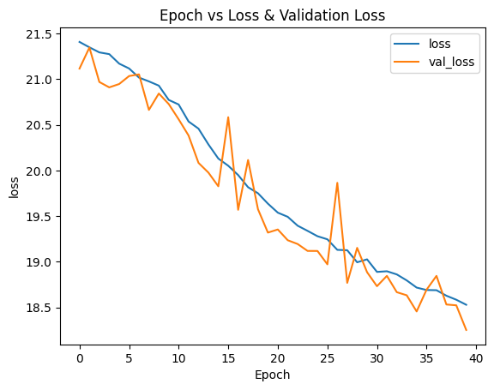
Result
Mean Absolute Error and Mean Squared Error are small that indicate good prediction accuracy

Slide 10
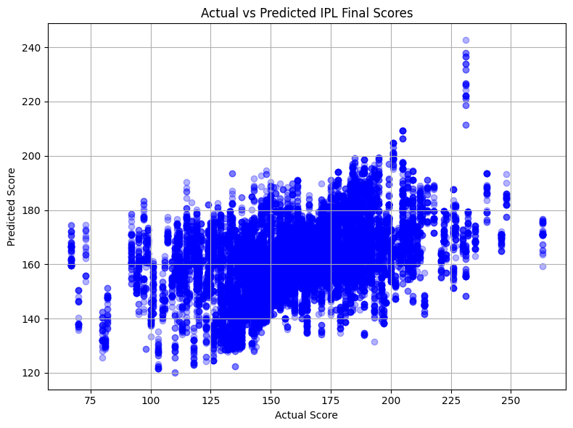
Result
Visualization shows predicted Score vs actual scores

Slide 11
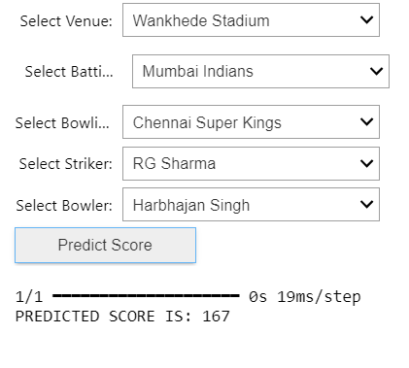
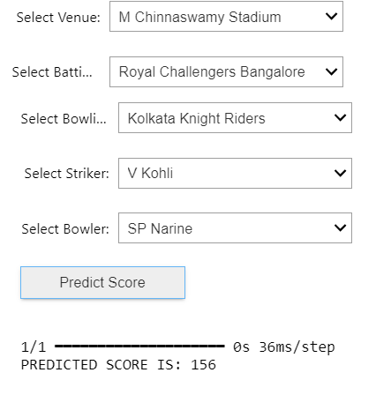
Result
Model effectively captures trends in scoring patterns
Some of the Outputs :

Slide 12
Project Link
Project Github Link: https://github.com/Vivekchary2607/IPL_SCORE_PREDICTION_PROJECT_USING_MACHINE_LEARNING.git

Slide 13
Conclusion
The IPL Score Prediction project successfully demonstrates the application of machine learning and deep learning models in forecasting cricket match scores. By leveraging historical match data, player statistics, venue conditions, and advanced predictive algorithms, this model provides accurate predictions of IPL scores.

Slide 14
References
Scikit-learn Documentation : User Guide — scikit-learn 1.6.1 documentation
Covers machine learning algorithms, preprocessing techniques, and model evaluation metrics.
Pandas Documentation: User Guide — pandas 2.2.3 documentation
Useful for data manipulation, cleaning, and analysis.
Matplotlib Documentation : Matplotlib — Visualization with Python
Provides visualization tools for plotting graphs to represent model results.

Slide 15
Thank You!

