Slide 1
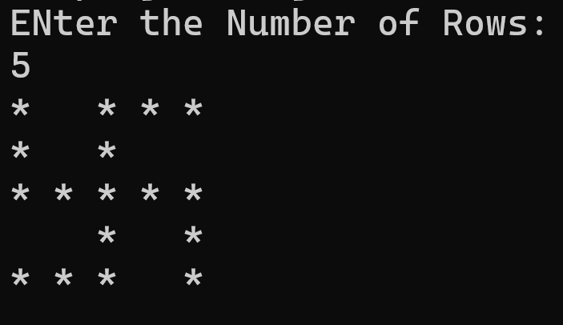
Pattern Programming

Slide 2
Pattern Programming

Slide 3
Pattern Programming
A B C D E
F G H I
J K L
M N
O

Slide 4
Pattern Programming
E D C B A
I H G F
L K J
N M
O

Slide 5
Pattern Programming
O N M L K
J I H G
F E D
C B
A
Important
Don’t leave it..!!

Slide 6
Pattern Programming
K L M N O
G H I J
D E F
B C
A

Slide 7
Pattern Programming
9 8 7
6 5 4
3 2
1
Important
Don’t leave it..!!

Slide 8
Pattern Programming
15 14 13 12 11
7 8 9 10
6 5 4
2 3
1
Important
Don’t leave it..!!

Slide 9
Pattern Programming
A
B C
D E F
G H I J
K L M N O

Slide 10
Pattern Programming
A
C B
F E D
J I H G
O N M L K
Important
Don’t leave it..!!

Slide 11
Pattern Programming
O
N M
L K J
I H G F
E D C B A
Important
Don’t leave it..!!

Slide 12
Pattern Programming
O
M N
J K L
F G H I
A B C D E

Slide 13
Pattern Programming
1 2 3 4 5
6 7 8 9
10 11 12
13 14
15

Slide 14
Pattern Programming
5 4 3 2 1
9 8 7 6
12 11 10
14 13
15
Important
Don’t leave it..!!

Slide 15
Pattern Programming
15 14 13 12 11
10 9 8 7
6 5 4
3 2
1
Important
Don’t leave it..!!

Slide 16
Pattern Programming
11 12 13 14 15
7 8 9 10
4 5 6
2 3
1
Important
Don’t leave it..!!

Slide 17
Pattern Programming
1
2 3
4 5 6
7 8 9 10
11 12 13 14 15

Slide 18
Pattern Programming
1
3 2
6 5 4
10 9 8 7
15 14 13 12 11
Important
Don’t leave it..!!

Slide 19
Pattern Programming
15
14 13
12 11 10
9 8 7 6
5 4 3 2 1
Important
Don’t leave it..!!

Slide 20
Pattern Programming
15
13 14
10 11 12
6 7 8 9
1 2 3 4 5
Important
Don’t leave it..!!

Slide 21
Pattern Programming
15
13 14
12 11 10
6 7 8 9
5 4 3 2 1

Slide 22
Pattern Programming
1
3 2
4 5 6
10 9 8 7
11 12 13 14 15

Slide 23
Pattern Programming
1
2 3
6 5 4
7 8 9 10
15 14 13 12 11

Slide 24
Pattern Programming
15
13 14
12 11 10
6 7 8 9
5 4 3 2 1

Slide 25
Pattern Programming
15
14 13
10 11 12
9 8 7 6
1 2 3 4 5

Slide 26
Pattern Programming
5
6 4
12 7 3
13 11 8 2
15 14 10 9 1
Most Difficult

Slide 27
Pattern Programming
1
9 2
10 8 3
14 11 7 4
15 13 12 6 5
Most Difficult

Slide 28
Pattern Programming
1
2 3 4
5 6 7 8 9
Important
Don’t leave it..!!

Slide 29
Pattern Programming
9
8 7 6
5 4 3 2 1
Important
Don’t leave it..!!

Slide 30
Pattern Programming
1
1 1 2
3 4 1 5 6
7 8 9 1 10 11 12
Important
Don’t leave it..!!

Slide 31
Pattern Programming
0
1 0 1
2 1 0 1 2
3 2 1 0 1 2 3
4 3 2 1 0 1 2 3 4
Important
Don’t leave it..!!

Slide 32
Pattern Programming
1
2 1 2
3 2 1 2 3
4 3 2 1 2 3 4
5 4 3 2 1 2 3 4 5
Important
Don’t leave it..!!

Slide 33
Pattern Programming
1
1 2 1
1 2 3 2 1
1 2 3 4 3 2 1
1 2 3 4 5 4 3 2 1
Important
Don’t leave it..!!

Slide 34
Pattern Programming
1
2 1 2
3 2 1 2 3
4 3 2 1 2 3 4
5 4 3 2 1 2 3 4 5
Important
Don’t leave it..!!

Slide 35
Pattern Programming
1 2 3 4 5 4 3 2 1
1 2 3 4 3 2 1
1 2 3 2 1
1 2 1
1
Important
Don’t leave it..!!

Slide 36
Pattern Programming
5 4 3 2 1 2 3 4 5
4 3 2 1 2 3 4
3 2 1 2 3
2 1 2
1
Important
Don’t leave it..!!

Slide 37
Pattern Programming
1
2 1 3
4 5 1 6 7
8 9 10 1 11 12 13
14 15 1 16 17
18 1 19
1
Important
Don’t leave it..!!

Slide 38
Pattern Programming
1
2 1 3
4 5 1 6 7
8 9 10 1 11 12 13
14 15 1 16 17
18 1 19
Important
Don’t leave it..!!

Slide 39
Pattern Programming
@
* @ *
* * @ * *
@ @ @ @ @ @ @
* * @ * *
* @ *
@
Important
Don’t leave it..!!

Slide 40
Pattern Programming
*
1 * 2
3 4 * 5 6
* * * * * * *
7 8 * 9 10
11 * 12
*
Important
Don’t leave it..!!

Slide 41
Pattern Programming
1 2 3 4 1 5 6 7 8
1 2 3 1 4 5 6
1 2 1 3 4
1 1 2
1
Important
Don’t leave it..!!

Slide 42
Pattern Programming
1 2 3 4 1 5 6 7 8
9 10 11 1 12 13 14
15 16 1 17 18
19 1 20
1
Important
Don’t leave it..!!

Slide 43
Pattern Programming
*
* *
* *
* *
* *
* *
* *
* *
*

Slide 44
Pattern Programming
*
* * *
* * *
* * *
* * * * * * *
* * *
* * *
* * *
*

Slide 45
Pattern Programming
1 2 3 4 5
16 17 18 19 6
15 24 25 20 7
14 23 22 21 8
13 12 11 10 9

Slide 46
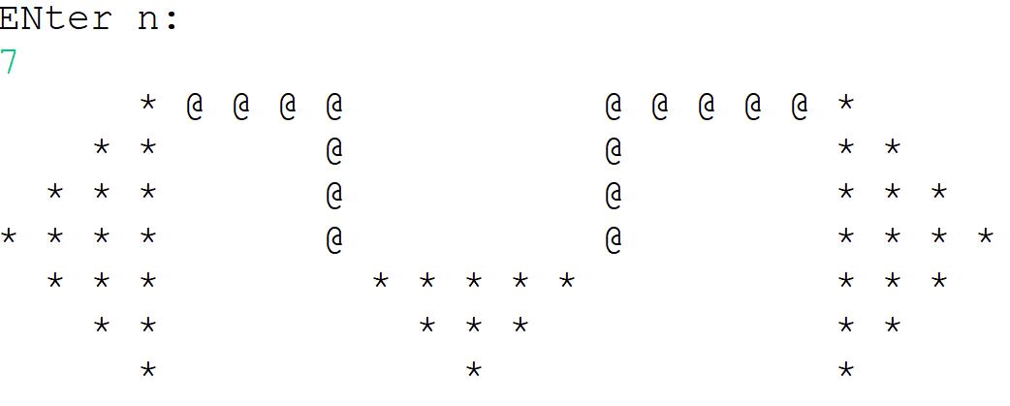
Pattern Programming

Slide 47
Pattern Programming
*
***
*****
*******
*
*
*

Slide 48
Pattern Programming
*
***
*****
*******
*
***
*****
*******
*
***
*****
*******

Slide 49
Pattern Programming
*
***
*****
*******
*
*
*
*
***
*****
*******
*
*
*
*
***
*****
*******
*
*
*

Slide 50
Pattern Programming
*
***
*****
*******
*
***
*****
*******
*
***
*****
*******

Slide 51
Pattern Programming
*
***
*****
*******
*
*
*
*
***
*****
*******
*
*
*
*
***
*****
*******
*
*
*

Slide 52
Pattern Programming
*
***
*****
*******
*
***
*****
*******
@@@@@

Slide 53
Pattern Programming
*
***
*****
*******
*
***
*****
*******
@@@@@

Slide 54
Pattern Programming
*
***
*****
*******
*
***
*****
*******
*
***
*****
*******

