Slide 1
Software Testing & Quality Assurance
Unit-I: Topic- Nature of errors

Slide 2
Software errors are common in software testing and development.
Errors are always present in every software
What is Software Error
Software error is a mismatch between the program and its specification. i.e.software error is present in a program when the program does not do what its end user expects

Slide 3
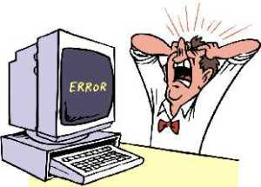
Categories of Software Errors
User interface errors such as output errors or incorrect user messages.
Function errors
Hardware defects
Incorrect program version
Requirements errors
Design errors
Documentation errors
Architecture errors
Module interface errors
Performance errors
Boundary-related errors
Logic errors such as calculation errors, State-based behavior errors, Communication errors, Program structure errors, such as control-flow errors.

Slide 4
Two Ways to Deliver Software Free of Errors
Preventing the introduction of errors in the first place.
Identifying the bugs lurking in program code, seek them out, and destroy them

Slide 5
1. Functionality Errors:
Functionality is a way the software is intended to behave. Software has a functionality error if something that you expect it to do is hard, awkward, confusing, or impossible.

Slide 6
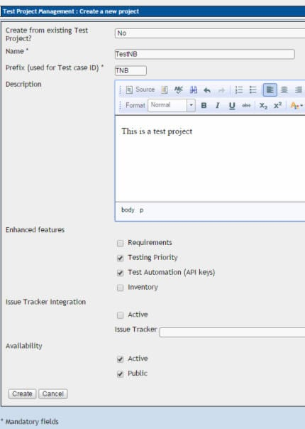
Expected Functionality for Cancel button is that the ‘Create new project’ window should close and none of the changes should be saved (i.e. no new project must be created). If the Cancel button is not clickable then it is a functionality error.

Slide 7
2) Communication Errors:
These errors occur in communication from software to end-user. Anything that the end user needs to know in order to use the software should be made available on screen.
Few examples of communication errors are – No Help instructions/menu provided, features that are part of the release but are not documented in the help menu, a button named ‘Save’ should not erase a file

Slide 8
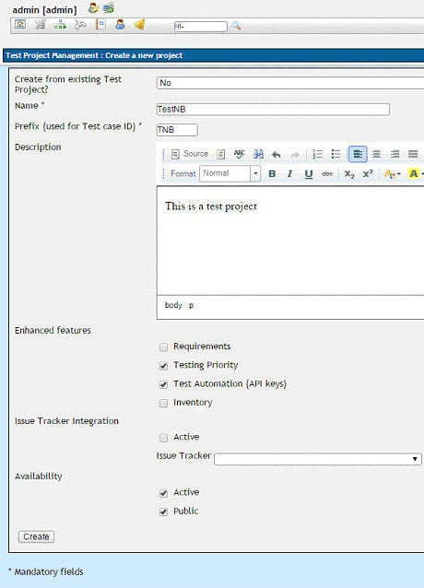
3) Missing command errors:
This happens to occur when an expected command is missing.
This window allows the user to create a new project. However, there is no option for the user to exit from this window without creating the project. Since ‘Cancel’ option/button is not provided to the user, this is a missing command error

Slide 9
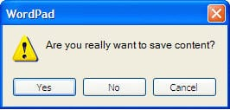
4) Syntactic Error:
Syntactic errors are misspelled words or grammatically incorrect sentences and are very evident while testing software GUI. It do NOT refer to syntax errors in code. The compiler will warn the developer about any syntax errors that occur in the code

Slide 10
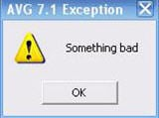
5) Error handling errors:
Any errors that occur while the user is interacting with the software needs to be handled in a clear and meaningful manner. If not, it is called as an Error Handling Error.
The error message gives no indication of what the error actually is. Is it missing mandatory field, saving error, page loading error or is it a system error? Hence, this is an ‘Error Handling Error'.

Slide 11
6) Calculation Errors:
These errors occur due to any of the following reasons:
Bad logic
Incorrect formulae
Data type mismatch
Coding errors
Function call issues ,

Slide 12
7) Control flow errors:
The control flow of a software describes what it will do next and on what condition. Due to unending loop, Backtracking to a wrong state
For example, consider a system where user has to fill in a form and the options available to user are:
Save,
Save and Close, and
Cancel.
If a user clicks on ‘Save and Close’ button, the user information in the form should be saved and the form should close.
If clicking on the button does not close the form, then it is a control flow error.

Slide 13
example of syntax errors in Python:
myfunction(x, y):
return x + y
else:
print("Hello!")
if mark >= 50
print("You passed!")
if arriving:
print("Hi!")
esle:
print("Bye!")
if flag:
print("Flag is set!")
There are five syntax errors:
Missing def keyword in function definition
else clause without an if
Missing colon after if condition
Spelling mistake (“esle”)
The if block is empty because the print statement is not indented correctly

Slide 14
Find sources of logic errors in this code:
product = 0
for i in range(10):
product *= i
sum_squares = 0
for i in range(10):
i_sq = i**2
sum_squares += i_sq
nums = 0
for num in range(10):
num += num
If you are accumulating a number total by multiplication, not addition, you need to initialise the total to 1, not 0, otherwise the product will always be zero!
The line which adds i_sq to sum_squares is not aligned correctly, and will only add the last value of i_sq after the loop has concluded.
The wrong variable is used: at each loop iteration the current number in the range is added to itself and nums remains unchanged.

Slide 15
Find potential sources of runtime errors in this code :
for x in range (a,b):
Print ("(%f, %f, %f)" % my_list[x])
a, b and my_list need to be defined before this code.
The attempt to access the list element with index x may fail during one of the loop iterations if the range from a to b exceeds the size of my_list.
The string formatting operation inside the print statement expects my_list[x] to be a tuple with three numbers. If it has too many or too few elements, or isn’t a tuple at all, the attempt to format the string will fail.

