Slide 1
Selenium is an open source Web UI automation testing suite.
Selenium supports automation across different browsers, platforms and programming languages.
Selenium supports various operating systems, browsers and programming languages.

Slide 2
Programming Languages: C#, Java, Python, PHP, Ruby, Perl,and JavaScript
Operating Systems: Android, iOS, Windows, Linux, Mac, Solaris.
Browsers: Google Chrome, Mozilla Firefox, Internet Explorer, Edge, Opera, Safari

Slide 3
It can be considered as the leading cloud-based testing platform which helps testers to record their actions and export them as a reusable script with a simple-to-understand and easy-to-use interface.
It also supports parallel test execution which reduces time and increases the efficiency of tests.
Selenium can be integrated with frameworks like Ant and Maven for source code compilation.
Selenium can also be integrated with testing frameworks like TestNG for application testing and generating reports.

Slide 4
Selenium web driver does not require server installation.
Selenium can be used to automate functional tests and can be integrated with automation test tools such as Maven, Jenkins, & Docker to achieve continuous testing.

Slide 5
Selenium Limitations
Selenium does not support automation testing for desktop applications.
Since Selenium is open source software.
We can't perform automation tests on web services like SOAP or REST using Selenium.
We should know at least one of the supported programming languages to create tests scripts in Selenium WebDriver.

Slide 6
It does not have built-in Object Repository to maintain objects/elements in centralized location.
Selenium does not have any inbuilt reporting capability; we have to rely on plug-ins like JUnit and TestNG for test reports.
It is not possible to perform testing on images. We need to integrate Selenium with Sikuli for image based testing.

Slide 7
Automation testing covers both functional and performance test on an application.
Functional automation is used for automation of functional test cases.
For example, regression tests, which are repetitive in nature, are automated.

Slide 8
Performance automation is used for automation of non-functional performance test cases.
For example, measuring the response time of the application under considerable (say 100 users) load.

Slide 9
Automation Testing tools which are used for functional automation:
Quick Test Professional, provided by HP.
Rational Robot, provided by IBM.
Coded UI, provided by Microsoft.
Selenium, open source.
Auto It, open Source.

Slide 10
Automation Testing tools which are used for non-functional automation:
Load Runner, provided by HP.
JMeter, provided by Apache.
Burp Suite, provided by PortSwigger.
Acunetix, provided by Acunetix.

Slide 11
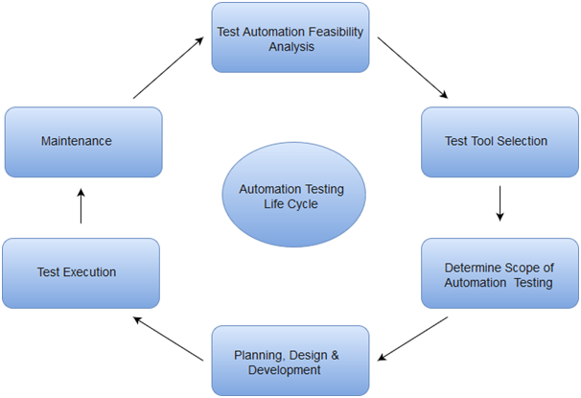

Slide 12
Why Automated Testing
Automated testing tools are able to playback pre-recorded and pre-defined actions.
Automation testing supports frequent regression testing.

Slide 13
It provides unlimited iterations of test case execution.
Automated test generates customized defect reports.
Less error prone as compared to manual testing.

Slide 14
The most effective manner to carry out test automation for web application is to adopt a pyramid testing strategy. This pyramid testing strategy includes automation tests at three different levels.

Slide 15
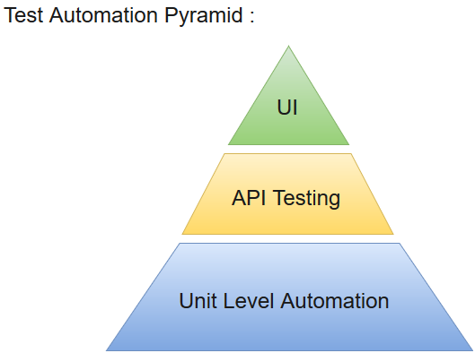

Slide 16
Examination Questions:
Q.1) Write distinguishing features of Selenium and discuss its limitations.
Q.2) Distinguish between functional and non-functional automation.
Q.3) Discuss importance of automation testing with respect to pyramid strategy.

Slide 17
Installation of IDE for running test cases.
Install Mozilla Firefox latest version.
Write the following URL:
https://addons.mozilla.org/en- us/firefox/addon/selenium-ide/
3. Add to the firefox.
4. Click on selenium IDE and launch.

Slide 18
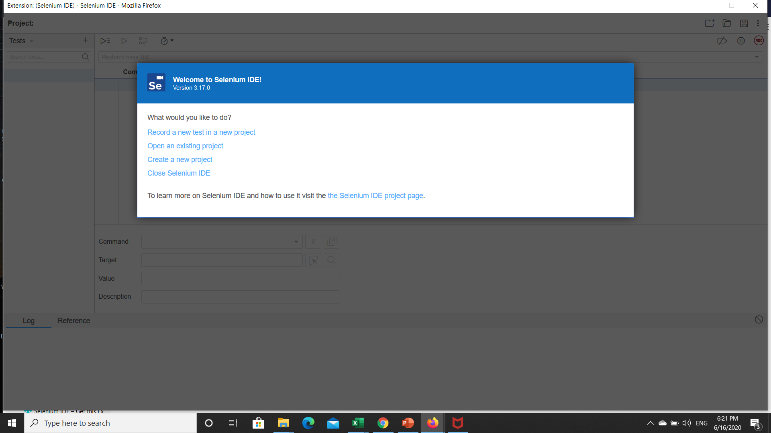

Slide 19
5. Thus new project is created Project in selenium for test case.
6. Type the URL:
www.google.com
www.gmail.com
7. Now click on record button at the right top corner of your screen.

Slide 20
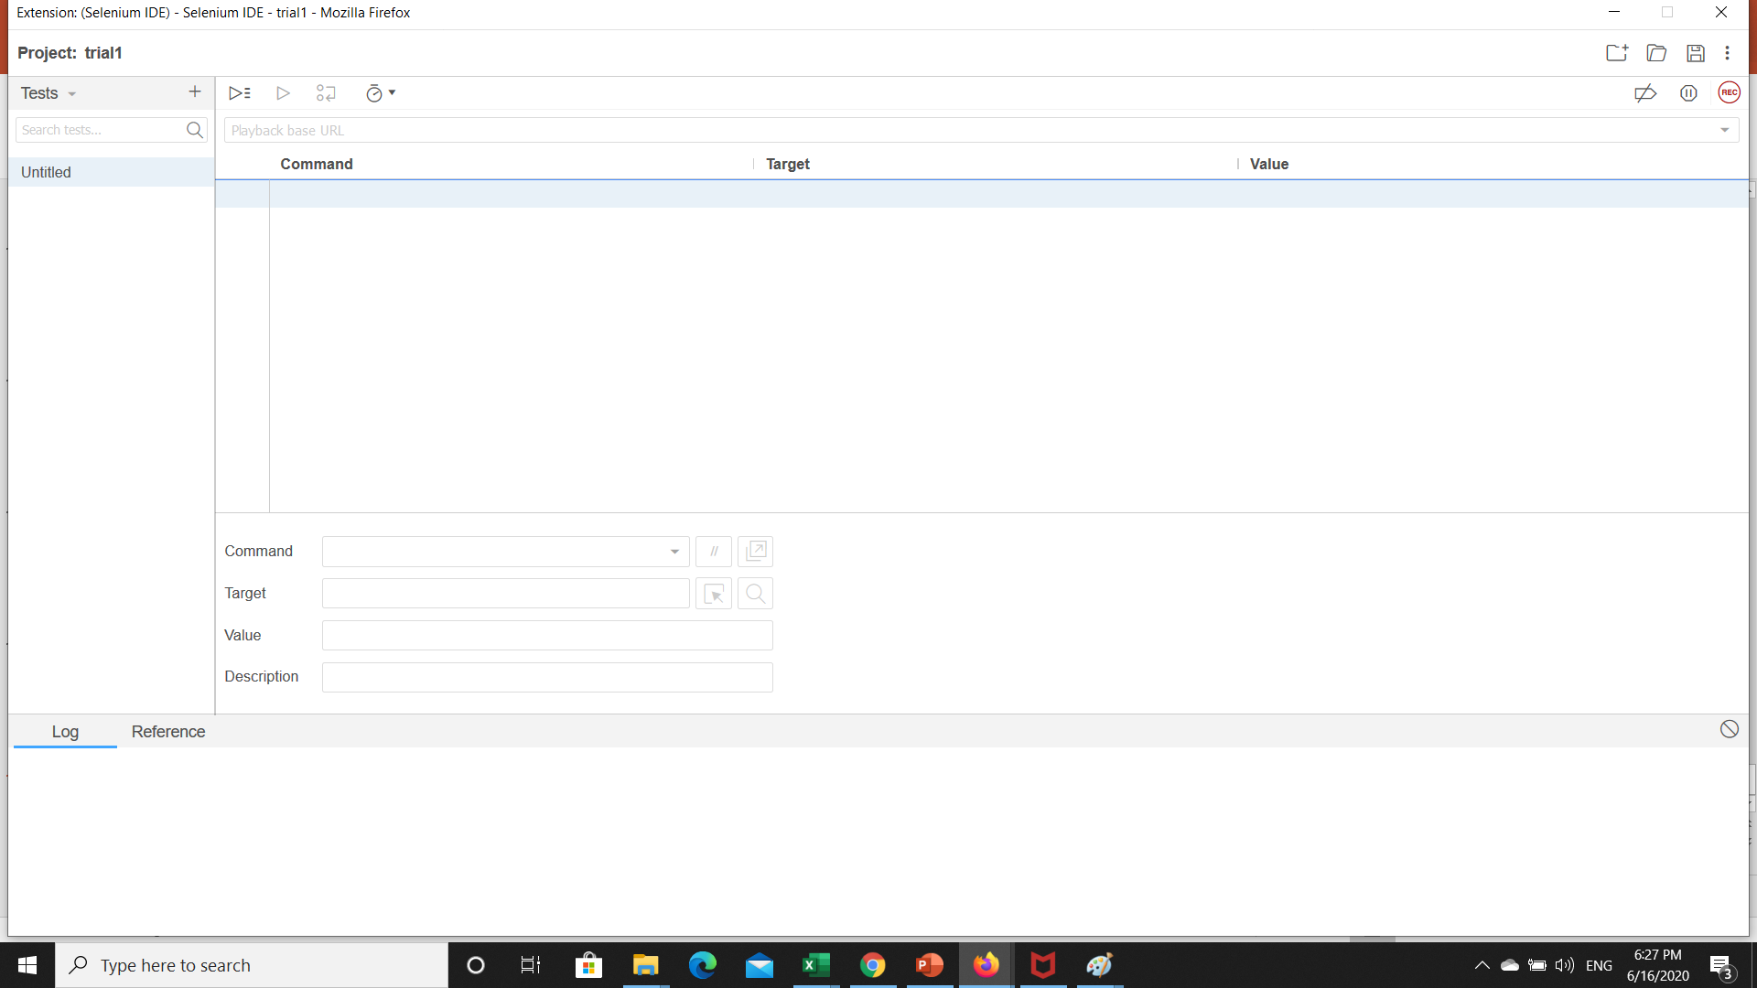

Slide 21
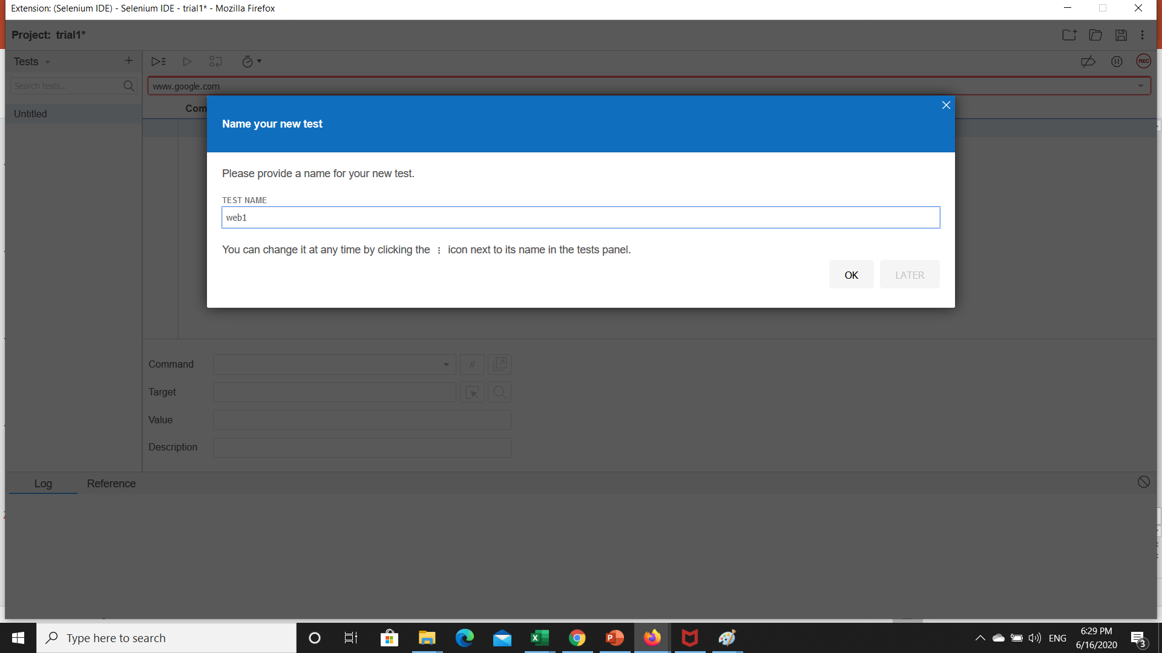

Slide 22
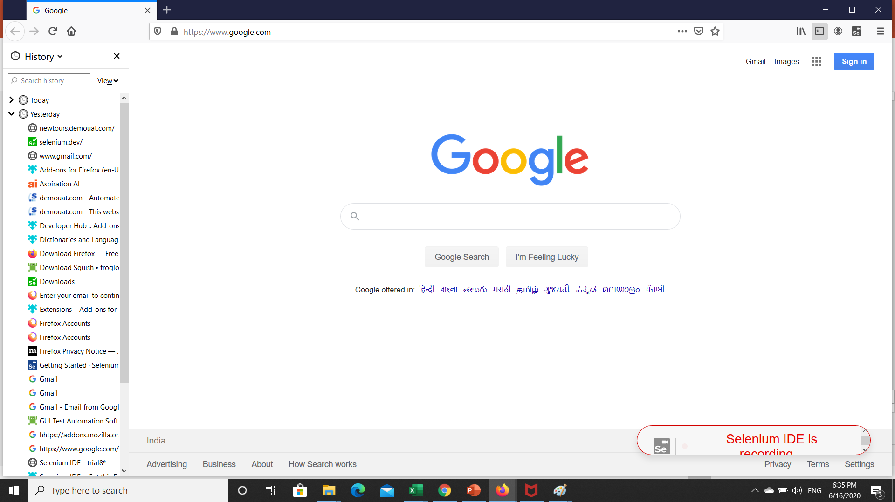

Slide 23
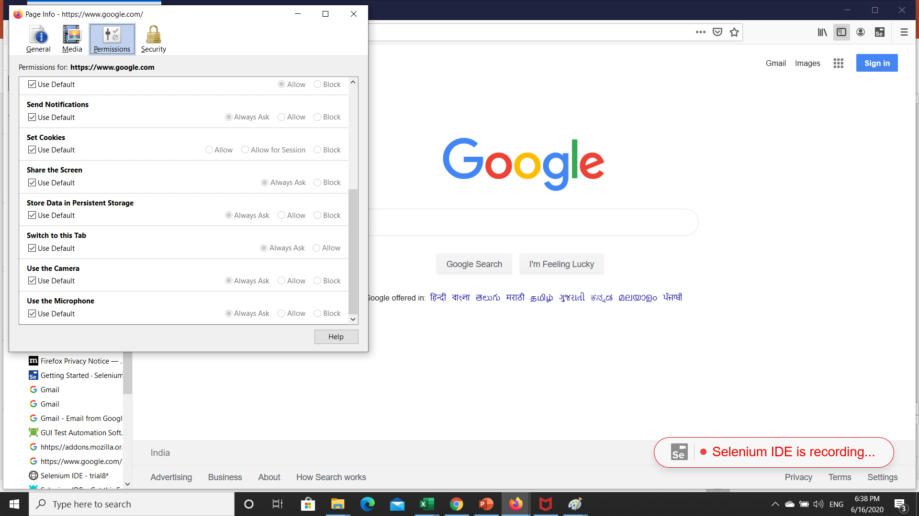

Slide 24
Testing process
Any testing is a complex task that requires planning, preparation, performance control, and results analysis.
With performance testing, it is necessary to collect all the data, which is able to influence the result.
Locust is an open-source testing tool, which allows us to specify loading scenarios by a Python code, supports distributed loading
Python 3
python3 -m pip install locustio

Slide 25
Software Performance testing determine the performance of system to the measure, validate or verify quality attributes of the system like
responsiveness,
Speed,
Scalability,
Stability under variety of load conditions.
load means increasing number of concurrent users, transactions & check the behavior of application under test till the load reaches the threshold value.

Slide 26
Testing printer by sending large job.
Editing a very large document for testing of word processor
Continuously reading and writing data into hard disk.
Running multiple applications simultaneously on server.
Testing of mail server by accessing thousands of mailboxes
In case of zero-volume testing & system fed with zero load.
Simple examples of load testing:

Slide 27
Stress Testing:
“To determine or validate an application’s behavior when it is pushed beyond normal or peak load conditions.”
Stress testing comes under the Non Functional Testing :
(Features -----):
Availability, Compatibility, Configuration, Documentation

Slide 28
Spike testing is a subset of stress testing for validating performance characteristics.
Endurance testing is a non functional type of testing. Endurance testing involves testing a system with a expected amount of load over a long period of time to find the behavior of system.

Slide 29
Scalability Testing:
At what peak the system prevent more scaling.
scale up in terms of any of its non-functional capability like:
the user load supported,
the number of transactions,
the data volume

Slide 30
Volume testing:
Main objective of this testing is to monitor the performance of application under varying database volumes.
Tools used for Performance Testing
Performance testing is significant in real time, particularly from a point of view of customer satisfaction. Performance testing tools are:
Apache JMeter
LoadRunner
WebLOAD
LoadUI

Slide 31
How does JMeter perform Testing?
Different steps performed by JMeter during testing:
It creates a request and sends to the server.
It receives the response from server, collects them and visualizes those details in a chart or graph.
It processes the response from the server.
It generates the test result in several formats such as text, XML, JSON so that the tester can analyze data.

Slide 32
Step 1 – Install Java (ver 10.0.2)
Step 2 – Download JMeter
Step 3 – Install JMeter
Elements of JMeter
The different components of JMeter are called Elements. Each Element is designed for a specific purpose. Some of the main elements are :
Thread Group
Samplers
Listeners
Configuration

Slide 33
Objective | Carried out to validate software actions. | It is done to validate the performance of the software.
Testing Types | Examples of Functional Testing Types Unit testing Smoke testing User Acceptance Integration Testing Regression testing Localization Globalization Interoperability | Examples of Non-functional Testing Types Performance Testing Volume Testing Scalability Usability Testing Load Testing Stress Testing Compliance Testing Portability Testing Disaster Recover Testing

Slide 34
Functional testing is based on customer’s requirements whereas Non Functional testing is based on customer’s expectations.
Functional testing has a goal to validate software actions whereas Non Functional testing has a goal to validate the performance of the software.
--

Slide 35
A Functional Testing example is to check the login functionality whereas a Non Functional testing example is to check the dashboard should load in 2 seconds.
Functional describes what the product does whereas Non Functional describes how the product works.
Functional testing is performed before the non-functional testing.

Slide 36
smoke testing : The objective is not to perform exhaustive testing, but to verify that the critical functionality of the system is working fine.
while regression testing is useful to check for any small changes in the code and ensures old functionalities are not affected by these new changes

