Slide 1
Web Service
TYBSC (Computer Science)
Overview of XML

Slide 2
Event-driven processing mechanisms
Point-to-point queuing
Many large systems are divided into several separate units. The point-to-point messaging model allows clients to send and receive messages both synchronously and asynchronously via queues.
Also Known as pull-based or polling- based model.
Messages are requested from a queue instead of being pushed to the client automatically as is the case with publish /subscribe model.
The publish /subscribe approach is based on a push-based model, which means that messages are delivered to consumers without having to request them.
A given queue may be used by multiple receivers, but only a single receiver may consume each message delivered to the queue.
Each message is consumed only once by the next available receiver in a group.

Slide 3
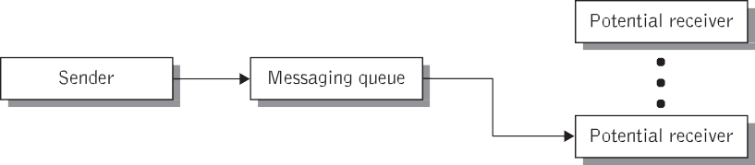

Slide 4
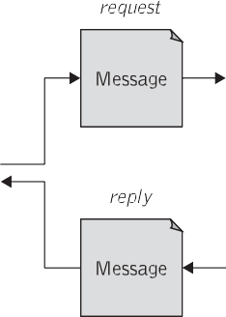
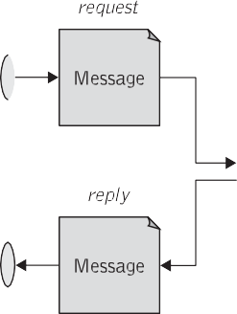


Request/reply messaging
Asynchronous method is fire and Forget

Slide 5
Extensible markup language used for the description and delivery of marked-up electronic text over the Web
An XML document is composed of named containers and their contained data values.
These containers are represented as declarations, elements, and attributes.
<?xml version="1.0" encoding="UTF-8"?>
<BillingInformation>
<Name> Right Plastic Products </Name>
<BillingDate> 2002-09-15 </BillingDate>
<Address>
<Street> 158 Edward st. </Street>
<City> Brisbane </City>
<State> QLD </State>
<PostalCode> 4000 </PostalCode>
</Address>
</BillingInformation>

Slide 6
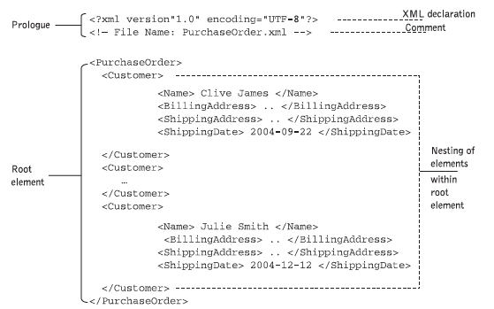
XML declaration
The first few characters of an XML document must make up an XML declaration.

Slide 7
Elements
The topmost element of the XML document is a single element known as the root element.
The content of an element can be character data, other nested elements, or a combination of both.
Elements contained in other elements are referred to as nested elements.
The containing element is the parent element and the nested element is called the child element.
The data values contained within a document are known as the content of the document.

Slide 8
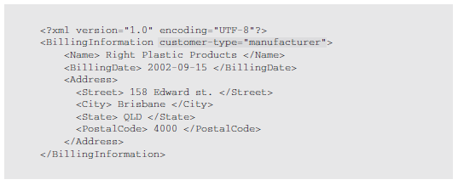
Attributes
Another way of putting data into an XML document is by adding attributes to start tags. Attributes are used to better specify the content of an element on which they appear by adding information about a defined element.

