Slide 1

Mini Project Presentation (KCS-554) On “ Shopper : An E- Commerce ”
Raj Kumar Goel Institute of Technology
Department of Computer Science Engineering & Technology
5th KM. STONE, DELHI-MEERUT ROAD, GHAZIABAD (U.P)-201003
Students
Vivek Kumar Maurya (2100330100249)
Yash Kumar Singh (2100330100253)
Vivek Singh (2100330100251)
Under the Guidance of
Mr. Vineet Srivastava
Assistant Professor
Department of CSE

Slide 2
CONTENTS
INTRODUCTION
OBJECTIVE
LITERATURE SURVEY
METHODOLOGY
HARDWARE AND SOFTWARE USE
SCREENSHOTS
REFERENCES

Slide 3
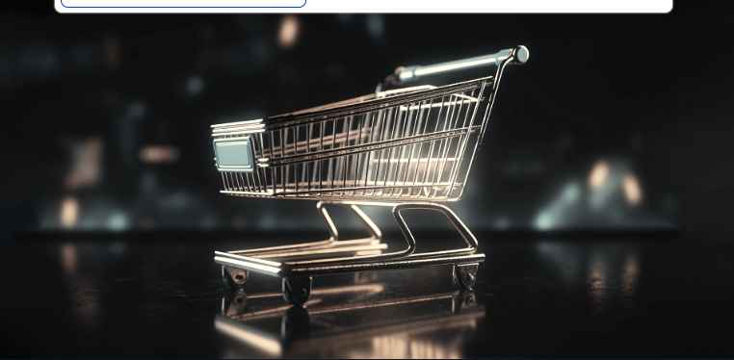
INTRODUCTION "Shopper" - Your Ultimate E-commerce Destination
"Shopper" Debut: Unveiling a revolutionary e-commerce site that transcends the ordinary – a digital fashion haven promising style and simplicity.
Immersive Journey: Beyond products, "Shopper" crafts a tailored shopping experience, inviting you to explore thoughtful features and a seamlessly integrated design.
Tech Powerhouse: Running on Express and MongoDB, our platform blends aesthetic appeal with a secure and efficient engine, delivering reliability and a touch of innovation.
Adaptive Design: Experience the magic of a responsive interface that adapts to your lifestyle, providing a dynamic and user-friendly online shopping environment.
Reliable & Secure: More than just a website, "Shopper" assures data security and reliability, setting the stage for an exciting future in online fashion exploration.

Slide 4
OBJECTIVE
Introduce "Shopper"
E-commerce Platform.
Highlight User Authentication.
Showcase Category Pages..
Display Total Amount in Cart.
Discuss Backend Technologies and Data Persistence..

Slide 5
Literature Survey
1. E- Commerce Trends
Current and emerging trends in the e-commerce industry
2. Customer Behavior
Understanding how customer shop Online
3. Competitor Analysis
Analyzing the strategies of e-commerce platform
4. Importance of User Experience
Positive user experience drives customer satisfaction and loyalty

Slide 6
METHODOLOGY
Initiation:
~Define project goals and engage stakeholders.
Requirement Analysis:
~Develop user stories and gather client input.
Technology Stack:
~Choose ReactJS, Express, and MongoDB for development.
Design:
~Create wireframes, design UI/UX, and build prototypes.
Development:
~Code frontend (ReactJS) and backend (Express, MongoDB).
~Conduct unit and integration testing.
User Authentication:
~Implement secure sign-up/login with encryption.
Category Pages and Cart:
~Create intuitive category pages.
~Implement cart management with real-time updates.
Testing:
~Conduct thorough testing, including UAT.
Deployment:
~Deploy on a secure and scalable cloud platform.
Documentation:
~Prepare technical documentation and user guides.
Launch and Post-Launch:
~Officially launch and provide ongoing support.
Feedback and Iteration:
~Gather user feedback and implement iterative updates

Slide 7
HARDWARE & SOFTWARE USE
REACT JS
NODE JS
EXPRESS JS
MONGODB

Slide 8
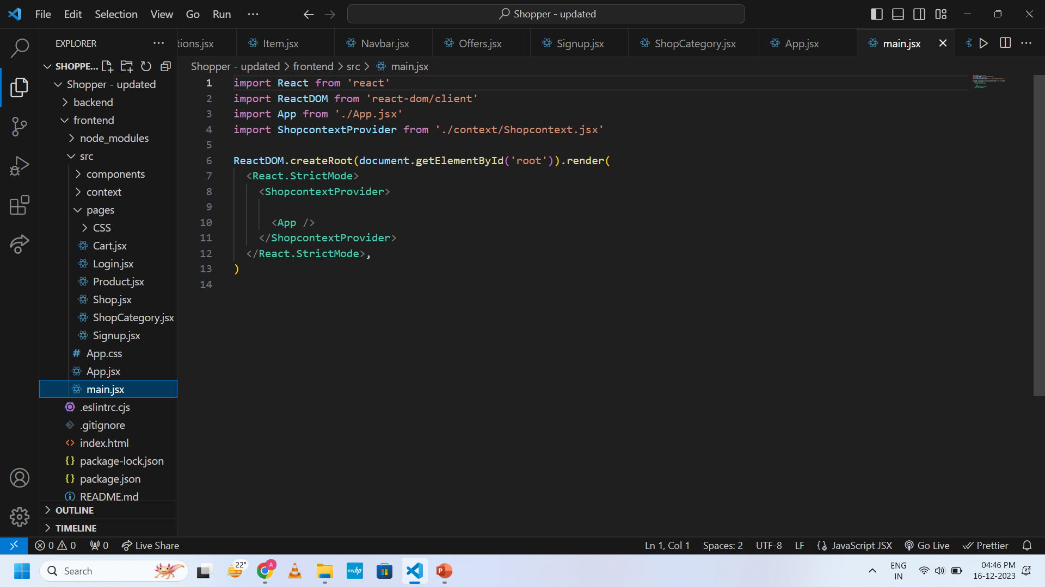
Screenshots of Project

Slide 9
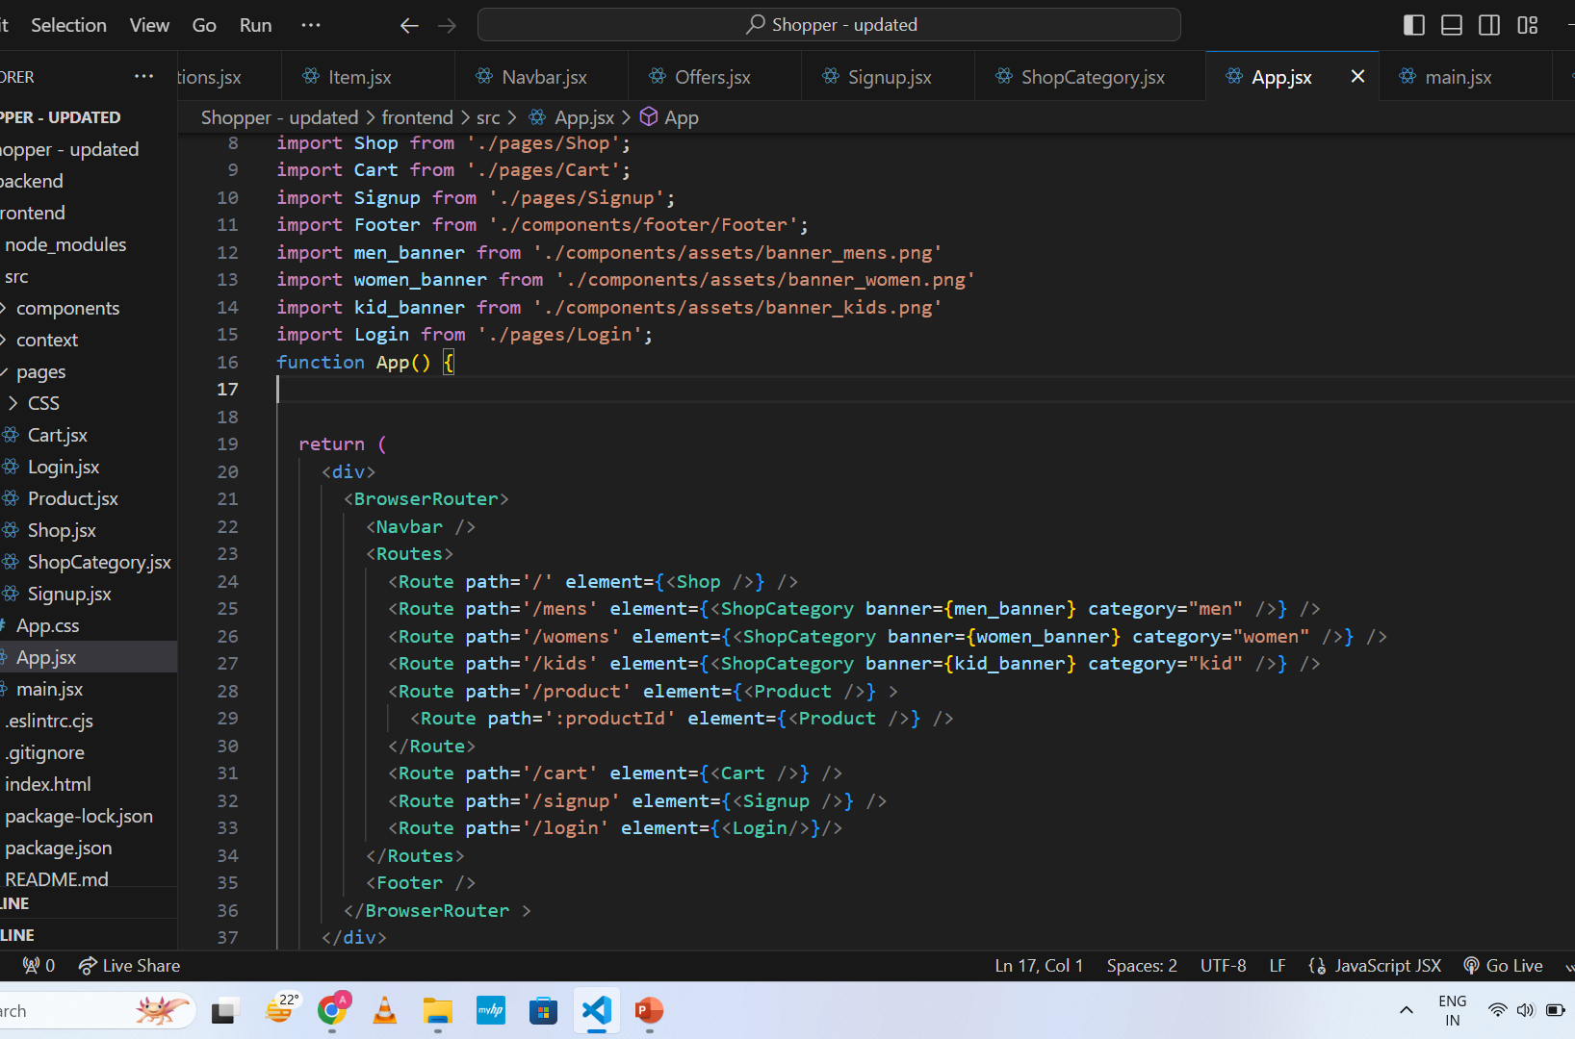

Slide 10
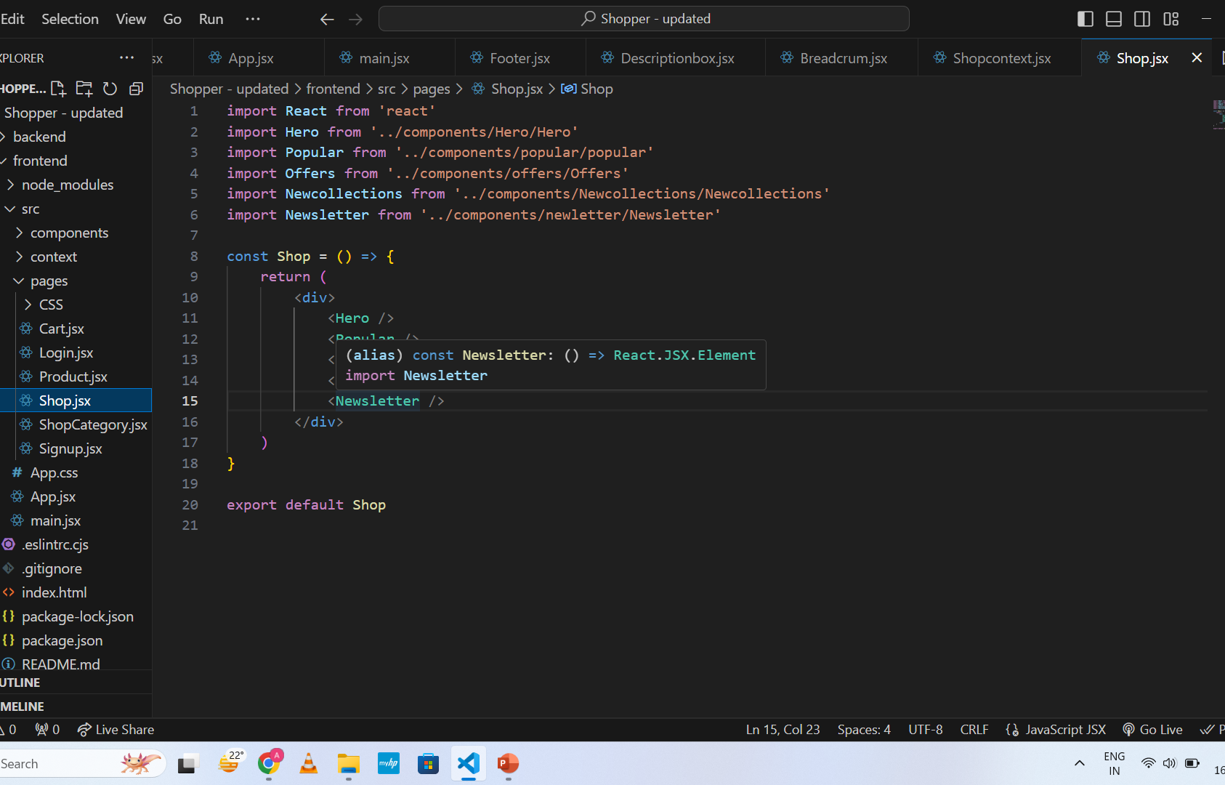

Slide 11
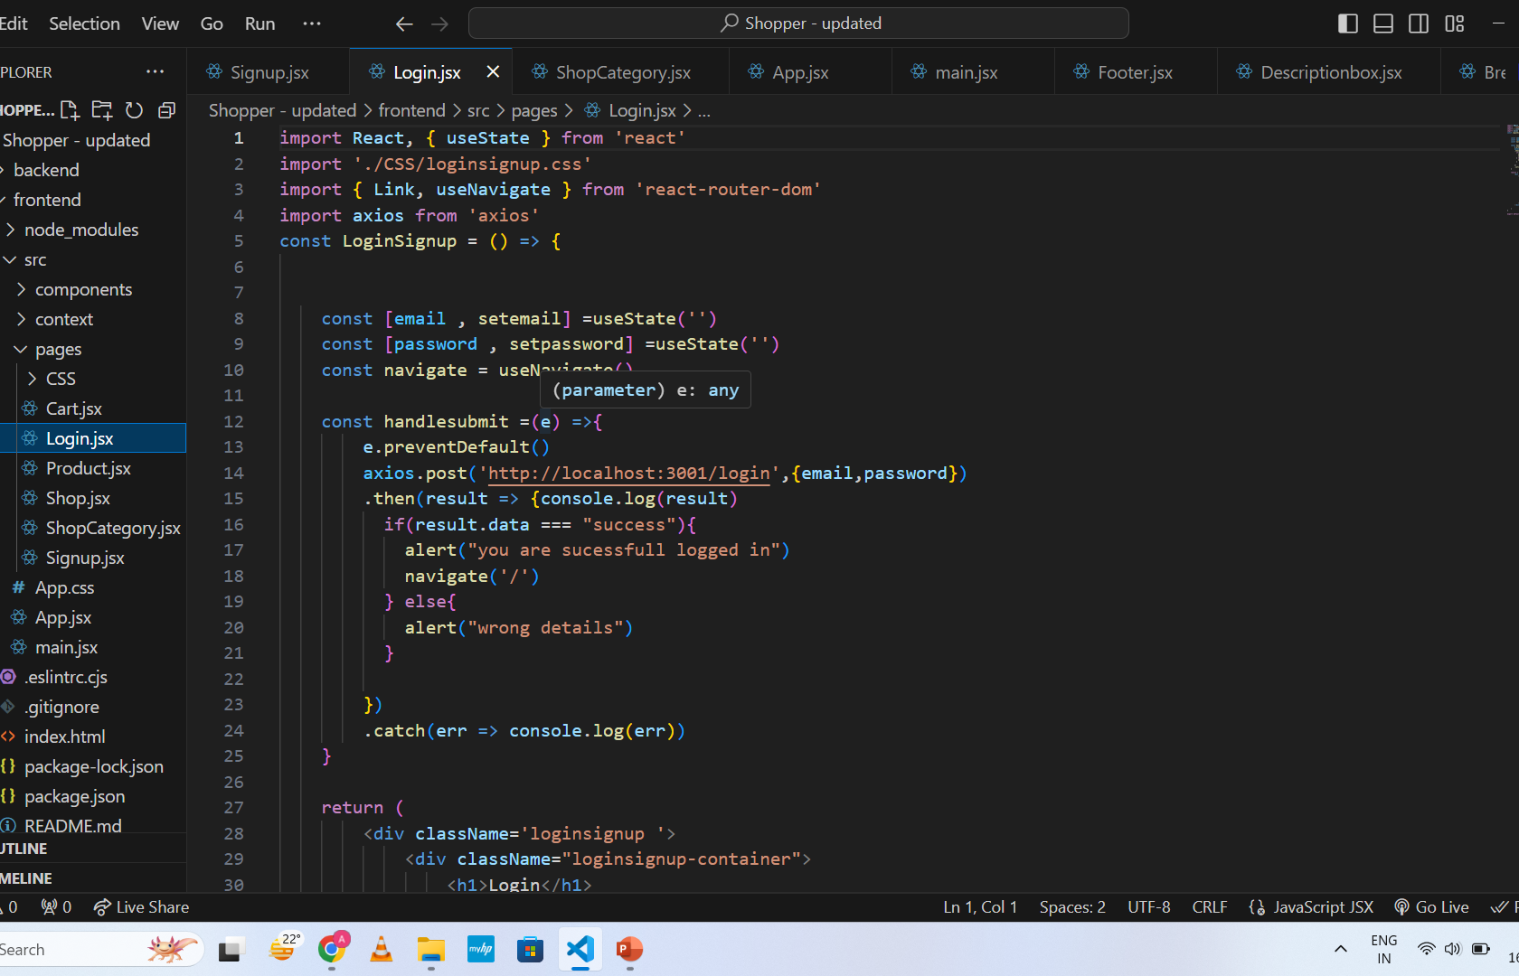

Slide 12
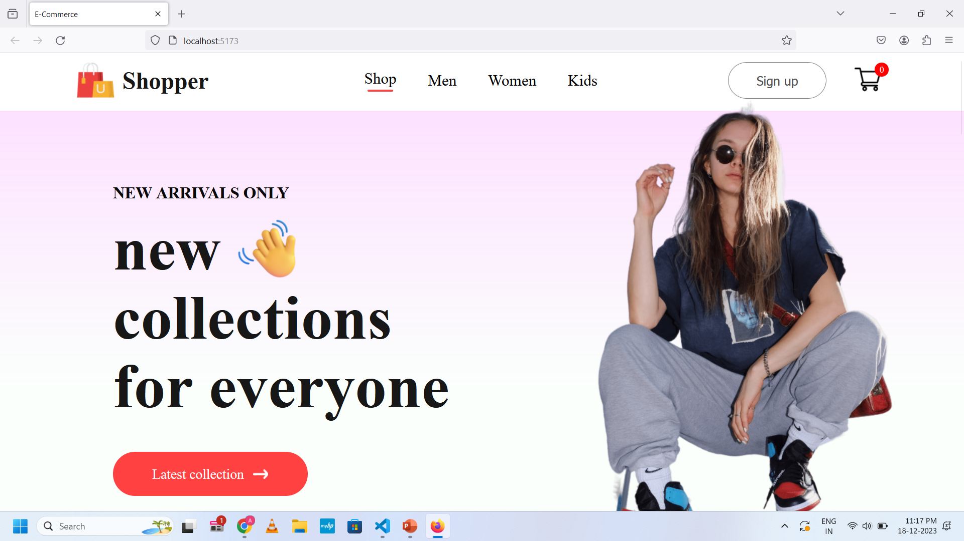

Slide 13
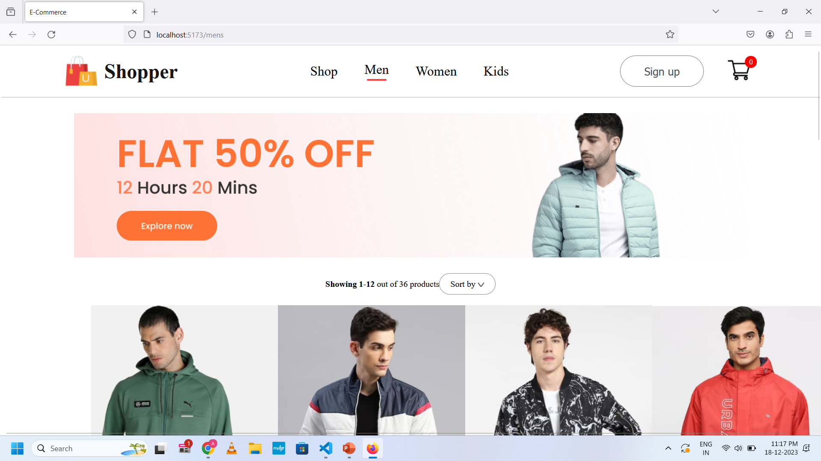

Slide 14
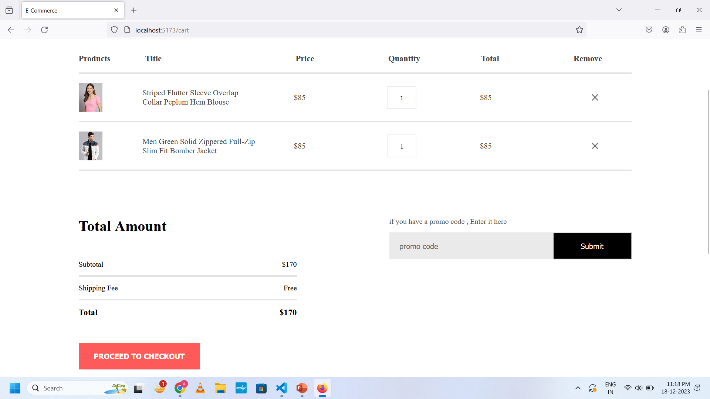

Slide 15
References
1. FRONTEND
GreatStackDev :
YouTube:
https://www.youtube.com/@GreatStackDev
2. BACKEND
CodeWithHarry:
YouTube:
https://www.youtube.com/c/CodeWithHarry
3. SIGNUP AND LOGIN
codingstar6809:
YouTube:
https://www.youtube.com/@codingstar6809

