Slide 1
Ring.com
Digital Performance Analysis
January – December 2025
146K
$3.33M
11.2K
7.68%
Sessions
Revenue
Orders
Conversion Rate

Slide 2
EXECUTIVE SUMMARY
The Story in Four Lines
01
Strong Traffic, Low Conversion
Ring.com attracted 146K sessions in 2025 generating $3.33M revenue — but only 7.68% of sessions resulted in a purchase, revealing a significant conversion gap.
02
Product Page is the #1 Bottleneck
43% of all sessions end on the product page without any further action. Once users pass this stage, 99% complete their purchase — making the product page the single biggest opportunity.
03
Buy Now Click = 2.75x Higher Conversion
Sessions where users clicked 'Buy Now' convert at 13.5% vs 4.9% for those that don't — the strongest behavioral intent signal in the dataset.
04
Paid Social: High Volume, Low Efficiency
Paid Social drives 38% of all sessions but has the lowest conversion rate. SMS and Affiliate deliver significantly better ROI despite lower volume.

Slide 3
DATA OVERVIEW
Understanding the Dataset
session_table
146,000 rows
pageview_table
354,456 rows
Traffic source, device, UTM data
Page paths & navigation flow
click_table
204,752 rows
scroll_table
292,106 rows
CTA clicks & element interactions
Scroll depth per page
add_to_cart_table
25,133 rows
order_table
11,206 rows
Product add-to-cart events
Completed orders & discounts
order_line_item_table
22,406 rows
user_table
102,435 rows
Product-level order details
User purchase history flags
Key Assumptions: Pageview = the highest time for the session id is the last page viewed | session_id = unique for different session | Discount = % on the price

Slide 4
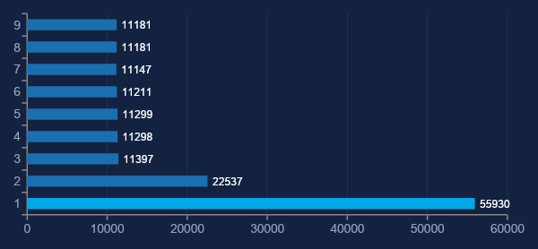
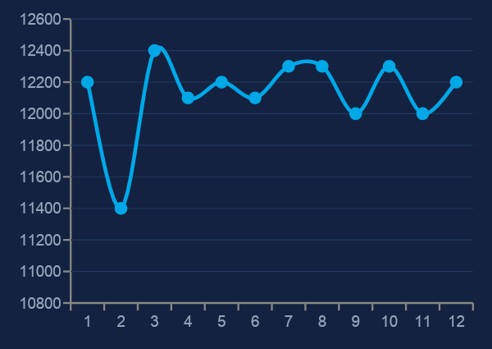
TRAFFIC OVERVIEW
Who is Coming to Ring.com?
146K
102K
50/50
70%
Total Sessions
Unique Users
Desktop / Mobile
US Traffic
Sessions by Channel
Monthly Session Trend

Slide 5
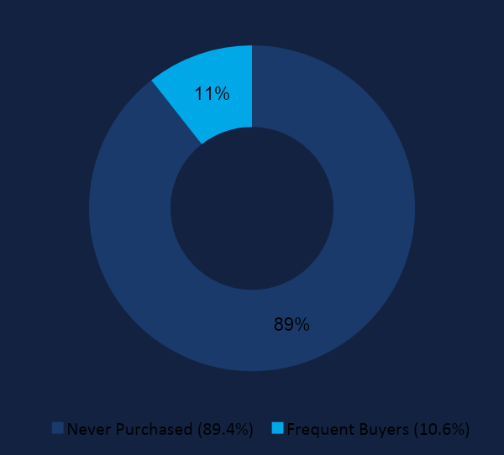
USER PROFILE
We Have the Traffic. Conversion is the Problem.
102,435
Total Tracked Users
89.4%
Have NEVER purchased
10.6%
Frequent / Active buyers
10,853
Unique users placed an order
💡 Insight: The acquisition funnel is working — 102K users reached the site. The challenge is converting the 89% who never purchased.

Slide 6
WHERE WE LOSE USER
43% of Sessions Never Leave the Product Page
All Sessions
146,000
100%
Product Page
62,649
42.9%
Category Page
⚠ BIGGEST
DROP-OFF
20,826
14.3%
Cart
20,693
14.2%
43% of sessions
stop here
Checkout
21,021
14.4%
Purchased ✓
20,811
14.2%
✓ Once past the product page, the funnel is remarkably healthy — Cart → Checkout → Purchase maintains ~99% retention.

Slide 7
PRODUCT PAGE ANALYSIS
Users Are Reading But Not Acting
📖
Users DO scroll — avg scroll depth is 85% across all sessions, meaning users read the product pages thoroughly
62,649
🖱️
Only 17.2% of sessions add to cart — content is seen but not convincing enough to trigger action
sessions ended on the product page
= 43% of ALL traffic
💭
Hypothesis: lack of social proof, unclear CTA prominence, price hesitation without reviews
🎯
Even a 5% improvement in product page → cart rate = ~3,000 additional orders annually
⚡ Priority Action: Optimizing the product page is the highest-leverage improvement available to the business right now.

Slide 8
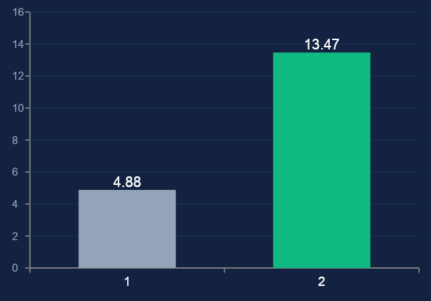
PURCHASE INTENT SIGNALS
'Buy Now' Click is the Strongest Predictor of Purchase
2.75x
higher conversion rate
for sessions with Buy Now click
Buy Now Click
✅ Strong Signal
2.75x conversion lift
Scroll Depth
❌ No Signal
No difference (85% for all)
Device Type
❌ No Signal
Desktop ≈ Mobile (7.69% vs 7.66%)
💡 Use 'Buy Now' clickers who didn't purchase as a high-priority retargeting audience — they are your most valuable unconverted segment.

Slide 9
CHANNEL PERFORMANCE
Paid Social: High Volume, Low Efficiency
Channel
Sessions
Cart Rate
Conv. Rate
Efficiency
KEY
FINDING
SMS
11,298
17.5%
7.99%
HIGH
Internal
11,147
17.5%
7.83%
HIGH
Paid Social
drives 38%
of traffic
but lowest
conversion
Affiliate
11,211
17.3%
7.81%
HIGH
Display
11,299
17.2%
7.76%
MED
Email
22,537
17.2%
7.71%
MED
SMS converts
2x more
efficiently
per session
CPC
11,397
16.9%
7.59%
MED
Paid Social
Paid Social
55,930
55,930
17.2%
17.2%
7.60%
7.60%
LOW ⚠
LOW ⚠
Organic
11,181
17.2%
7.39%
LOW
⚡ Paid Social traffic drive is 5x larger than any other channel — yet delivers the worst conversion rate. Rebalancing toward SMS & Affiliate could significantly improve ROI.

Slide 10
CHANNEL × PRODUCT ANALYSIS
No Single Channel Works Best for Every Product
Video
Doorbell
Stick Up
Cam
Ring
Alarm
Indoor
Cam
💡 Green = best performing channel per product. SMS wins for Video Doorbell & Ring Alarm. Display for Stick Up Cam. Affiliate & Internal for Indoor Cam.
SMS
8.31%
7.87%
8.26%
7.52%
Display
7.44%
8.33%
7.85%
7.43%
Affiliate
7.88%
7.40%
7.77%
8.22%
Internal
7.38%
7.83%
7.94%
8.17%
Email
7.44%
7.54%
7.80%
8.05%
CPC
7.89%
7.34%
7.11%
7.99%
Paid Social
7.66%
7.48%
7.70%
7.55%

Slide 11
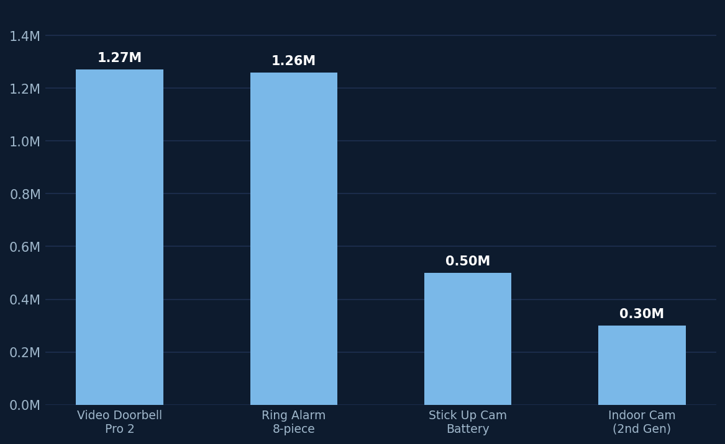
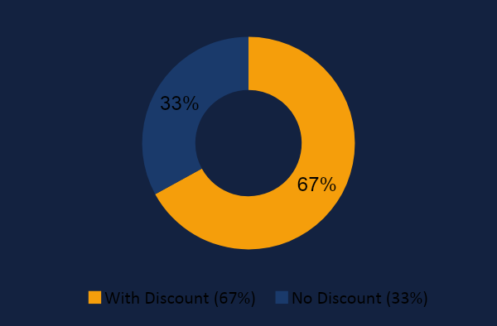
REVENUE ANALYSIS
Revenue Concentrated in Two Products, Dependent on Discounts
Discount Dependency
$3.33M
34K
$496
67%
Total Revenue
Units Sold
Avg Order Value
Orders with Discount
⚠ 67% discount dependency risks margin erosion. Video Doorbell & Ring Alarm = 76% of revenue — over-reliance on two SKUs is a concentration risk.

Slide 12
KEY INSIGHTS
Five Findings That Matter Most
01
Product Page is the #1 Conversion Bottleneck
43% of all sessions end on the product page. Users scroll 85% deep — they read the content, but only 17.2% take action. The issue is persuasion, not awareness.
02
'Buy Now' Click = 2.75x Conversion Lift
Sessions with a Buy Now click convert at 13.47% vs 4.88% without. This is the most actionable behavioral signal in the data — scroll and device type show zero differentiation.
03
Paid Social: Volume Without Value
Paid Social accounts for 38% of all traffic (55,930 sessions) but delivers the lowest conversion rate. SMS and Affiliate convert significantly better with far less spend.
04
Each Product Has a Different Best Channel
SMS is best for Video Doorbell & Ring Alarm. Display leads for Stick Up Cam. Affiliate & Internal for Indoor Cam. A single channel strategy across all products wastes budget.
05
67% Discount Dependency = Margin Risk
Two-thirds of all orders require a discount to close. This suppresses margin and trains customers to wait for promotions rather than buying at full price.

Slide 13
RECOMMENDATIONS
Five Actions to Drive Growth
R1
Optimize the Product Page CTA
HIGH PRIORITY
→ Add reviews, trust badges, urgency signals & stronger Buy Now placement
💰 5% improvement = ~3,000 extra orders/year
R2
Retarget 'Buy Now' Clickers
HIGH PRIORITY
→ Build retargeting audience from Buy Now clickers who didn't purchase
💰 Highest-intent unconverted segment — low cost, high return
R3
Rebalance Channel Budget
MED PRIORITY
→ Shift spend from Paid Social toward SMS & Affiliate (2x better efficiency)
💰 Same budget, significantly more conversions
R4
Product-Specific Channel Strategy
MED PRIORITY
→ Run SMS for Doorbell/Alarm, Display for Stick Up Cam, Affiliate for Indoor Cam
💰 Eliminate wasted spend from low-converting channel/product combos
R5
Reduce Discount Dependency
LOW PRIORITY
→ Test bundles, free accessories, and value messaging instead of flat % discounts
💰 Protect margin on $3.33M revenue base

Slide 14
NEXT STEPS
What to Do Next
🧪
A/B Test Buy Now Button
📱
Channel Efficiency Dashboard
Test placement, color, and copy of the Buy Now CTA on product pages. Measure impact on cart rate.
Build a live dashboard tracking revenue per session by channel — not just conversion rate.
🎯
Build Retargeting Audiences
🔍
Organic SEO Audit
Segment Buy Now clickers who didn't purchase as a priority retargeting group in paid channels.
Organic has the lowest conversion rate. Investigate whether traffic quality or landing page mismatch is the issue.
💡
Price Sensitivity Testing
Run experiments to understand how much of the 67% discount usage is driven by actual price sensitivity vs habit.
With more time: session-level attribution modeling, multi-touch channel analysis, and predictive churn scoring for the 89% non-purchasers.

Slide 15
Thank You
Ring.com Digital Performance Analysis 2025
146K
$3.33M
5
5
Sessions Analysed
Total Revenue
Key Insights
Recommendations

