Slide 1
Chapter 12
Object-Oriented Design

Slide 2
Object-oriented Design
Designing systems using self-contained objects and object classes

Slide 3
Objectives
To explain how a software design may be represented as a set of interacting objects that manage their own state and operations
To describe the activities in the object-oriented design process
To introduce various models that describe an object-oriented design
To show how the UML may be used to represent these models

Slide 4
Topics covered
Objects and object classes
An object-oriented design process
Design evolution

Slide 5
Characteristics of OOD
Objects are abstractions of real-world or system entities and manage themselves
Objects are independent and encapsulate state and representation information.
System functionality is expressed in terms of object services
Shared data areas are eliminated. Objects
communicate by message passing
Objects may be distributed and may execute
sequentially or in parallel

Slide 6
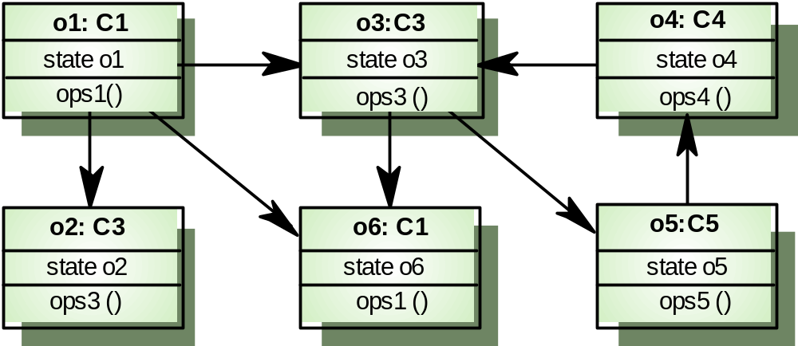
Interacting objects

Slide 7
Advantages of OOD
Easier maintenance. Objects may be
understood as stand-alone entities
Objects are appropriate reusable components
For some systems, there may be an obvious
mapping from real world entities to system
objects

Slide 8
Object-oriented development
Object-oriented analysis, design and programming are related but distinct
OOA is concerned with developing an object model of the application domain
OOD is concerned with developing an object-oriented system model to implement requirements
OOP is concerned with realising an OOD using an OO programming language such as Java or C++

Slide 9
Objects and object classes
Objects are entities in a software system which represent instances of real-world and system entities
Object classes are templates for objects. They may be used to create objects
Object classes may inherit attributes and services from other object classes

Slide 10
Objects
An object is an entity which has a state and a defined set of operations which operate on that state. The state is represented as a set of object attributes. The operations associated with the object provide services to other objects (clients) which request these services when some computation is required.
Objects are created according to some object class definition. An object class definition serves as a template for objects. It includes declarations of all the attributes and services which should be associated with an object of that class.

Slide 11
The Unified Modeling Language
Several different notations for describing object-oriented designs were proposed in the 1980s and 1990s
The Unified Modeling Language is an integration of these notations
It describes notations for a number of different models that may be produced during OO analysis and design
It is now a de facto standard for OO modelling

Slide 12
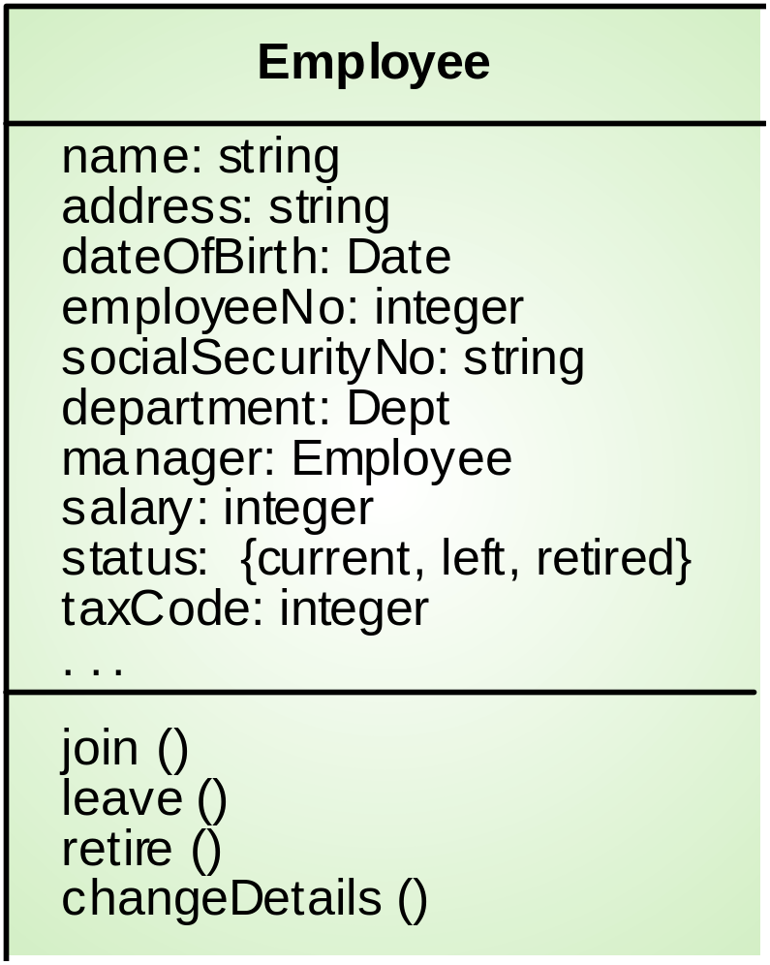
Employee object class (UML)

Slide 13
Object communication
Conceptually, objects communicate by
message passing.
Messages
  The name of the service requested by the calling object.
  Copies of the information required to execute the service
  and the name of a holder for the result of the service.
In practice, messages are often implemented
by procedure calls
  Name = procedure name.
  Information = parameter list.

Slide 14
Message examples
// Call a method associated with a buffer
// object that returns the next value
// in the buffer
v = circularBuffer.Get () ;
// Call the method associated with a
// thermostat object that sets the
// temperature to be maintained
thermostat.setTemp (20) ;

Slide 15
Generalisation and inheritance
Objects are members of classes which define
attribute types and operations
Classes may be arranged in a class hierarchy
where one class (a super-class) is a generalisation of one or more other classes (sub-classes)
A sub-class inherits the attributes and
operations from its super class and may add
new methods or attributes of its own
Generalisation in the UML is implemented as inheritance in OO programming languages

Slide 16
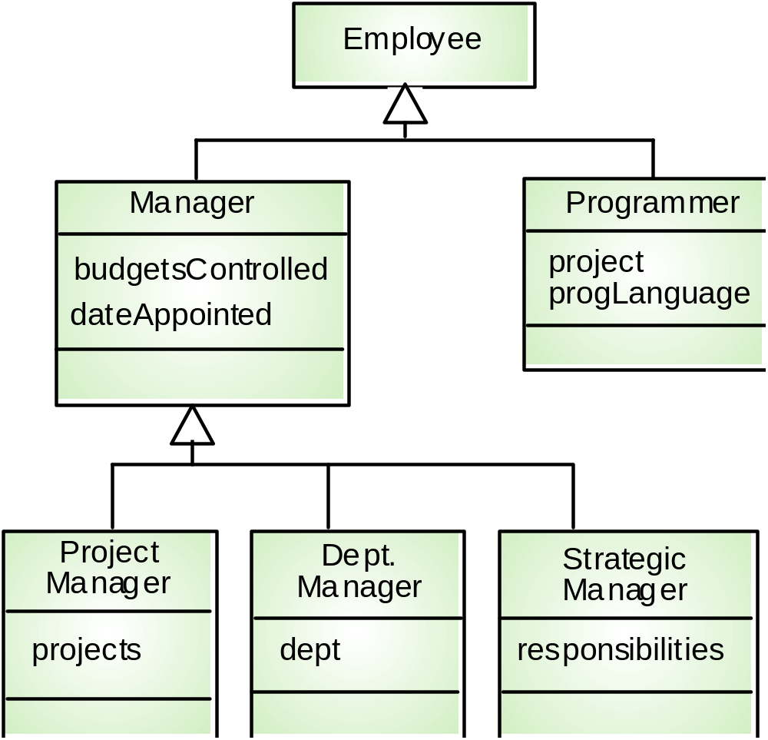
A generalisation hierarchy

Slide 17
Advantages of inheritance
It is an abstraction mechanism which may be used to classify entities
It is a reuse mechanism at both the design and the programming level
The inheritance graph is a source of organisational knowledge about domains and systems

Slide 18
Problems with inheritance
Object classes are not self-contained. they cannot be understood without reference to their super-classes
Designers have a tendency to reuse the inheritance graph created during analysis. Can lead to significant inefficiency
The inheritance graphs of analysis, design and implementation have different functions and should be separately maintained

Slide 19
Inheritance and OOD
There are differing views as to whether
inheritance is fundamental to OOD.
  View 1. Identifying the inheritance hierarchy or network is a fundamental part of object-oriented design. Obviously this can only be implemented using an OOPL.
  View 2. Inheritance is a useful implementation concept which allows reuse of attribute and operation definitions. Identifying an inheritance hierarchy at the design stage places unnecessary restrictions on the implementation
Inheritance introduces complexity and this is undesirable, especially in critical systems

Slide 20
UML associations
Objects and object classes participate in relationships with other objects and object classes
In the UML, a generalised relationship is indicated by an association
Associations may be annotated with information that describes the association
Associations are general but may indicate that an attribute of an object is an associated object or that a method relies on an associated object

Slide 21
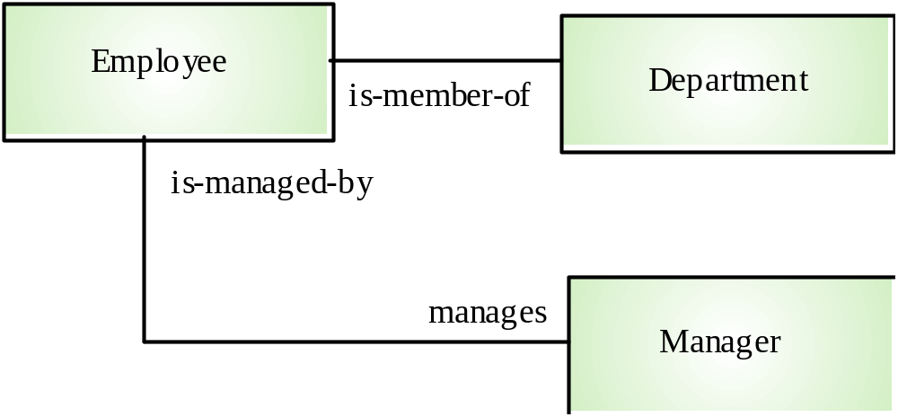
An association model

Slide 22
Concurrent objects
The nature of objects as self-contained entities
make them suitable for concurrent
implementation
The message-passing model of object
communication can be implemented directly if
objects are running on separate processors in a
distributed system

Slide 23
Servers and active objects
Servers.
  The object is implemented as a parallel process (server)
  with entry points corresponding to object operations. If no
  calls are made to it, the object suspends itself and waits for further requests for service
Active objects
  Objects are implemented as parallel processes and the
  internal object state may be changed by the object itself and
  not simply by external calls

Slide 24
Active transponder object
Active objects may have their attributes modified by operations but may also update them autonomously using internal operations
Transponder object broadcasts an aircraft’s position. The position may be updated using a satellite positioning system. The object periodically update the position by triangulation from satellites

Slide 25
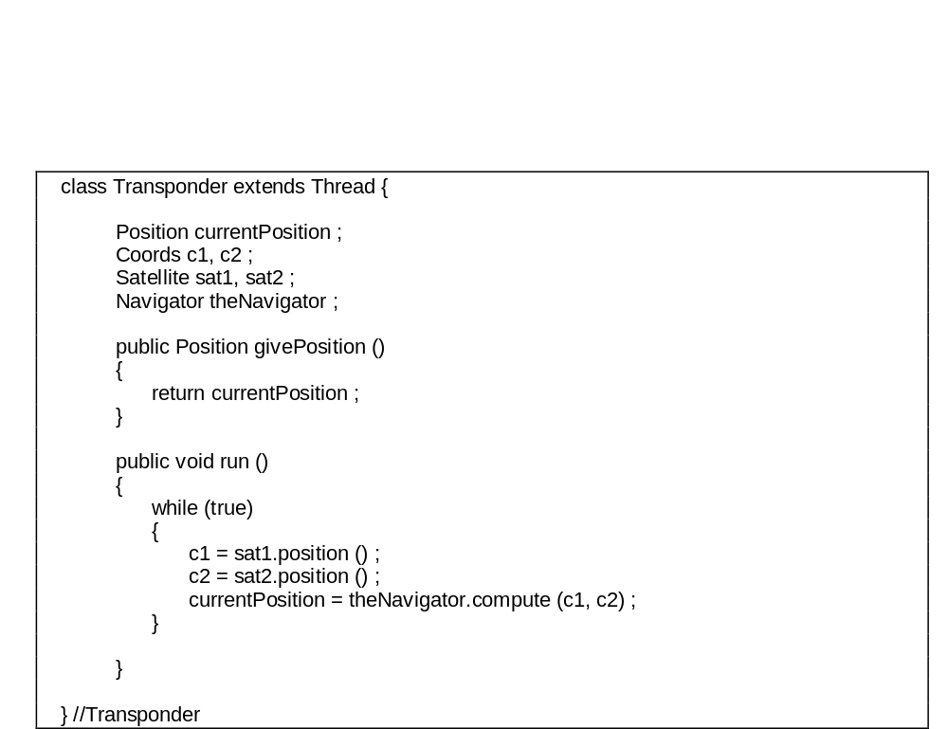
An active transponder object

Slide 26
Java threads
Threads in Java are a simple construct for implementing concurrent objects
Threads must include a method called run() and this is started up by the Java run-time system
Active objects typically include an infinite loop so that they are always carrying out the computation

Slide 27
An object-oriented design process
Define the context and modes of use of the system
Design the system architecture
Identify the principal system objects
Develop design models
Specify object interfaces

Slide 28
Weather system description
A weather data collection system is required to generate weather maps on a regular basis using data collected from remote, unattended weather stations and other data sources such as weather observers, balloons and satellites. Weather stations transmit their data to the area computer in response to a request from that machine.
The area computer validates the collected data and integrates it with the data from different sources. The integrated data is archived and, using data from this archive and a digitised map database a set of local weather maps is created. Maps may be printed for distribution on a special-purpose map printer or may be displayed in a number of different formats.

Slide 29
Weather station description
A weather station is a package of software controlled instruments which collects data, performs some data processing and transmits this data for further processing. The instruments include air and ground thermometers, an anemometer, a wind vane, a barometer and a rain gauge. Data is collected every five minutes.
When a command is issued to transmit the weather data, the weather station processes and summarises the collected data. The summarised data is transmitted to the mapping computer when a request is received.

Slide 30
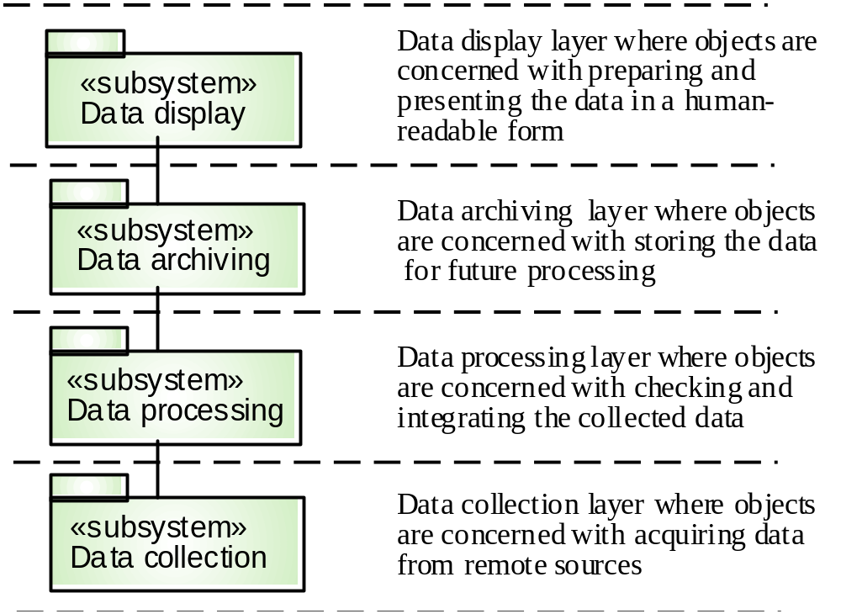
Layered architecture

Slide 31
System context and models of use
Develop an understanding of the relationships between the software being designed and its external environment
System context
  A static model that describes other systems in the environment. Use a subsystem model to show other systems. Following slide shows the systems around the weather station system.
Model of system use
  A dynamic model that describes how the system interacts with its environment. Use use-cases to show interactions

Slide 32
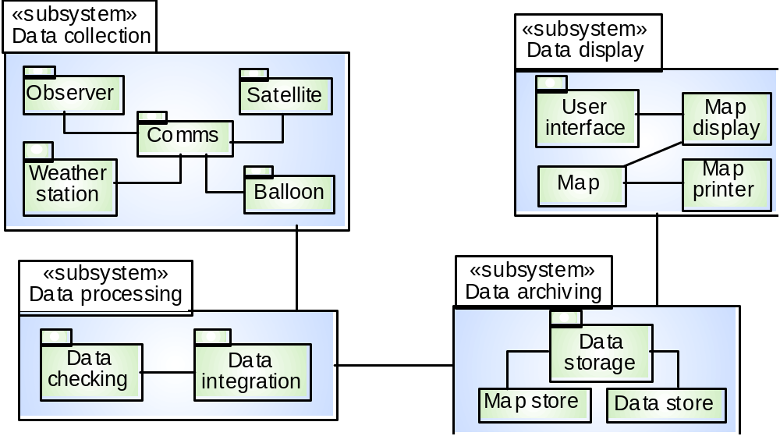
Subsystems in the weather mapping system

Slide 33
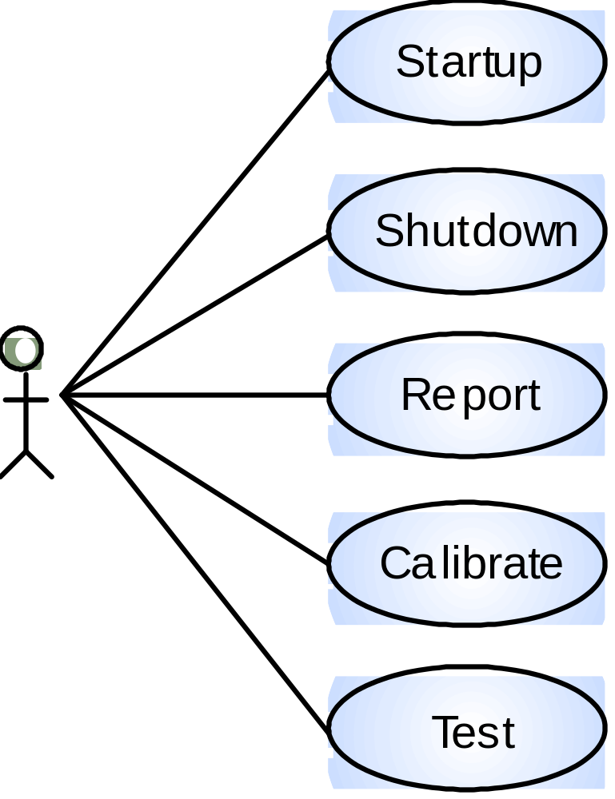
Use-cases for the weather station

Slide 34
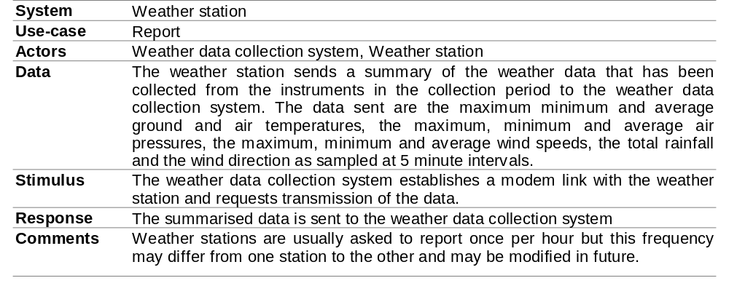
Use-case description

Slide 35
Architectural design
Once interactions between the system and its environment have been understood, you use this information for designing the system architecture
Layered architecture is appropriate for the weather station
  Interface layer for handling communications
  Data collection layer for managing instruments
  Instruments layer for collecting data
There should be no more than 7 entities in an architectural model

Slide 36
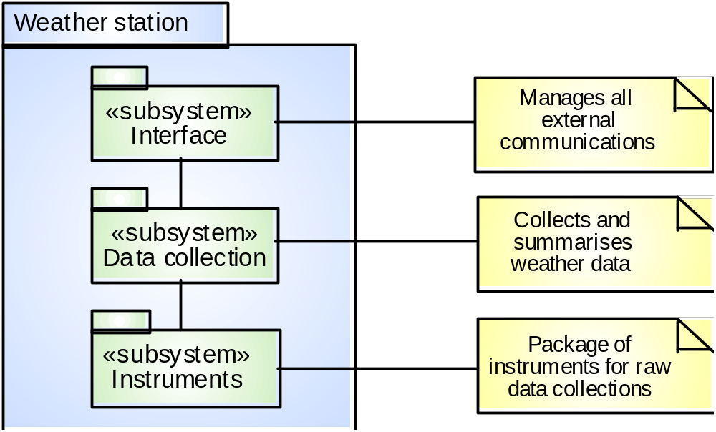
Weather station architecture

Slide 37
Object identification
Identifying objects (or object classes) is the most difficult part of
object oriented design
There is no 'magic formula' for object identification. It relies on the skill, experience
and domain knowledge of system designers
Object identification is an iterative process. You are unlikely to get it right first time

Slide 38
Approaches to identification
Use a grammatical approach based on a natural language description of the system (used in Hood method)
Base the identification on tangible things in the application domain
Use a behavioural approach and identify objects based on what participates in what behaviour
Use a scenario-based analysis. The objects, attributes and methods in each scenario are identified

Slide 39
Weather station object classes
Ground thermometer, Anemometer, Barometer
  Application domain objects that are ‘hardware’ objects related to the instruments in the system
Weather station
  The basic interface of the weather station to its environment. It therefore reflects the interactions identified in the use-case model
Weather data
  Encapsulates the summarised data from the instruments

Slide 40
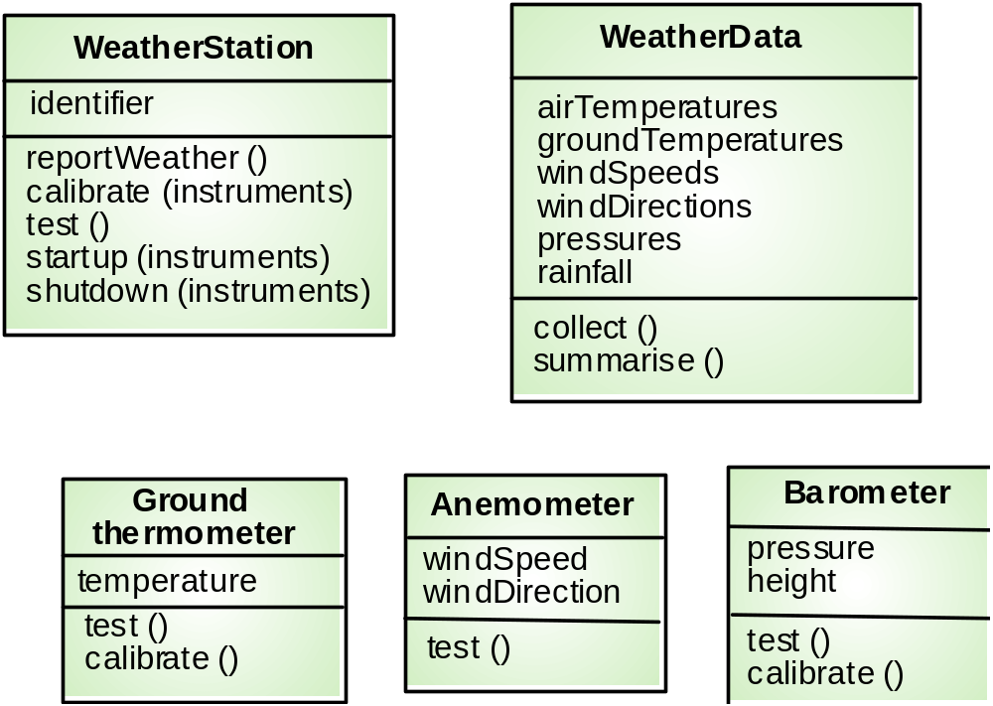
Weather station object classes

Slide 41
Further objects and object refinement
Use domain knowledge to identify more objects and operations
  Weather stations should have a unique identifier
  Weather stations are remotely situated so instrument failures have to be reported automatically. Therefore attributes and operations for self-checking are required
Active or passive objects
  In this case, objects are passive and collect data on request rather than autonomously. This introduces flexibility at the expense of controller processing time

Slide 42
Design models
Design models show the objects and object classes and relationships between these entities
Static models describe the static structure of the system in terms of object classes and relationships
Dynamic models describe the dynamic interactions between objects.

Slide 43
Examples of design models
Sub-system models that show logical groupings of objects into coherent subsystems
Sequence models that show the sequence of object interactions
State machine models that show how individual objects change their state in response to events
Other models include use-case models, aggregation models, generalisation models,etc.

Slide 44
Subsystem models
Shows how the design is organised into logically related groups of objects
In the UML, these are shown using packages - an encapsulation construct. This is a logical model. The actual organisation of objects in the system may be different.

Slide 45
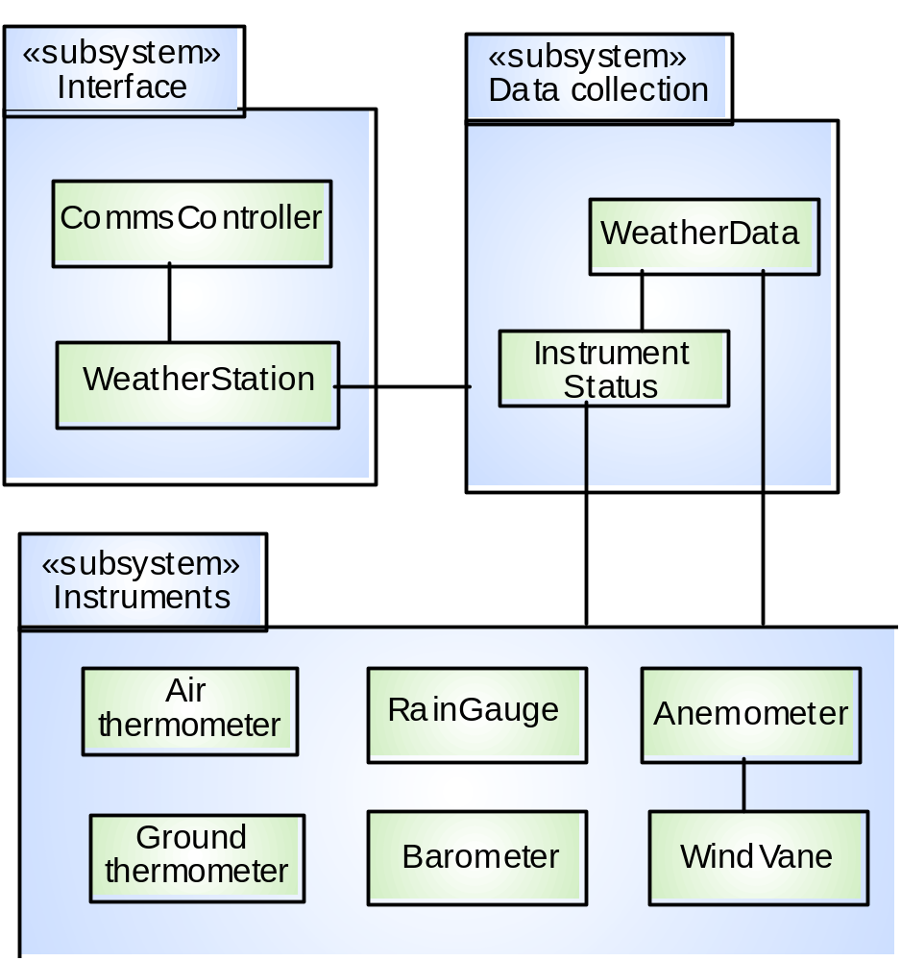
Weather station subsystems

Slide 46
Sequence models
Sequence models show the sequence of object interactions that take place
  Objects are arranged horizontally across the top
  Time is represented vertically so models are read top to bottom
  Interactions are represented by labelled arrows, Different styles of arrow represent different types of interaction
  A thin rectangle in an object lifeline represents the time when the object is the controlling object in the system

Slide 47
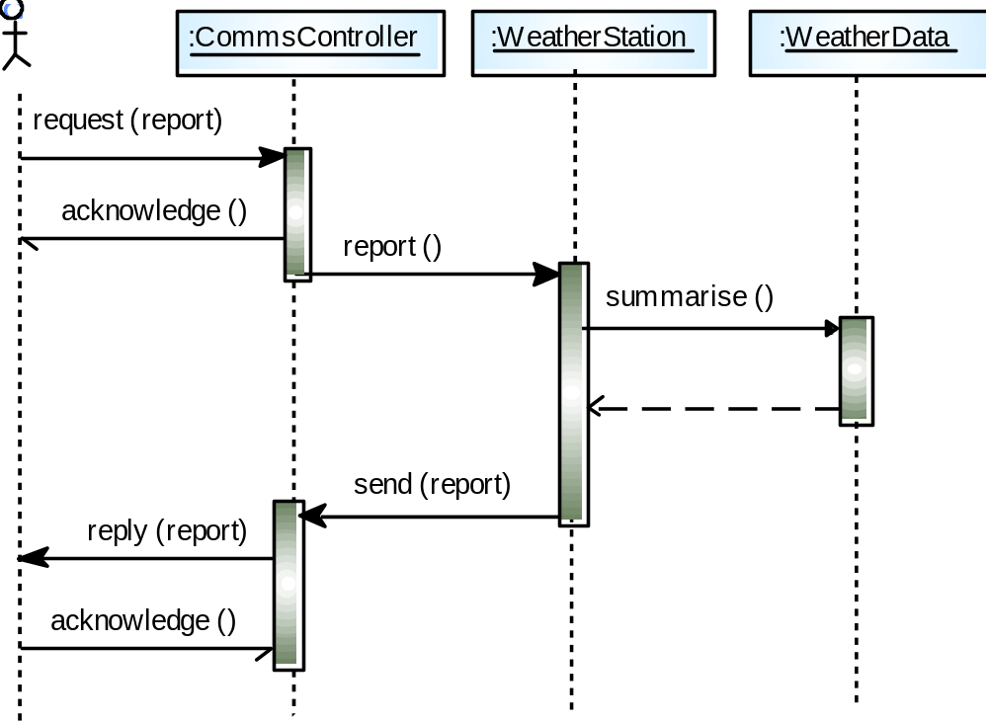
Data collection sequence

Slide 48
Statecharts
Show how objects respond to different service requests and the state transitions triggered by these requests
  If object state is Shutdown then it responds to a Startup() message
  In the waiting state the object is waiting for further messages
  If reportWeather () then system moves to summarising state
  If calibrate () the system moves to a calibrating state
  A collecting state is entered when a clock signal is received

Slide 49
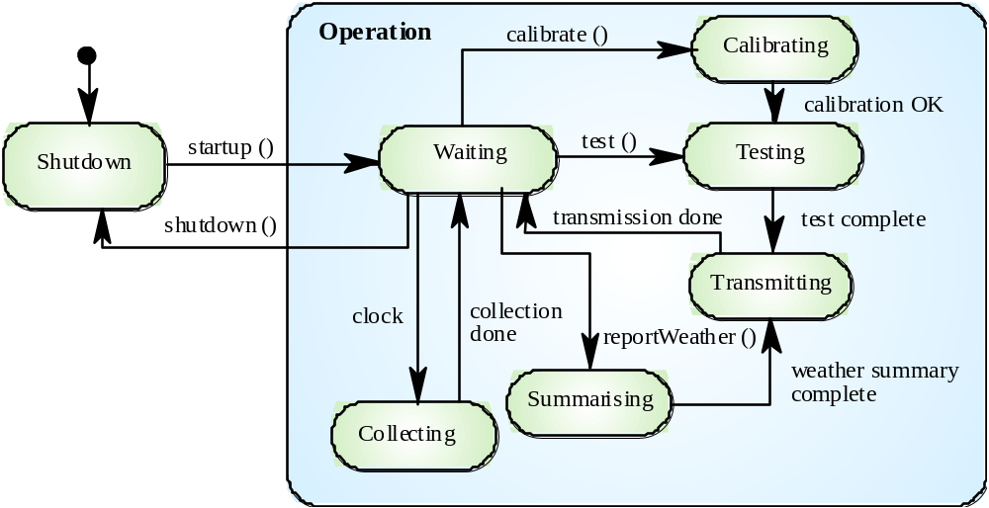
Weather station state diagram

Slide 50
Object interface specification
Object interfaces have to be specified so that the objects and other components can be designed in parallel
Designers should avoid designing the interface representation but should hide this in the object itself
Objects may have several interfaces which are viewpoints on the methods provided
The UML uses class diagrams for interface specification but Java may also be used

Slide 51
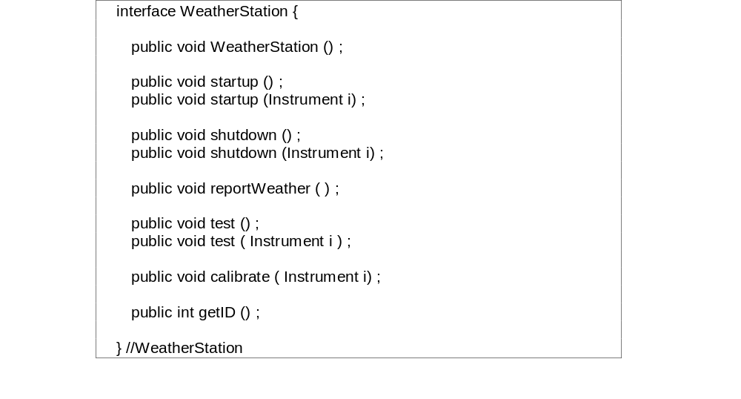
Weather station interface

Slide 52
Design evolution
Hiding information inside objects means that
changes made to an object do not affect other
objects in an unpredictable way
Assume pollution monitoring facilities are to be
added to weather stations. These sample the
air and compute the amount of different
pollutants in the atmosphere
Pollution readings are transmitted with weather
data

Slide 53
Changes required
Add an object class called ‘Air quality’ as part of WeatherStation
Add an operation reportAirQuality to WeatherStation. Modify the control software to collect pollution readings
Add objects representing pollution monitoring instruments

Slide 54
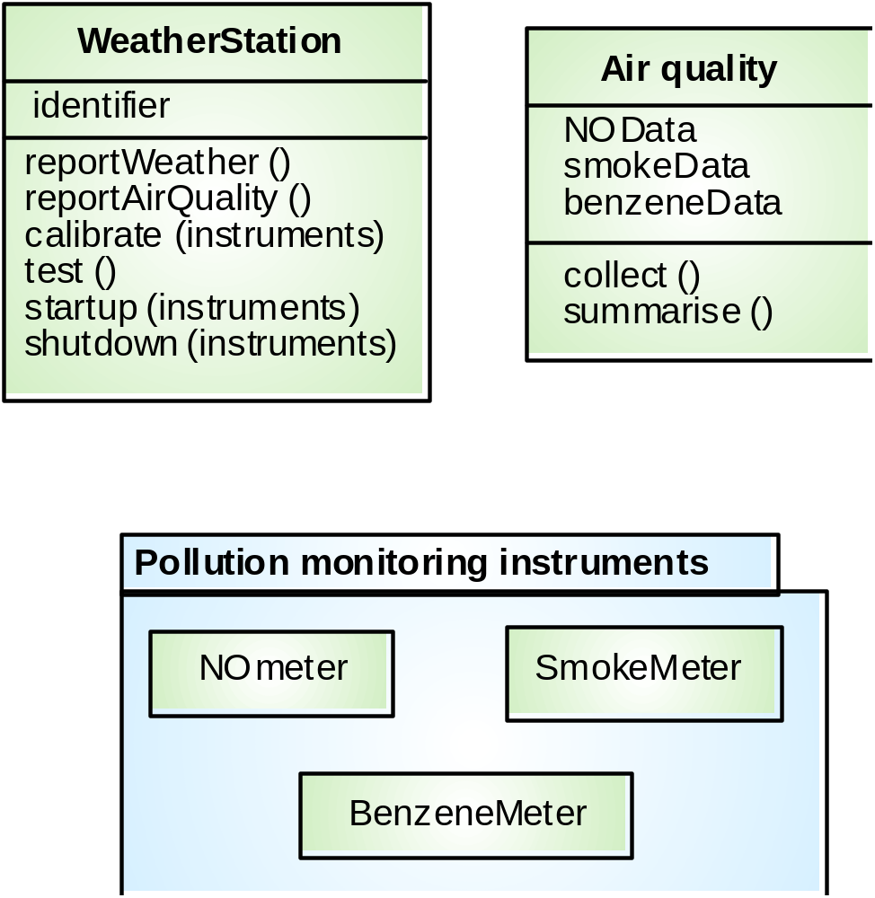
Pollution monitoring

Slide 55
Key points
OOD is an approach to design so that design components have their own private state and operations
Objects should have constructor and inspection operations. They provide services to other objects
Objects may be implemented sequentially or concurrently
The Unified Modeling Language provides different notations for defining different object models

Slide 56
Key points
A range of different models may be produced during an object-oriented design process. These include static and dynamic system models
Object interfaces should be defined precisely using e.g. a programming language like Java
Object-oriented design simplifies system evolution

