Slide 1
Project Estimation and scheduling
Outline:
  Estimation overview
  Cocomo: concepts, process and tool.
  Detailed schedule/planning terminology and processes
  Planning Tools (MS Project)

Slide 2
Estimation
“The single most important task of a project: setting realistic expectations.
Unrealistic expectations based on inaccurate estimates are the single largest cause of software failure.”
Futrell, Shafer and Shafer, “Quality Software Project Management”

Slide 3
Why its important to you!
Program development of large software systems normally experience 200-300% cost overruns and a 100% schedule slip
15% of large projects deliver…NOTHING!
Key reasons…poor management and inaccurate estimations of development cost and schedule
If not meeting schedules, developers often pay the price!

Slide 4
The Problems
Predicting software cost
Predicting software schedule
Controlling software risk
Managing/tracking project as it progresses

Slide 5
Fundamental estimation questions
How much effort is required to complete an activity?
How much calendar time is needed to complete an activity?
What is the total cost of an activity?
Project estimation and scheduling are interleaved management activities.

Slide 6
Software cost components
Hardware and software costs.
Travel and training costs.
Effort costs (the dominant factor in most
projects)
  The salaries of engineers involved in the project;
  Social and insurance costs.
Effort costs must take overheads into account
  Costs of building, heating, lighting.
  Costs of networking and communications.
  Costs of shared facilities (e.g library, staff restaurant, etc.).

Slide 7
Costing and pricing
Estimates are made to discover the cost, to the developer, of producing a software system.
There is not a simple relationship between the development cost and the price charged to the customer.
Broader organisational, economic, political and business considerations influence the price charged.

Slide 8
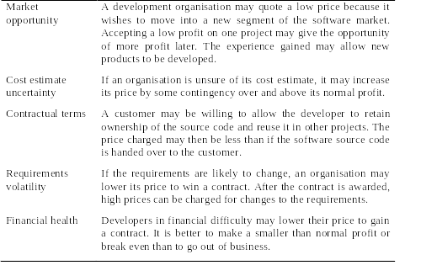
Software pricing factors

Slide 9
Nature of Estimates
Man Months (or Person Months), defined as 152 man-hours of direct-charged labor
Schedule in months (requirements complete to acceptance)
Well-managed program

Slide 10
4 Common (subjective) estimation models
Expert Judgment
Analogy
Parkinson’s law
Price to win

Slide 11
Expert judgment
One or more experts in both software development and the application domain use their experience to predict software costs. Process iterates until some consensus is reached.
Advantages: Relatively cheap estimation method. Can be accurate if experts have direct experience of similar systems
Disadvantages: Very inaccurate if there are no experts!

Slide 12
Estimation by Analogy
The cost of a project is computed by comparing the project to a similar project in the same application domain.
Advantages: May be accurate if project data available and people/tools the same
Disadvantages: Impossible if no comparable project has been tackled. Needs systematically maintained cost database.

Slide 13
Parkinson's Law
The project costs whatever resources are available
Advantages: No overspend
Disadvantages: System is usually unfinished

Slide 14
Cost Pricing to win
The project costs whatever the customer has to spend on it
Advantages: You get the contract
Disadvantages: The probability that the customer gets the system he or she wants is small. Costs do not accurately reflect the work required.
How do you know what customer has?
Only a good strategy if you are willing to take a serious loss to get a first customer, or if Delivery of a radically reduced product is a real option.

Slide 15
Top-down and bottom-up estimation
Any of these approaches may be used top-down or bottom-up.
Top-down
  Start at the system level and assess the overall system functionality and how this is delivered through sub-systems.
Bottom-up
  Start at the component level and estimate the effort required for each component. Add these efforts to reach a final estimate.

Slide 16
Top-down estimation
Usable without knowledge of the system architecture and the components that might be part of the system.
Takes into account costs such as integration, configuration management and documentation.
Can underestimate the cost of solving difficult low-level technical problems.

Slide 17
Bottom-up estimation
Usable when the architecture of the system is known and components identified.
This can be an accurate method if the system has been designed in detail.
It may underestimate the costs of system level activities such as integration and documentation.

Slide 18
Estimation methods
Each method has strengths and weaknesses.
Estimation should be based on several methods.
If these do not return approximately the same result, then you have insufficient information available to make an estimate.
Some action should be taken to find out more in order to make more accurate estimates.
Pricing to win is sometimes the only applicable method.

Slide 19
Pricing to win
This approach may seem unethical and un-businesslike.
However, when detailed information is lacking it may be the only appropriate strategy.
The project cost is agreed on the basis of an outline proposal and the development is constrained by that cost.
A detailed specification may be negotiated or an evolutionary approach used for system development.

Slide 20
Algorithmic cost modeling
Cost is estimated as a mathematical function of product, project and process attributes whose values are estimated by project managers
The function is derived from a study of historical costing data
Most commonly used product attribute for cost estimation is LOC (code size)
Most models are basically similar but with different attribute values

Slide 21
Criteria for a Good Model
Defined—clear what is estimated
Accurate
Objective—avoids subjective factors
Results understandable
Detailed
Stable—second order relationships
Right Scope
Easy to Use
Causal—future data not required
Parsimonious—everything present is important

Slide 22
Software productivity
A measure of the rate at which individual
engineers involved in software development
produce software and associated
documentation.
Not quality-oriented although quality assurance is a factor in productivity assessment.
Essentially, we want to measure useful
functionality produced per time unit.

Slide 23
Productivity measures
Size related measures based on some output from the software process. This may be lines of delivered source code, object code instructions, or the number of pages of system documentation etc.
Function-related measures based on an estimate of the functionality of the delivered software. Productivity is expressed in terms of the amount of useful functionality produced in some give time. Function-points are the best known of this type of measure.

Slide 24
Measurement problems
Estimating the size of the measure (e.g. how many function points).
Estimating the total number of programmer
months that have elapsed.
Estimating contractor productivity (e.g.
documentation team) and incorporating this
estimate in overall estimate.

Slide 25
Lines of code
What's a line of code?
  The measure was first proposed when programs were typed on cards with one line per card;
  How does this correspond to statements as in Java which can span several lines or where there can be several statements on one line.
What programs should be counted as part of the system?
This metric assumes that there is a linear relationship between system size and volume of documentation.
A key thing to understand about early estimates is that the uncertainty is more important than the initial line – don’t see one estimate, seek justifiable bounds.

Slide 26
Lines of source code per programmer-month is a widely-used metric in productivity measurement.
This is computed by counting the total number of lines of source code which are delivered .
The count is divided by the total time in programmer-months required to complete the project.

Slide 27
Productivity comparisons
The lower level the language, the more
productive the programmer
  The same functionality takes more code to implement in a lower-level language than in a high-level language.
The more verbose the programmer, the higher
the productivity
  Measures of productivity based on lines of code suggest that programmers who write verbose code are more productive than programmers who write compact code.

Slide 28
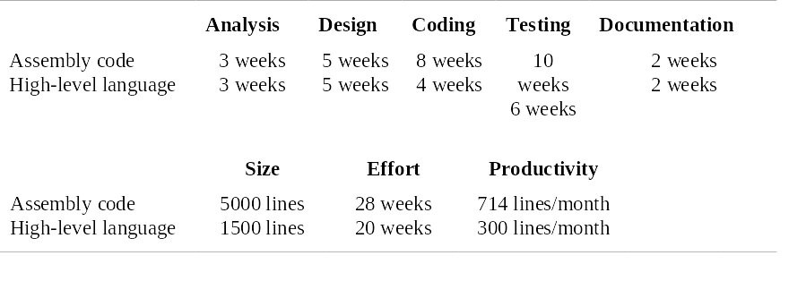
System development times

Slide 29
Function points
Based on a combination of program characteristics
  external inputs and outputs;
  user interactions;
  external interfaces;
  files used by the system.
A weight is associated with each of these and the function point count is computed by multiplying each raw count by the weight and summing all values.

Slide 30
Function Points
Function points measure a software project by quantifying the information processing functionality associated with major external data input, output, or file types. Five user function types should be identified as defined below.
  External Input (Inputs) - Count each unique user data or user control input type that (i) enters the external boundary of the software system being measured and (ii) adds or changes data in a logical internal file.
  External Output (Outputs) - Count each unique user data or control output type that leaves the external boundary of the software system being measured.
  Internal Logical File (Files) - Count each major logical group of user data or control information in the software system as a logical internal file type. Include each logical file (e.g., each logical group of data) that is generated, used, or maintained by the software system.
  External Interface Files (Interfaces) - Files passed or shared between software systems should be counted as external interface file types within each system.
  External Inquiry (Queries) - Count each unique input-output combination, where an input causes and generates an immediate output, as an external inquiry type.

Slide 31
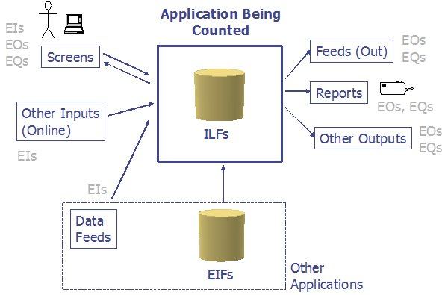

Slide 32
Function points
The function point count is modified by complexity of the project
FPs can be used to estimate LOC depending on the average number of LOC per FP for a given language
  LOC = AVC * number of function points;
  AVC is a language-dependent factor varying from 200-300 for assemble language to 2-40 for a 4GL;
FPs are very subjective. They depend on the estimator
  Automatic function-point counting is impossible.

Slide 33
Object points
Object points (alternatively named application points) are an alternative function-related measure to function points when 4Gls or similar languages are used for development.
Object points are NOT the same as object classes.
The number of object points in a program is a weighted estimate of
  The number of separate screens that are displayed;
  The number of reports that are produced by the system;
  The number of program modules that must be developed to supplement the database code;

Slide 34
Object point estimation
Object points are easier to estimate from a specification than function points as they are simply concerned with screens, reports and programming language modules.
They can therefore be estimated at a fairly early point in the development process.
At this stage, it is very difficult to estimate the number of lines of code in a system.

Slide 35
Productivity estimates
Real-time embedded systems, 40-160
LOC/P-month.
Systems programs , 150-400 LOC/P-month.
Commercial applications, 200-900
LOC/P-month.
In object points, productivity has been measured between 4 and 50 object points/month depending on tool support and developer capability.

Slide 36
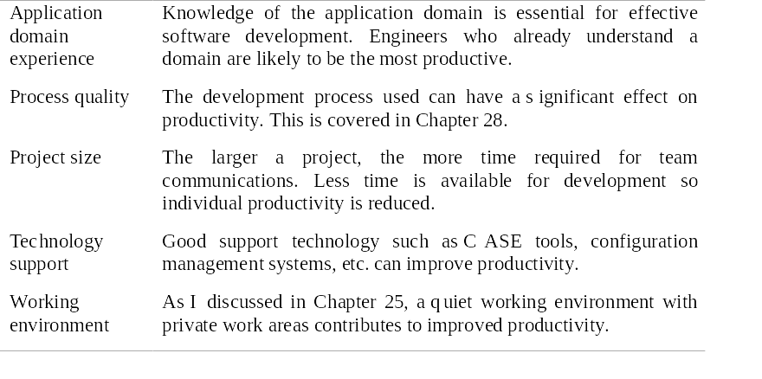
Factors affecting productivity

Slide 37
Quality and productivity
All metrics based on volume/unit time are
flawed because they do not take quality into
account.
Productivity may generally be increased at the
cost of quality.
It is not clear how productivity/quality metrics
are related.
If requirements are constantly changing then an approach based on counting lines of code is not meaningful as the program itself is not static;

Slide 38
Estimation techniques
There is no simple way to make an accurate estimate of the effort required to develop a software system
  Initial estimates are based on inadequate information in a user requirements definition;
  The software may run on unfamiliar computers or use new technology;
  The people in the project may be unknown.
Project cost estimates may be self-fulfilling
  The estimate defines the budget and the product is adjusted to meet the budget.

Slide 39
Changing technologies
Changing technologies may mean that previous estimating experience does not carry over to new systems
  Distributed object systems rather than mainframe systems;
  Use of web services;
  Use of ERP or database-centred systems;
  Use of off-the-shelf software;
  Development for and with reuse;
  Development using scripting languages;
  The use of CASE tools and program generators.

Slide 40
Empirical Model (COCOMO)
  Provide computational means for deriving S/W cost estimates as functions of variables (major cost drivers)
  Functions used contain constants derived from statistical analysis of data from past projects:
      can only be used if data from past projects is available
      must be calibrated to reflect local environment
      relies on initial size and cost factor estimates which themselves are questionable
Notes:
- Over the years, dozens of software cost models have been developed for various purposes. Algorithmic cost models (especially COCOMO) have been used successfully in several organizations.
- We will focus on one of the most widely cited algorithmic models, COCOMO. As one of the earliest algorithmic software cost models, COCOMO is the most widely accepted software cost and schedule estimation method. Over the years it has served as a benchmark for evaluating the performances of various cost estimation models and methods.
- Additionally, it is used in various forms, by DoD components to estimate software development and life-cycle costs.
- In using COCOMO, the estimator makes assumptions about the software to be developed and from them derives a set of numeric values. These numeric values are used in the COCOMO equations to compute estimated labor effort, monetary cost and duration of the project.

Slide 41
COCOMO
COCOMO (CONSTRUCTIVE COST MODEL) -First published by Dr. Barry Boehm, 1981
Interactive cost estimation software package that models the cost, effort and schedule for a new software development activity.
  Can be used on new systems or upgrades
Derived from statistical regression of data from a base of 63 past projects (2000 - 512,000 DSIs)
Notes:
COCOMO is an empirical model derived from statistical regression. Other algorithmic software cost models take different approaches, such as economic production theory and manpower distribution.

Slide 42
Where to Find CoCoMo
http://sunset.usc.ede
Or do a Google search on Barry Boehm.

Slide 43
Productivity Levels
Tends to be constant for a given programming shop developing a specific product.
~100 SLOC/MM for life-critical code
~320 SLOC/MM for US Government quality code
~1000 SLOC/MM for commercial code

Slide 44
Nominal Project Profiles
Size | 2000 SLOC | 8000 SLOC | 32000 SLOC | 128000 SLOC
MM | 5 | 21 | 91 | 392
Schedule Months | 5 | 8 | 14 | 24
Staff | 1.1 | 2.7 | 6.5 | 16
SLOC/ MM | 400 | 376 | 352 | 327

Slide 45
Input Data
Delivered K source lines of code(KSLOC)
Various scale factors:
  Experience
  Process maturity
  Required reliability
  Complexity
  Developmental constraints

Slide 46
COCOMO
Uses Basic Effort Equation
  Effort=A(size)^{exponent}
  Effort=EAF*A(size)^{exponent}
  Estimate man-months (MM) of effort to complete S/W project
    1 MM = 152 hours of development
  Size estimation defined in terms of Source lines of code delivered in the final product
  15 cost drivers (personal, computer, and project attributes)

Slide 47
COCOMO Mode & Model
Three development environments (modes)
  Organic Mode
  Semidetached Mode
  Embedded Mode
Three increasingly complex models
  Basic Model
  Intermediate Model
  Detailed Model

Slide 48
COCOMO Modes
Organic Mode
  Developed in familiar, stable environment
  Product similar to previously developed product
  <50,000 DSIs (ex: accounting system)
Semidetached Mode
  somewhere between Organic and Embedded
Embedded Mode
  new product requiring a great deal of innovation
  inflexible constraints and interface requirements
  (ex: real-time systems)

Slide 49
COCOMO Models
Basic Model
  Used for early rough, estimates of project cost, performance, and schedule
  Accuracy: within a factor of 2 of actuals 60% of time
Intermediate Model
  Uses Effort Adjustment Factor (EAF) fm 15 cost drivers
  Doesn’t account for 10 - 20 % of cost (trng, maint, TAD, etc)
  Accuracy: within 20% of actuals 68% of time
Detailed Model
  Uses different Effort Multipliers for each phase of project (everybody uses intermediate model)

Slide 50
Basic Model
Effort Equation (COCOMO 81)
Effort=A(size)^{exponent}
  A is a constant based on the developmental mode
    organic = 2.4
    semi = 3.0
    embedded = 3.6
  Size = 1000s Source Lines of Code (KSLOC)
  Exponent is constant given mode
    organic = 1.05
    semi = 1.12
    embedded = 1.20

Slide 51
Basic Model
Schedule Equation (COCOMO 81)
MTDEV (Minimum time to develop) = 2.5*(Effort)^{exponent}
2.5 is constant for all modes
Exponent based on mode
  organic = 0.38
  semi = 0.35
  embedded = 0.32
Note that MTDEV does not depend on number of people assigned.

Slide 52
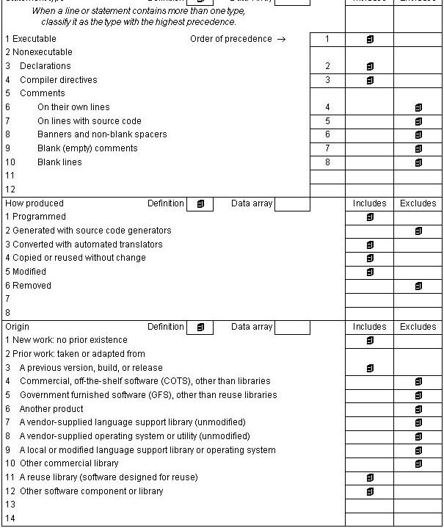
Counting KSLOC

Slide 53
Still how to estimate KSLOC
Get 2 “experts” to provide estimates.
  Better if estimates are based on software requirements
  Even better if estimates are based on design doc
  Good to get best estimate as well as “+- size.
  Make sure they address “integration/glue” code/logic.
  Take average of experts.
If using Work Breakdown Structure (WBS) in scheduling, estimate KSLOC per task. Note not all “tasks” have KSLOC.
    Remember COCOMO is strict development effort not management, reporting or user support.
    COCOMO Does NOT include defining the Requirements/Specification!

Slide 54
Some beginners guidelines
A good estimate is defendable if the size of the product is identified in reasonable terms that make sense for the application. Without serious experience, estimating Lines of Code for a substantial application can be meaningless, so stick to what makes sense. Bottom up is better for beginners.
An estimate is defendable if it is clear how it was achieved. If the estimate simply came from SWAG, or whatever sugar-coated term you would like to give for an undefendable number), that information itself gives us an understanding of the legitimacy we can apply to the numbers, and we should expect a large uncertainty.
If it was achieved by taking the business targets and simply suggesting we can fit all the work into the available time, we can send the estimator back to the drawing board.
A good estimate allows all the stakeholders to understand what went into the estimate, and agree on the uncertainty associated with that estimate. With that, realistic decisions can be made. If there is any black magic along the way, or if there is a suggestion that you can accurately predict, you are in for trouble.

Slide 55
Basic COCOMO assumptions
Implicit productivity estimate
Organic mode = 16 LOC/day
Embedded mode = 4 LOC/day
Time required is a function of total effort NOT team size
Not clear how to adapt model to personnel availability

Slide 56
Intermediate COCOMO
Takes basic COCOMO as starting point
Identifies personnel, product, computer and project attributes which affect cost and development time.
Multiplies basic cost by attribute multipliers which may increase or decrease costs

Slide 57
Attributes
Personnel attributes
Analyst capability
Virtual machine experience
Programmer capability
Programming language experience
Application experience
Product attributes
Reliability requirement
Database size
Product complexity

Slide 58
More Attributes
Computer attributes
Execution time constraints
Storage constraints
Virtual machine volatility
Computer turnaround time
Project attributes
Modern programming practices
Software tools
Required development schedule

Slide 59
Intermediate Model
Effort Equation (COCOMO 81)
Effort=EAF*A(size)^{exponent}
  EAF (effort adjustment factor) is the product of effort multipliers corresponding to each cost driver rating
  A is a constant based on the developmental mode
    organic = 3.2
    semi = 3.0
    embedded = 2.8
  Size = 1000s Delivered Source Instruction (KDSI)
  Exponent is constant given mode

Slide 60
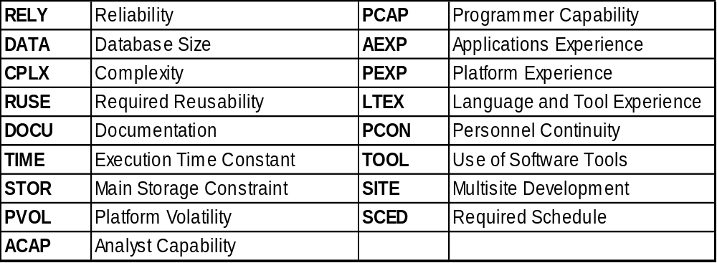
COCOMO COST DRIVERS
Ratings range: VL, L, N, H, VH, XH
Gone:VIRT,TURN,MDDP,VEXP New: RUSE, DOCU, PVOL, PCON

Slide 61
Example COCOMO
TURN and TOOL Adjustments
COCOMO 81 Rating L N H VH
COCOMO Multiplier:
CPLX 1.00 1.15 1.23 1.3
COCOM Multiplier:
TOOL 1.24 1.10 1.00

Slide 62
Intermediate Model Example
Highly complex intermediate organic project
with high tool use:
Estimate 3000 DSIs
CPLX = 1.3 (VH)
TOOL = 1.10 (L)
EAF = 1.3*1.10 = 1.43
Effort = 1.43 * 3.2 * 3^{1.05} = 14.5 man months
MTDEV = 2.5 * 14.5^{0.38} = 6.9 months
Staff required = 14.5/6.9 = 2.1 people
Effort=EAF*A(KDSI)^{exp1}
MTDEV= 2.5*(Effort)^{exp2}

Slide 63
Example with “options”
Embedded software system on microcomputer hardware.
Basic COCOMO predicts a 45 person-month effort requirement
Attributes = RELY (1.15), STOR (1.21), TIME (1.10), TOOL (1.10)
Intermediate COCOMO predicts
45 * 1.15 * 1.21 * 1.10 *1.10 = 76 person-months.
Assume total cost of person month = $7000.
Total cost = 76 * $7000 = $532, 000

Slide 64
Option: Hardware Investment
Processor capacity and store doubled
TIME and STOR multipliers = 1
Extra investment of $30, 000 required
Fewer tools available
TOOL = 1.15
Total cost = 45 * 1.24 * 1.15 * $7000 = $449, 190
Cost saving = $83, 000

Slide 65
Option: Environment Investment
Environment investment in addition to hardware
Reduces turnaround, tool multipliers. Increases experience multiplier
C = 45 * 0.91 * 0.87 * 1.1 * 1.15 * 7000
= $315, 472
Saving from investment = $133, 718

Slide 66
COCOMO Family
COCOMO 81, Revised Enhanced Version of Intermediate COCOMO (REVIC), and COCOMO II
COCOMO 81
  MK 1 MOD 0
  15 cost drivers
REVIC
  Developed by Mr Raymond Kile, Hughes Aerospace
  Coefficients used in the Effort Equation based on DOD
  Uses PERT statistical method to determine SLOCs
  PC compatiable

Slide 67
COCOMO Family
COCOMO II
  Sensitivity analysis and calibration very important
  Modes replace by five scale factors
  17 cost drivers
  Rosetta Stone conversion tables/guidelines for
  COCOMO 81 to COCOM II
    Five scale factors for size exponent
    Converts DSIs and FPs to SLOCs
    Mode and Scale Factor conversions
    Cost driver conversion factors
  Accuracy based on 89 projects

Slide 68
Cocomo History
1981 - The original COCOMO is introduced in Dr. Barry Boehm's textbook Software Engineering Economics. This model is now generally called "COCOMO 81".
1987 - Ada COCOMO and Incremental COCOMO are introduced (proceedings, Third COCOMO Users Group Meeting, Software Engineering Institute).
1988, 1989 - Refinements are made to Ada COCOMO.
1995, 1996 - Early papers describing COCOMO 2 published.
1997 - The first calibration of COCOMO II is released by Dr. Boehm, and named "COCOMO II.1997".
1998 - The second calibration of COCOMO II is released. It's named "COCOMO II.1998".
1999 - COCOMO II.1998 is renamed to COCOMO II.1999 and then to COCOMO II.2000 (all three models are identical).
2000 - The book Software Cost Estimation with COCOMO II (Dr. Barry Boehm, et al) is published to document how to apply the latest estimation model. Most of the original Software Engineering Economics is still applicable to modern software projects.
The Center continues to do research on COCOMO (COnstructive COst MOdel), a tool which allows one to estimate the cost, effort, and schedule associated with a prospective software development project. First published in 1981, the original COCOMO model has recently been superseded by COCOMO II, which reflects the improvements in professional software development practice, positioning COCOMO for continued relevancy into the 21st century.

Slide 69
COCOMOII (Cocomo 2)
COCOMO 81 was developed with the assumption that a waterfall process would be used and that all software would be developed from scratch.
Since its formulation, there have been many changes in software engineering practice and COCOMO II is designed to accommodate different approaches to software development.

Slide 70
COCOMO 81 II
Converting Size Estimates
COCOMO 81 COCOMO 2 (II)
-Second Generation Languages -Reduce DSI by 35 %
-Third-Generation Languages -Reduce DSI by 25 %
-Fourth-Generation Languages -Reduce DSI by 40 %
-Object-oriented Languages -Reduce DSI by 30 %
Function Points Use the expansion factors developed by Capers Jones
to determine equivalent SLOCs
Feature Points Use Capers Jones factors

Slide 71
COCOMO 2 models
COCOMO 2 incorporates a range of sub-models that produce increasingly detailed software estimates.
The sub-models in COCOMO 2 are:
  Application composition model. Used when software is composed from existing parts.
  Early design model. Used when requirements are available but design has not yet started.
  Reuse model. Used to compute the effort of integrating reusable components.
  Post-architecture model. Used once the system architecture has been designed and more information about the system is available.

Slide 72


Use of COCOMO 2 models
Number of
Based on
Application
Used for
Prototype systems
application points
composition model
developed using
scripting, DB
programming etc.
Number of function
Based on
Used for
Initial effort
points
Early design model
estimation based on
system requirements
and design options
Number of lines of
Based on
Used for
Effort
to integrate
code reused or
Reuse model
reusable components
generated
or automatically
generated code
Number of lines of
Based on
Post-architecture
Used for
Development effor
t
source code
model
based on system
design specification

Slide 73
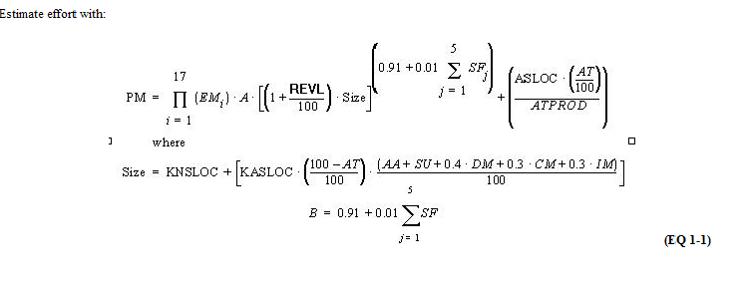
Cocomo II Estimate Formula
Cocomo II is too complex for use without training or “tool” with online-help

Slide 74
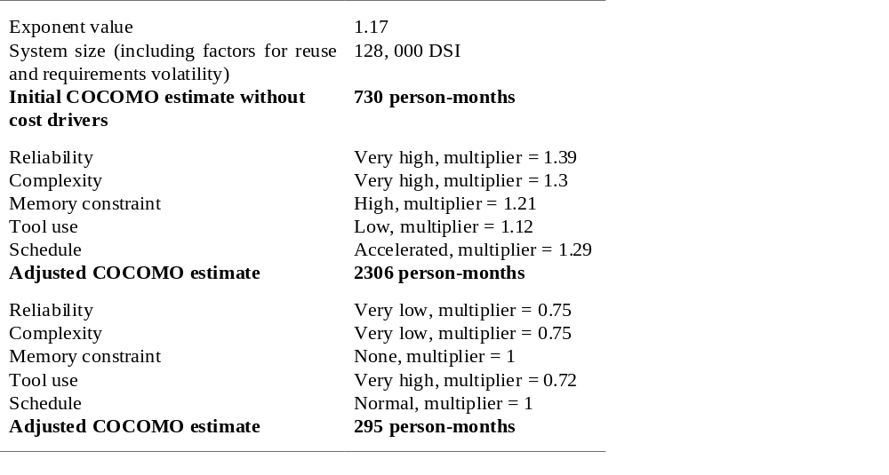
Cocomo 2 Effects of cost drivers

Slide 75
Cocomo in practice (89 projects)
Canned Language Multipliers were accurate – can be tuned/calibrated for a company.
Modeling personnel factors, and creating options/scenarios can be a valuable tool.
Assumptions and Risks should be factored into the model

Slide 76
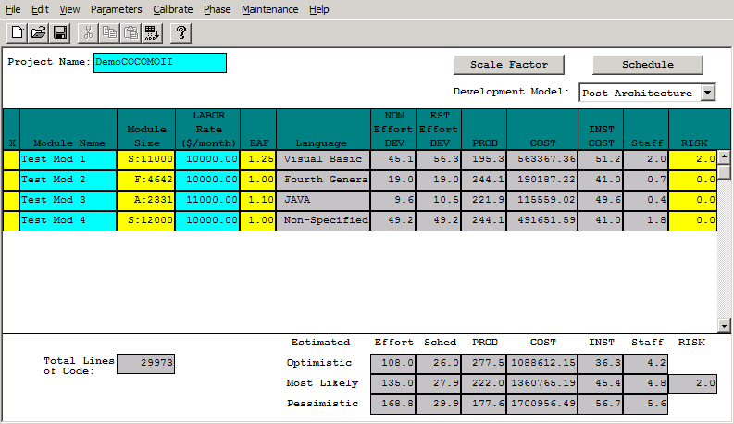
Tool Demonstration
(web based version)
http://sunset.usc.edu/research/COCOMOII/expert_cocomo/expert_cocomo2000.html
http://sunset.usc.edu/research/COCOMOII/expert_cocomo/expert_cocomo2000.html
Its Free and easy to use. So Use it!
You can also get a standalone win32 version

Slide 77
Free CoCoMo Tools
COCOMO II - This program is an implementation of the 1981 COCOMO Intermediate Model. It predicts software development effort, schedule and effort distribution. It is available for SunOS or MS Windows and can be downloaded for free. The COCOMO II model is an update of COCOMO 1981 to address software development practice's in the 1990's and 2000's.
Revised Intermediate COCOMO (REVIC) is available for downloading from the US Air Force Cost Analysis Agency (AFCAA).
TAMU COCOMO is an on-line version of COCOMO from Texas A&M University.
Agile COCOMO - The Center continues to do research on Agile COCOMO II a cost estimation tool that is based on COCOMO II. It uses analogy based estimation to generate accurate results while being very simple to use and easy to learn.
COCOTS - The USC Center is actively conducting research in the area of off-the-shelf software integration cost modelling. Our new cost model COCOTS (COnstructive COTS), focuses on estimating the cost, effort, and schedule associated with using commercial off-the-shelf (COTS) components in a software development project. Though still experimental, COCOTS is a model complementary to COCOMO II, capturing costs that traditionally have been outside the scope of COCOMO. Ideally, once fully formulated and validated, COCOTS will be used in concert with COCOMO to provide a complete software development cost estimation solution.

Slide 78
Sample of Commercial Tools
*COCOPRO implements Boehm's COCOMO technique for estimating costs of software projects. It supports the intermediate COCOMO model, and allows automatic calibration of the model to a cost history database.
*COOLSoft uses a hybrid of intermediate and detailed versions of COCOMO. This allows for the reuse of existing code, development of new code, the purchase and integration of third party code, and hardware integration.
*Costar is a software cost estimation tool based on COCOMO. A software project manager can use Costar to produce estimates of a project's duration, staffing levels, effort, and cost. Costar is an interactive tool that permits managers to make trade-offs and experiment with what-if analyses to arrive at the optimal project plan.

Slide 79
Resources
Software Cost Estimating With COCOMO II – Boehm, Abts, Brown, Chulani, Clark, Horowitz, Madachy, Reifer, Steece ISBN:0-13-026692-2
COCOMO II - http://sunset.usc.edu/research/COCOMOII/
NASA Cost Estimating Web Site - http://www1.jsc.nasa.gov/bu2/COCOMO.html
Longstreet Consulting - http://www.ifpug.com/freemanual.htm
Barry Boehm Bio - http://sunset.usc.edu/Research_Group/barry.html

Slide 80
Conclusions
Experience shows that seat-of-the-pants estimates of cost and schedule are 50%- 75% of the actual time/cost. This amount of error is enough to get a manager fired in many companies.
Lack of hands-on experience is associated with massive cost overruns.
Technical risks are associated with massive cost overruns.
Do your estimates carefully!
Keep them up-to-date!
Manage to them!

Slide 81
Project Scheduling/Planning
COCOMO his high-level resource estimation. To actually do project need more refined plan.

Slide 82
Work breakdown structures (WBS)
Types: Process, product, hybrid
Formats: Outline or graphical org chart
High-level WBS does not show dependencies or durations
What hurts most is what’s missing
Becomes input to many things, esp. schedule

Slide 83
Estimation
History is your best ally
  Especially when using LOC, function points, etc.
Use multiple methods if possible
  This reduces your risk
  If using “experts”, use two
Get buy-in
Remember: it’s an iterative process!
Know your “presentation” techniques

Slide 84
Estimation
Bottom-up
    More work to create but more accurate
    Often with Expert Judgment at the task level
Top-down
    Used in the earliest phases
    Usually with/as Analogy or Expert Judgment
Analogy
    Comparison with previous project: formal or informal
Expert Judgment
    Via staff members who will do the work
    Most common technique along w/analogy
    Best if multiple ‘experts’ consulted

Slide 85
Estimation
Parametric Methods
  Know the trade-offs of: LOC & Function Points
Function Points
  Benefit: relatively independent of the technology used to develop the system
  We will re-visit this briefly later in semester (when discussing “software metrics”)
  Variants: WEBMO (no need to know this for exam)
Re-Use Estimation
  See QSPM outline
U Calgary

Slide 86
Your Early Phase Processes
Initial Planning:
    Why
      SOW, Charter
    What/How (partial/1st pass)
      WBS
      Other planning documents
        Software Development Plan, Risk Mgmt., Cfg. Mgmt.
Estimating
    Size (quantity/complexity) and Effort (duration)
    Iterates
Scheduling
    Begins along with 1st estimates
    Iterates

Slide 87
Scheduling
Once tasks (from the WBS) and size/effort (from estimation) are known: then schedule
Primary objectives
    Best time
    Least cost
    Least risk
Secondary objectives
    Evaluation of schedule alternatives
    Effective use of resources
    Communications

Slide 88
Terminology
Precedence:
    A task that must occur before another is said to have precedence of the other
Concurrence:
    Concurrent tasks are those that can occur at the same time (in parallel)
Leads & Lag Time
    Delays between activities
    Time required before or after a given task

Slide 89
Terminology
Milestones
  Have a duration of zero
  Identify critical points in your schedule
  Shown as inverted triangle or a diamond
  Often used at “review” or “delivery” times
    Or at end or beginning of phases
    Ex: Software Requirements Review (SRR)
    Ex: User Sign-off
  Can be tied to contract terms

Slide 90
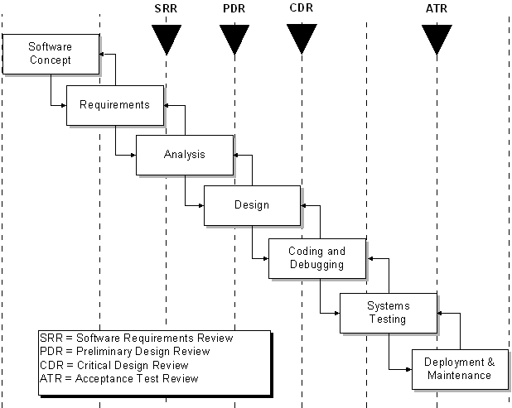
Terminology
Example
Milestones

Slide 91
Terminology
Slack & Float
  Float & Slack: synonymous terms
  Free Slack
      Slack an activity has before it delays next task
  Total Slack
      Slack an activity has before delaying whole project
  Slack Time T_{S} = T_{L} – T_{E}
    T_{E} = earliest time an event can take place
    T_{L} = latest date it can occur w/o extending project’s completion date

Slide 92
Scheduling Techniques
  Mathematical Analysis
    Network Diagrams
      PERT
      CPM
      GERT
  Bar Charts
    Milestone Chart
    Gantt Chart

Slide 93
Network Diagrams
Developed in the 1950’s
A graphical representation of the tasks necessary to complete a project
Visualizes the flow of tasks & relationships

Slide 94
Mathematical Analysis
PERT
  Program Evaluation and Review Technique
CPM
  Critical Path Method
Sometimes treated synonymously
All are models using network diagrams

Slide 95
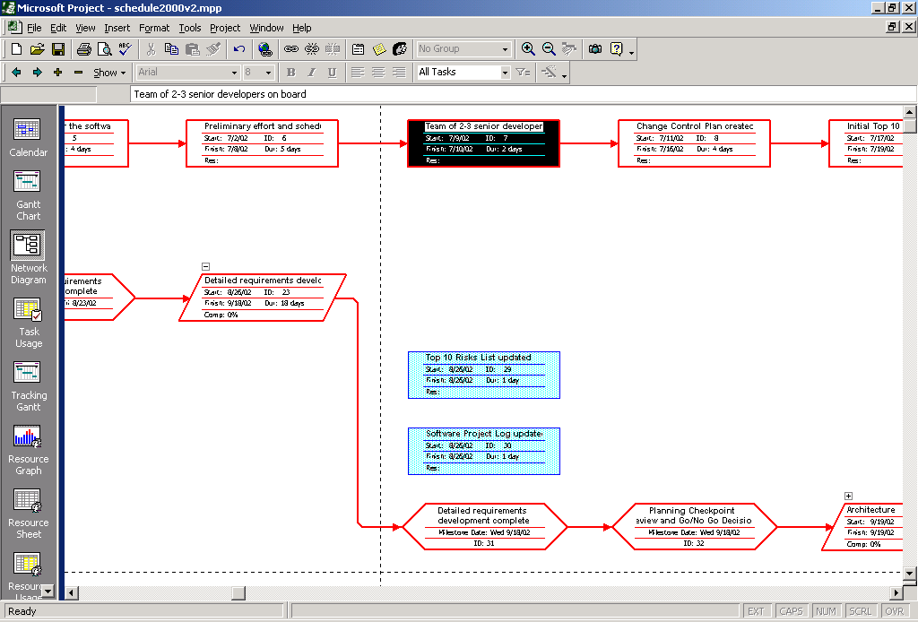
MS-Project Example

Slide 96
Network Diagrams
Two classic formats
  AOA: Activity on Arrow
  AON: Activity on Node
Each task labeled with
    Identifier (usually a letter/code)
    Duration (in std. unit like days)
There are other variations of labeling
There is 1 start & 1 end event
Time goes from left to right

Slide 97
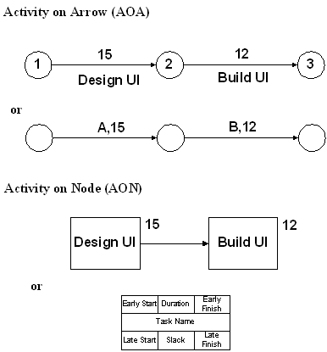
Node Formats

Slide 98
Network Diagrams
AOA consists of
    Circles representing Events
      Such as ‘start’ or ‘end’ of a given task
    Lines representing Tasks
      Thing being done ‘Build UI’
    a.k.a. Arrow Diagramming Method (ADM)
AON
    Tasks on Nodes
      Nodes can be circles or rectangles (usually latter)
      Task information written on node
    Arrows are dependencies between tasks
    a.k.a. Precedence Diagramming Method (PDM)

Slide 99
Critical Path
“The specific set of sequential tasks upon which the project completion date depends”
  or “the longest full path”
All projects have a Critical Path
Accelerating non-critical tasks do not directly shorten the schedule

Slide 100
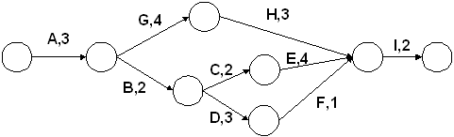
Critical Path Example

Slide 101
CPM
Critical Path Method
  The process for determining and optimizing the critical path
Non-CP tasks can start earlier or later w/o impacting completion date
Note: Critical Path may change to another as you shorten the current
Should be done in conjunction with the you & the functional manager

Slide 102
4 Task Dependency Types
Mandatory Dependencies
    “Hard logic” dependencies
    Nature of the work dictates an ordering
    Ex: Coding has to precede testing
    Ex: UI design precedes UI implementation
Discretionary Dependencies
    “Soft logic” dependencies
    Determined by the project management team
    Process-driven
    Ex: Discretionary order of creating certain modules

Slide 103
4 Task Dependency Types
External Dependencies
    Outside of the project itself
    Ex: Release of 3rd party product; contract signoff
    Ex: stakeholders, suppliers, Y2K, year end
Resource Dependencies
    Two task rely on the same resource
    Ex: You have only one DBA but multiple DB tasks

Slide 104




Task Dependency Relationships
Finish-to-Start (FS)
  B cannot start till A finishes
  A: Construct fence; B: Paint Fence
Start-to-Start (SS)
  B cannot start till A starts
  A: Pour foundation; B: Level concrete
Finish-to-Finish (FF)
  B cannot finish till A finishes
  A: Add wiring; B: Inspect electrical
Start-to-Finish (SF)
  B cannot finish till A starts (rare)

Slide 105
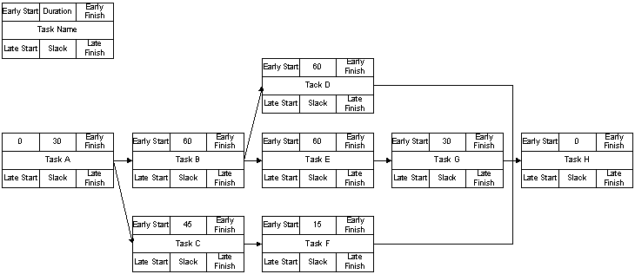
Example Step 1

Slide 106
Forward Pass
To determine early start (ES) and early finish (EF) times for each task
Work from left to right
Adding times in each path
Rule: when several tasks converge, the ES for the next task is the largest of preceding EF times

Slide 107
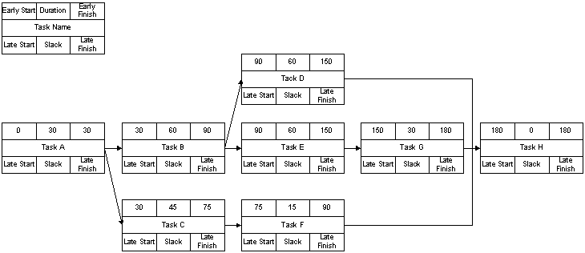
Example Step 2

Slide 108
Backward Pass
To determine the last finish (LF) and last start (LS) times
Start at the end node
Compute the bottom pair of numbers
Subtract duration from connecting node’s earliest start time

Slide 109
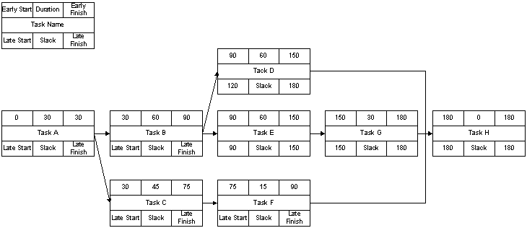
Example Step 3

Slide 110
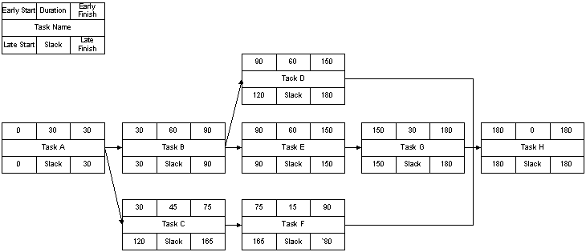
Example Step 4

Slide 111
Slack & Reserve
How can slack be negative?
What does that mean?
How can you address that situation?

Slide 112
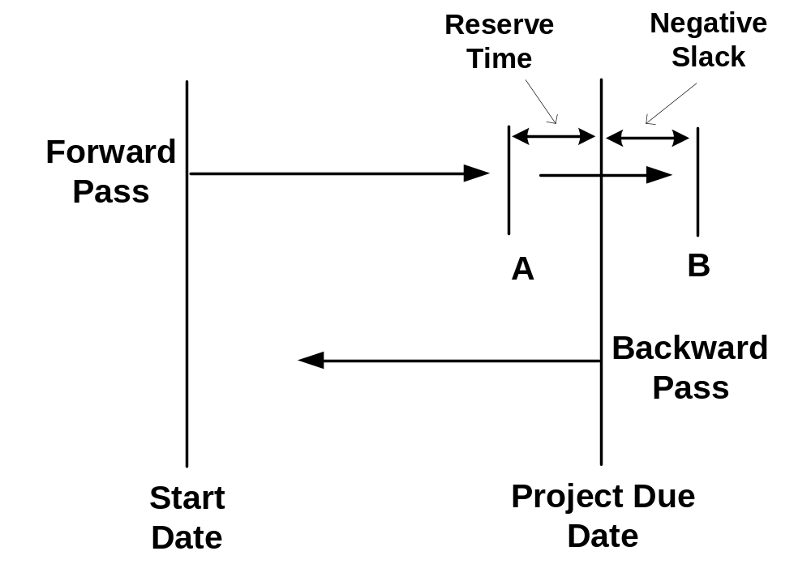
Slack & Reserve

Slide 113
Network Diagrams
Advantages
  Show precedence well
  Reveal interdependencies not shown in other techniques
  Ability to calculate critical path
  Ability to perform “what if” exercises
Disadvantages
  Default model assumes resources are unlimited
    You need to incorporate this yourself (Resource Dependencies) when determining the “real” Critical Path
  Difficult to follow on large projects

Slide 114
PERT
Program Evaluation and Review Technique
Based on idea that estimates are uncertain
  Therefore uses duration ranges
  And the probability of falling to a given range
Uses an “expected value” (or weighted average) to determine durations
Use the following methods to calculate the expected durations, then use as input to your network diagram

Slide 115
PERT
Start with 3 estimates
  Optimistic
    Would likely occur 1 time in 20
  Most likely
    Modal value of the distribution
  Pessimistic
    Would be exceeded only one time in 20

Slide 116
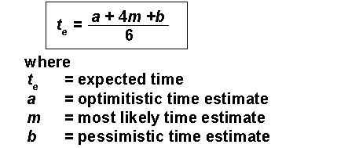
PERT Formula
Combined to estimate a task duration

Slide 117


PERT Formula
Confidence Interval can be determined
Based on a standard deviation of the expected time
    Using a bell curve (normal distribution)
For the whole critical path use

Slide 118
PERT Example
Description | Planner 1 | Planner 2
m | 10d | 10d
a | 9d | 9d
b | 12d | 20d
PERT time | 10.16d | 11.5d
Std. Dev. | 0.5d | 1.8d
Confidence interval for P2 is 4 times wider than P1 for a given probability
Ex: 68% probability of 9.7 to 11.7 days (P1) vs. 9.5-13.5 days (P2)

Slide 119
PERT
Advantages
  Accounts for uncertainty
Disadvantages
  Time and labor intensive
  Assumption of unlimited resources is big issue
  Lack of functional ownership of estimates
  Mostly only used on large, complex project
Get PERT software to calculate it for you

Slide 120
CPM vs. PERT
Both use Network Diagrams
CPM: deterministic
PERT: probabilistic
CPM: one estimate, PERT, three estimates
PERT is infrequently used

Slide 121
Milestone Chart
Sometimes called a “bar charts”
Simple Gantt chart
  Either showing just highest summary bars
  Or milestones only

Slide 122
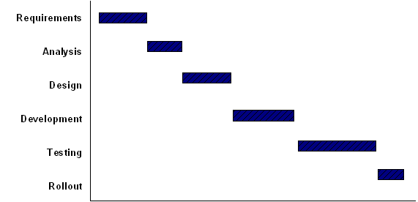
Bar Chart

Slide 123
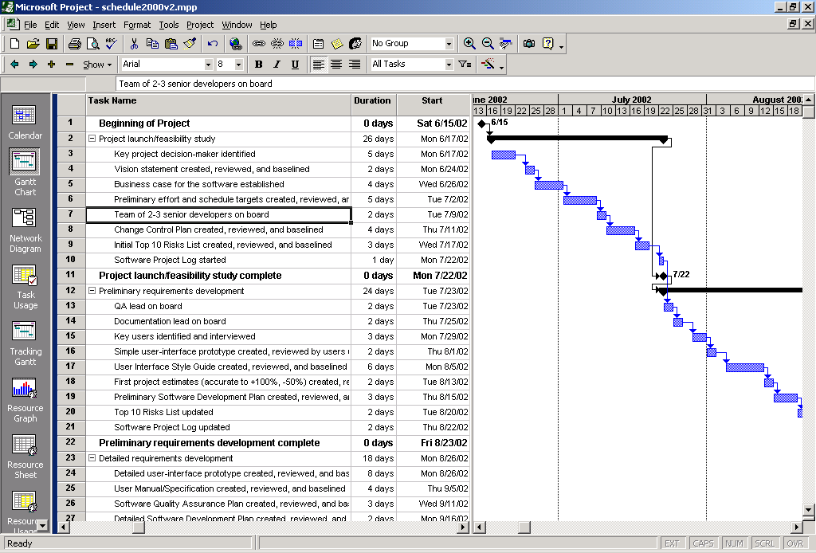
Gantt Chart

Slide 124
Gantt Chart
Disadvantages
  Does not show interdependencies well
  Does not uncertainty of a given activity (as does PERT)
Advantages
  Easily understood
  Easily created and maintained
Note: Software now shows dependencies among tasks in Gantt charts
  In the “old” days Gantt charts did not show these dependencies, bar charts typically do not. Modern Gantt charts do show them.

Slide 125
Reducing Project Duration
How can you shorten the schedule?
Via
  Reducing scope (or quality)
  Adding resources
  Concurrency (perform tasks in parallel)
  Substitution of activities

Slide 126
Compression Techniques
Shorten the overall duration of the project
Crashing
    Looks at cost and schedule tradeoffs
    Gain greatest compression with least cost
    Add resources to critical path tasks
    Limit or reduce requirements (scope)
    Changing the sequence of tasks
Fast Tracking
    Overlapping of phases, activities or tasks that would otherwise be sequential
    Involves some risk
    May cause rework

Slide 127
Mythical Man-Month
Book: “The Mythical Man-Month”
  Author: Fred Brooks
“The classic book on the human elements of software engineering”
First two chapters are full of terrific insight (and quotes)
Notes:
draw graphs
Training == ramp-up
Software is a ‘systems effort’

Slide 128
Mythical Man-Month
“Cost varies as product of men and months, progress does not.”
“Hence the man-month as a unit for measuring the size of job is a dangerous and deceptive myth”
Reliance on hunches and guesses
  What is ‘gutless estimating’?
The myth of additional manpower
  Brooks Law
  “Adding manpower to a late project makes it later”
Notes:
draw graphs
Training == ramp-up
Software is a ‘systems effort’

Slide 129
Mythical Man-Month
Optimism
  “All programmers are optimists”
  1st false assumption: “all will go well” or “each task takes only as long as it ‘ought’ to take”
  The Fix: Consider the larger probabilities
Cost (overhead) of communication (and training)
    His formula: n(n-1)/2
  How long does a 12 month project take?
      1 person: 1 month
      2 persons = 7 months (2 man-months extra)
      3 persons = 5 months (e man-months extra)
  Fix: don’t assume adding people will solve the problem

Slide 130
Mythical Man-Month
Sequential nature of the process
  “The bearing of a child takes nine months, no matter how many women are assigned”
What is the most mis-scheduled part of process?
    Testing (the most linear process)
Why is this particularly bad?
    Occurs late in process and w/o warning
    Higher costs: primary and secondary
Fix: Allocate more test time
    Understand task dependencies
Notes:
I don’t agree with his formula
He advocates 50% of schedule to Test
Late
Highest cost: most staffed time
Changes cost more
Secondary costs
You need to understand Critical Path and other dependencies

Slide 131
Mythical Man-Month
Q: “How does a project get to be a year late”?
  A: “One day at a time”
Studies
  Each task: twice as long as estimated
  Only 50% of work week was programming
Fixes
  No “fuzzy” milestones (get the “true” status)
  Reduce the role of conflict
  Identify the “true status”
Notes:
what does Brooks mean by this?
Termites not tornadoes
Imperceptibly but inexorably
Hard to recognize
Reduce conflict: status vs. action meetings

Slide 132
Planning and Scheduling Tools
Big variety of products, from simple/single project to enterprise resource management
See for instance:
  http://www.columbia.edu/~jm2217/#OtherSoftware
  http://www.startwright.com/project1.htm
Some free tools to play with:
  Ganttproject (java based)
  Some tools on linux
Free evaluation
  Intellysis project desktop
  FastTrack Schedule

Slide 133
MS-Project
Mid-market leader
Has approx. 50% overall market share
70-80% MS-Project users never used automated project tracking prior (a “first” tool)
Not a mid/high-end tool for EPM (Enterprise Project Mgmt.)
While in this class you can get a free copy though MS Academic Alliance – email me if interested.

Slide 134
Project Pros
Easy outlining of tasks including support for hierarchical Work breakdown structures (WBS)
Resource management
Accuracy: baseline vs. actual; various calculations
Easy charting and graphics
Cost management
Capture historical data

Slide 135
Project Cons
Illusion of control
Workgroup/sharing features ok, still in-progress
Scaling
No estimation features
Remember:
  Being a MS-Project expert does not make you an expert project manager!
  No more so than knowing MS-Word makes you a good writer.

Slide 136
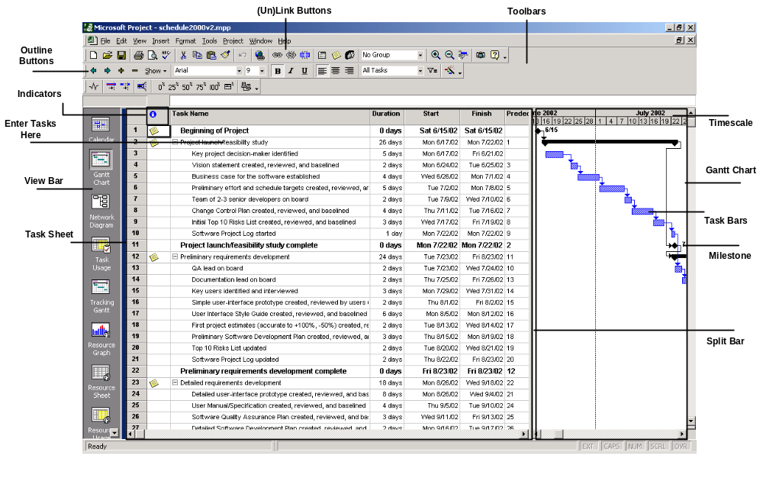
Project UI

Slide 137
The MS-Project Process
Move WBS into a Project outline (in Task Sheet)
Add resources (team members or roles)
Add costs for resources
Assign resources to tasks
Establish dependencies
Refine and optimize
Create baseline
Track progress (enter actuals, etc.)

Slide 138
Create Your Project
File/New
Setup start date
Setup calendar
  Menu: Project/Project Information
  Often left with default settings
  Hours, holidays

Slide 139
Enter WBS
Outlining
Sub-tasks and summary tasks
Do not enter start/end dates for each
Just start with Task Name and Duration for each
Use Indent/Outdent buttons to define summary tasks and subtasks
You can enter specific Start/End dates but don’t most of the time

Slide 140
Establish Durations
Know the abbreviations
  h/d/w/m
  D is default
Can use partial
  .5d is a half-day task
Elapsed durations
Estimated durations
  Put a ‘?’ after duration
DURATION != WORK (but initial default is that it is)

Slide 141
Add Resources
Work Resources
  People
    (can be % of a person. All resources split equally on task.
      Tboult[25%], Eng1 means task gets 25% of tboult’s time, 100% of Eng1 thus it gets 1.25MM per month).
Material Resources
  Things
  Can be used to track costs
    Ex: amount of equipment purchased
  Not used as often in typical software project

Slide 142
Resource Sheet
Can add new resources here
  Or directly in the task entry sheet
    Beware of mis-spellings (Project will create near-duplicates)
Setup costs
  Such as annual salary (put ‘yr’ after ‘Std. Rate’)

Slide 143
Effort-Driven Scheduling
MS-Project default
Duration * Units = Work
    Duration = Work / Units (D = W/U)
    Work = Duration * Units (W = D*U)
    Units = Work / Duration (U = W/D)
Adding more resources to a task shortens duration
Can be changed on a per-task basis
    In the advanced tab of Task Information dialog box
    Task Type setting
Beware the Mythical Man-month
    Good for laying bricks, not always so for software development

Slide 144
Link Tasks
On toolbar: Link & Unlink buttons
  Good for many at once
Or via Gantt chart
  Drag from one task to another

Slide 145
Milestones
Zero duration tasks
Insert task ‘normally’ but put 0 in duration
Common for reports, Functional module/test completions, etc.
  Good SE practice says milestones MUST be measurable and well spread through the project.

Slide 146
Make Assignments
Approach 1. Using Task Sheet
  Using Resource Names column
  You can create new ones by just typing-in here
2. Using Assign Resources dialog box
  Good for multiple resources
  Highlight task, Tools/Resources or toolbar button
3. Using Task Information dialog
  Resources tab
4. Task Entry view
  View/More Views/Task Entry
  Or Task Entry view on Resource Mgmt. toolbar

Slide 147
Save Baseline
Saves all current information about your project
  Dates, resource assignments, durations, costs

Slide 148
Fine Tune
Then is used later as basis for comparing against “actuals”
Menu: Tools/Tracking/Save Baseline

Slide 149
Project 2002
3 Editions: Standard, Professional, Server
MS Project Server 2002
  (TB’s never used server 2002 or newer) Based on docs.
    Upgrade of old “Project Central”
    Includes “Project Web Access”, web-based UI (partial)
    Workgroup and resource notification features
    Requires SQL-Server and IIS
    “Portfolio Analyzer”
      Drill-down into projects via pivot tables & charts
    “Portfolio Modeler”
      Create models and “what-if” scenarios
    SharePoint Team Services integration

Slide 150
Newer versions of Project
MS-Project Professional
  “Build Team” feature
    Skills-based resource matching
  Resource Pools: with skill set tracking
  Resource Substitution Wizard
“Project Guide” feature
  Customizable “process component”

Slide 151
Notation | Activity | Effort in person-month
T1 | Requirement specification | 1
T2 | Design | 2
T3 | Code actuator interface module | 2
T4 | Code sensor interface module | 5
T5 | Code user interface part | 3
T6 | Code control processing part | 1
T7 | Integrate and test | 6
T8 | Write User manual | 3

Slide 152
The precedence relation Ti<={Tj,Tk} implies that the task Ti must complete before either task Tj or Tk can start . The following precedence relation is known to hold among different tasks:T1<=T2<={T3,T4,T5,T6}<=T7. Draw the activity network for the project.
Q. 2. Suppose you are the project manager of a software project requiring the following activities.

