Slide 1
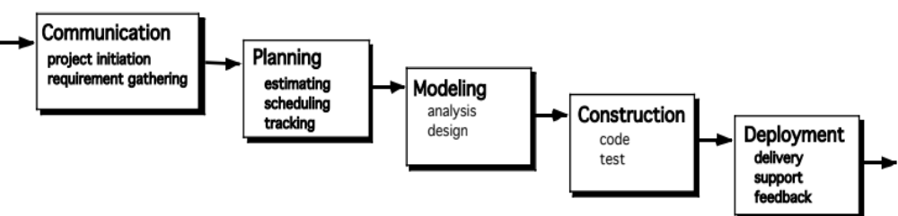
The Waterfall Model
It is the oldest paradigm for SE. When requirements are well defined and reasonably stable, it leads to a linear fashion.
(problems: 1. rarely linear, iteration needed. 2. hard to state all requirements explicitly. Blocking state. 3. code will not be released until very late.)
The classic life cycle suggests a systematic, sequential approach to software development.

Slide 2

The V-Model
A variation of waterfall model depicts the relationship of quality assurance actions to the actions associated with communication, modeling and early code construction activates.
Team first moves down the left side of the V to refine the problem requirements. Once code is generated, the team moves up the right side of the V, performing a series of tests that validate each of the models created as the team moved down the left side.

Slide 3
The Incremental Model
When initial requirements are reasonably well defined, but the overall scope of the development effort precludes a purely linear process. A compelling need to expand a limited set of new functions to a later system release.
It combines elements of linear and parallel process flows. Each linear sequence produces deliverable increments of the software.
The first increment is often a core product with many supplementary features. Users use it and evaluate it with more modifications to better meet the needs.

Slide 4
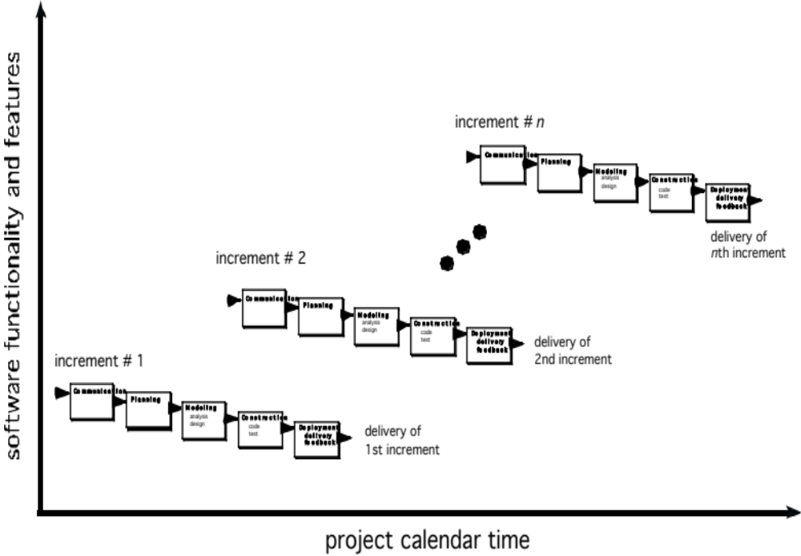
The Incremental Model

Slide 5
Evolutionary Models
Software system evolves over time as requirements often change as development proceeds. Thus, a straight line to a complete end product is not possible. However, a limited version must be delivered to meet competitive pressure.
Usually a set of core product or system requirements is well understood, but the details and extension have yet to be defined.
You need a process model that has been explicitly designed to accommodate a product that evolved over time.
It is iterative that enables you to develop increasingly more complete version of the software.
Two types are introduced, namely Prototyping and Spiral models.

Slide 6
Evolutionary Models: Prototyping
When to use: Customer defines a set of general objectives but does not identify detailed requirements for functions and features. Or Developer may be unsure of the efficiency of an algorithm, the form that human computer interaction should take.
What step: Begins with communication by meeting with stakeholders to define the objective, identify whatever requirements are known, outline areas where further definition is mandatory. A quick plan for prototyping and modeling (quick design) occur. Quick design focuses on a representation of those aspects the software that will be visible to end users. ( interface and output). Design leads to the construction of a prototype which will be deployed and evaluated. Stakeholder’s comments will be used to refine requirements.
Both stakeholders and software engineers like the prototyping paradigm. Users get a feel for the actual system, and developers get to build something immediately. However, engineers may make compromises in order to get a prototype working quickly. The less-than-ideal choice may be adopted forever after you get used to it.

Slide 7
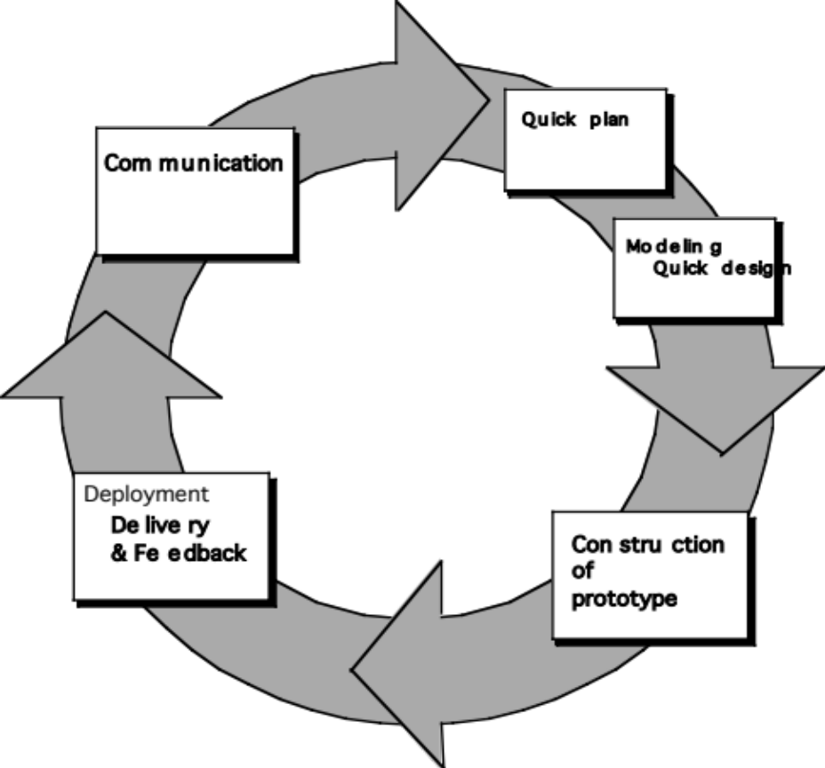
Evolutionary Models: Prototyping
Quick
plan
communication
Modeling
Quick design
Deployment
delivery &
feedback
Construction
of prototype
Construction
of prototype

Slide 8
Evolutionary Models: The Spiral
It couples the iterative nature of prototyping with the controlled and systematic aspects of the waterfall model and is a risk-driven process model generator that is used to guide multi-stakeholder concurrent engineering of software intensive systems.
Two main distinguishing features: one is cyclic approach for incrementally growing a system’s degree of definition and implementation while decreasing its degree of risk. The other is a set of anchor point milestones for ensuring stakeholder commitment to feasible and mutually satisfactory system solutions.
A series of evolutionary releases are delivered. During the early iterations, the release might be a model or prototype. During later iterations, increasingly more complete version of the engineered system are produced.
The first circuit in the clockwise direction might result in the product specification; subsequent passes around the spiral might be used to develop a prototype and then progressively more sophisticated versions of the software. Each pass results in adjustments to the project plan. Cost and schedule are adjusted based on feedback. Also, the number of iterations will be adjusted by project manager.
Good to develop large-scale system as software evolves as the process progresses and risk should be understood and properly reacted to. Prototyping is used to reduce risk.
However, it may be difficult to convince customers that it is controllable as it demands considerable risk assessment expertise.

Slide 9
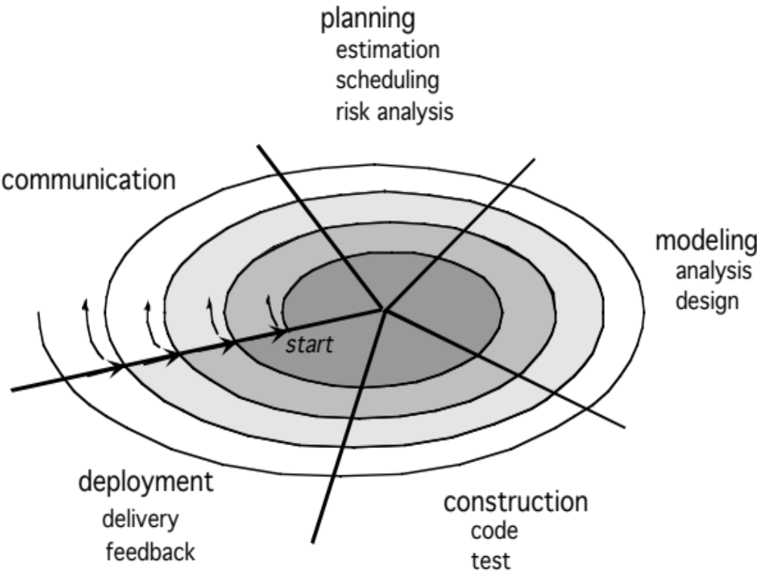
Evolutionary Models: The Spiral

Slide 10
Three Concerns on Evolutionary Processes
First concern is that prototyping poses a problem to project planning because of the uncertain number of cycles required to construct the product.
Second, it does not establish the maximum speed of the evolution. If the evolution occur too fast, without a period of relaxation, it is certain that the process will fall into chaos. On the other hand if the speed is too slow then productivity could be affected.
Third, software processes should be focused on flexibility and extensibility rather than on high quality. We should prioritize the speed of the development over zero defects. Extending the development in order to reach high quality could result in a late delivery of the product when the opportunity niche has disappeared.

Slide 11
Concurrent Model
Allow a software team to represent iterative and concurrent elements of any of the process models. For example, the modeling activity defined for the spiral model is accomplished by invoking one or more of the following actions: prototyping, analysis and design.
The Figure shows modeling may be in any one of the states at any given time. For example, communication activity has completed its first iteration and in the awaiting changes state. The modeling activity was in inactive state, now makes a transition into the under development state. If customer indicates changes in requirements, the modeling activity moves from the under development state into the awaiting changes state.
Concurrent modeling is applicable to all types of software development and provides an accurate picture of the current state of a project. Rather than confining software engineering activities, actions and tasks to a sequence of events, it defines a process network. Each activity, action or task on the network exists simultaneously with other activities, actions or tasks. Events generated at one point trigger transitions among the states.

Slide 12
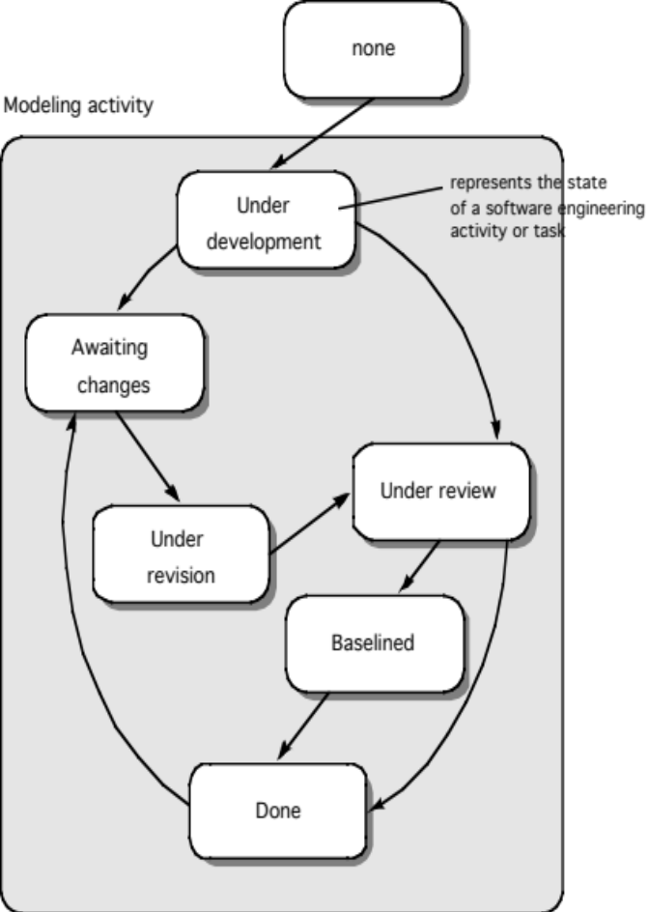
Concurrent Model

Slide 13
Still Other Process Models
Component based development—the process to apply when reuse is a development objective ( like spiral model)
Formal methods—emphasizes the mathematical specification of requirements ( easy to discover and eliminate ambiguity, incompleteness and inconsistency)
Aspect Oriented software development (AOSD)—provides a process and methodological approach for defining, specifying, designing, and constructing aspects
Unified Process—a “use-case driven, architecture-centric, iterative and incremental” software process closely aligned with the Unified Modeling Language (UML) to model and develop object-oriented system iteratively and incrementally.

Slide 14

The Unified Process (UP)
elaboration
inception

Slide 15
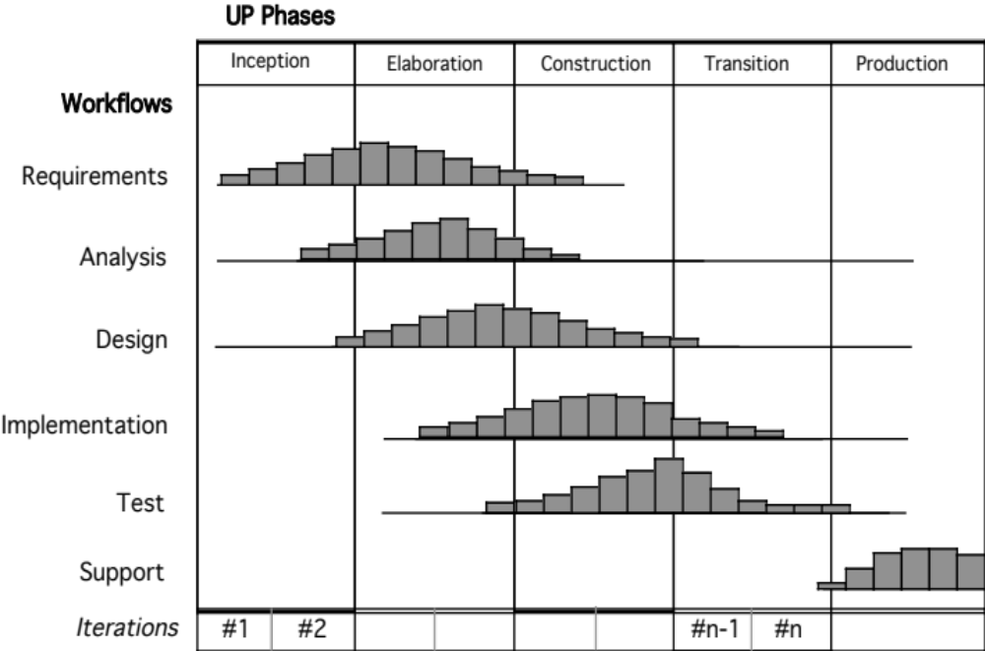
UP Phases

Slide 16
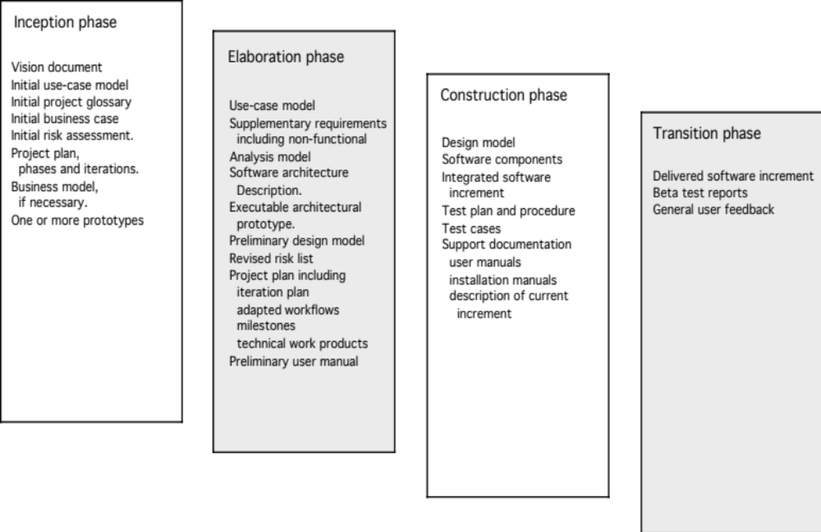
UP Work Products

Slide 17
Personal Software Process (PSP)
Planning. This activity isolates requirements and develops both size and resource estimates. In addition, a defect estimate (the number of defects projected for the work) is made. All metrics are recorded on worksheets or templates. Finally, development tasks are identified and a project schedule is created.
High-level design. External specifications for each component to be constructed are developed and a component design is created. Prototypes are built when uncertainty exists. All issues are recorded and tracked.
High-level design review. Formal verification methods (Chapter 21) are applied to uncover errors in the design. Metrics are maintained for all important tasks and work results.
Development. The component level design is refined and reviewed. Code is generated, reviewed, compiled, and tested. Metrics are maintained for all important tasks and work results.
Postmortem. Using the measures and metrics collected (this is a substantial amount of data that should be analyzed statistically), the effectiveness of the process is determined. Measures and metrics should provide guidance for modifying the process to improve its effectiveness.

Slide 18
Team Software Process (TSP)
Build self-directed teams that plan and track their work, establish goals, and own their processes and plans. These can be pure software teams or integrated product teams (IPT) of three to about 20 engineers.
Show managers how to coach and motivate their teams and how to help them sustain peak performance.
Accelerate software process improvement by making CMM Level 5 behavior normal and expected.
  The Capability Maturity Model (CMM), a measure of the effectiveness of a software process, is discussed in Chapter 30.
Provide improvement guidance to high-maturity organizations.
Facilitate university teaching of industrial-grade team skills.

