Slide 1
My friend , Shreya is making her first project in Machine Learning as she is new in this field, also she is very afraid of Big mathematics equations which is always going to come under ML, and she want to complete the project, but she just got stuck in some places, so need my help in making this project.
Shreya :
Hey Vivek, can you help me in making a project in Machine Learning?
Me :
Yes sure, Let's begin!
Let's begin the journey to help Shreya in making a ML project!

Slide 2

US Airline Twitter Sentiment Analyses
Bachelor of Technology
In
Computer Science
Maharaja Surajmal Institute of Technology
Submitted By,
Vivek Kumar
07115002717

Slide 3
Let me introduce what is Machine Learning and little bit about our project format
One word comes to the mind of almost every student after hearing the word MACHINE LEARNING is ROBOTS. As it has given tremendous scope to the students and it shows the glimpse to a new World.
This thing has admired me a lot to choose my career in it and the project I have chosen is based on Natural Language Processing (NLP). I think the best part of NLP is Data Cleaning or Data Processing. The Project I have chosen is “US Airline Twitter Sentiment Analyses”.
NLP is a branch of artificial intelligence that deals with the interaction between computers and humans using the natural language just like a “A Human Talk To The Machines”.
This US Airline Dataset contains 10980 data points for 3 classes (positive, negative, neutral).

Slide 4

Objective
Shreya is saying, Is it possible ?
The main objective of my project is just to classify the tweets which is given by the people is negative, positive, or neutral.
It look quiet interesting for me to predict the nature of the tweet by just looking and analysing the tweet using Machine Learning Algorithms.
Let's see how we are going to answer Shreya's question.

Slide 5

Shreya : What kind of softwares we require in making this projects?
Me: These are the software which we will be going to use in Making this Project
Shreya : Ok
Python
Jupyter Notebook
Sklearn
Pandas
Matplotlib

Slide 6
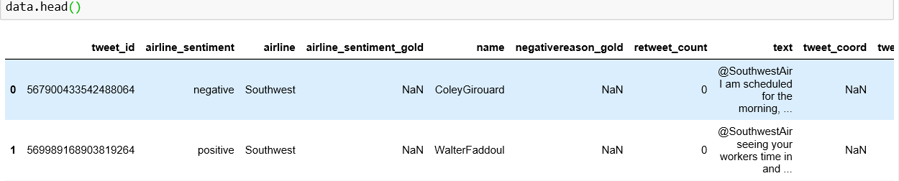
Me: Let me show you how I get the data into Jupyter Notebook and make sure you know what kind of data I am using.
There is an inbuild function to import data in Pandas library and the encoding is just describing that our data also contain big text files.
Shreya : Now as we imported our data in the notebook how can we see our data?
Me : This is how we can see our data using head() function and as you can see it is in the form of mainly of text.

Slide 7
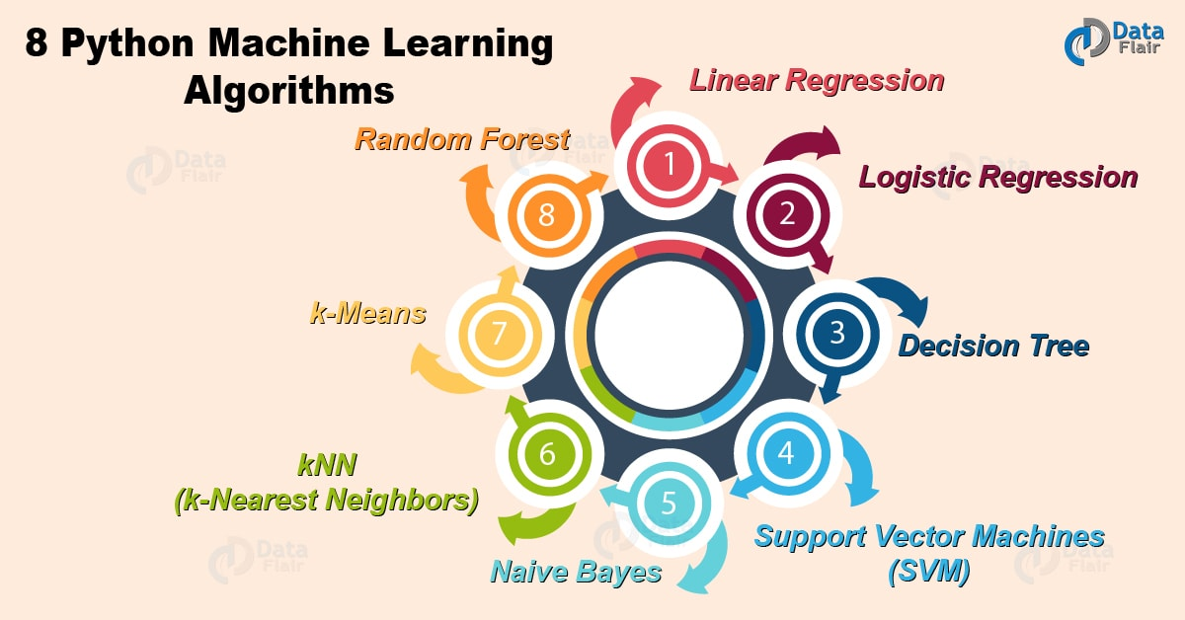
Shreya : The data looks so good and can we apply Machine Learning algorithm now?
Me: No Shreya, this is not the correct time to apply any algorithm, we need to follow some steps before applying any ML algorithm.
It contains some specific steps like:
Data Cleaning
Splitting the data into train and test.
Converting text data into numeric as there is no algorithm which can fit our model with text data.
By seeing data , finding what kind of problem it is? There are different algorithm to do different tasks like classification, image, binary, audio but few algorithms can really good in all of them.
At last fitting our model and predicting the output.

Slide 8
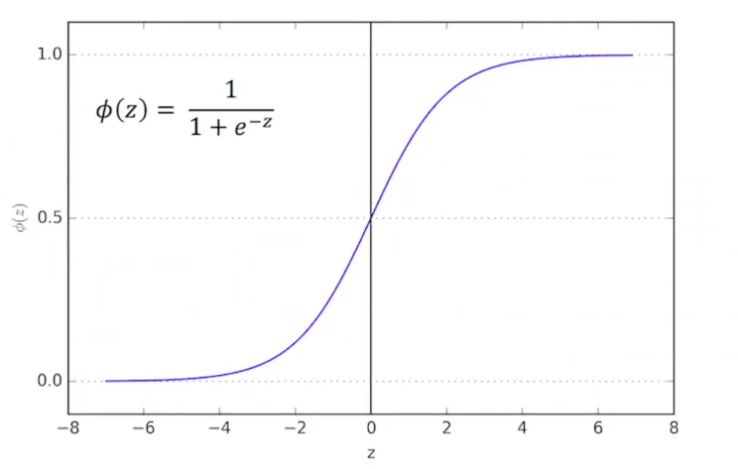
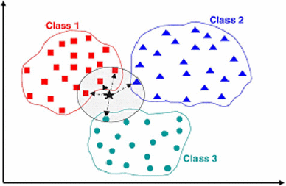
Shreya : Oh, that's so cool ! What kind of problem we are having? Is it a Classification?
Me: Yes, Shreya it's a Classification problem in which we are going to predict nature of the tweet.
Shreya :What are the algorithm we are going to use in it?
Me : We will use 2 algorithms so that we can compare which one will better. One is Logistic Regression and other is K-Nearest Neighbors.
Shreya : So, let's start fitting our data with the algorithm.
Me : No, first we need to follow the rules of ML.
Shreya : Oh! , Yes.
Me : Let's start the rules in our data so that we apply algorithms. There are two graph showing
Logistic Regression [Fig-1]
K-Nearest Neighbor [Fig-2]

Slide 9
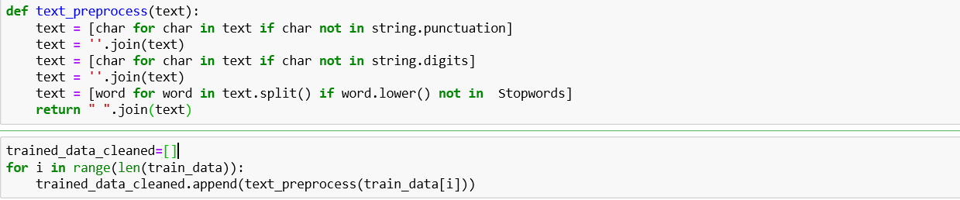
Me : Importing different libraries for the Data Cleaning process
Some Common used libraries are:
Shreya : I think now I am getting how we deal with the text data.
Me: Now our data got cleaned in new_train and the labels have a seperate column in our dataset I have removed it earlier.
Shreya : What we need to do now ?
Me: Calling of my own function from scratch to clean data
1.
2.

Slide 10
Me: Just follow the steps, now we apply train and test in our new_train and the lables.
Lables and Split of data
Shreya : oh!, yes I forget.
Me: This function will split the data into x_train,y_train,x_test,y_test.
Shreya :Four parameter? But Why?
Me: We will first train our model using training data and after that we will predict using testing data, after that we will compare the score of our predicted value with y_test.
Shreya : Alright, it seems really interesting
Me : Here look at the data splitting in [Fig-3]
Me : What's the next part we are going to do,Can you tell me ?
Shreya : Yes, we need to convert the text data into numeric form.

Slide 11
Me: Yes,absolutely, we will use TfiDf Vectorizer to convert that text into numeric form using one-hot encoded .
Shreya : what does this mean?
Me: This actually means that I am just taking top with greatest frequency or according to TfiDf we choose 1500 word from the document and then make them as our features and convert them into tabular form so that it convert into numeric form.
Shreya : Alright this is really interesting part.
Me: What's next step to take?
Shreya : We should call our algoirthm to train our model and predicting the output.
Me: Now i think you got the better Idea what's is going on Machine Learning.
Coverting labels and x_train into numeric

Slide 12
Me: Fitting on both the algorithm
Fit function on both Logistic and KNN
Shreya : Yes, I understand how this is going to work.
Me: Now let me show you how can we predict the values also.
This is how our data look like testing & training.

Slide 13
Me: Predictions and Scores we get from our algorithm
Logistic Regression Score
KNN Score
Shreya : Oh Wow!, Finally we did it we got a very good accuracy in case of Logistic but not in K-NN.
Me: It is just because we are using text data which is very difficult to handle and also we got a very god score.
Shreya : Yes, you are right.
Me: I hope Shreya you must have got a good knowledge about the Machine Learning and the steps we need to follow.
Shreya : Yes, definately, This project has given me huge confidence in this field. I hope i can make better projects in it.
Me: Definately you will!

Slide 14
Future Scope
I think Machine learning will help in upcoming future, as it has a tremendous scope and you will notice Machine Learning is applied everwhere like Facebook, Whatsapp, Instagram, Mobile phones ,Whether forcasting , Big Companies like Google, Amazon, Flipkart are using Machine Learning for the storing of useful data and also for the prediction purpose.
We now have weak AI's , hope is what which can do anything and may be in upcoming futures our scientists may developed a “Robot” and a strong AI like 'JARVIS” in movie “Iron Man”.

Slide 15


