Slide 1
Sentiment Analysis using CNN And LSTM
Ramcharan Varma Golla
Vivek Reddy Doudagiri
Venugopal Gonela

Slide 2
Outline
Motivation
Dataset
Previous Work
SVM Methodology
CNN methodology
RNN-LSTM methodology
Results
Conclusion

Slide 3
Motivation
Sentiment analysis aims to determine the attitude of a speaker, writer, or other subject with respect to some topic or the overall contextual polarity or emotional reaction to a document, interaction, or event
Conventional methods treat all words as independent while calculating sentiment
Using Dependencies among words help to predict the sentiment more accurately

Slide 4
Dataset
Movie Review data from Rotten Tomatoes
Originally collected by Pang and Lee
10,662 example review sentences equally distributed among positive and negative classes
70% training, 10% validation & 20% testing

Slide 5
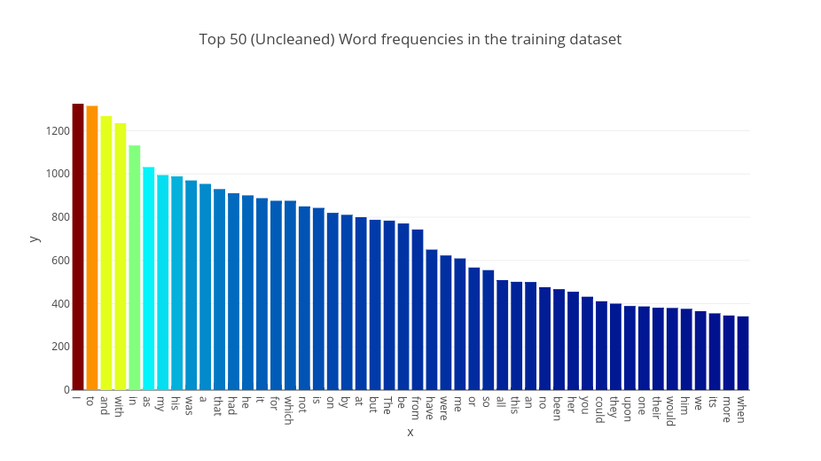
Most Frequent Words

Slide 6
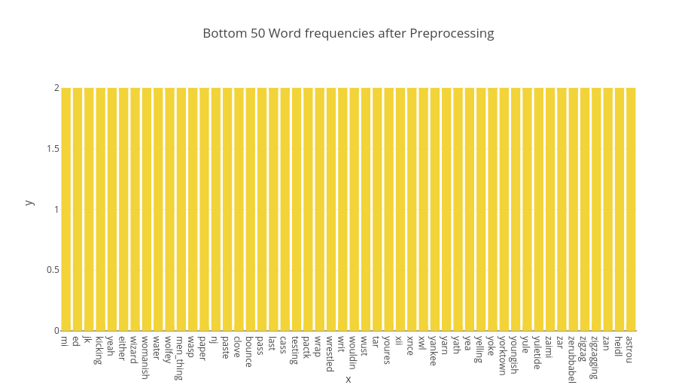
Less Frequent Words

Slide 7
Previous Work
The early research in this field was focused on product reviews, such as reviews of different products on Amazon.com
Xi Ouyang, Cheng Hua Li, Lijun Liu proposed a deep learning frame work based on CNN
Andrew M. Dai and Quoc V. Le have proposed two approaches for sequence learning

Slide 8
SVM Methodology
Step 1
Step 2
Step 3
Pre-processing
Extract features – Unigrams and Bigrams
Train RBF Kernel SVM
Tune Hyper-parameters C and Gamma on Development set
C = 26.83
Gamma = 0.001
Report Accuracy on test dataset
Accuracy = 73.71

Slide 9
CNN Methodology
Step 1
Step 2
Step 3
Word Embedding
Word2vec – Google embeddings with 300 dimensions
Convolution
Maxpooling
Feature Concatenation
Fully Connected
Softmax Layer
Cross Entropy Loss

Slide 10
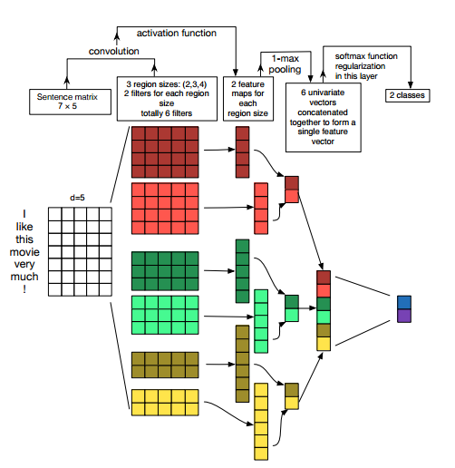

Slide 11
Hyper Parameters
Embedding dimensions = 300
Filter window size = 3, 4, 5
Feature maps = 128
Dropout = 0.7
Loss function = Cross entropy
Learning Rate (Adam) = 0.001
Batch Size = 64
Variable Epochs

Slide 12
Results
Models | Accuracy
SVM | 73.71
CNN Rand | 74.12
CNN – Word2Vec | 77.29

Slide 13
RNN - LSTM Methodology
Step 1
Step 2
Step 3
Word Embedding
Google Word2vec with 300 dimensions
LSTM
Adam optimizer
Dropout
Recurrent dropout
Sigmoid
Binary Cross Entrophy

Slide 14
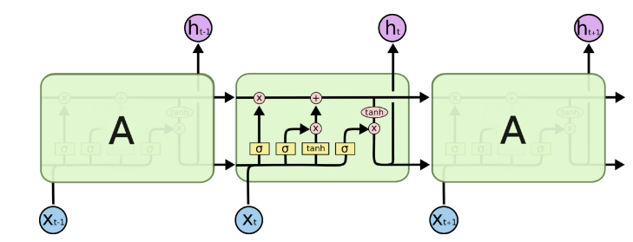
Fig 2: Long Short Term Memory Recurrent Network

Slide 15
Hyper Parameters
Embeddings = word2vec
Dropout = 0.5
Recurrent Dropout = 0.4
Optimizer = Adam
Loss function = Binary Cross Entropy
Variable epochs
Early stopping with patience of 30

Slide 16
Results
Models | Accuracy
SVM | 73.71
CNN Rand | 74.12
CNN – Word2Vec | 77.29
RNN (LSTM) Rand | 74.93
RNN (LSTM) – Word2Vec | 78.57

Slide 17
Conclusion
Sentiment Analysis is a challenging task.
By properly tuning the parameters the maximum accuracy is obtained using RNN (LSTM) using word2vec.
LSTM considers the long-term dependencies of previous words, hence it performed better than CNN and SVM model.

Slide 18
Thank you

