Slide 1

Command-Line Interaction with Large Language Models
Submitted in the partial fulfillment for the award of the degree of
BACHELOR OF ENGINEERING
IN
Computer Science and Engineering (Big Data Analytics)
Submitted by:
Vivek 21BCS11853
Apoorv Tyagi 21BCS11852
Under the Supervision of:
Mr. Rosevir Singh
Department of AIT-CSE
DISCOVER . LEARN . EMPOWER

Slide 2
Outline
Overview
Problem Formulation
Objective
Benefits of Large Learning Model
Accessing LLM via the Command Line
Implementing Command-Line Interaction
Practical Applications and Use Cases
Methodology
Conclusion & Future Scope

Slide 3

Overview of Large Language Models
What are LLMs?
Capabilities
Limitations
Large language models are advanced AI systems trained on vast amounts of text data to understand and generate human-like language.
LLMs excel at tasks like language translation, text generation, question answering, and even coding and creative writing.
LLMs can exhibit biases, lack common sense, and require careful prompting to achieve desired outputs.

Slide 4
Problem Formulation
The central problem identified in this project is the lack of a dedicated, user-friendly command-line
interface (CLI) that allows users to interact seamlessly with Large Language Models (LLMs) to perform
natural language processing (NLP) tasks. Despite the growing popularity and sophistication of LLMs,
such as GPT-4 and BERT, the primary modes of interaction with these models continue to be through
graphical user interfaces (GUIs) or complex application programming interfaces (APIs). These access
methods are effective for general users and developers with extensive programming knowledge, but
they are often inaccessible, inefficient, or cumbersome for individuals who prefer or require a
command-line environment. This gap highlights a significant issue in the accessibility and usability of
LLMs for users whose workflows and technical preferences align with CLI-based interactions

Slide 5
Objective
Design a Minimalist, User-Friendly CLI: Develop a streamlined CLI interface that prioritizes usability and
efficiency, making it easy for command-line users to execute NLP tasks such as text generation,
translation, and paraphrasing.
2. Enable Real-Time Interaction: Optimize the CLI for low-latency responses, ensuring that users can perform
LLM tasks in real-time without delays, similar to the responsiveness of web-based solutions.
3. Achieve Broad Compatibility with LLMs: Integrate support for multiple LLMs, allowing users to select their
preferred model based on task requirements, and enabling flexibility in model usage.
4. Incorporate Error Handling and User Feedback Mechanisms: Develop robust error-handling protocols and
feedback features within the CLI to enhance user experience and reduce friction during interaction.
5. Support Workflow Integration and Automation: Design the CLI to be compatible with scripts, automated
workflows, and batch processing, enhancing productivity for users working within server-based or remote
environments.
6. Promote Scalability and Future Adaptation: Ensure that the CLI can be easily extended to support new LLMs
and NLP tasks, adapting to future advancements in the field

Slide 6

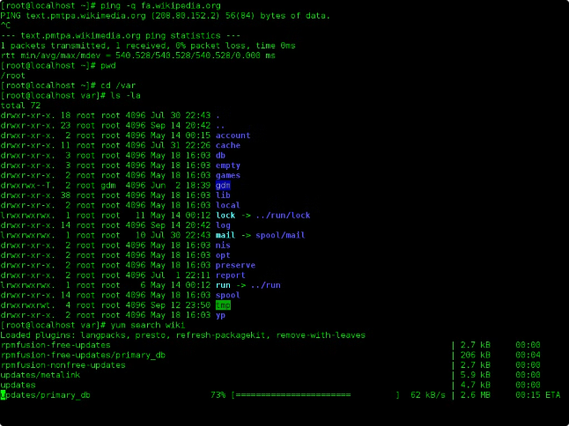
Benefits of Command-Line Interaction
1
Flexibility
2
Efficiency
Interact with LLMs programmatically, automating workflows and integrating with other tools.
Quickly test and refine prompts, without the overhead of a graphical user interface.
3
Transparency
4
Customization
See the full input and output, enabling better understanding and debugging.
Tailor the interaction experience to your specific needs and preferences.

Slide 7

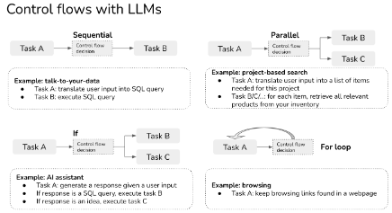
Accessing Large Language Models via the Command Line
API Integration
Scripting Workflows
Connect directly to LLM API endpoints using command-line tools like cURL or Postman.
Automate LLM interactions by incorporating them into shell scripts and programming languages.
1
2
3
CLI Wrappers
Use dedicated command-line interfaces (CLIs) that abstract the API complexity.

Slide 8

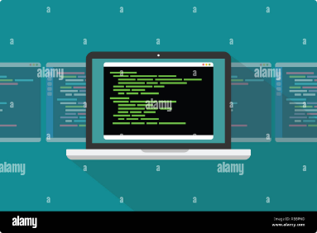
Implementing Command-Line Interaction
Prompt Engineering
Error Handling
Carefully craft prompts to elicit desired responses from the LLM.
Anticipate and gracefully handle any issues or errors that may arise during interactions.
Output Parsing
Iterative Refinement
Extract and process the relevant information from the LLM's responses.
Continuously test and refine your approach to improve the effectiveness of your interactions.

Slide 9

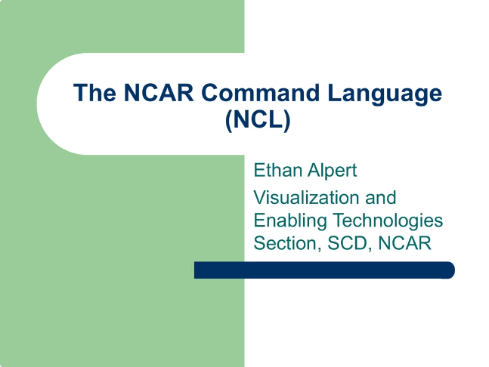




Practical Applications and Use Cases
Code Generation
Content Creation
Leverage LLMs to generate, explain, and optimize code snippets.
Automate the production of articles, reports, and other written materials.
Data Analysis
Task Automation
Enhance data processing and interpretation workflows with LLM-powered insights.
Streamline various business and personal tasks through LLM-driven automation.

Slide 10
Methodology
The implementation plan for the CLI tool is structured into phased stages, ensuring systematic development,
testing, and deployment. This methodology emphasizes modularity, testing, and user feedback integration
to deliver a reliable and user-friendly command-line interface for interacting with Large Language Models
(LLMs). Each phase is designed to build upon previous work, allowing iterative testing and refinement to
ensure the CLI tool meets performance, usability, and security standards.

Slide 11

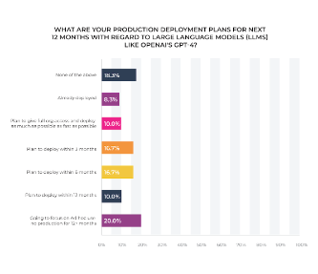



Conclusion and Future Considerations
Unlocking Potential
Ethical Considerations
Ongoing Evolution
Command-line interaction with LLMs opens up new possibilities for productivity, creativity, and problem-solving.
As the capabilities of LLMs continue to grow, it's essential to address issues of bias, privacy, and responsible use.
The field of command-line interaction with LLMs is rapidly evolving, with exciting advancements on the horizon.

Slide 12
THANKYOU
THANK YOU

