Slide 1
Objective
To analyze the loans dataset and find out the people who are likely to default

Slide 2
Problem Statement
We have been given a loans dataset with multiple columns. The applicant can either pay the loan or not pay the loan. We have to figure out if we can approve the loan to an applicant or not.

Slide 3
Business Objective
We have to minimize the amount of credit loss. If the applicant is likely to pay the loan, then not approving the loan is a loss of business to the company. Similarly, if the applicant can’t repay the loan, then approving the loan is again a loss to the company.

Slide 4
Analysis Approach
Removed all the unnecessary columns. Had to read through the data and understand which data might not have any impact on result.
Removed the columns which had more than 90% of null values.
Removed duplicates.
Filtered the data - removed “months” string from term column, converted interest from % to just integers. Did multiple columns data cleaning, and filtering.
Changed the datatype from object to int and float ac to requirement
Plotted univariate graphs and bivariate graphs
Used different kinds of graph to come to a conclusion.

Slide 5
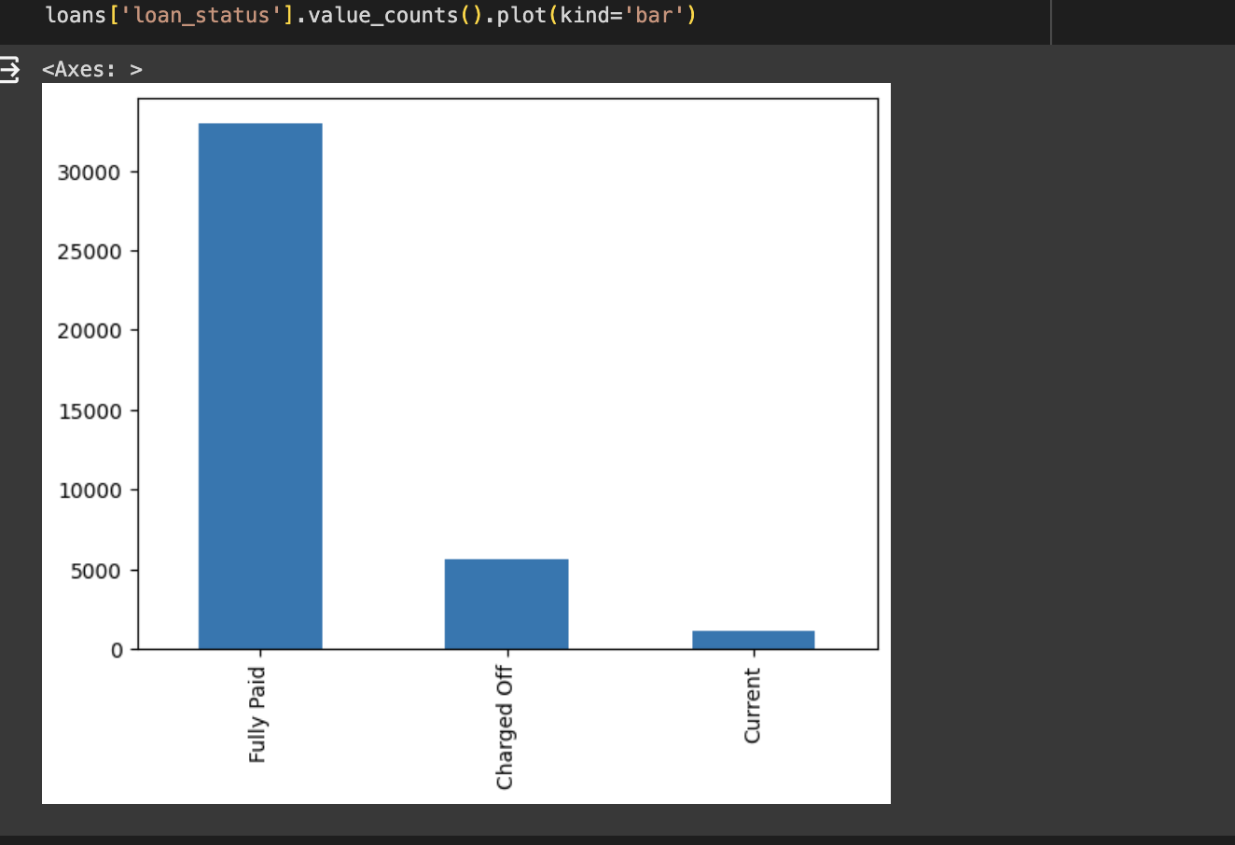
Univariate Analysis in Business terms
The main purpose of this kind of analysis is to describe the data and find patterns that exists within the data.
With this graph, we can get the count of different loan types.
Majorly of the data set consists of fully paid Applicants. Charged off is around 5000.

Slide 6
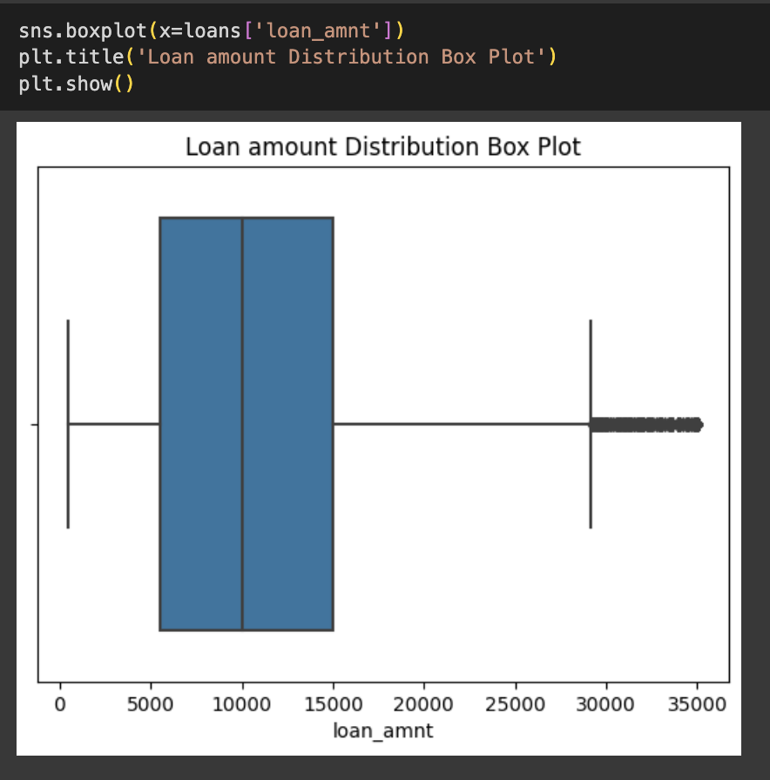
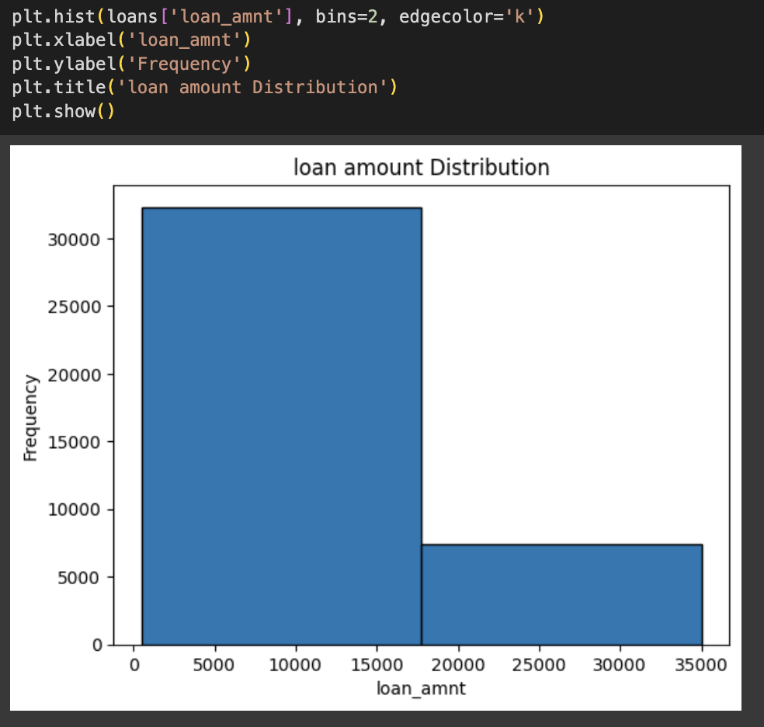
We can assume from above plots that most of the loan amount is in between 5000 to 15000.

Slide 7
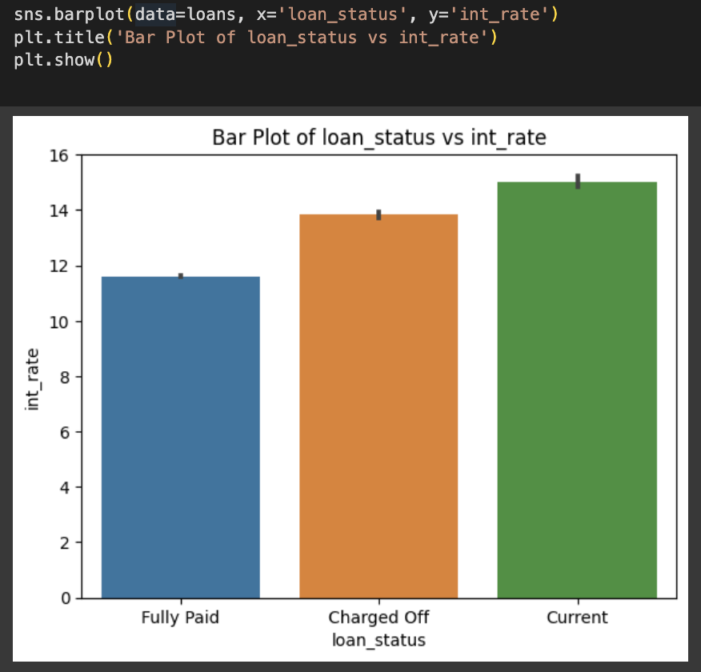
Bivariate Analysis
The analysis deals with finding relationships among two variables.
This bar plot suggests that applicants are likely to pay the loan if interest rate is below 11.5. However if interest rate is above 12 then applicant might default, or maybe is in current loan status.

Slide 8
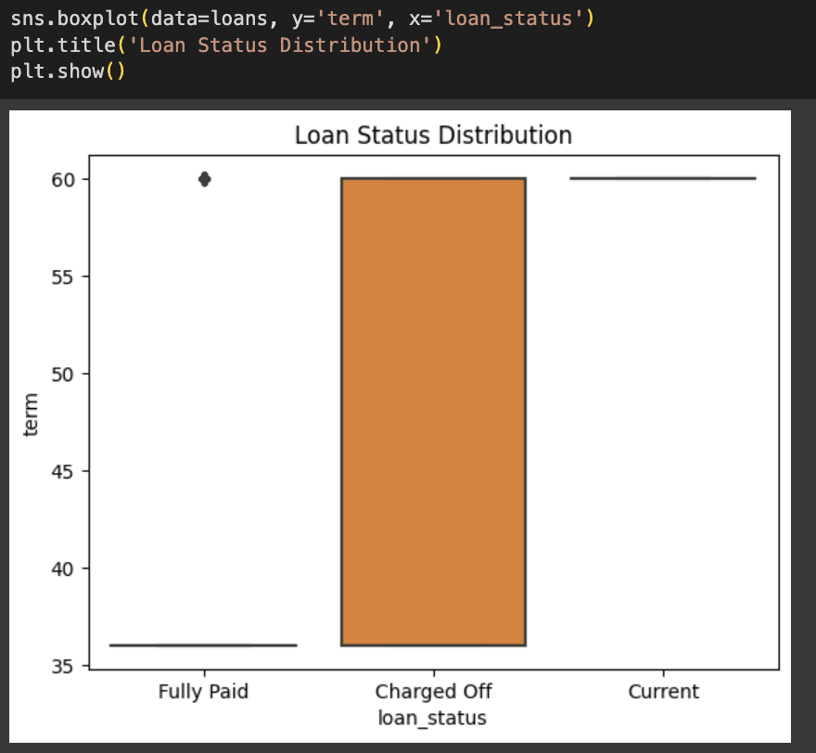
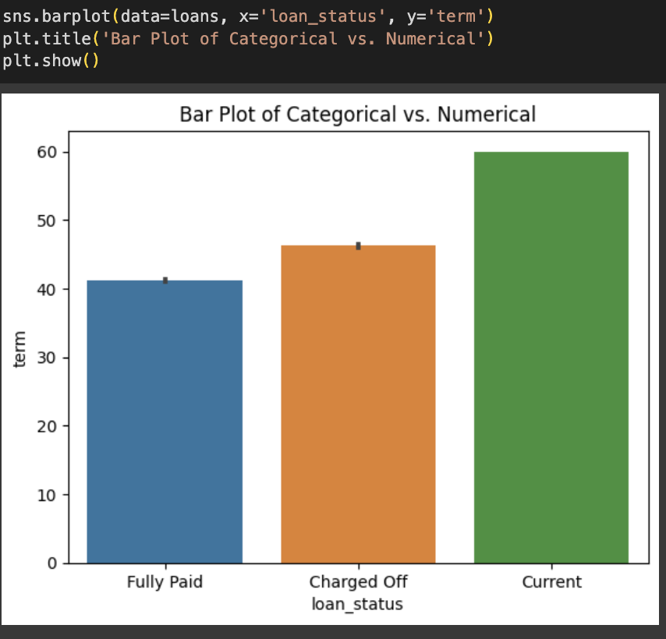
The graph shows that if the term for loan duration is more than 40, then applicant is likely to default or be in current state.

Slide 9
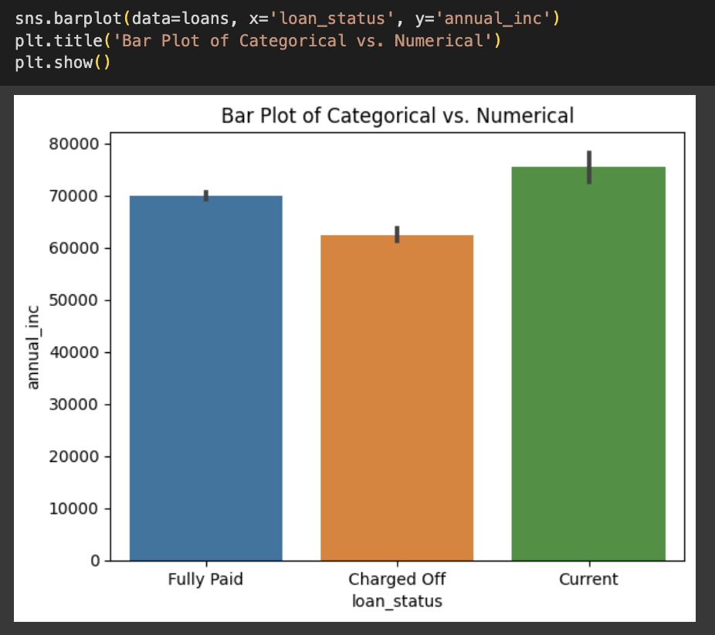
The bar chart proves that if the annual income is less than 60000, then the applicant might default.

Slide 10
Conclusion
With this we have done analysis on loans dataset, to figure out which applicants are more likely to default.
loan_amt, term, interest rate, and annual income are a few key factors which directly impacted the applicant being a defaulter.

