Slide 1

*
25th, June 2025
PMI Dashboard
KT for DSO

Slide 3
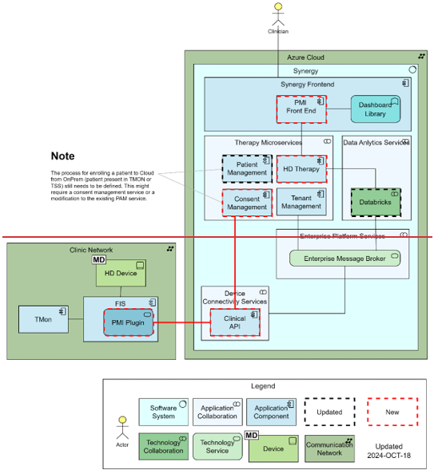
PMI Dashboard – Architectural informations
PMI Dashboard is an addition to the TMON application that allows HCPs to have the best situational awareness of their patients' conditions. They can have a quick overview before a shift starts by visualizing the Patient List, and a deeper understanding of their progress overtime by navigating into Patient Record.

Slide 4
PMI Dashboard
MVP startup and
decommissioning

Slide 5
PMI Dashboard – MVP startup and decommissioning
MVP Startup
Setup Identity provider clients
Create a dedicated tenant for MVP
Enroll users with required roles
Install and configure plugin #240
Enroll the first patients using TMON ID
Check charts page
MVP Decommissioning
Delete the tenant

Slide 6
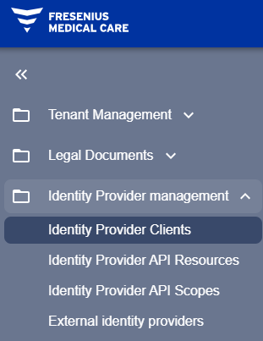
PMI Dashboard – Setup Identity provider clients
Go to the ‘admin’ tenant of the interested environment example: https://host-v1.tms.fmcgds-np.com/admin
Navigate to Identity Provider Management / Identity Provider Clients

Slide 7
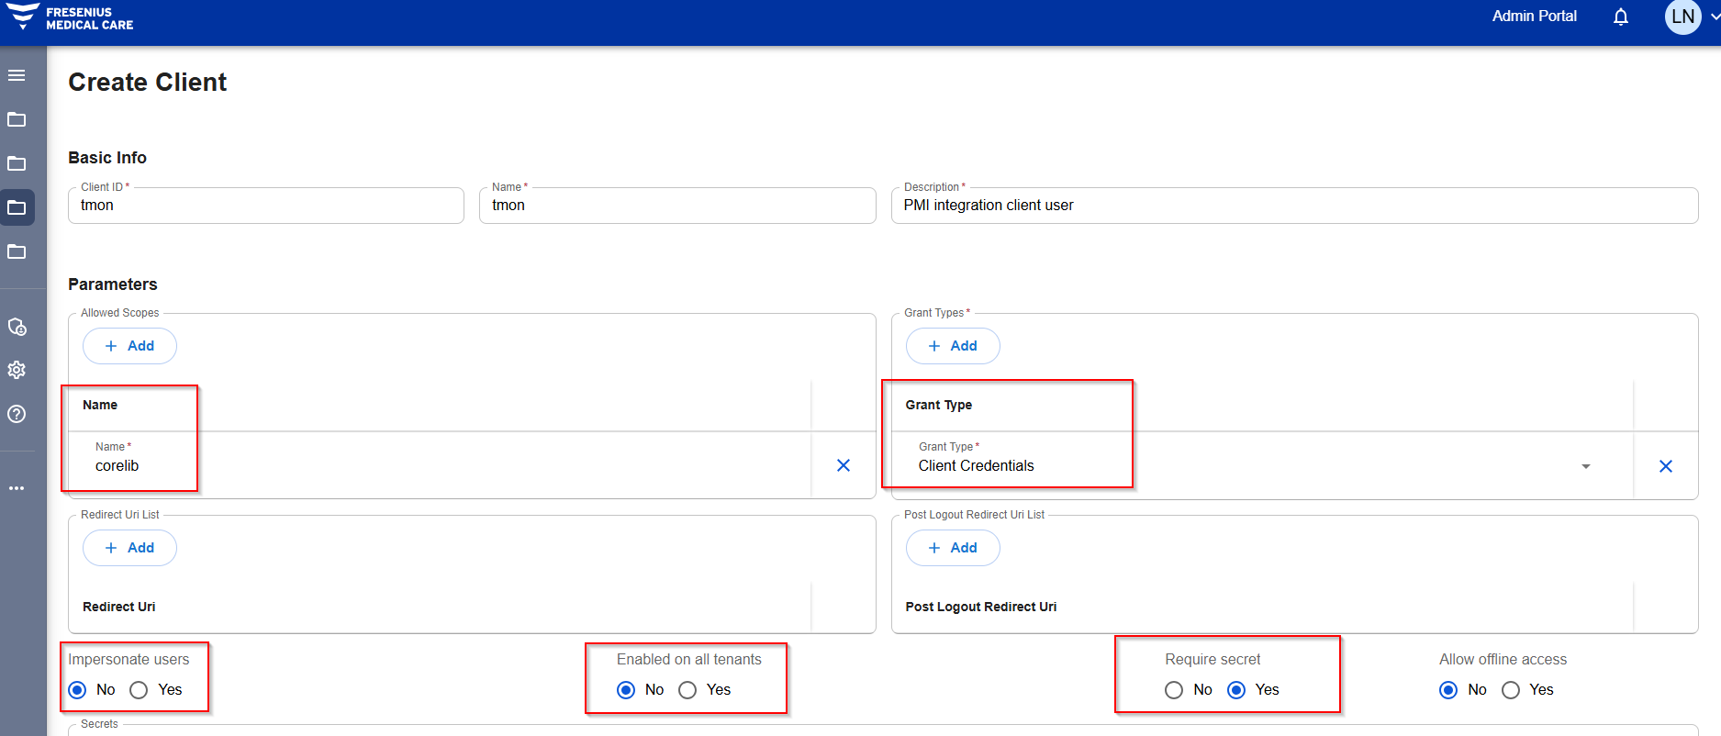
PMI Dashboard – Setup Identity provider clients
The client must be configured as follows (clientId, name and description can be of course changed, the ones reported in the screenshot are examples):

Slide 8
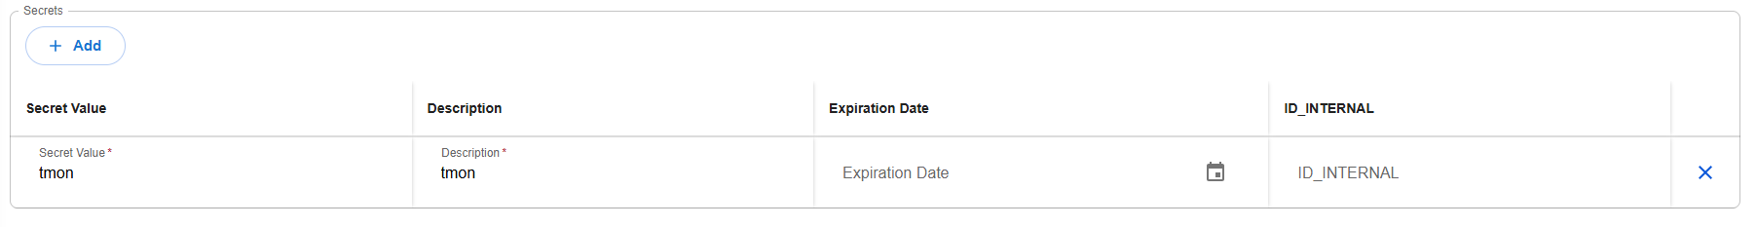
PMI Dashboard – Setup Identity provider clients
A secret must be added to the client from the apposite section at the bottom of the page (also in this case the inserted values are examples):
IMPORTANT: take note of the Client Id and the Secret Value of the Identity Provider Clients just created. You ​​will need these values during the configuration of the plugin #240.

Slide 9
PMI Dashboard – Create tenant
Go to the ‘admin’ tenant of the environment example: https://host-v1.tms.fmcgds-np.com/admin
Create a new tenant: Name: name of the clinic (example: emea_clinic) Customer name: name of the clinic/customer Country: country of the clinic/customer Default language: language for the clinic/customer Time zone: time zone of the country/clinic/customer Multi-factor authentication: yes Retention period: 1 year Inactivity timeout: 15 minutes Microservices enabled: CLINICALAPI, DPR, HD, PAM, AUDIT (CMPS and USM should be automatically selected) Admin contact data first name, last name and e-mail of a responsible Product name choose a good description («MVP of PMI Dashboard») Fresenius Medical Care country same country as above Support contacts configuration / Email e-mail of the technical support on this tenant
Click on the Create button and wait for the tenant to be created successfully

Slide 10
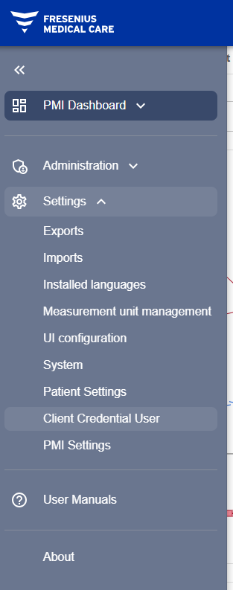
PMI Dashboard – Setup Identity provider clients
Navigate to the tenant just created example: https://host-v1.tms.fmcgds-np.com/PMI-test
Navigate to Settings / Client Credential User

Slide 11
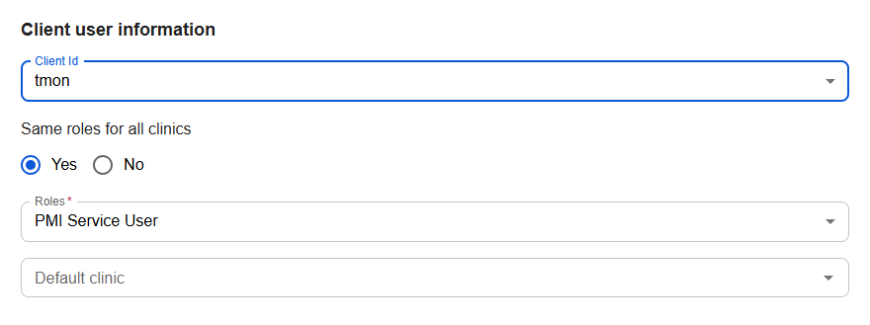
PMI Dashboard – Setup Identity provider clients
Create a new Client User
The “ClientUser” can be enabled on all clinics (like in the following example) or on specific ones. In each clinic, it must have role “PMI Service User” enabled

Slide 12
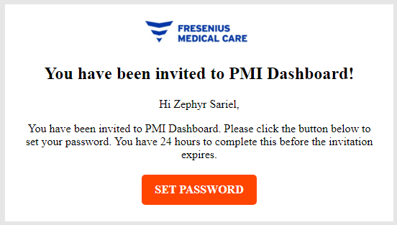
PMI Dashboard – Enroll users with required roles
Navigate to the tenant just created example: https://host-v1.tms.fmcgds-np.com/PMI-test
Navigate to: Administration / User management / Users
Click on the button «Create user»
Fill all mandatory fields Roles: PMI User
After saving, the user just created is in ‘Draft’ status
The user receive an e-mail containing a link to setup his password:

Slide 13
PMI Dashboard – Enroll users with required roles
Now the user shoud be able to login into the tenant dedicated to the MVP of PMI Dashboard example: https://host-v1.tms.fmcgds-np.com/PMI-test
The user go into the ‘Active’ status
Please note that users can also follow the workflow for the self registration, explained here:
https://dev.azure.com/GRD-EMEA/Therapy%20Management%20Suite/_wiki/wikis/Therapy-Management-Suite.wiki/9317/User-Self-Registration

Slide 14
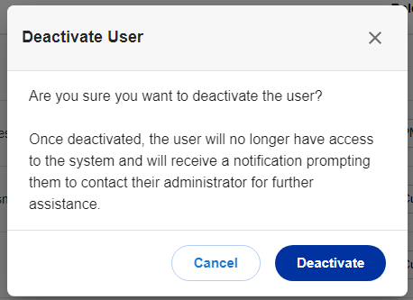
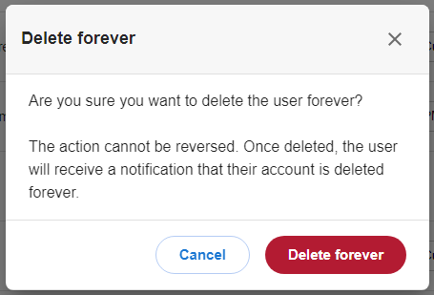
PMI Dashboard – Deactivate and delete forever a user
Navigate to the tenant just created example: https://host-v1.tms.fmcgds-np.com/PMI-test
Navigate to Administratio / User management / Users
Deactivate the user using the row actions
Delete forever the user

Slide 15
PMI Dashboard – Install plugin #240
Requirements As general rule, the Plugin 240 follows the requirements imposed by TMON 2.3\TMON 2.4 (depending on the plugin version). On the chosen operative system, all updates must be installed. The machine on which Plugin 240 is installed, must be able to reach Synergy address (the communication between the plugin 240 and Synergy is made via HTTPS). Remember also to configure accordingly Plugin 240 if a network proxy is used (see details below).
Compatibility TMON 2.3, TMON 2.4, TMON 2.5
The tenant used in order to exchange data must have AUDIT, CLINICALAPI, DPR, HD and PAM microservices installed and running.

Slide 16
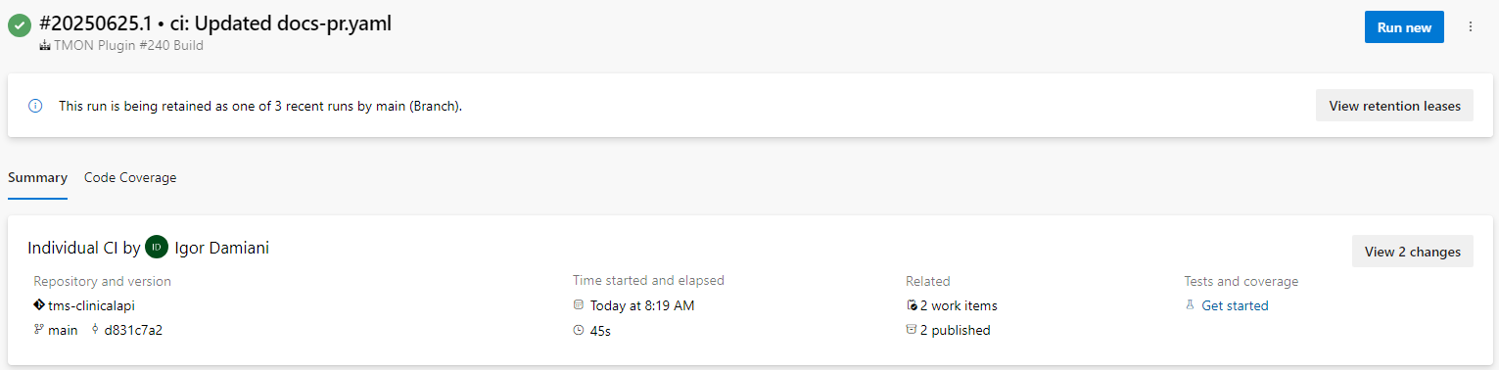
PMI Dashboard – Install plugin #240
Download plugin
The latest version of the plugin can be downloaded directly from Azure DevOps using this link:
https://dev.azure.com/GRD-EMEA/Therapy%20Management%20Suite/_build?definitionId=1753
Click on the most recent row completed successfully. Then click on the link highlighted below to download artifacts generated.

Slide 17
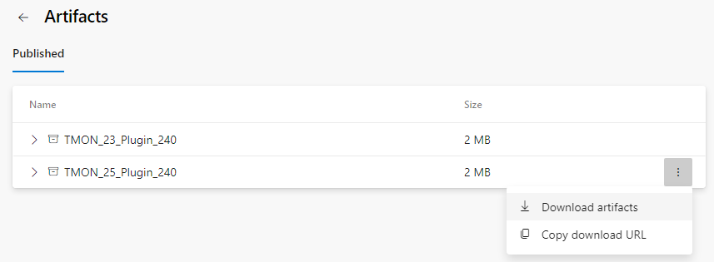
PMI Dashboard – Install plugin #240
Two versions of the Plugin #240 are available here. Please download the correct one based on the TMON installed.
TMON 2.3 → TMON_23_Plugin_240.zip
TMON 2.4 → TMON_25_Plugin_240.zip
TMON 2.5 → TMON_25_Plugin_240.zip

Slide 18
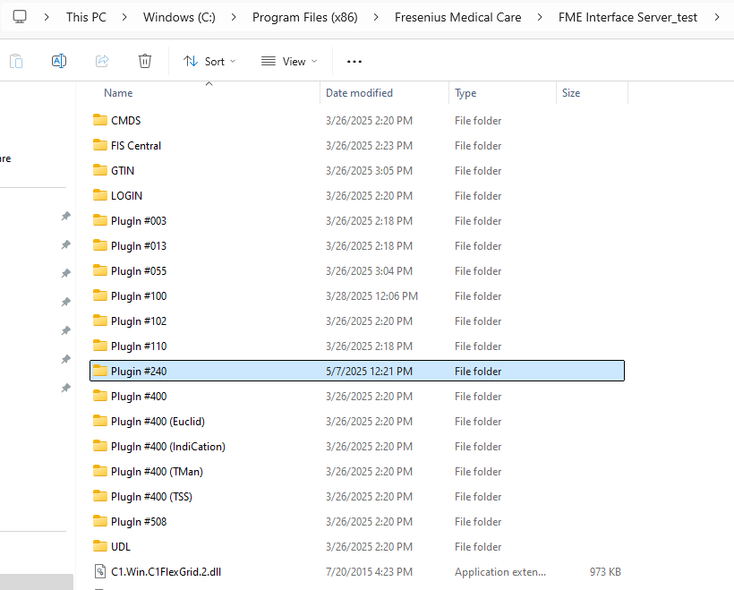
PMI Dashboard – Install plugin #240
Stop FIS service
Locate your FIS service folder, create a new folder named “Plugin #240” and unzip the content of zip file downloaded before inside it.

Slide 19
PMI Dashboard – Install plugin #240
Open fis.ini and insert the following rows:
In the same file add the following row in PERIODIC commands section:
In this way Plugin #240 will appear inside FIS Plugin configuration tab and, in the “Periodic commands” section, the new “pmisync” command will appear, with a default value of 60 minutes.
* TMS
PLUGIN = 240, TMS.Plugin240.Commands, PlugIn #240\TMS.Plugin240.dll, 0, 0
*
* PERIODIC = 240, "pmisync", 60, 0

Slide 20
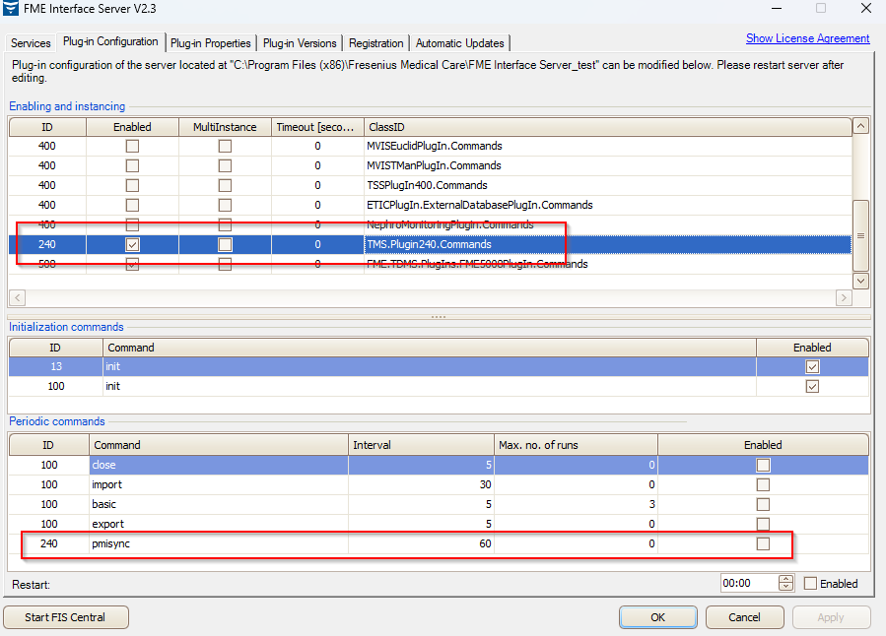
PMI Dashboard – Install plugin #240

Slide 21
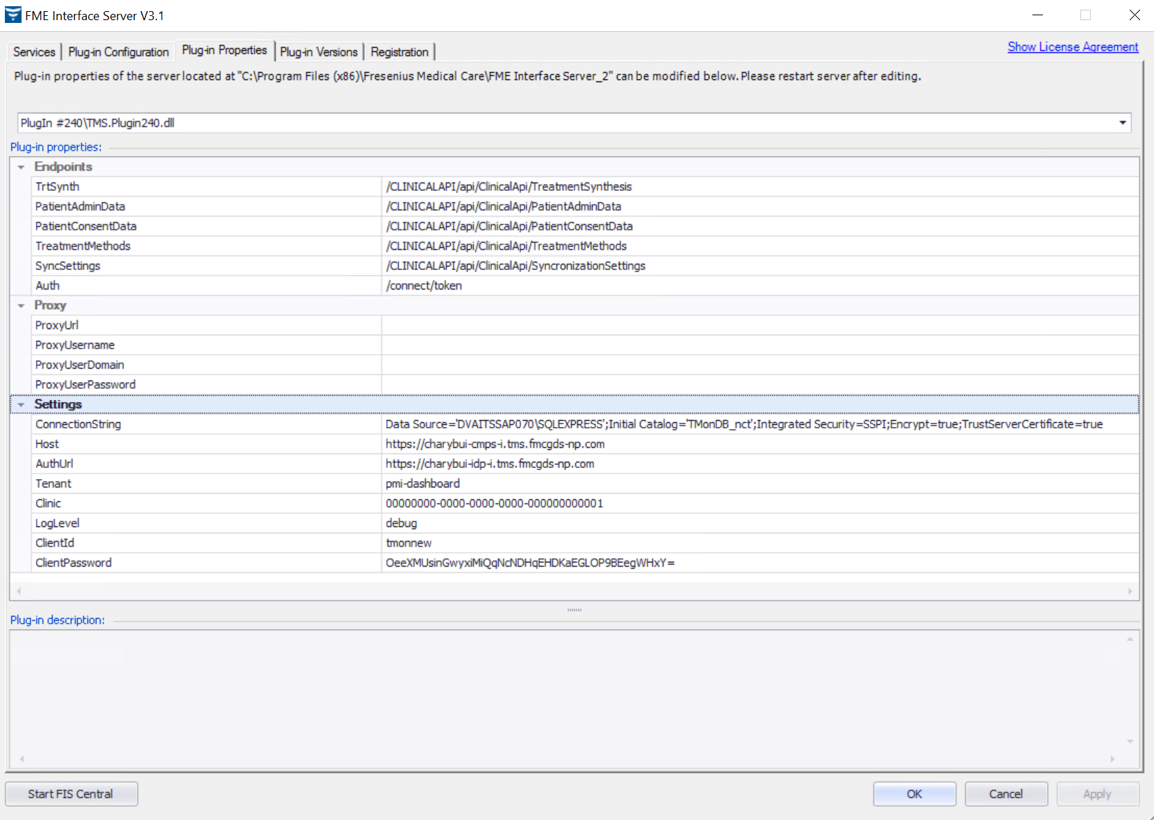
PMI Dashboard – Install plugin #240
Open FIS and navigate under “Plug-in properties” tab, then select “Plugin #240” from the selector:

Slide 22
PMI Dashboard – Install plugin #240
The following settings will be displayed:
Endpoints: are the endpoints that the plugin will use in order to send and retrieve data from Synergy. Do not edit them.
Proxy: this section allows to specify the proxy configuration if needed, in order to connect to Synergy
Settings: this section contains the setup of the plugin, and must be filled with information related to the Synergy tenant \ environment that must be connected with the plugin, and the TMON instance from which the data will be transferred o ConnectionString: this is the connection string of the TMON database o Host: Synergy host URL (https://host-cmps-v1.tms.fmcgds-np.com) o Auth: Synergy authentication URL (https://auth2-v1.tms.fmcgds-np.com) o Tenant: name of the Synergy tenant that must be connected to the TMON instance o Clinic: Guid of the clinic inside the tenant, that will host the exported data (refer to appendix 1 in order to know how to identify the clinic guid) o LogLevel: this is the log level of the plugin. Leave it to debug o ClientId: is the client id of the “Identity provider client” from Pre-installation step o ClientPassword: is the name of the secret associated to the “Identity provider client” from Pre-installation step

Slide 23
PMI Dashboard – Enroll the first patients using TMON ID
Navigate to the tenant just created example: https://host-v1.tms.fmcgds-np.com/PMI-test
Navigate to Administration / Patient enrollment
Click on the button «Create enrollment request»
Fill the list with one or more TMON Ids, check the Patient Consent and click on «Create» button
Wait for the first synchronization executed by the Plugin #240
Now it’s possible to approve/decline each enrollment, based on Name/ID/DOB values
When an enrollment is approved, it moves to go tab «Enrolled patients» All data about the patient will become available and visible after a further synchronization from TMON and Plugin #240
More details are available on the official wiki page:
https://dev.azure.com/GRD-EMEA/Therapy%20Management%20Suite/_wiki/wikis/Therapy-Management-Suite.wiki/8106/Patient-consent-workflow

Slide 24
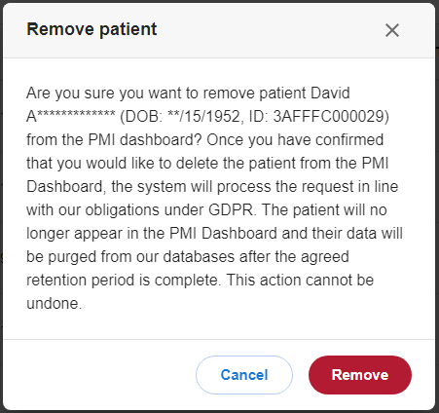
PMI Dashboard – Revoke a single enrolled patient
Navigate to the tenant just created example: https://host-v1.tms.fmcgds-np.com/PMI-test
Navigate to Administration / Patient enrollment
Move to the tab «Enrolled patients»
Click on the Recycle Bin button inside the row actions
Please consider that PMI Dashboard relies on Data Protection (DPR) microservice to perform the actual patient deletion.

Slide 25
PMI Dashboard – Check charts page
Navigate to the tenant just created example: https://host-v1.tms.fmcgds-np.com/PMI-test
Navigate to PMI Dashboard / Patient list
Click on any enrolled patient
A chart page appears reporting treatment data of the selected patient
Apply filters based on dates and number of sessions

Slide 26
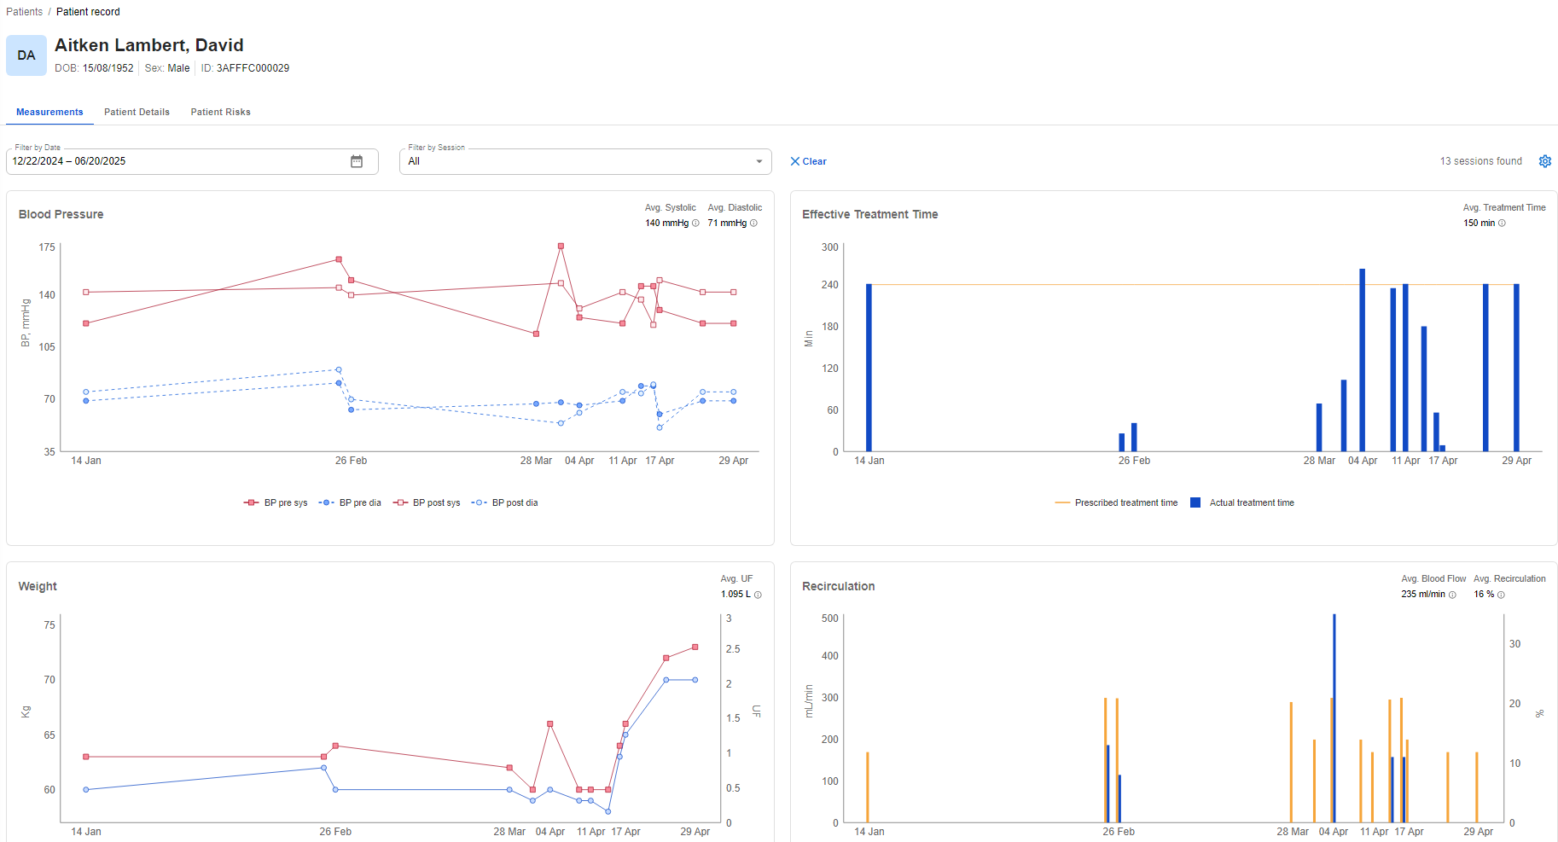
PMI Dashboard – Check charts page

Slide 27
PMI Dashboard
Decommissioning

Slide 28
PMI Dashboard – Delete the tenant
Delete a tenant means delete all the data stored in the tenant itself.
For PMI Dashboard, it means delete:
All users/roles/permissions
All clinics defined
All patients data (also enrollments)
All data created in Patient Management microservice (PAM)
All treatments data imported
All settings related to the tenant

Slide 29
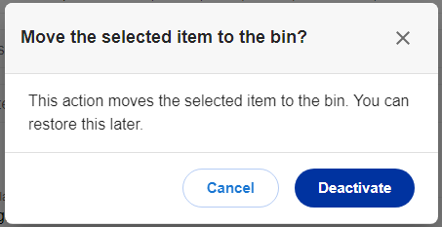
PMI Dashboard – Delete the tenant
Go to the ‘admin’ tenant of the interested environment example: https://host-v1.tms.fmcgds-np.com/admin
Search for the tenant to be deleted (example: emea_clinic)
Deactivate the tenant
«Delete forever» the tenant
More details are available on the official wiki page:
https://dev.azure.com/GRD-EMEA/Therapy%20Management%20Suite/_wiki/wikis/Therapy-Management-Suite.wiki/9325/Deactivate-Reactivate-Delete-Forever-Tenants

Slide 30
PMI Dashboard
APPENDICES SECTION

Slide 31
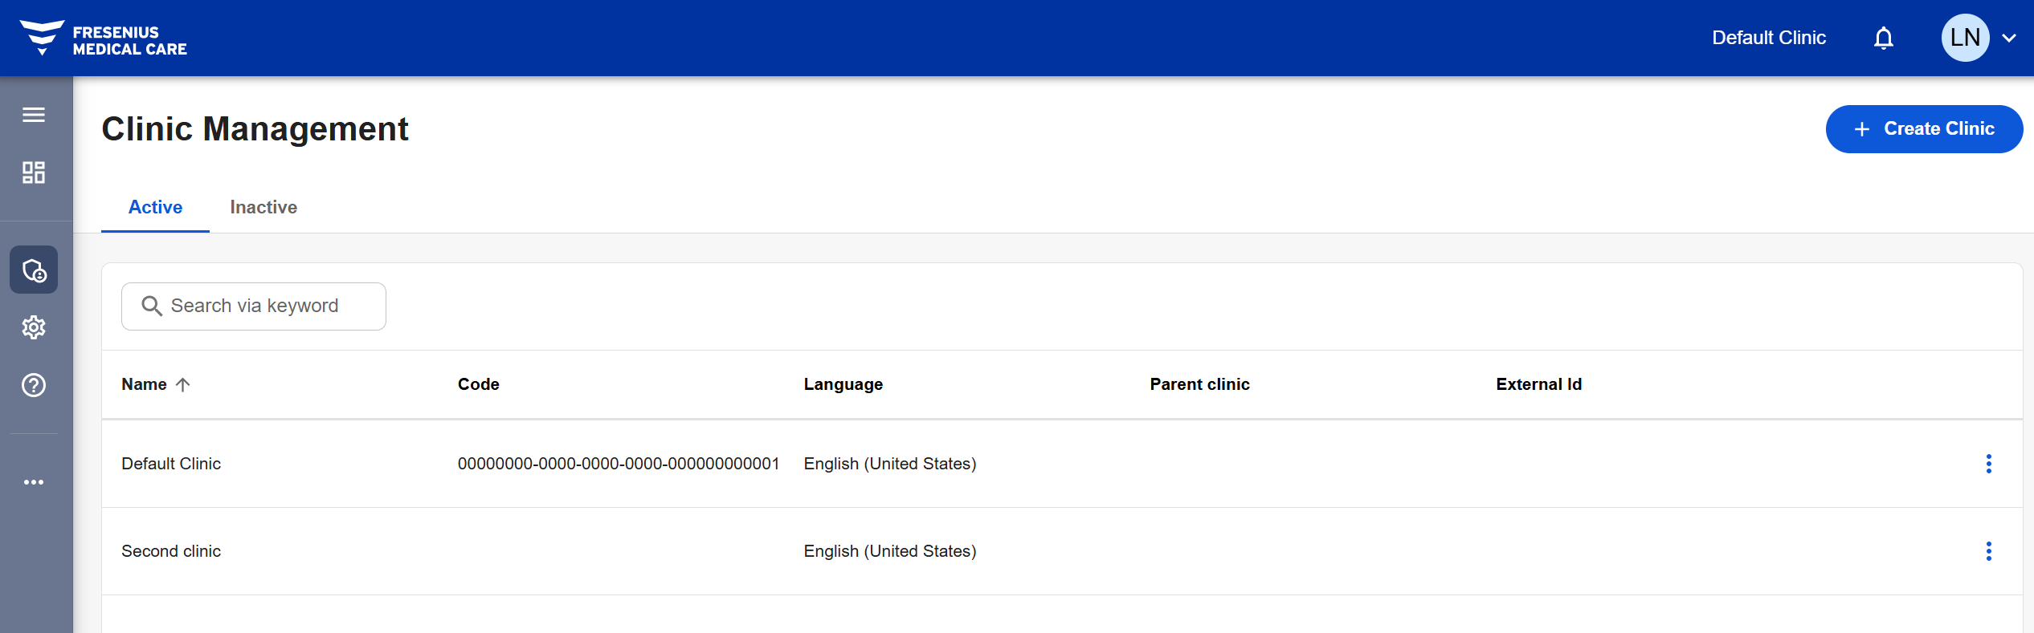
PMI Dashboard – Appendix 1: Identification of Clinic Id
Navigate to the tenant just creation example: https://host-v1.tms.fmcgds-np.com/PMI-test
Navigate to Clinic Management menu
Then click on the desired clinic record, and copy the guid of the clinic as shown in the screenshot below (the id of the clinic is the last text before the question mark – see next slide for details)

Slide 32
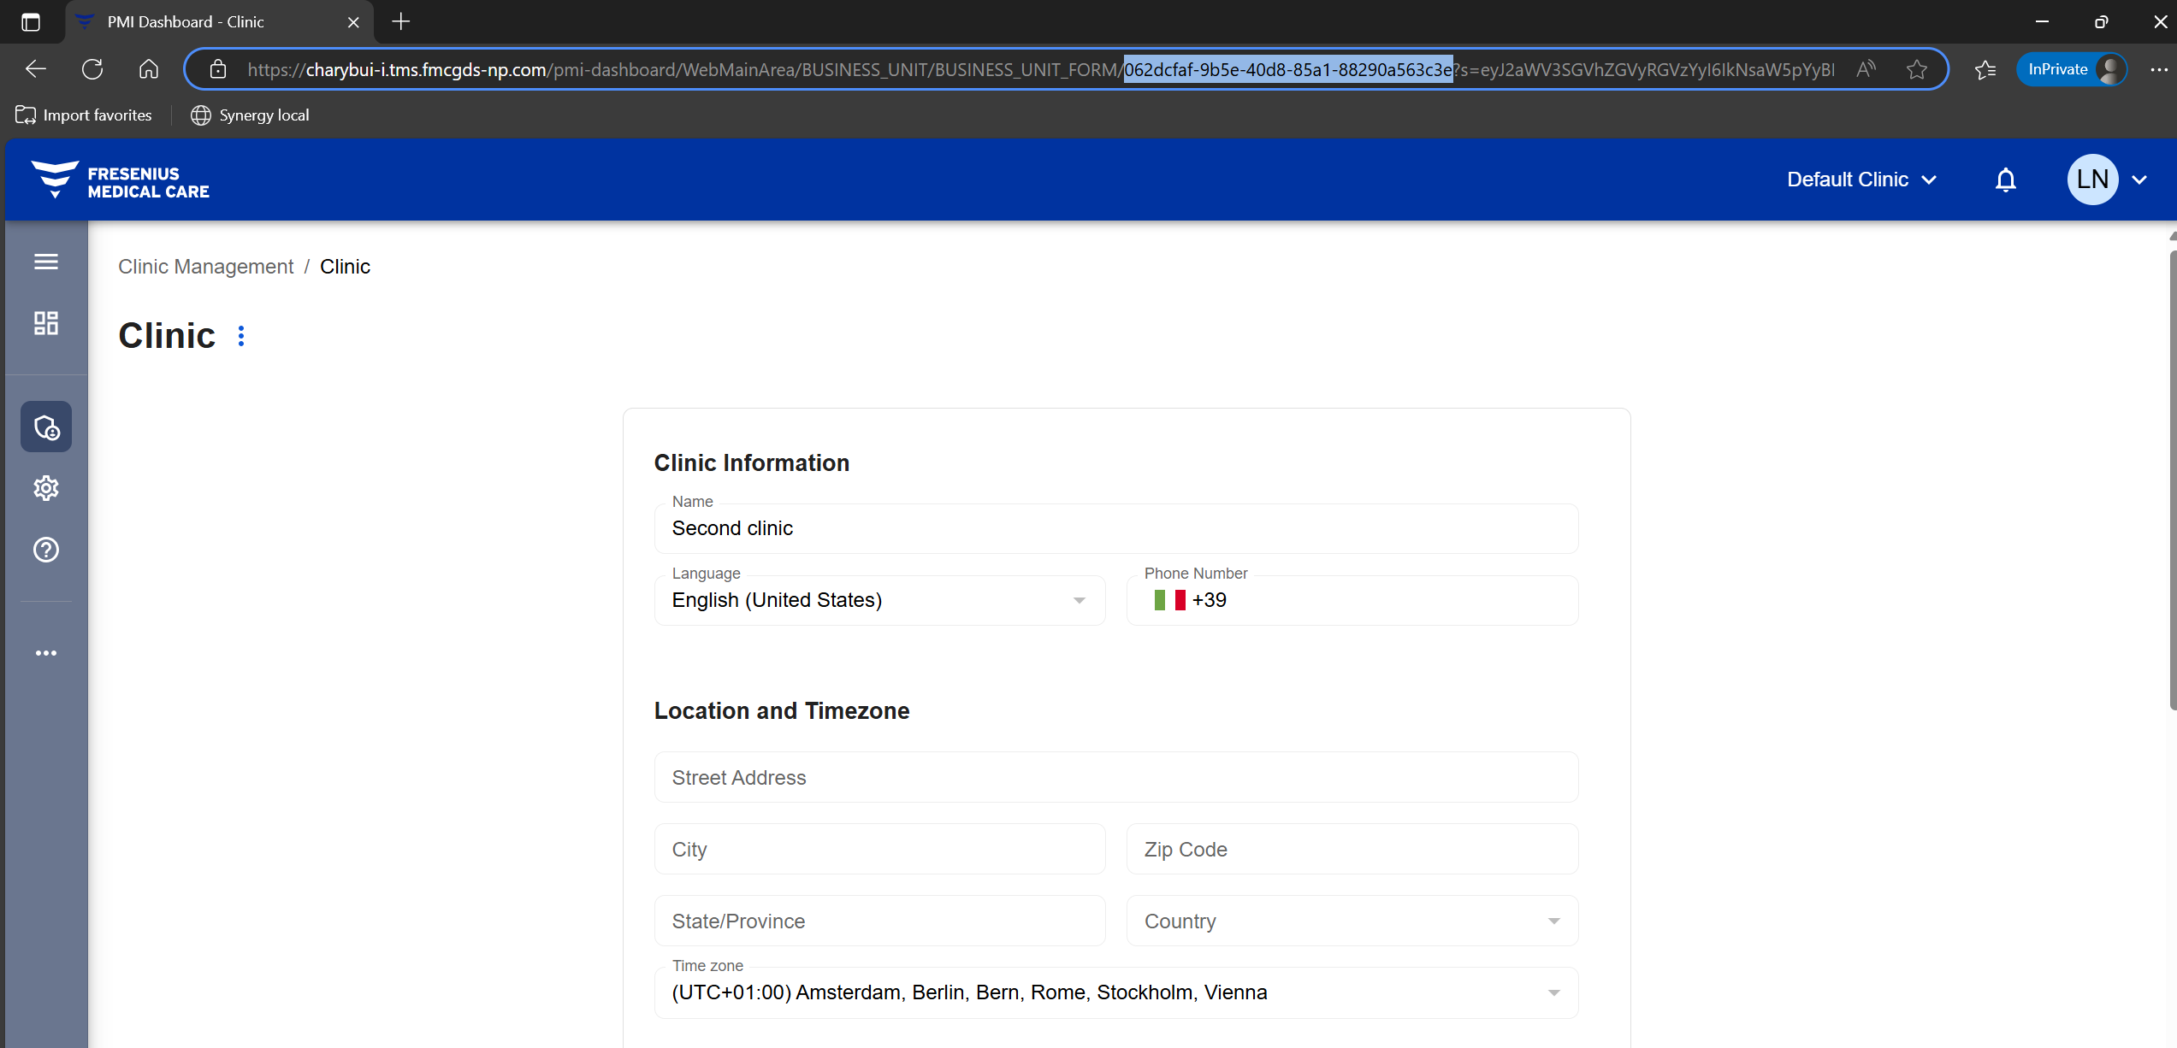
PMI Dashboard – Appendix 1: Identification of Clinic Id

Slide 33
PMI Dashboard – Appendix 2: Wiki References
Tenant Management
https://dev.azure.com/GRD-EMEA/Therapy%20Management%20Suite/_wiki/wikis/Therapy-Management-Suite.wiki/9323/View-Create-Edit-Tenants
https://dev.azure.com/GRD-EMEA/Therapy%20Management%20Suite/_wiki/wikis/Therapy-Management-Suite.wiki/9894/Auto-Log-off
https://dev.azure.com/GRD-EMEA/Therapy%20Management%20Suite/_wiki/wikis/Therapy-Management-Suite.wiki/9325/Deactivate-Reactivate-Delete-Forever-Tenants
User Management
https://dev.azure.com/GRD-EMEA/Therapy%20Management%20Suite/_wiki/wikis/Therapy-Management-Suite.wiki/9300/View-Create-Edit-Users
https://dev.azure.com/GRD-EMEA/Therapy%20Management%20Suite/_wiki/wikis/Therapy-Management-Suite.wiki/9167/User-Profile
https://dev.azure.com/GRD-EMEA/Therapy%20Management%20Suite/_wiki/wikis/Therapy-Management-Suite.wiki/9317/User-Self-Registration

Slide 34
PMI Dashboard – Appendix 2: Wiki References
PMI Dashboard
https://dev.azure.com/GRD-EMEA/Therapy%20Management%20Suite/_wiki/wikis/Therapy-Management-Suite.wiki/8106/Patient-consent-workflow

Slide 35


