Slide 1







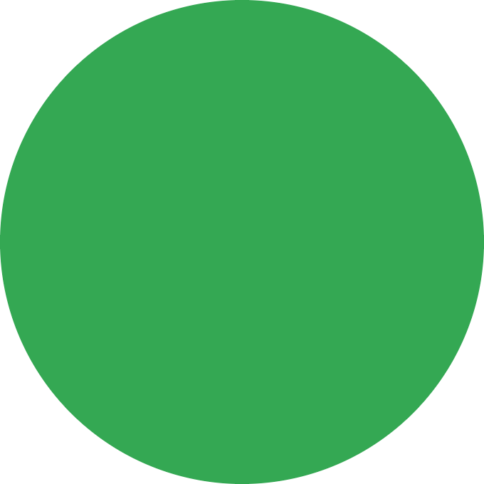
Missed the session?
Google Developer Groups on Campus · A. P. Shah Institute of Technology
Skill Boost registration guide, step by step
For anyone who missed the session: how to register for Skill Boost (now called Google Skills). Follow the screenshots to fill in both forms.
Short steps
Screenshots
Both forms covered
Register by 31 Oct 2026

Slide 2
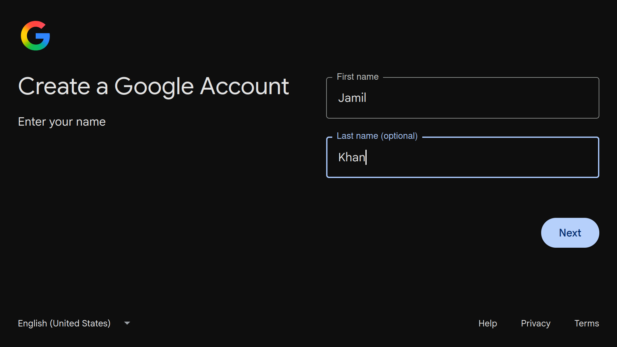
Step 1: Create a fresh Google account
Start with a new account made for this program, so only your new badges count.
1
Open the sign-up page
Go to accounts.google.com and choose Create account, then For my personal use.
2
Enter your name
Type your first and last name in the first red box, then click Next.
3
Finish the setup properly
Add birthday, pick a username and a strong password, and verify your phone. Note them down.

Slide 3
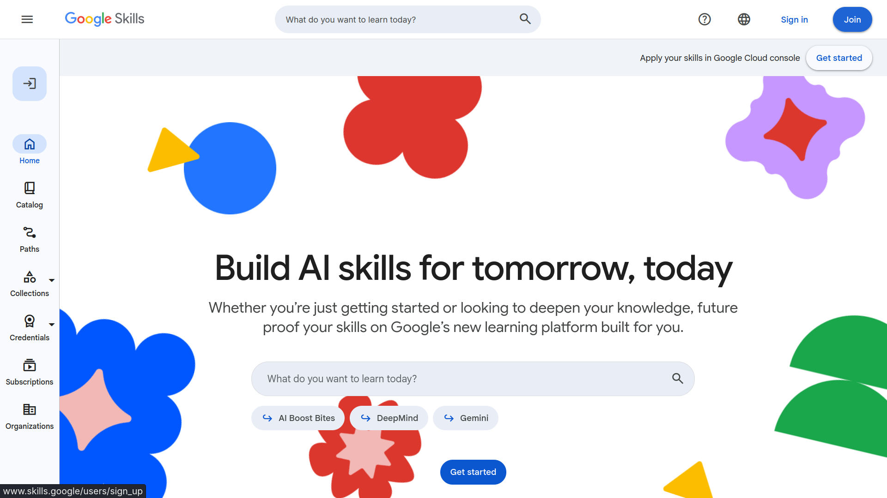
Step 2: Go to Google Skills
Go to this site, then join with the fresh Google account you created in Step 1.
1
Go to this site
Open skills.google (Google Skills, formerly Cloud Skills Boost) in your browser.
2
Click Join
Click Join at the top right, marked with the red box and arrow.
3
Join with your fresh account
Use the new Google account you just created, not an old one.

Slide 4
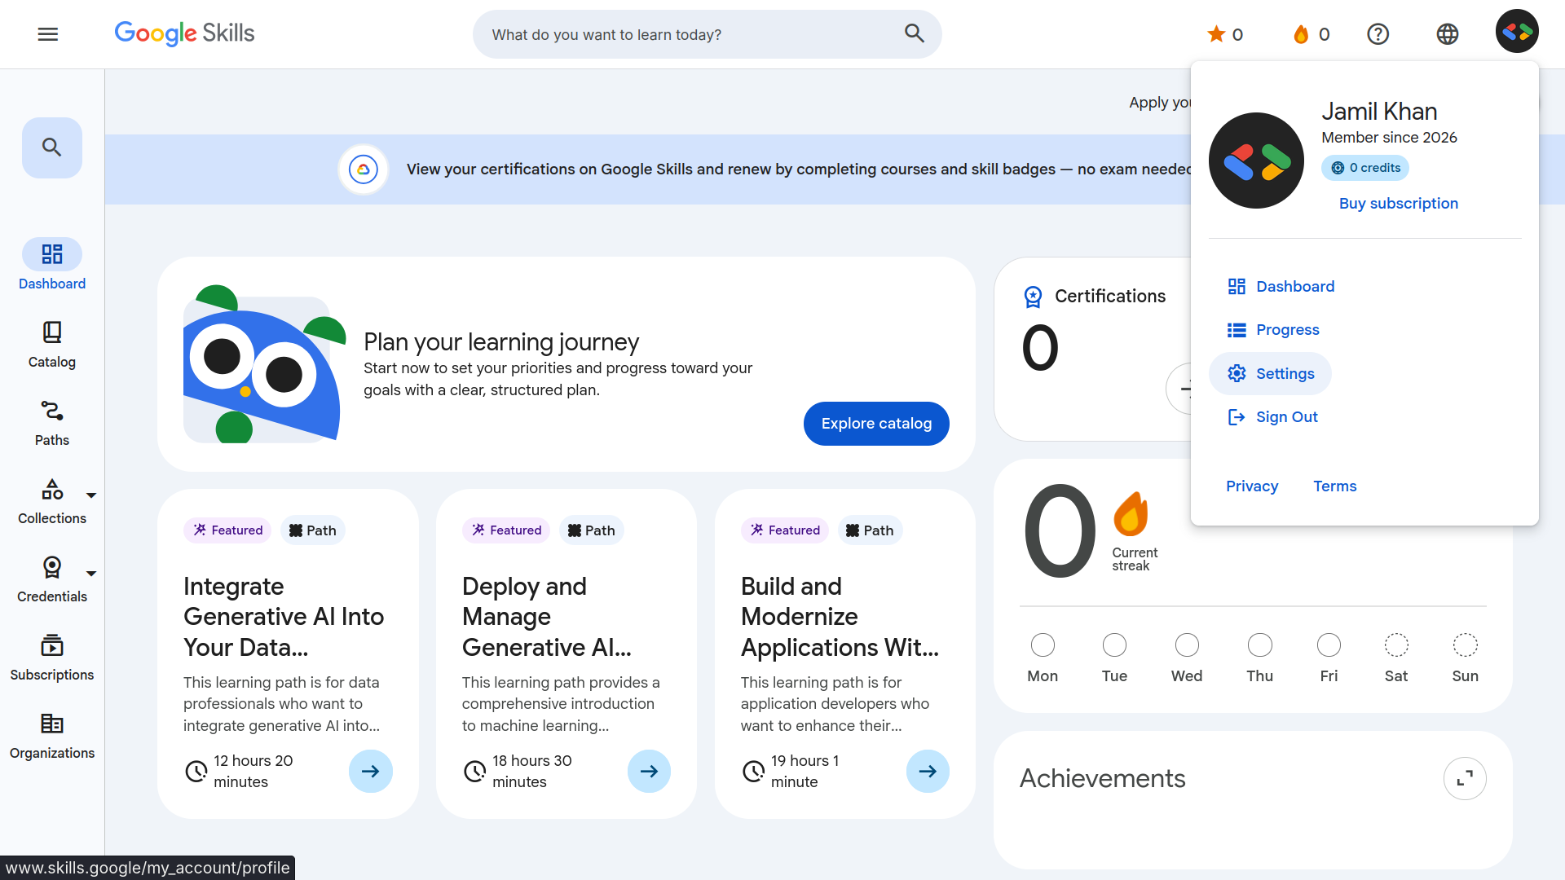
Step 3: Open your profile settings
Once you have joined, open Settings from your profile menu.
1
Click your profile icon
Click your profile icon at the top right, marked with the red box.
2
Choose Settings
Pick Settings from the menu, shown by the arrow.
3
Get ready to go Public
Next, you will set your profile to Public.

Slide 5
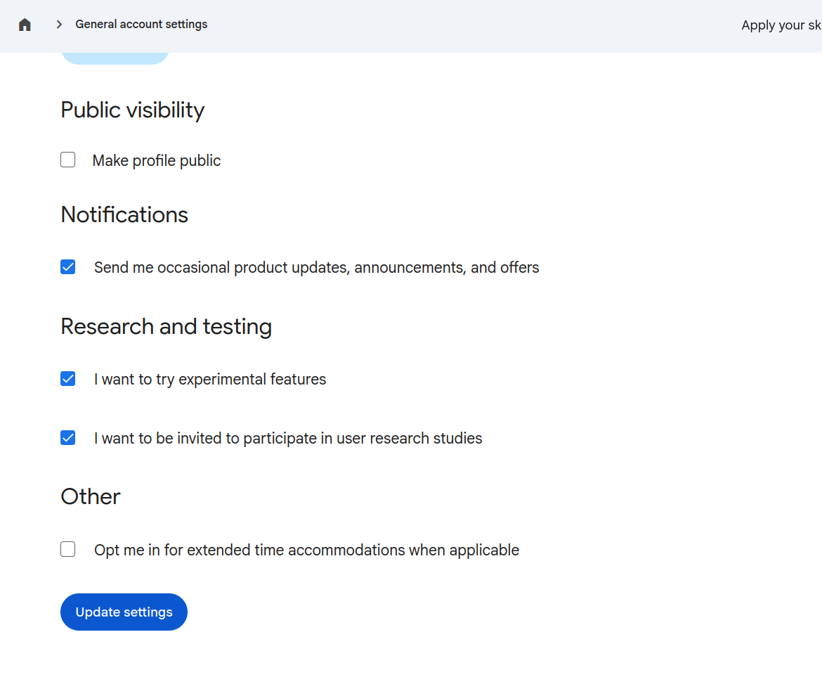
Step 4: Make your profile public
In Settings, scroll down to the Public visibility section so Google can verify your badges.
1
Tick Make profile public
Scroll down to Public visibility, then tick the checkbox in the first red box.
Mark this box
2
Click Update settings
Press the blue button at the bottom to save, marked with the second red box.
3
Your profile is now public
Your badges can now be verified.

Slide 6
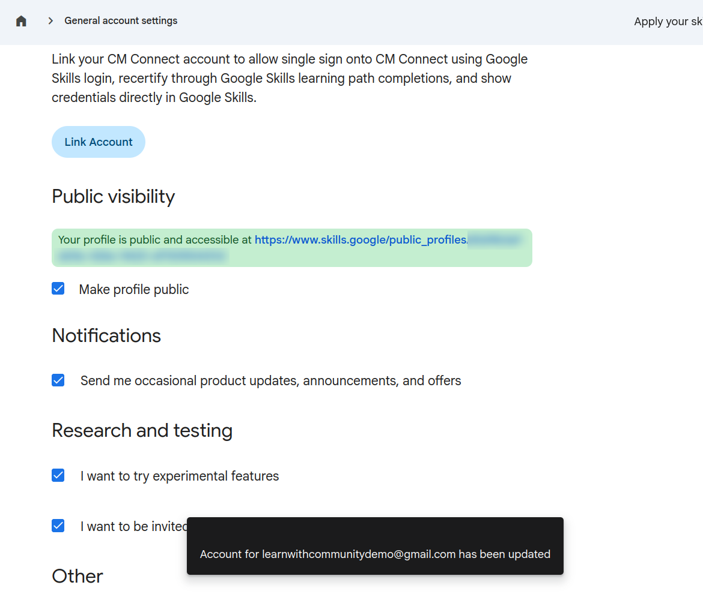
Step 5: Copy your public profile link
You need this link for the registration form, so save it before you move on.
1
Find your public link
A green box shows your profile link, marked with the red box.
2
Copy the link
Select the whole link and copy it.
3
Save it somewhere safe
Paste it in Notes or a message to yourself. You will need it soon.

Slide 7
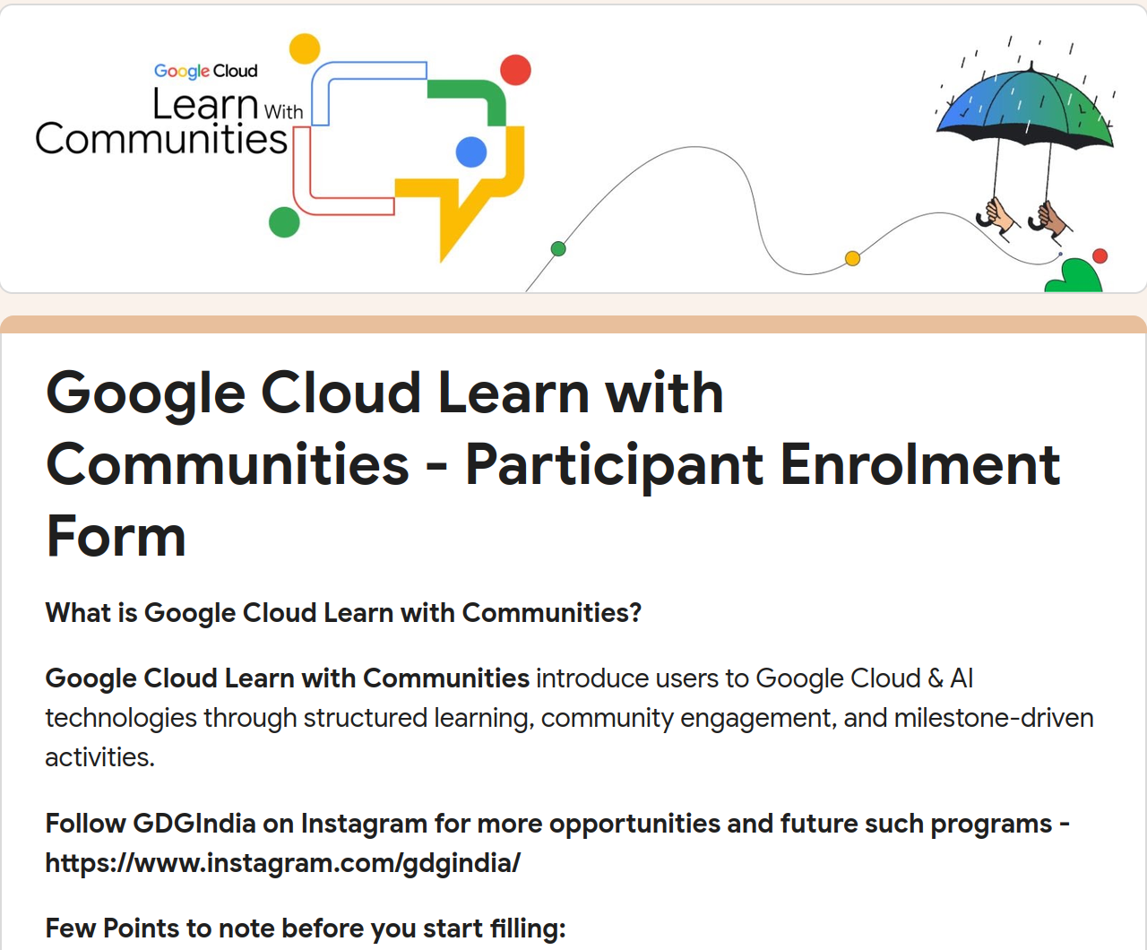
Step 6: Open the enrolment form
With your profile link saved, open the Participant Enrolment Form.
1
Open the form link
Open forms.gle/VDXwE13LoaNhA2VeA in your browser.
2
Check the form title
You should see Google Cloud Learn with Communities - Participant Enrolment Form.
3
Read before you fill
Read the points to note at the top, then start filling in the form.

Slide 8
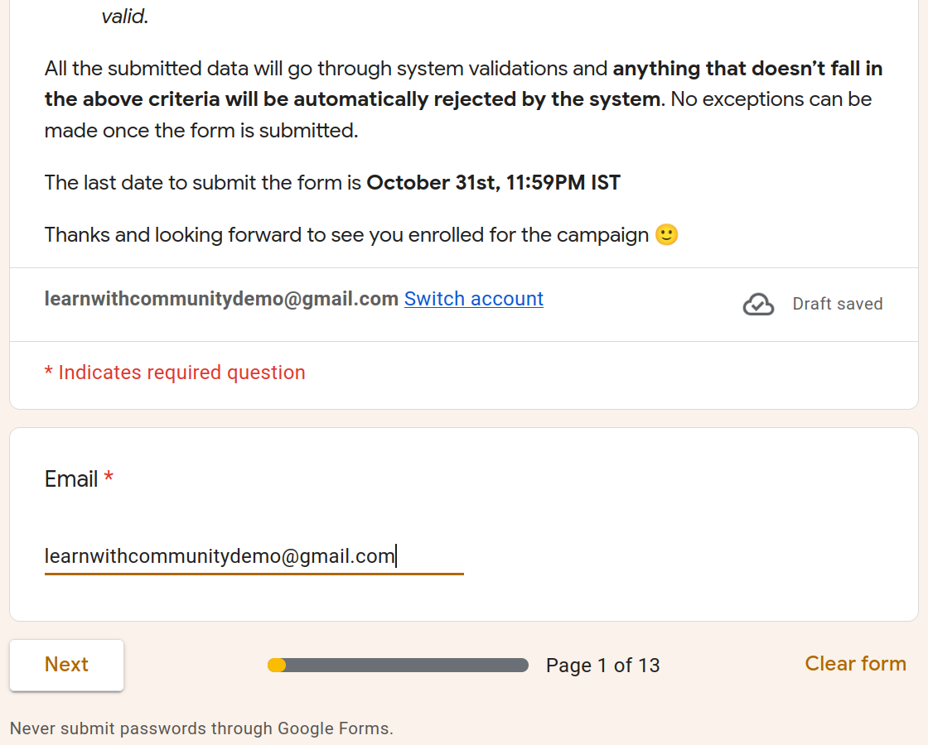
Step 7: Enter your email
Page 1 of 13: start with your email address.
1
Type your email
Enter the email of the fresh Google account you created, in the first red box.
2
Check it carefully
Make sure there are no typos, because Google emails your access code.
3
Click Next
Press Next, marked with the second red box, to go to the next page.

Slide 9
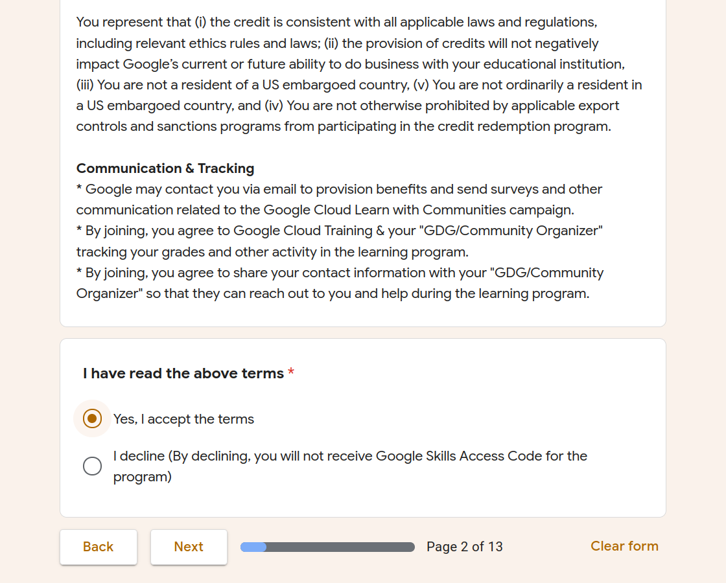
Step 8: Accept the terms
Page 2 of 13: read the terms, then accept them.
1
Read the terms
Read the terms above, including Communication and Tracking.
2
Accept the terms
Select Yes, I accept the terms, marked with the red box.
3
Click Next
If you decline you will not receive your Google Skills Access Code. Accept, then click Next.

Slide 10
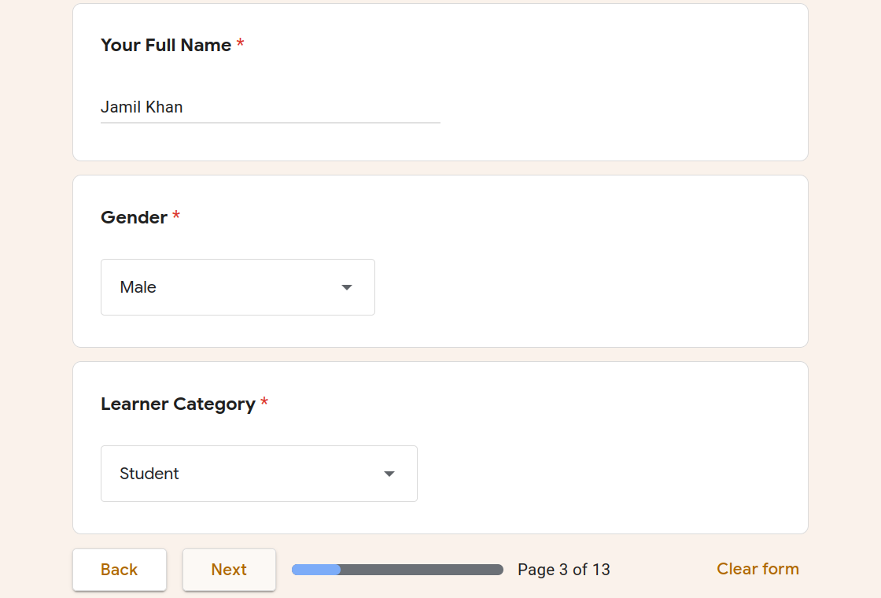
Step 9: Fill in your details
Page 3 of 13: three required fields, marked with red boxes.
1
Your full name
Type your full name in the first red box.
2
Gender
Open the dropdown in the second red box and choose your gender.
3
Learner category
Choose the option that fits you, such as Student, then click Next.

Slide 11
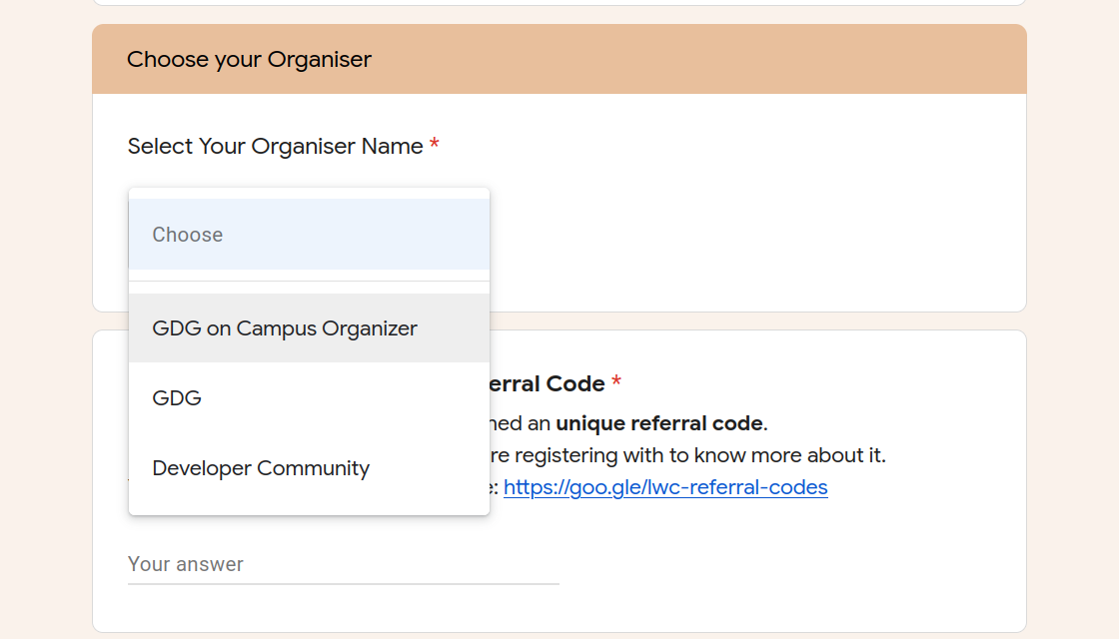
Step 10: Choose your organiser
Page 4 of 13: the most important page, so choose carefully.
1
Open the dropdown
Under Select Your Organiser Name, click the dropdown that says Choose.
2
Choose the first option
Select GDG on Campus Organizer, marked with the red box.
Important
3
Do not pick the others
Do not choose GDG or Developer Community.

Slide 12
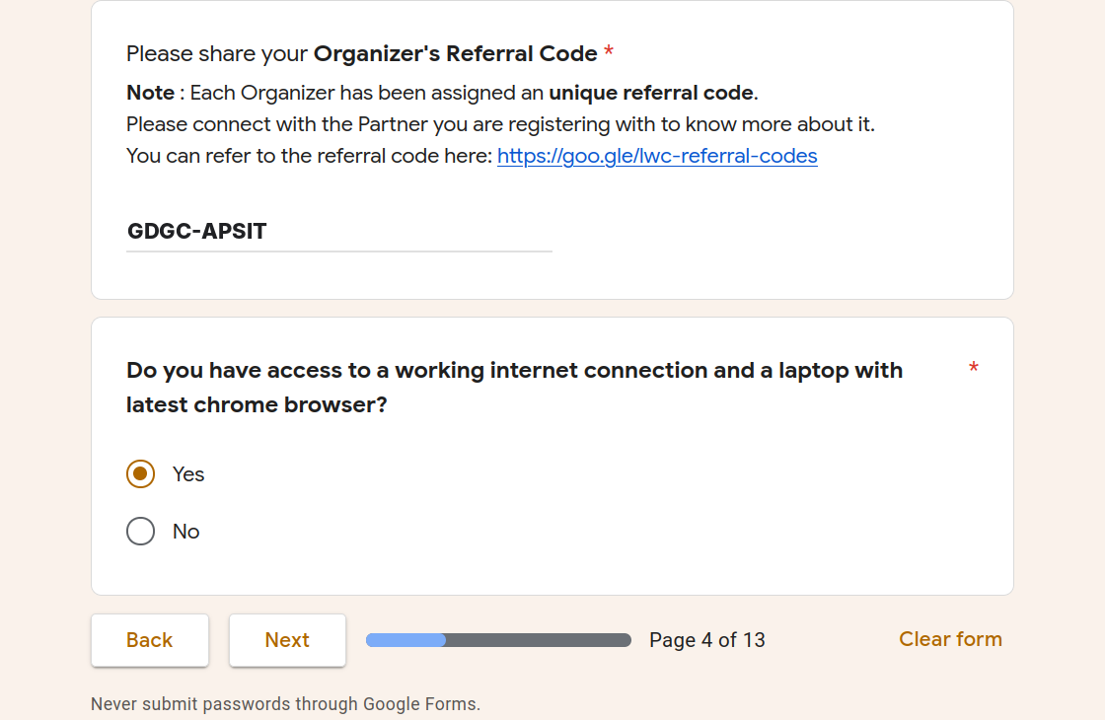
Step 11: Enter the referral code
Still on page 4: the code links your registration to GDG on Campus APSIT.
1
Click the answer box
Under Please share your Organizer's Referral Code, click the answer box.
Important
2
Type GDGC-APSIT
Type GDGC-APSIT exactly, in capitals with the hyphen, or you will not be credited.
3
Choose Yes, then click Next
Select Yes for the internet and laptop question, then click Next.

Slide 13
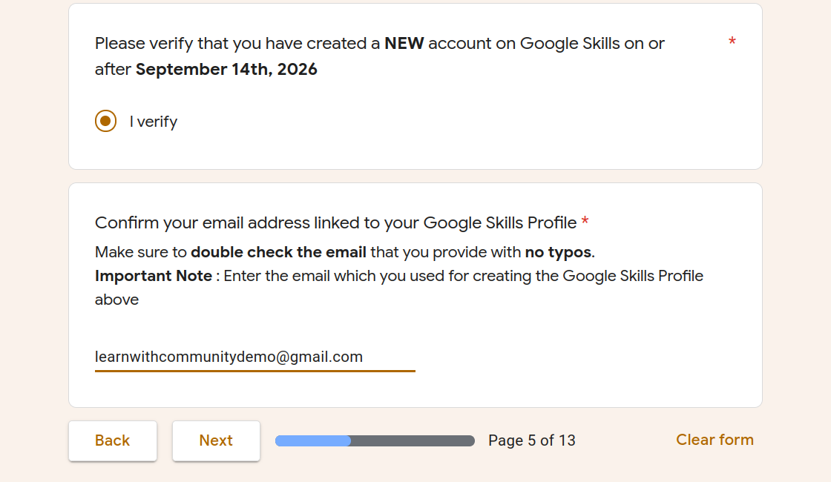
Step 12: Verify and confirm your email
Page 5 of 13: confirm your new Google Skills account.
1
Select I verify
Confirm you created a NEW Google Skills account on or after September 14th, 2026.
2
Enter your Google Skills email
Type the email you used for your Google Skills profile. Double check it for typos.
3
Click Next
Check the email once more, then press Next.

Slide 14
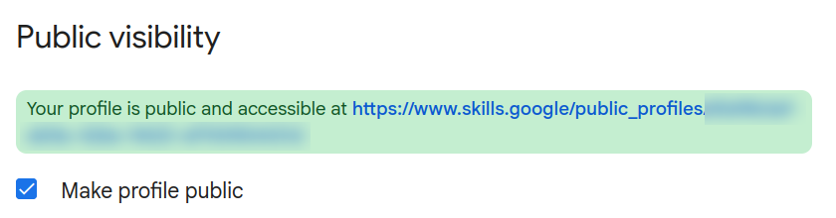
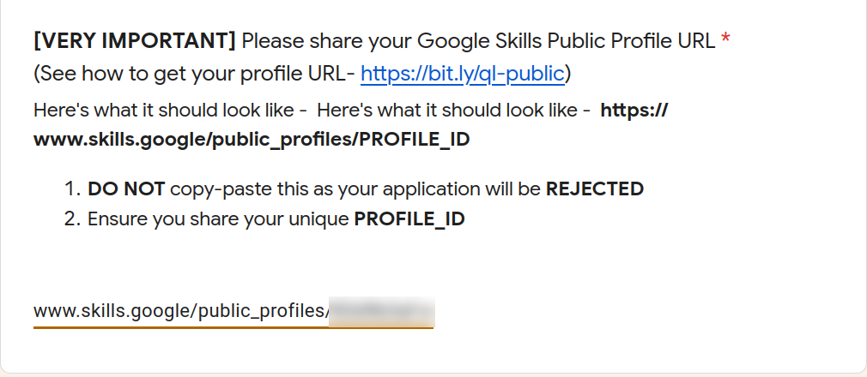
Step 13: Paste your public profile link
Page 6 of 13: use your own link, never ours.
1
Copy your own link
Go back to the green box from Step 5 (top picture) and copy YOUR profile link.
2
Paste it in the form
Paste it in the answer box (bottom picture) so it ends with your own unique ID.
3
Use your own, not ours
Our link is blurred on purpose. Copied links get rejected, so use only yours.

Slide 15
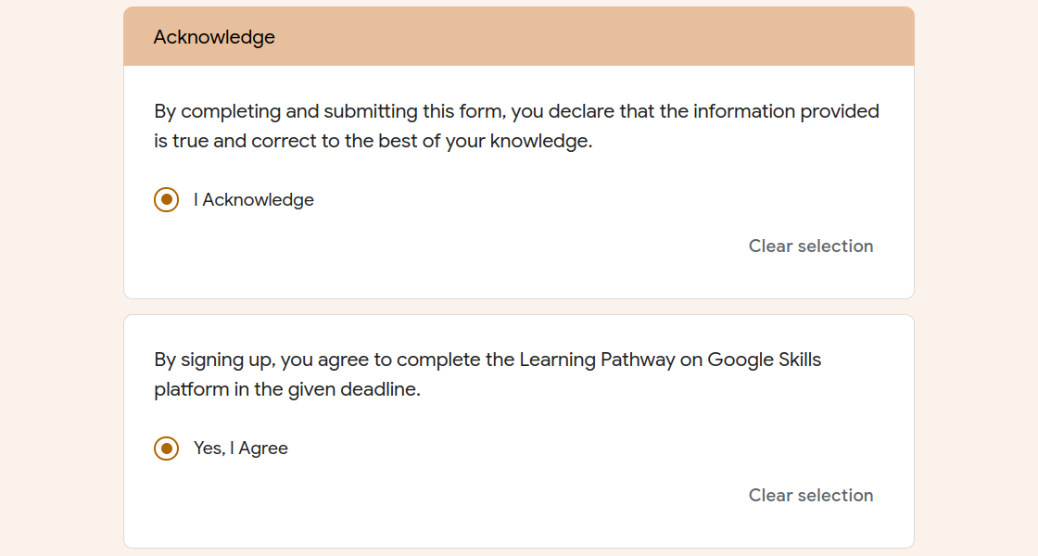
Step 14: Acknowledge the declarations
Pages 7 to 12 need no input: just click Next until you reach page 13.
1
Select I Acknowledge
Tick the first red box: the information you gave is true and correct.
2
Select Yes, I Agree
Tick the second red box: you agree to finish the Learning Pathway on time.
3
Scroll down
Read the Points to Note before you submit, shown on the next slide.

Slide 16
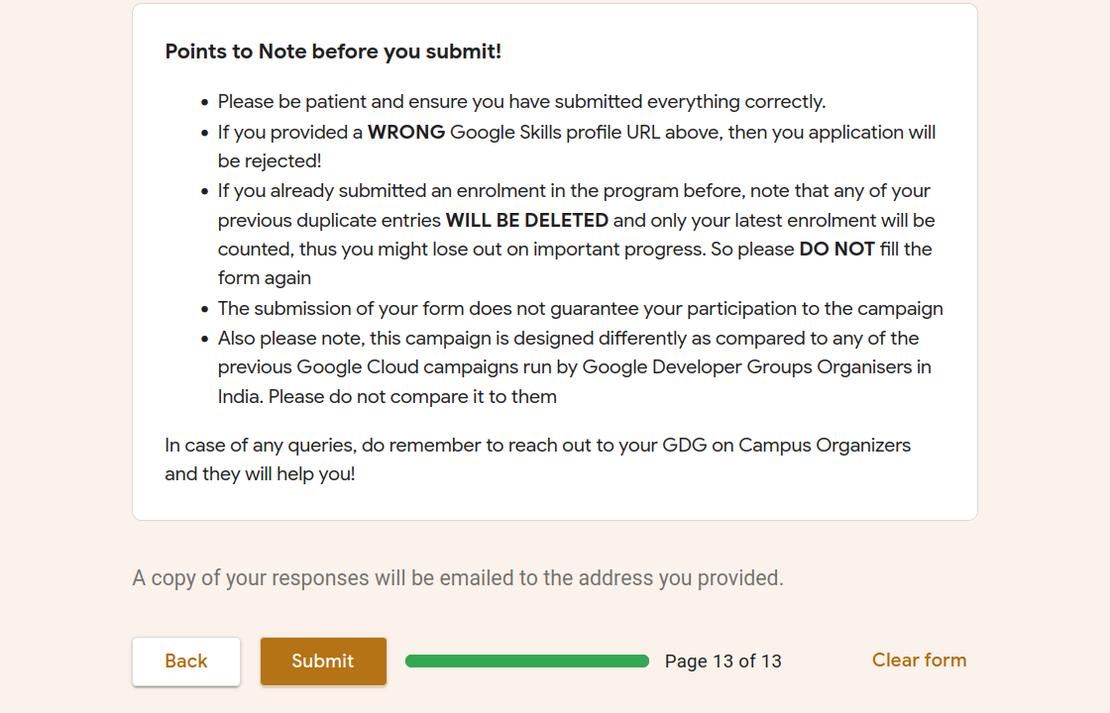
Step 15: Read the notes and submit
Check everything, then submit the form only once.
1
Read the points to note
A wrong profile URL gets you rejected. Submit only once: if you fill it again, earlier entries are deleted.
2
Click Submit
Press Submit (last red box) once all answers are correct. A copy is emailed to you.
3
Wait for your result
Submitting does not guarantee a seat. For queries, contact your GDG on Campus Organizers.

Slide 17
Part 1 complete!
Google Developer Groups on Campus · A. P. Shah Institute of Technology
Enrolment form submitted, now the second form
Well done! Next, check your inbox for the form receipt, then fill in the second form to confirm your seat. You are not finished yet.
Part 1 done
Check inbox
Then form 2
Not done yet

Slide 18
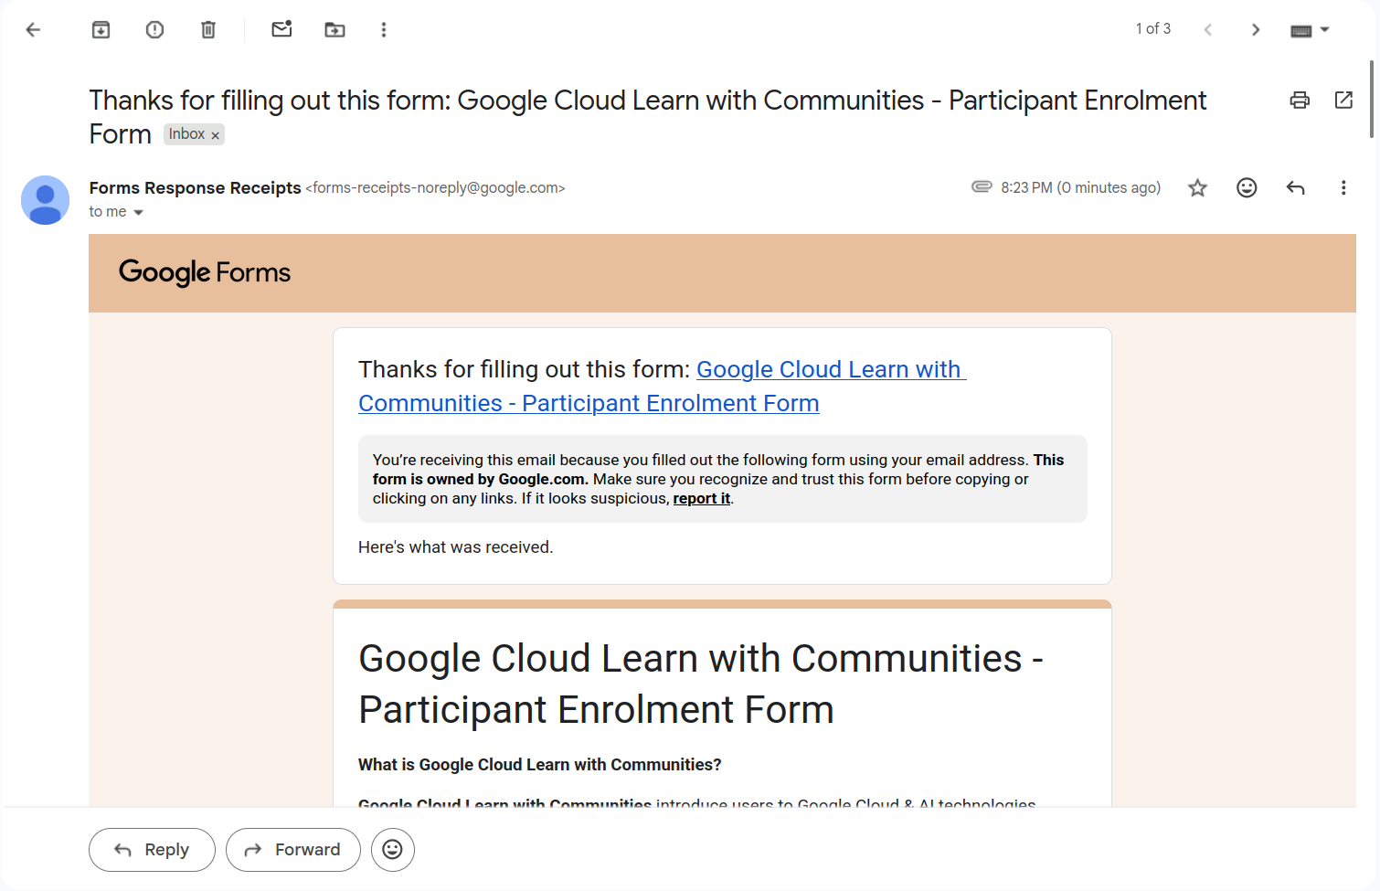
Step 16: Check your confirmation email
Your first form is done. Now look in your inbox.
1
Find the email
Look for Thanks for filling out this form from Forms Response Receipts.
2
Open it
It confirms your enrolment form was received.
3
Open the second form
This is the next step, shown on the next slide. It is mandatory.

Slide 19
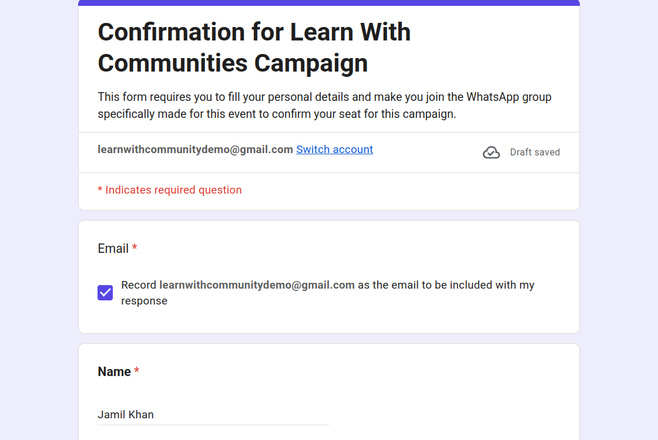
Step 17: Open the second form
This step is mandatory to confirm your seat for the Main event.
1
Open the second form
Open forms.gle/kkvPUmsR8FRjVuf47 in your browser.
2
Tick the email box
Keep the box ticked so your email is recorded with your response.
3
Enter your details
Type your full name, then fill in the questions below it.

Slide 20
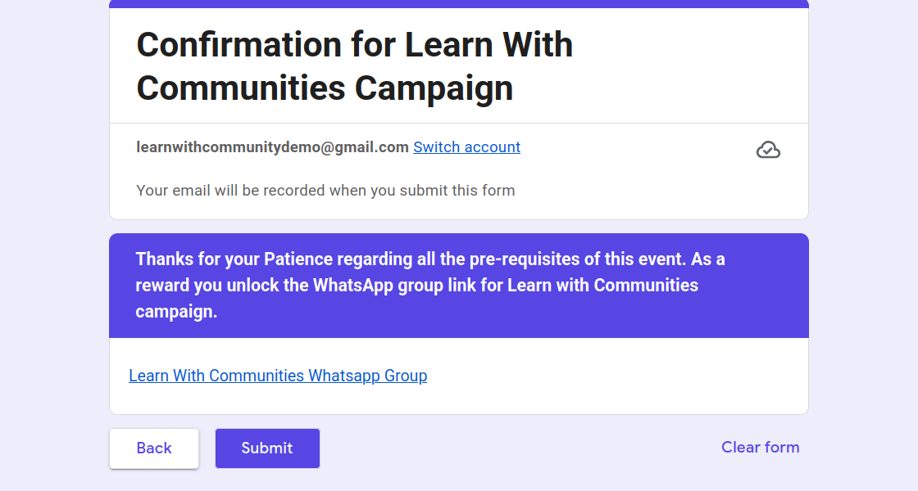
Step 18: Join WhatsApp and submit
The last page of the second form confirms your seat.
1
Open the WhatsApp group link
Click Learn With Communities Whatsapp Group and join the group.
2
Join the group
The form asks you to join the event WhatsApp group to confirm your seat.
3
Click Submit
Press Submit to finish the second form.

Slide 21



Congratulations, you're done!
Both parts are complete
Have any doubts in any step? Contact these people:
Jamil Khan
Nitish Jain
Sairaj Lad
+91 79000 46862
+91 820 080 1599
+91 98196 16475
Message on WhatsApp
Message on WhatsApp
Message on WhatsApp
Tap Message on WhatsApp to open a chat with them directly.

