Slide 1
Fund Finance Facility
Risk Monitor
An engineering view of lender-side credit logic
6 layers • 4 industry-standard upgrades • 14 tests

Slide 2
The problem
Why fund finance has no off-the-shelf library
▸ A bank lends to a private fund — secured by uncalled commitments (subscription line) or by NAV (NAV facility).
▸ Risk question is not 'will the market go up?' but 'how much can we safely lend, where is the binding constraint, and when do we act?'
▸ Stack is fragmented: borrowing base + credit scoring + concentration + liquidity + covenants + stress + triggers. No QuantLib equivalent.
▸ Common interview gap: candidates can talk LTV, but cannot defend why LTV is the wrong covenant to watch first.
▸ This project is a self-contained, modular re-implementation of the underwriting logic — designed to be explained, not productionised.
Design contribution
Six reusable sub-problems, each borrowing a mature open-source / industry pattern, recomposed into one engine.
Fund Finance Facility Risk Monitor | Synthetic data — illustrative only
2 / 12

Slide 3
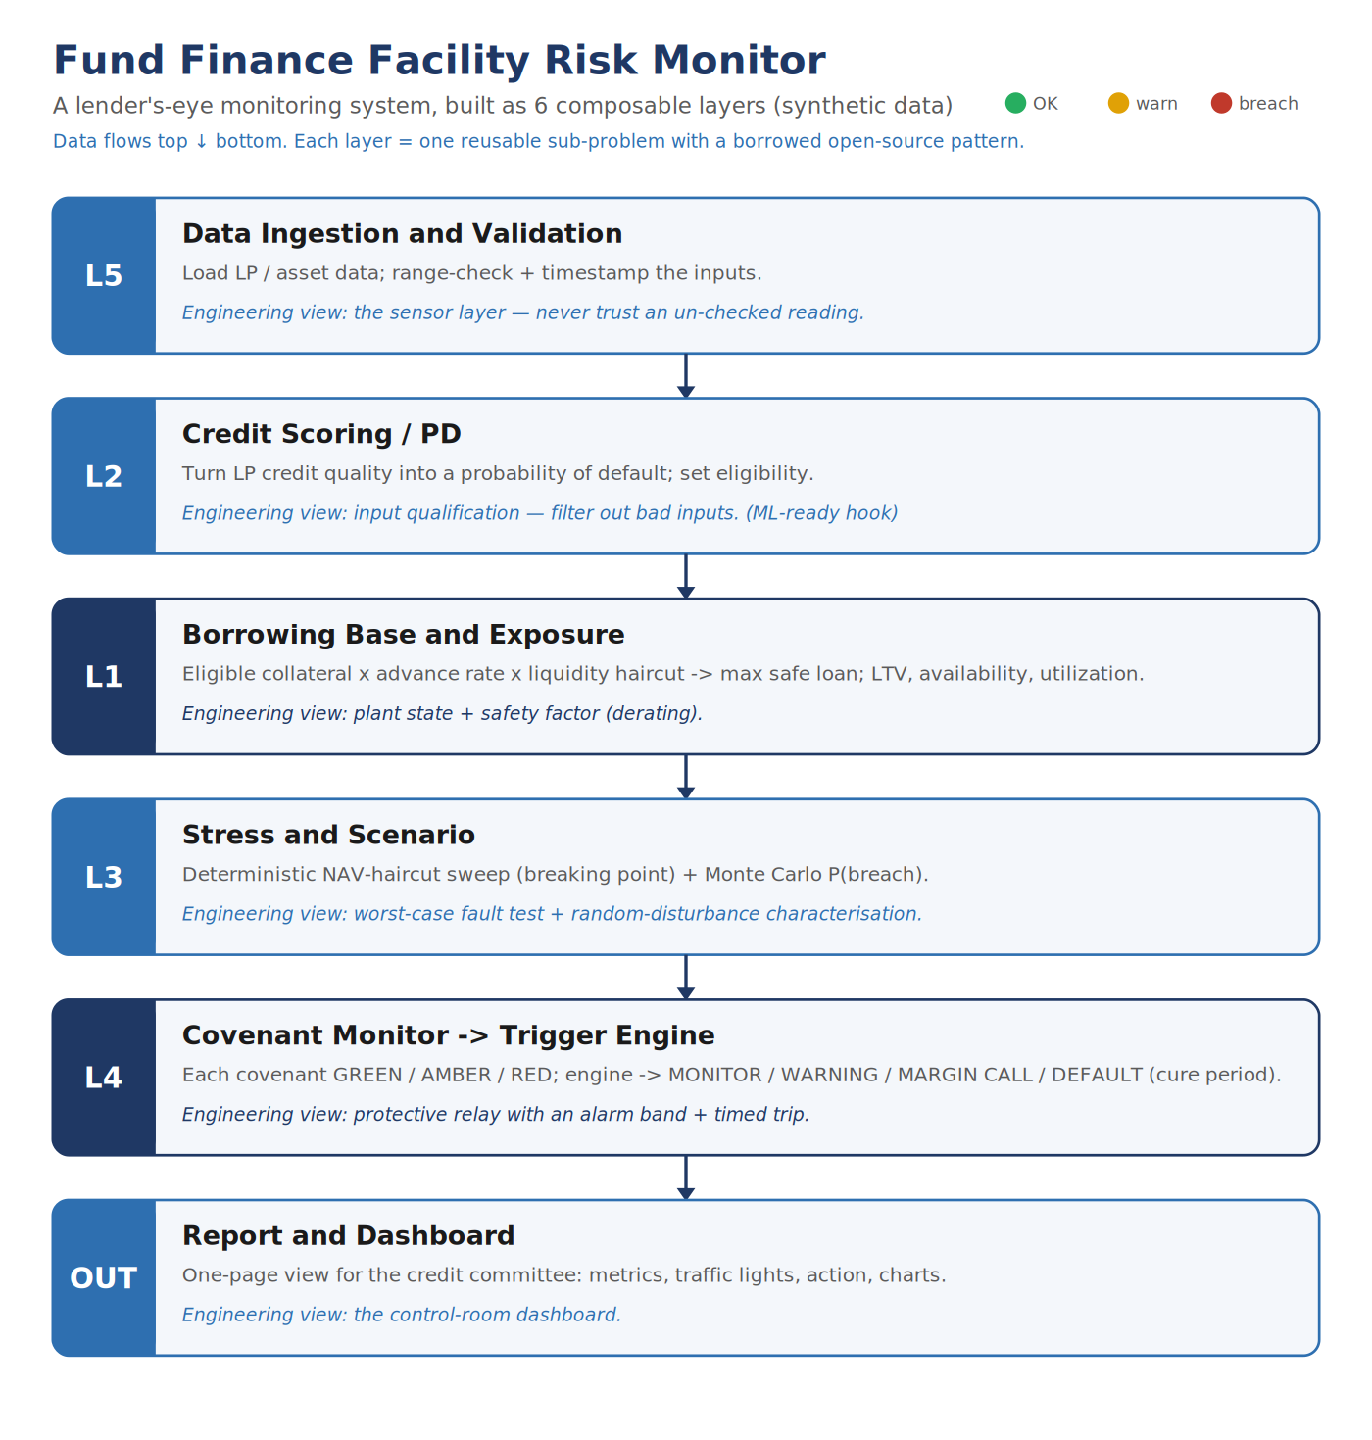
Architecture: six composable layers
Each layer borrows a mature open-source / industry pattern
# | Layer | Borrowed pattern
L5 | Data ingest + validation | Collateral-mgmt range checks
L2 | Credit / EL | Basel III IRB EL = PD × LGD
L1 | Borrowing base + HF | Aave / Compound Health Factor
L5 | Liquidity | Per-asset haircut by days-to-sell
L3 | Stress (3 views) | Sweep • reverse-per-covenant • multi-factor MC
L4 | Covenants + triggers | Protective-relay with HF-aware cure
Fund Finance Facility Risk Monitor | Synthetic data — illustrative only
3 / 12

Slide 4
Upgrade 1 — Basel III IRB expected-loss weighting
Continuous risk-weighted collateral, not a step function
Formula
Per-LP impact (sample fund)
EL = PD × LGD (Basel III IRB) weight = max(0, 1 − EL / EL_CAP)
LP | Rating | PD | LGD | EL | Weight
Pension Fund A | A | 0.50% | 40% | 0.20% | 0.98
Insurer B | AA | 0.20% | 35% | 0.07% | 0.99
Endowment C | BBB | 2.00% | 45% | 0.90% | 0.91
Family Office D | NR | 10.00% | 50% | 5.00% | 0.50
Why this matters
▸ v1: binary cliff at PD ≤ 3% — Family Office D excluded entirely.
▸ v2: continuous weight ∈ [0,1] — D contributes 50% (partial), B contributes 99%.
▸ Step changes in eligibility cause step changes in borrowing base.
▸ EE analogue: power-device derating curve, not bang-bang.
Subscription line BB
v1: 58.5 → v2: 65.7 (because D now contributes partially under continuous EL weighting)
Fund Finance Facility Risk Monitor | Synthetic data — illustrative only
4 / 12

Slide 5
Upgrade 2 — Health Factor (Aave / Compound DeFi)
One number, normalised, with a clear liquidation threshold at 1.0
Formula
Health Factor bands
HF = (effective_limit × liq_thresh) / drawn = (33.75 × 0.85) / 30 = 0.956
HF ≥ 1.5
GREEN — safe
1.0 ≤ HF < 1.5
Why this matters
AMBER — early warning
▸ Utilization has no distance concept — 89% does not tell you how far.
▸ HF is normalised: HF=1.0 is the liquidation threshold, period.
▸ Captures collateral × threshold × debt in one number — sample HF=0.956 → already in margin-call territory.
▸ EE analogue: stability margin (phase/gain margin).
HF < 1.0
RED — margin call → default in cure_days
Sample NAV facility today
HF = 0.956 → RED → MARGIN CALL HF-aware cure window = 5 days (vs 10 negotiated)
Fund Finance Facility Risk Monitor | Synthetic data — illustrative only
5 / 12

Slide 6
Upgrade 3 — Multi-factor Monte Carlo (MSCI Barra style)
Sector correlations + VaR + CVaR + per-sector attribution
What changed
Sample run — NAV facility, 6-month horizon
▸ v1: single lognormal × all assets (implicit: sectors 100% correlated).
▸ v2: 10-dim multivariate lognormal with MSCI-Barra-style correlation.
▸ Vectorised with numpy — ~100× speedup vs Python loop.
▸ Adds VaR(95), CVaR(99) and per-sector attribution.
Metric | v1 (single shock) | v2 (multi-factor)
P(LTV breach) | 22% | 0.0%
VaR(95) of LTV | (n/a) | 19.4%
CVaR(99) of LTV | (n/a) | 22.1%
LTV p50 | 16.5% | 15.7%
LTV p99 | 26.8% | 21.2%
Sector attribution | (n/a) | Tech 49% / Fin 41% / Ind 32%
Two numbers, two stories
▸ P(LTV breach) drops 22% → 0% — diversification is now real.
▸ But CVaR(99) of LTV = 22.1%, glued to the 25% covenant cap.
▸ Single-shock MC hid both findings under one P(breach) number.
EE analogue: cross-PSD noise analysis — each sector has its own variance, off-diagonal coupling describes how they move together.
Fund Finance Facility Risk Monitor | Synthetic data — illustrative only
6 / 12

Slide 7
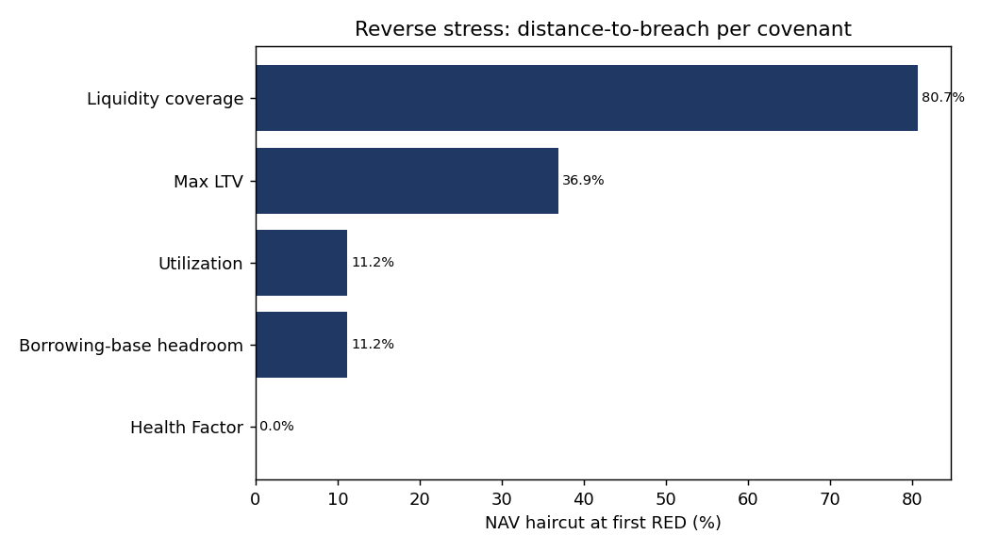
Upgrade 4 — Reverse stress per covenant (Basel SR 11-7)
Distance-to-breach ranked across every covenant — stability margin per loop
Algorithm
▸ Bisection on NAV haircut for every covenant.
▸ O(covenants × log(1/tol)) — fast even at scale.
▸ Returns the smallest haircut that flips each covenant to RED.
Headline finding (sample fund)
▸ Health Factor binds today (0% haircut).
▸ BB and Utilization both at 11.2% NAV drop.
▸ Max LTV at 36.9% — 25 percentage points further away.
▸ Asset / sector concentration are invariant under uniform NAV drop (need single-sector shock).
Fund Finance Facility Risk Monitor | Synthetic data — illustrative only
7 / 12

Slide 8
Sample run — NAV facility on Project Alpha Fund
Four eligible LPs, five sector-diverse assets, intentionally tight
Facility state today
Distance-to-breach ranking
Metric | Value | Status
Borrowing base | 33.75 | after liquidity haircut
Drawn | 30.00
Availability | 3.75 | very tight
Utilization | 88.9% | AMBER
LTV | 15.8% | well under 25% cap
Health Factor | 0.956 | RED — margin call
Liquidity coverage | 5.17x | GREEN
Rank | Covenant | Breaks at NAV drop
1 | Health Factor | 0.0% ← BINDING TODAY
2 | BB headroom | 11.2%
3 | Utilization | 11.2%
4 | Max LTV | 36.9%
5 | Liquidity coverage | 80.7%
— | Asset / sector / #assets | never under uniform haircut
Binding constraint is the Health Factor — not the LTV. Without reverse stress per covenant you would miss this.
Fund Finance Facility Risk Monitor | Synthetic data — illustrative only
8 / 12

Slide 9
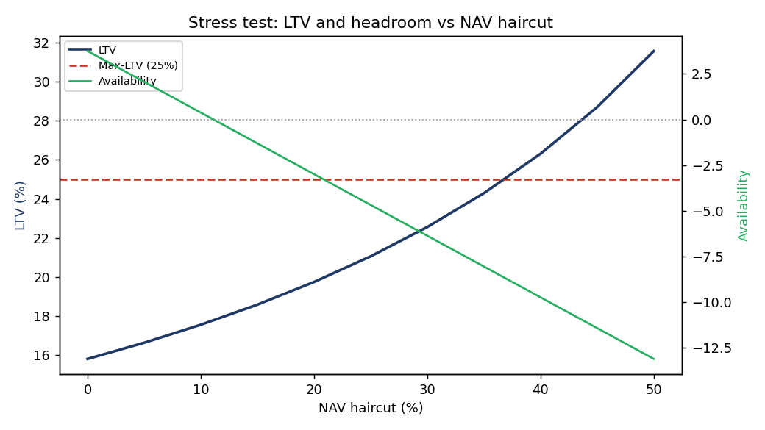
Three stress views, one engine
Step input, ramp input, noise input — through the same plant
Deterministic sweep — LTV and availability vs NAV haircut
Reverse stress — distance-to-breach per covenant
Multi-factor MC adds the third view: probability of breach, VaR(95), CVaR(99) and which sector is driving the tail. Three independent views; never trust one alone.
Fund Finance Facility Risk Monitor | Synthetic data — illustrative only
9 / 12

Slide 10
Engineering ↔ fund finance isomorphism
Why an EE perspective is structural, not decorative
Fund-finance concept | EE concept | Same problem solved
Advance rate | Derating factor | Margin against operating point
EL weight (PD × LGD) | Continuous gain function | Avoid step changes in main loop
Liquidity haircut | Bandwidth-limited signal | Discount slow / noisy inputs
Borrowing base | Plant capacity estimate | Safe operating envelope
Health Factor | Stability margin | Normalised distance to instability
Covenant alarm (AMBER) | Pre-trip alarm | Detect before fault
Covenant breach (RED) | Trip threshold | Open the breaker
Cure period | Time-graded trip delay | Avoid nuisance trips
HF-aware cure (shorter when worse) | Inverse-time overcurrent relay | Faster trip closer to fault
Reverse stress per covenant | Per-loop stability margin | Find the weakest loop
Multi-factor MC attribution | Cross-PSD noise analysis | Decompose disturbance source
Margin call → default | Two-stage breaker | Graduated protection
Fund Finance Facility Risk Monitor | Synthetic data — illustrative only
10 / 12

Slide 11
30-second pitch
"I built a fund-finance facility risk monitor. Because fund finance is a fusion problem with no ready library, I decomposed it into six layers — data validation, a Basel-IRB-style expected-loss weighting on subscription collateral, a borrowing base with an Aave-style Health Factor, reverse-stress-per-covenant ranking, and a multi-factor Monte Carlo with sector correlations giving VaR and CVaR. My EE background means I treat each piece as one part of a feedback control system: covenants are protective relays with an alarm band and a timed trip, the advance rate is a derating curve not a cliff, the Health Factor is a stability margin, and reverse stress is per-loop stability ranking. One result on the synthetic fund: a single-shock Monte Carlo says 22% breach probability; the multi-factor Monte Carlo says effectively zero — but CVaR(99) on LTV is still 22%, right at the covenant. Two views, two stories, both true. A lender’s view: protect principal, rank constraints, don’t forecast returns."

Slide 12
Ways to extend
Roadmap items, each with a known open-source / industry anchor
Trained PD model
Replace rating-table lookup with logistic regression or XGBoost trained on borrower features — interface already exposed at credit_scoring.estimate_pd.
Multi-period MC
Daily random-walk over the horizon; demonstrates the HF-aware cure window numerically; matches CCAR base / adverse / severe scenario libraries.
LP-default scenarios
drop_lp() helper plus reverse-stress engine → 'what NAV drop breaks each covenant if LP X defaults?'
Per-sector reverse stress
Single-sector shock instead of uniform haircut → asset / sector concentration covenants become reachable.
Streamlit / FastAPI dashboard
Same engine, web UI, live re-calculation per facility, ranked daily.
Historical calibration
Estimate sector vols and correlations from real PE-fund NAV history; replace MSCI-Barra approximations.
Fund Finance Facility Risk Monitor | Synthetic data — illustrative only
12 / 12

