Slide 1
FIRST LOOK
A power-electronics
risk lens on NAV facilities
Why "power electronics" is four different credits, and how sub-sector decomposition changes the covenant-breach picture for 2026 NAV / hybrid facilities.
Jiawen Cc
EE M.Sc. candidate, Politecnico di Milano
Prepared for UniCredit CIB · Fund Financing
June 2026

Slide 2
01 · EXECUTIVE SUMMARY
One page, three claims
2026 fund finance is shifting toward NAV and hybrid facilities — and the next underwriting bottleneck is sector-specific risk modelling on concentrated portfolios.
01
“Power electronics” is internally heterogeneous. EV powertrain, data-center power, renewables and industrial drives behave like four different credits — listed comparables in 2024–26 ranged from −75% to +280%.
02
A small Python sensitivity model makes the gap visible: at 50% initial LTV, EV-heavy tilts breach a 65% covenant under stress; data-center heavy tilts don't. Single-bucket haircuts can't see the line.
03
UniCredit Fund Financing · First Look · Jiawen Cc · Polimi EE M.Sc. · June 2026
2 / 13

Slide 3
02 · THE 2026 SETUP
NAV financing has moved from niche to core
What changed
NAV financing is now described by the Fund Finance Association as a "core liquidity solution across private markets" — driven by extended exit timelines and evolving LP expectations.
Hybrid facilities (sub-line + NAV) are gaining ground specifically because they handle concentrated portfolios better than single-collateral structures.
Ropes & Gray's 2026 outlook is explicit on the growth area: "greater sector specialisation and broader adoption across geographies and asset classes."
THE IMPLICATION
Lenders increasingly need underwriting capability that can read the underlying technology cycle — not just pull a sector haircut from a table.
Sources: Macfarlanes (15th FFA Symposium); Ropes & Gray (2026 outlook); Norton Rose Fulbright (hybrid facilities); Funds Europe (NAV financing).
UniCredit Fund Financing · First Look · Jiawen Cc · Polimi EE M.Sc. · June 2026
3 / 13

Slide 4
03 · THE SECTOR ARGUMENT
“Power electronics” is four different credits
A NAV facility against a fund 60% concentrated in EV powertrain is a fundamentally different credit than one 60% concentrated in data-center power —
even though both fall under the same investment-policy category.
SUB-SECTOR
DEMAND DRIVER
CYCLICALITY
CUSTOMER CONCENTRATION
EV powertrain
Consumer auto cycle
High, consumer-led
5–10 OEM buyers
Data-center power
Hyperscaler AI capex
Lumpy super-cycle
3–5 hyperscalers
Renewable power conv.
Subsidy + tariff regime
Policy-driven
Utilities + EPCs
Industrial drives
Industrial CapEx / IIoT
Mid-cycle, defensive
Fragmented
UniCredit Fund Financing · First Look · Jiawen Cc · Polimi EE M.Sc. · June 2026
4 / 13

Slide 5
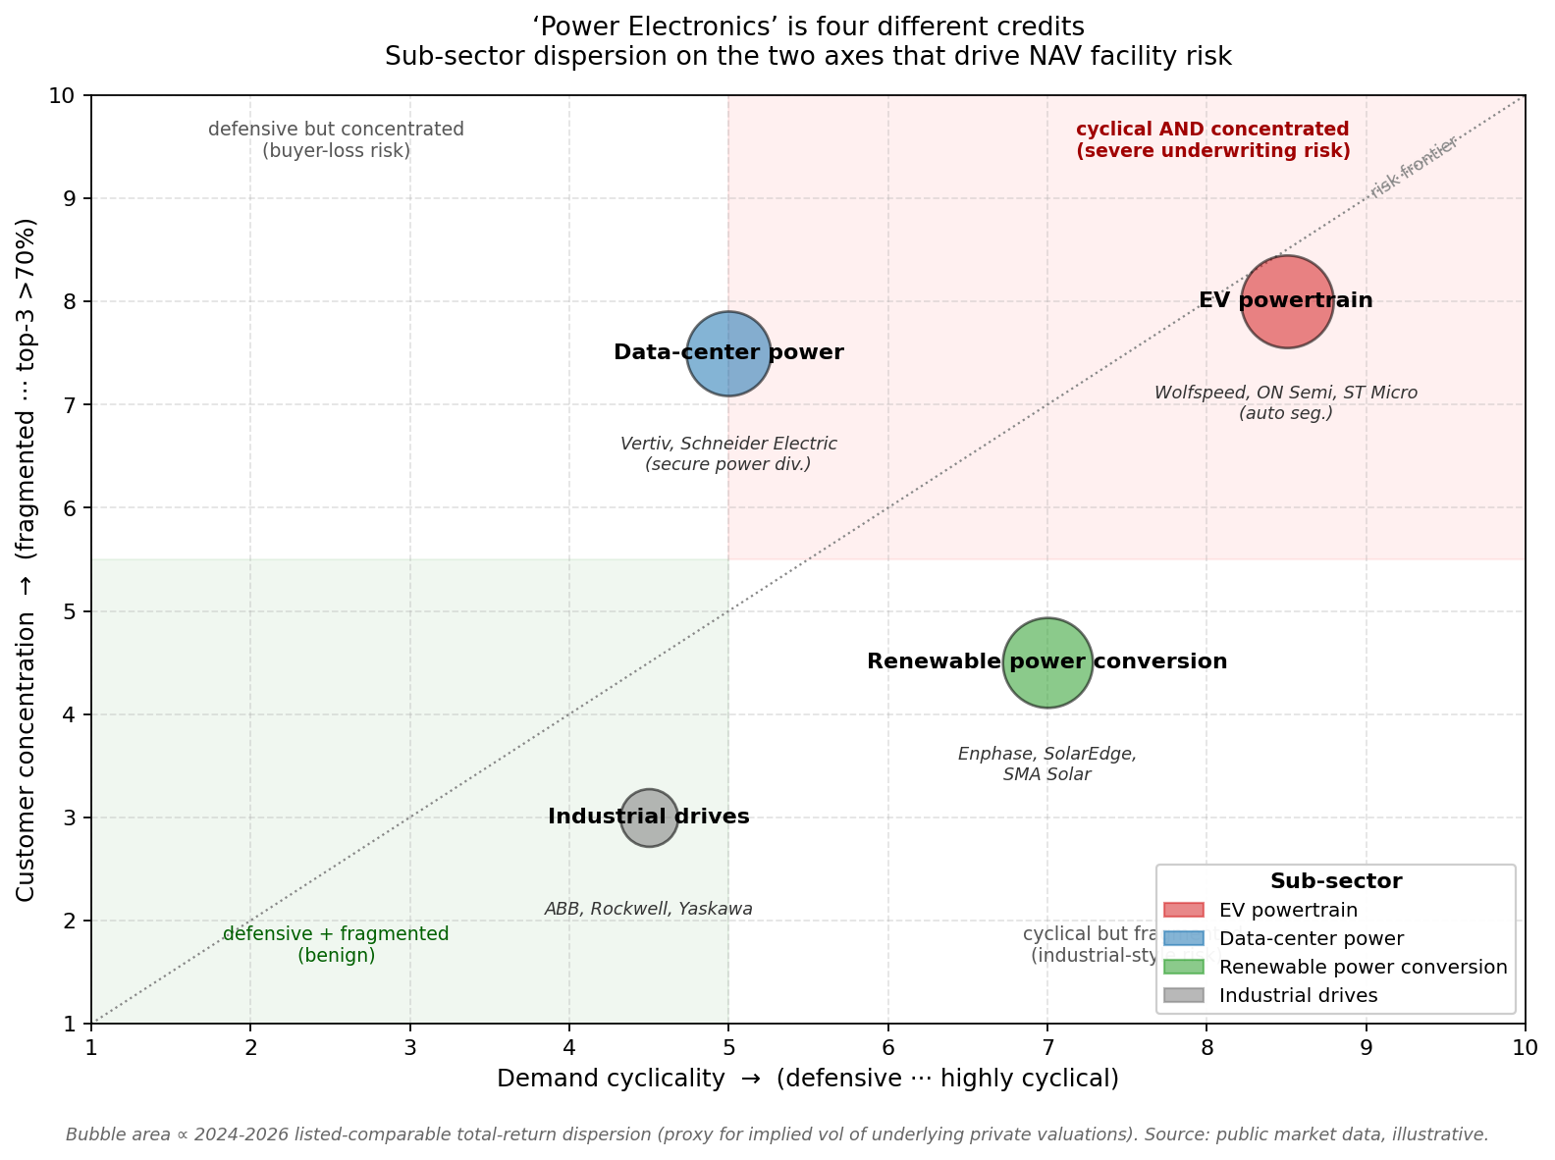
03 · THE SECTOR ARGUMENT (CONT.)
Sub-sectors on the axes that drive NAV facility risk
HOW TO READ
X-axis: demand cyclicality. Defensive (left) → highly cyclical (right).
Y-axis: customer concentration. Fragmented (bottom) → top-3 buyers >70% of revenue (top).
Bubble size: 2024–26 listed-comparable total-return dispersion (proxy for implied vol of private valuations).
EV powertrain sits in the worst quadrant — cyclical AND concentrated. It is the underwriting risk most likely to be mispriced under a single-sector haircut.
UniCredit Fund Financing · First Look · Jiawen Cc · Polimi EE M.Sc. · June 2026
5 / 13

Slide 6
04 · EMPIRICAL REALITY CHECK
2024–2026 listed comparables: a 350-point spread
LISTED COMPARABLE
SUB-SECTOR
2024–26 RETURN
Wolfspeed
EV powertrain (SiC)
≈ −70%
ON Semiconductor
EV powertrain
≈ −40%
Vertiv Holdings
Data-center power
≈ +280%
Schneider Electric
Data-center power (secure power div.)
≈ +60%
Enphase Energy
Renewable power conv.
≈ −75%
ABB
Industrial drives
≈ +25%
The dispersion is the point. Two listed names labelled “power electronics” returned −75% and +280% in the same window — a 350-point gap. Any underwriting model that aggregates them is, by construction, blind.
UniCredit Fund Financing · First Look · Jiawen Cc · Polimi EE M.Sc. · June 2026
6 / 13

Slide 7
05 · THE MODEL
Sensitivity setup: same fund, two facility regimes
BENIGN
AGGRESSIVE
Initial LTV 30%
Initial LTV 50%
NAV USD 500M
Facility USD 150M
Covenant LTV 65%
NAV USD 500M
Facility USD 250M
Covenant LTV 65%
SUB-SECTOR STRESS ASSUMPTIONS
EV powertrain
−35%
Calibrated to Wolfspeed / ON Semi (auto) 2024–26 drawdowns, dampened for private mark lag.
Data-center power
−10%
Mild — secular AI-capex tailwind. Vertiv / Schneider returns positive.
Renewable power
−30%
Policy + oversupply shock. Enphase / SolarEdge as anchors.
Industrial drives
−10%
Mid-cycle baseline. ABB / Rockwell range stable.
UniCredit Fund Financing · First Look · Jiawen Cc · Polimi EE M.Sc. · June 2026
7 / 13

Slide 8
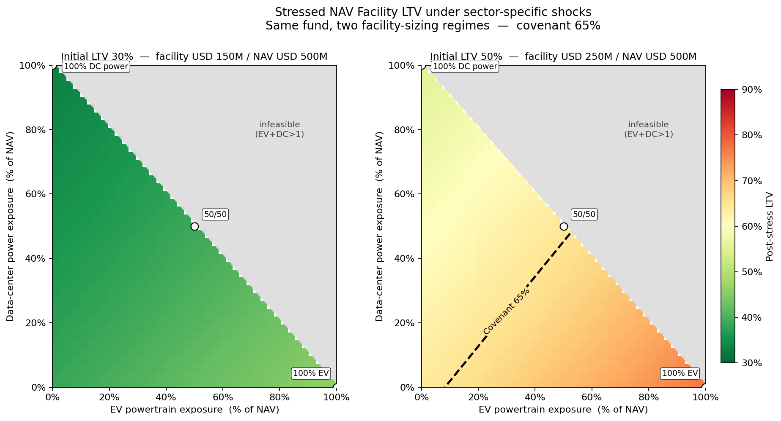
06 · RESULTS
Stressed LTV — same fund, two facility regimes
READ THE DASHED LINE
Left: no tilt breaches the 65% covenant. Right: the covenant contour cuts the feasible region — every portfolio lower-right of the dashed line is in breach. Same fund, same shocks; only the facility size changed.
UniCredit Fund Financing · First Look · Jiawen Cc · Polimi EE M.Sc. · June 2026
8 / 13

Slide 9
07 · PUNCHLINE
Reference portfolios — the dispersion in numbers
PORTFOLIO
DRAWDOWN
STRESSED NAV
LTV @ 30% INITIAL
LTV @ 50% INITIAL
100% EV powertrain
−35.0%
USD 325M
46.2%
76.9% BREACH
100% data-center power
−10.0%
USD 450M
33.3%
55.6%
Diversified (25/25/25/25)
−21.25%
USD 393.75M
38.1%
63.5%
01
02
03
At 30% initial LTV, no tilt breaches. Conservative facility sizing absorbs every shock.
At 50% initial LTV, EV-heavy tilts breach by ~12 points. Data-center heavy tilts stay 9 points inside.
Diversified 25/25/25/25 sits 1.5pp below covenant — safe on paper, fragile in practice. A 5pp extra EV tilt breaches.
UniCredit Fund Financing · First Look · Jiawen Cc · Polimi EE M.Sc. · June 2026
9 / 13

Slide 10
08 · HONEST LIMITS + ROADMAP
What the model is not — and what comes next
WHAT THIS MODEL IS NOT
WHAT I'D BUILD NEXT
Not a production NAV pricing model. No real advance rates, no redetermination logic, no recovery modelling.
Stress numbers are illustrative anchors calibrated from listed comparables — not consensus haircuts.
Cross-sub-sector correlation is implicitly zero. In practice EV and data-center are partially correlated through rates.
Workout mechanics for NAV facility defaults are not modelled — this is pre-recovery LTV.
Correlation block — at minimum a two-factor decomposition: rate sensitivity and AI-capex sensitivity.
Dynamic advance-rate redetermination, so a stress event triggers a borrowing-base reduction before the covenant breaches.
Extend to hybrid facilities — let the undrawn subscription line act as a fallback rail when NAV LTV drifts toward covenant.
Replace listed-comparable calibration with realised PE marks (your team has these; I don't).
UniCredit Fund Financing · First Look · Jiawen Cc · Polimi EE M.Sc. · June 2026
10 / 13

Slide 11
09 · METHODOLOGY TRANSFER
The reflex extends beyond power electronics
THESIS
The decomposition reflex is not specific to power electronics. Three sketches — sectors where the same approach applies, deliberately without numbers to avoid claiming expertise I don't yet have.
Semiconductors
Medical devices
Grid modernisation
AI-era semis PE fund
Surgical / interventional medtech PE
T&D / electrification PE fund
GPU / AI accelerators — hyperscaler concentration
ASIC specialists — per-customer design cycle
Advanced packaging (CoWoS / HBM) — capacity premium
Lithography & deposition (ASML, Applied, Lam) — oligopoly
Mature-node foundries — defensive baseline
Surgical robotics — 7–10y replacement cycles
Disposables & instruments — recurring, GMP moat
Digital surgery / workflow software — SaaS-like
Interventional cardiology — FDA-pipeline timing
Diagnostic imaging — reimbursement-code dynamics
T&D equipment — 2–4y lead-time crisis premium
Grid-scale storage integrators — queue-dependent
DERMS / utility software — recurring + integration
EV charging infrastructure — utilisation × policy
Interconnection / EPC services — queue management
STRESS DISPERSION FROM:
STRESS DISPERSION FROM:
STRESS DISPERSION FROM:
Customer concentration × process-node × capex-cycle
FDA timing × hospital capex × reimbursement codes
Utility capex × policy × queue length × lead-time
I can sketch the framework — calibrating any of these to covenant-relevant numbers needs the desk's private NAV marks. The reflex is the asset; calibration is the conversation.
UniCredit Fund Financing · First Look · Jiawen Cc · Polimi EE M.Sc. · June 2026
11 / 13

Slide 12
10 · ABOUT ME
An engineer applying to a non-engineering seat
BACKGROUND
WHAT I BRING
EE M.Sc. candidate at Politecnico di Milano, technical concentration in power electronics and control.
Most recent project: EMI filter design for a switched-mode converter — direct hands-on exposure to the components and end-markets PE capital is currently flowing into.
Why fund finance, why now: the analytical reflexes from EE — sensitivity, decomposition, stress testing — are the same ones NAV underwriting needs. And the sectors where NAV facilities are growing fastest in 2026 are exactly the ones where engineering literacy at the desk would differentiate the bank.
Engineering depth in power electronics
Python + sensitivity-analysis fluency
Reflex for decomposing concentrated risk
Willingness to admit what I don't know
WHAT I DON'T (YET)
Transaction experience on NAV deals
Legal / credit-document grammar
Workout mechanics of facility breaches
Desk-level pricing conventions
UniCredit Fund Financing · First Look · Jiawen Cc · Polimi EE M.Sc. · June 2026
12 / 13

Slide 13
THANK YOU
Happy to walk through the model live —
or step back honestly if it isn't the right fit.
Jiawen Cc · Jiawen.Cc@outlook.com
EE M.Sc. candidate · Politecnico di Milano
Source code + page + interview prep: Desktop/UniCredit-FundFinancing-Application/

