Slide 1
Activity Diagrams
Practices and Structures in SYD466

Slide 2
Introductory Notes
Activity Diagrams are very flexible and there are many ways to design a system
In the interests of making it more streamlined to learn and work with, we have a single set of standard structures that we will be using in the Systems stream.
You may notice different structures and patterns in other examples. This is fine, systems are complex and unique!

Slide 3
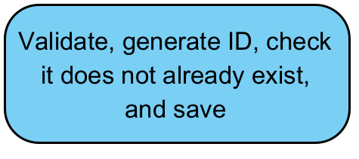
Actions
Should be unique
Should be meaningful
Should be atomic – do not try to do too much in one action

Slide 4
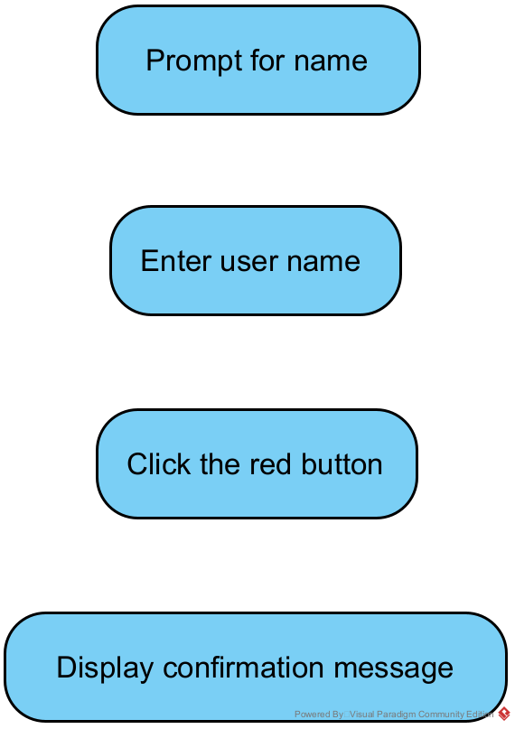
Actions to avoid
While there are exceptions, generally try to avoid the following:
Prompts – largely unnecessary, they are not usually meaningful actions
Data entry – unless it’s involving system interaction or otherwise complex, avoid it
UI – almost never necessary. Leave it to the UI designer!
Displays – a subset of UI. Rarely needed.

Slide 5
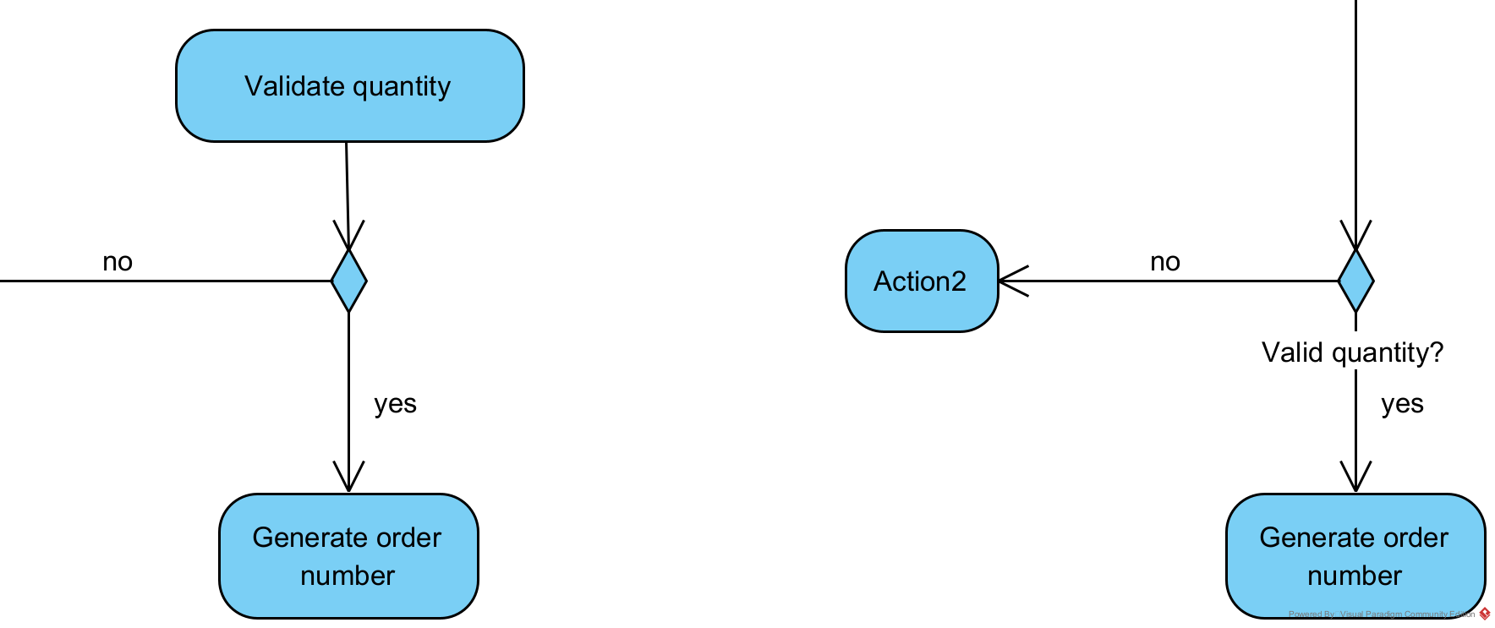
Decisions
Decisions must have only two paths leading out – a true/yes and a false/no
Decisions may be used instead of a simple action
=

Slide 6
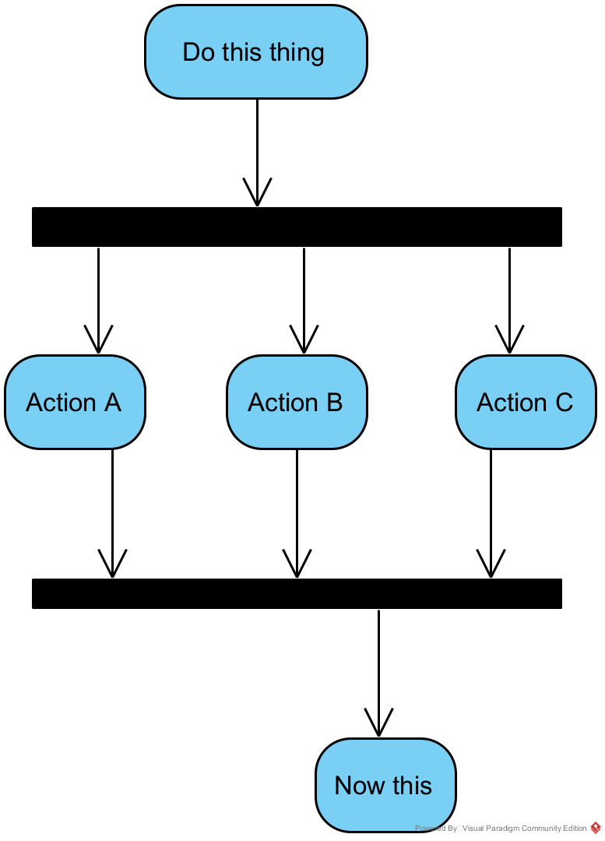
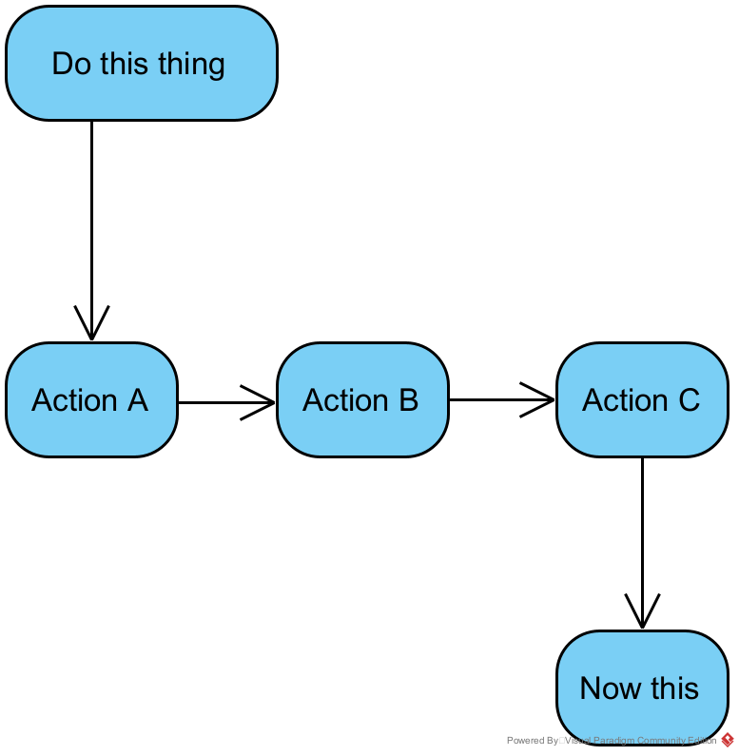
Fork and Join
Action A, then B, then C
Actions A, B, and C in any order
Note: all three of these actions are still required, none are optional

Slide 7
How many confirmations do you need?
Be aware of unnecessary actions in your flow – do you have too many steps?

Slide 8
Reminders
Consider all the paths through your logic.
  What happens when data isn’t found?
  What about if it doesn’t validate?
  What choices does the user have?
Keep your design unified! If you have an action in your activity diagram, you will be expected to model it in you specification and sequence diagram, and reference in your class diagram if necessary.

