Slide 1
Systems Use Cases

Slide 2
Systems Use Case Diagram
“The use case starts when an actor does something, causing the system to do something in response.
This dialog continues… until the system has done something useful for at least one actor.” *
* Use Case Modeling, Kurt Bittner & Ian Spence, Addison-Wesley, 2003, p. 24

Slide 3
Systems Use Case Diagram
“To indicate such interactions, we use a communicate association
between the use case where the interaction occurs and the actors involved in the interaction”. *
* Use Case Modeling, Kurt Bittner & Ian Spence, Addison-Wesley, 2003, p. 25

Slide 4
System Use Case Diagram
“The communicate association represents a dialog between the actor and the system, a kind of communication channel over which data flows in both directions during the dialog.” *
* Use Case Modeling, Kurt Bittner & Ian Spence, Addison-Wesley, 2003, p. 26

Slide 5
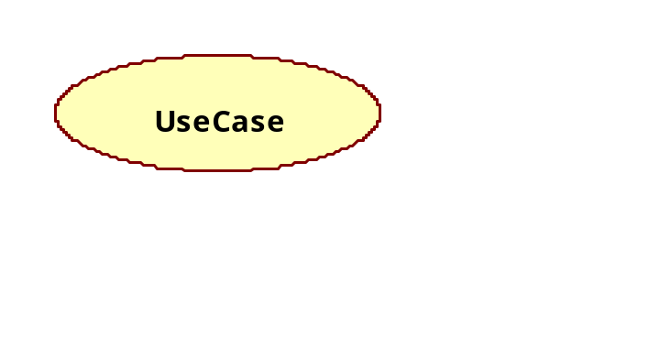
Systems Use Case
“The ellipse is a graphical representation of a use case
It is a placeholder for a description of how the system and its actors interact” *
* Use Case Modeling, Kurt Bittner & Ian Spence, Addison-Wesley, 2003, p. 23

Slide 6
Actors
“Can represent humans or other systems
Define the roles that users or other systems play when interacting with the system
Are outside the system, and usually outside the control of the system
Impose requirements on what the system being built must do” *
* Use Case Modeling, Kurt Bittner & Ian Spence, Addison-Wesley, 2003, p. 22

Slide 7
Examples of Actors
User
  Somebody who maintains the data, uses the data or generates reports
Applications
  External processes or software systems (email interface)
Devices
  External sensors (printers, scanners)
Time Events
  System clock

Slide 8
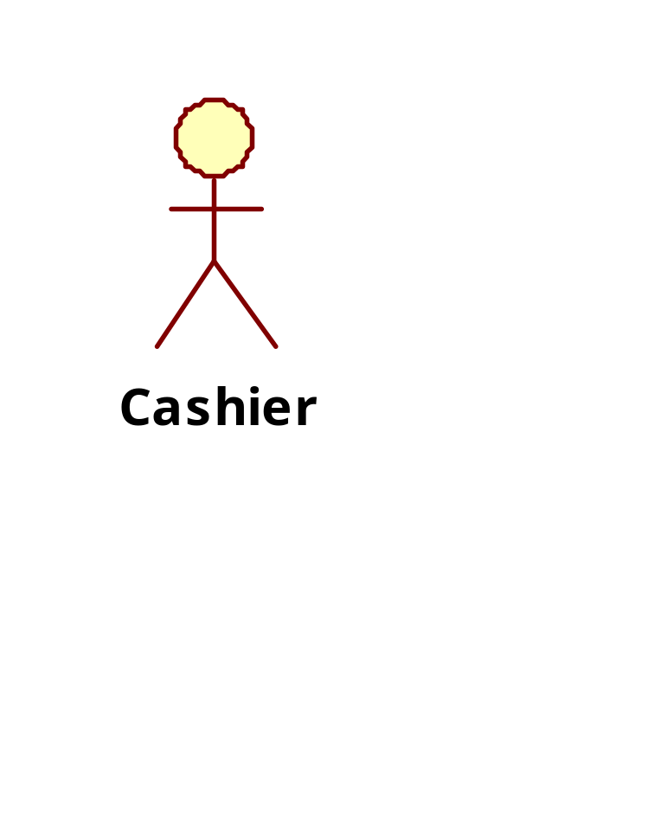
UML Notation
Actors are represented in UML by a ‘stick’ person
“I am an actor. I play a role
that involves using the system. I
am outside of the system.”
“My name indicates my role.”
“I can be a person, a department,
a system, hardware, scheduler, and so on”.

Slide 9
Actors communicate with the system
“To start the use case
To ask for some data stored in the system, which the use case then presents to the actor
To change data stored in the system by means of a dialog with the system
To report that something special has happened in the system’s surroundings that the system should be aware of” *
* Use Case Modeling, Kurt Bittner & Ian Spence, Addison-Wesley, 2003, p. 26

Slide 10
Use cases communicate with the Actor
“To report that something special has happened in the system that the actor should be aware of
To ask an actor for help in making a decision needed to achieve a goal
To delegate responsibility to an actor” *
* Use Case Modeling, Kurt Bittner & Ian Spence, Addison-Wesley, 2003, p. 26

Slide 11
Systems Use Case Diagram
“A use case has at most one communicate association to a specific actor, and an actor has…one communicate association to a specific use case, no matter how many interactions there are” *
* Use Case Modeling, Kurt Bittner & Ian Spence, Addison-Wesley, 2003, p. 25

Slide 12
Systems Use Case diagrams
One actor initiates a use case. However, after the use case has started, the use case can communicate with several actors.*
* Use Case Modeling, Kurt Bittner & Ian Spence, Addison-Wesley, 2003, p. 26

Slide 13
Systems Use Case Diagram
“The complete network of such associations provides a static picture of the communication between the system and its environment.” * (the boundaries of the system)
* Use Case Modeling, Kurt Bittner & Ian Spence, Addison-Wesley, 2003, pp. 25 -26

Slide 14
Scope of the system
The system use case diagram shows the scope of the system to be developed and is the foundation for your design
If the use case diagram and the use case specifications are not correct, your design will not work.

Slide 15
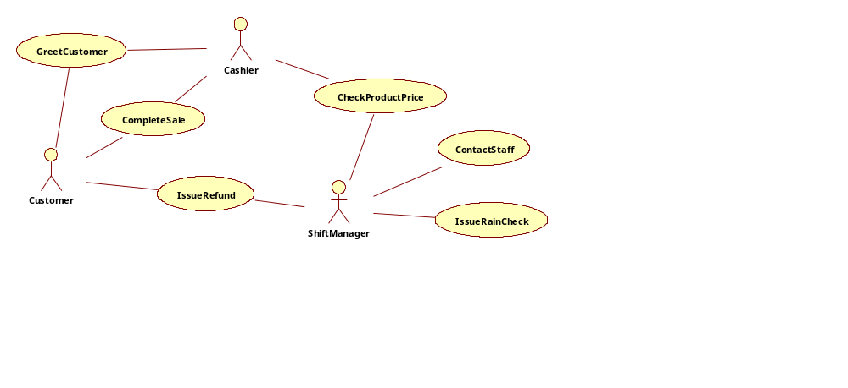
Partial Business Use Case Diagram

Slide 16
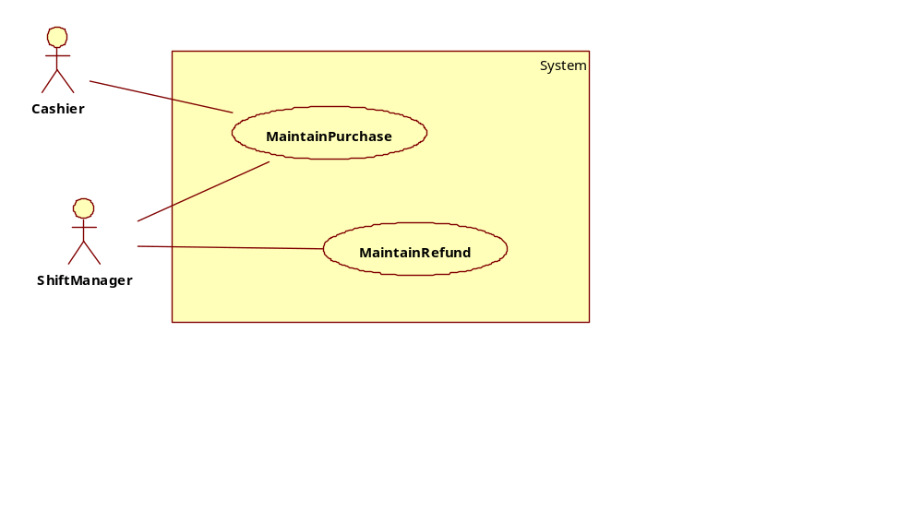
System Use Case Diagram 1

Slide 17
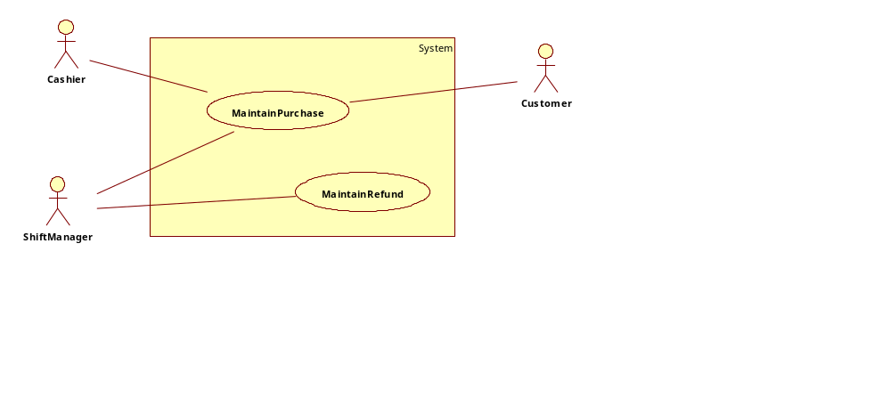
System Use Case Diagram 2
In this situation, the customer is able to purchase goods by themselves, such as through a self-checkout counter

