Slide 1
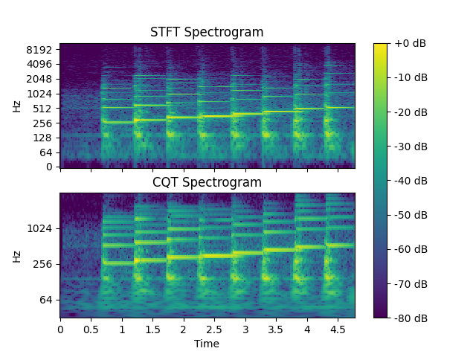
b
a

Slide 2
Depth-wise Separable CNN
Normal CNN
Input
n
Kernel
n
n
Output
Notes:
Depth-wise Separable Kernel

Slide 3
convolution + BatchNorm + ReLU (D: 1)
convolution + BatchNorm + ReLU (D: 1 x 2)
max pooling (K: 1 x 2, S: 1 x 2)
global max pooling
fully connected
CQT Input
3 x 3 x 64
3 x 3 x 128
3 x 3 x 256
3 x 3 x 512
1 x 1 x 512
representation layer
300
12 x 3 x 32
13 x 3 x 64
classification layer
# classes
Notes:
Model Architecture

