Slide 1

LondonAQ
Group: Rookie

Slide 2
Seeing Real-time Air Quality
LondonAQ
Rationale
In London, 9,400 premature deaths are attributed to poor air quality and a cost of between £1.4 and £3.7 billion a year to the health service. – London Councils
Issue revealing
Environmental education
User engagement
01
https://www.londoncouncils.gov.uk/node/33227

Slide 3
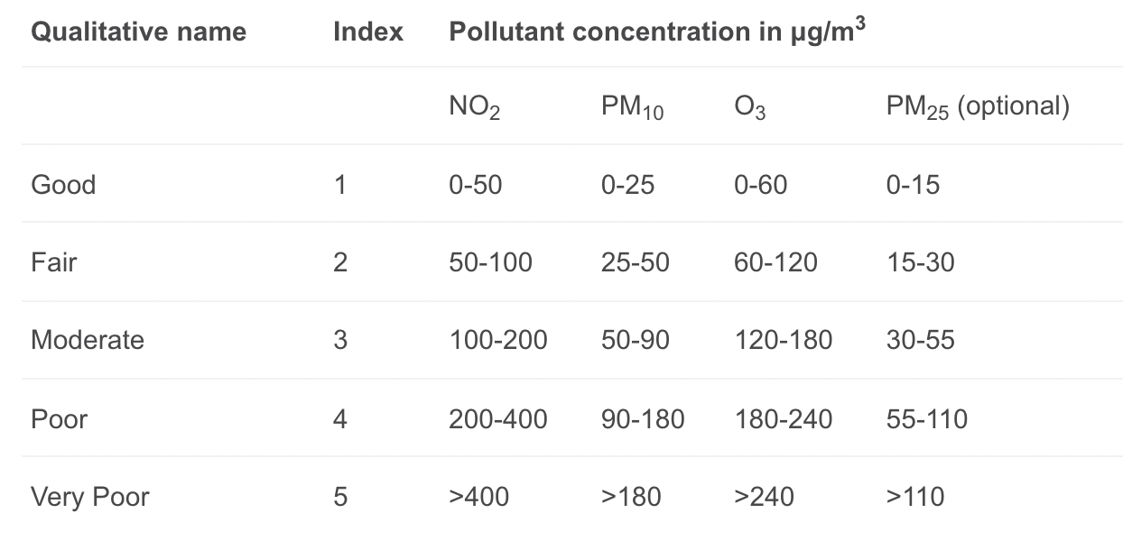
Data
LondonAQ
What it shows
Display:
Nitrogen dioxide (NO2)
Inhalable particles (PM10)
Fine inhalable particles (PM2.5)
Ozone (O3)
Air Quality Index (AQI)
Data Source: Open Weather Map Air Pollution API
A description of Air Quality Index levels
02
https://openweathermap.org/api/air-pollution

Slide 4
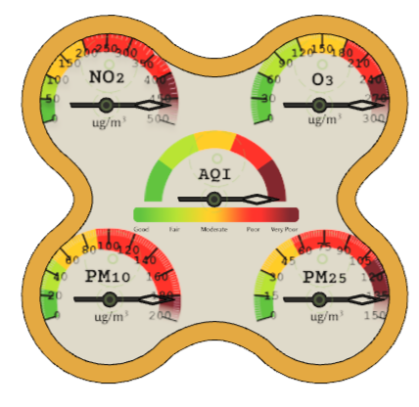
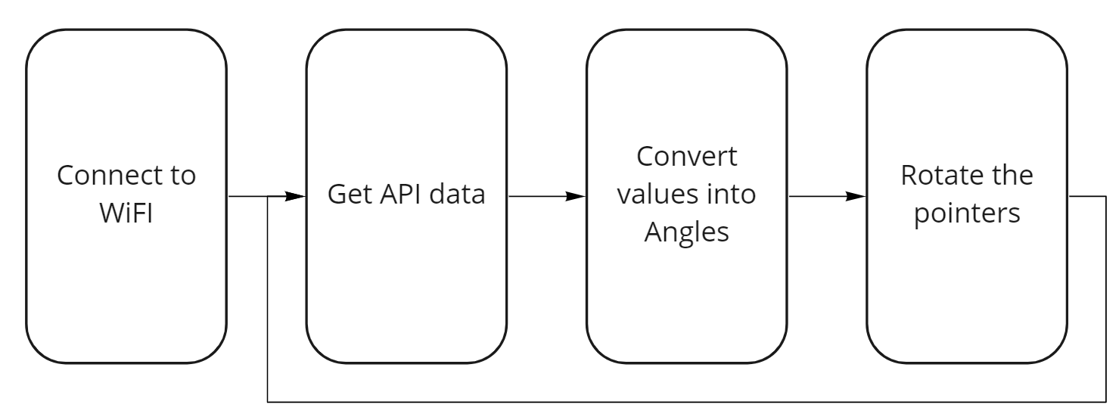
Air quality display
LondonAQ
How it works
Color code: Description of AQI level
03

Slide 5
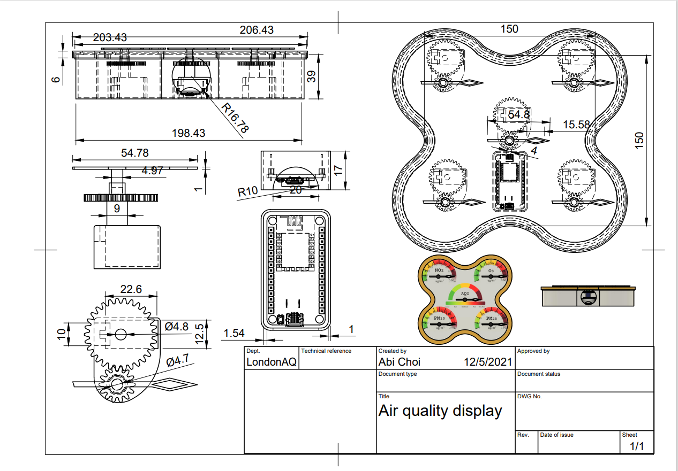
Blue Print
LondonAQ
04

Slide 6
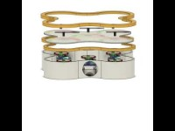
Disassemble
LondonAQ
https://www.youtube.com/watch?v=rYBuJvv1sHc
05

Slide 7
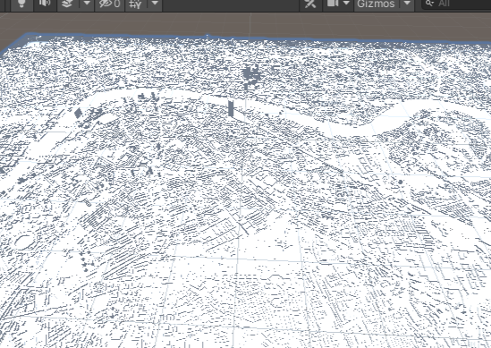
Digital Environment
LondonAQ
-We found a model of the whole London and we will introduce some UI to give the user an insight of the air quality conditions in the area.
-At the same time we will also place digital devices next to the scene, which can show different values, when it on different locations.
06
https://sketchfab.com/3d-models/london-uk-a920af7809ef4f38a510fe0b79639c36

Slide 8
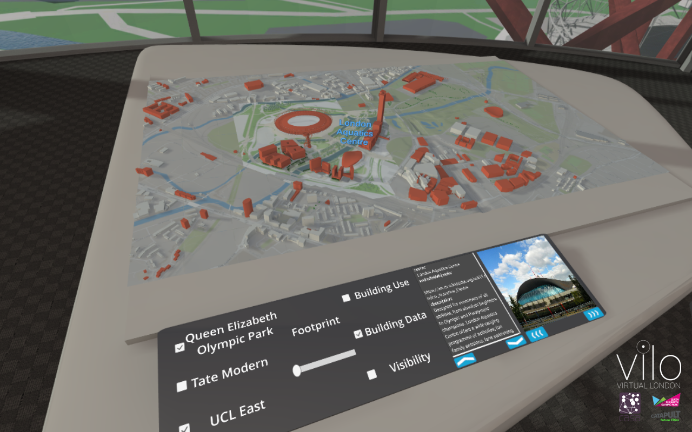
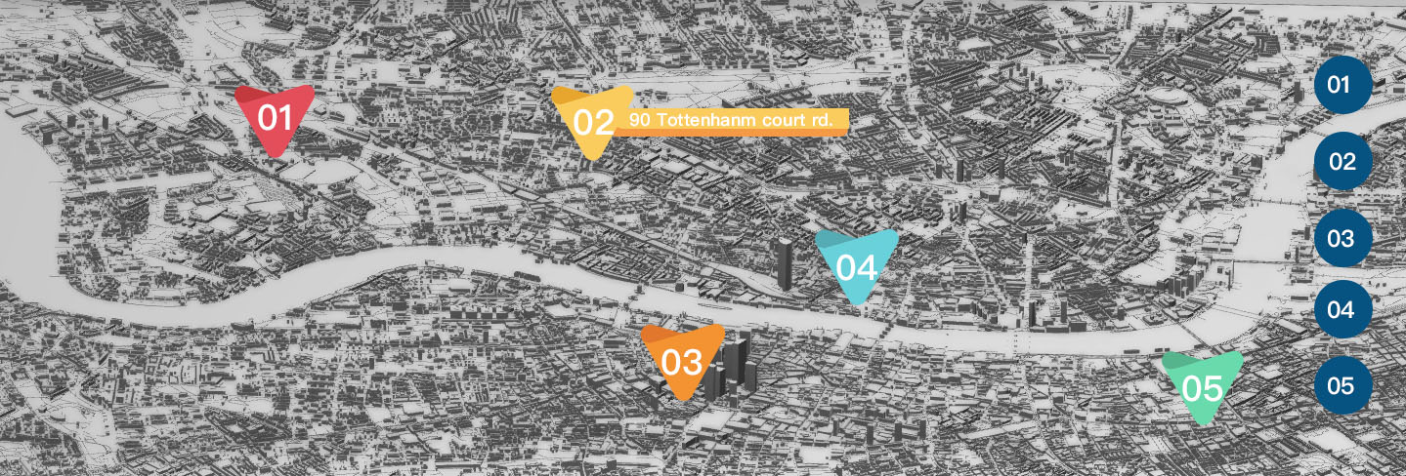
Scene in AR
LondonAQ
3D model of London City
- Buttons on the right hand side are for choosing different locations in London
Virtual Device
- Data feed changes based on the location selected
07
Reference: ViLO (ViLO – UCL Connected Environments (connected-environments.org))

Slide 9
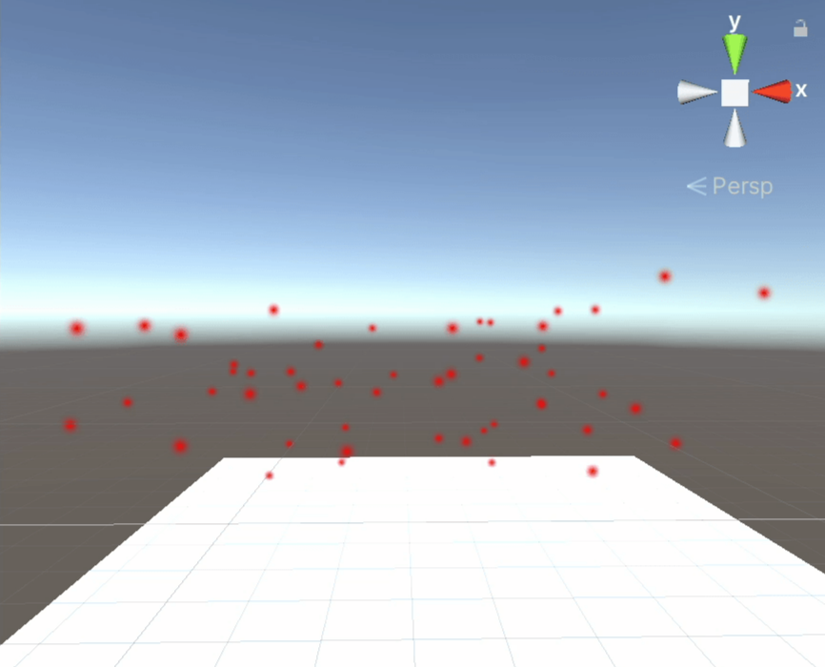
Effect in AR
LondonAQ
08
Particle system
- Particle will be shown on the top of the area selected.
- The size and colour of particle will be changed depend on the Air Quality Index.
Button onClick function
- Specific virtual device and particle will be shown based on the location selected.

Slide 10
Next Step
LondonAQ
Print out the physical device
Design a stand for the device
Build AR interaction functions in Unity (Switch scenes, button, particle system)
Modify and refine the 3D-model
Use API to display air quality data on our AR map
Use API to manipulate physical device and digital device
09

Slide 11
Challenges
LondonAQ
Not sure how to achieve a AR button
We need 4 servo motors that can turn over 180 degrees and 1 that can turn 180 degrees (May we borrow some?)
10

