Slide 1
Mindset & Mindful

Slide 2
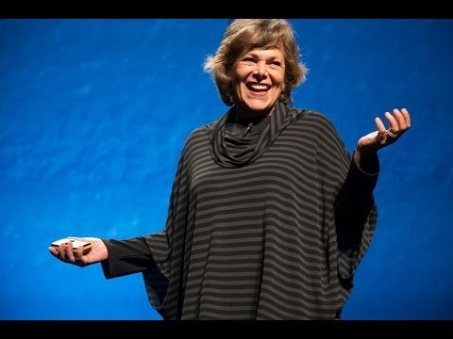
Mindful
https://www.youtube.com/watch?v=4XQUJR4uIGM#t=474
How does this relate to co-op and learning in general?
Notes:
End video at ~13:30

Slide 3
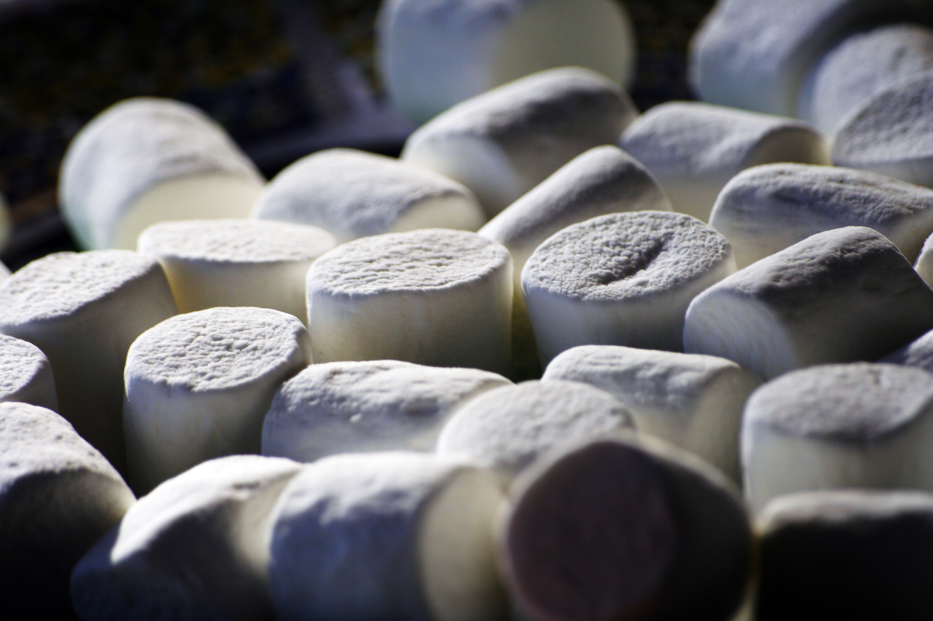
Marshmallow Challenge
Peter Skillman
Notes:
Explain the background of the challenge:
created for engineers to learn simple important concepts
adapted for workshops held around the world from CTOs of the Fortune 50s to kindergarteners

Slide 4

Purpose
To build the tallest free standing structure in 18 minutes.
The marshmallow must be on top.
Notes:
End video at ~13:30

Slide 5
Materials
20 sticks of spaghetti
1 yard of string
1 yard of tape
1 marshmallow
Notes:
End video at ~13:30

Slide 6

18 Minutes!
https://www.youtube.com/watch?v=w5fJaU3u-TM
Notes:
End video at ~13:30

Slide 7
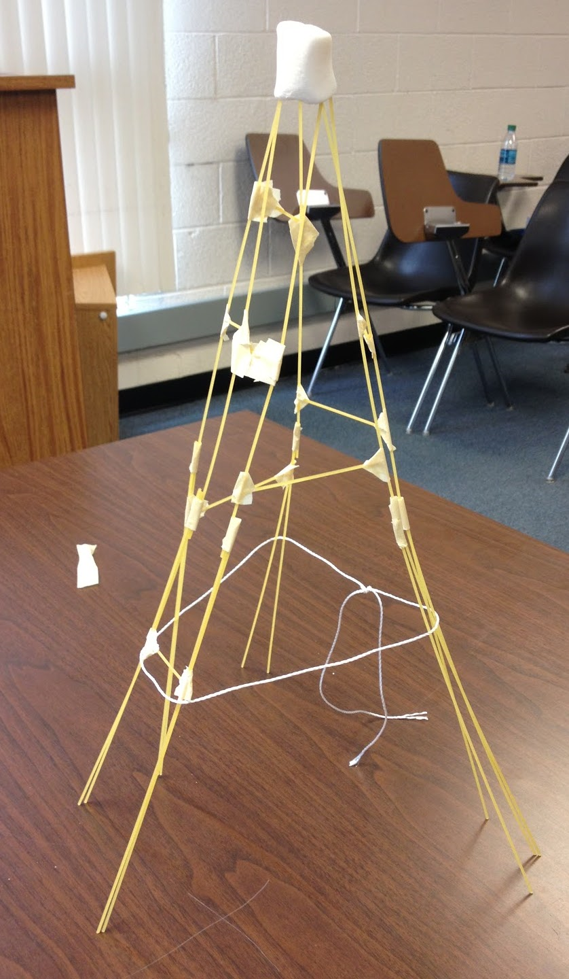
Debrief

Slide 8
Take-Aways
Mindset:
Redefine your relationship with failure
Reassess your beliefs about how you learn and what you’re good at
Mindful:
Make observations about what you’re learning
Monitor the messages you are sending to yourself
Be aware of your experiences and the learning process

Slide 9
ASSIGNMENT
Watch and complete the “Get Informed! Sexual Harassment Awareness for NU Co-op Students training module,” by 9 a.m. the day of your next class.
Must earn a 70% of higher to pass

