Slide 1
Predicting Flight Delays
A Data Science Approach

Slide 2
Overview
1.
2.
3.
4.
EDA/Processing
Classification
Regression
Insights
NaNs, Class Imbalance, Visuals
Random Forest, MLP, GridSearch
PCA, Logistic Regression, MLP
Feature Importance

Slide 3
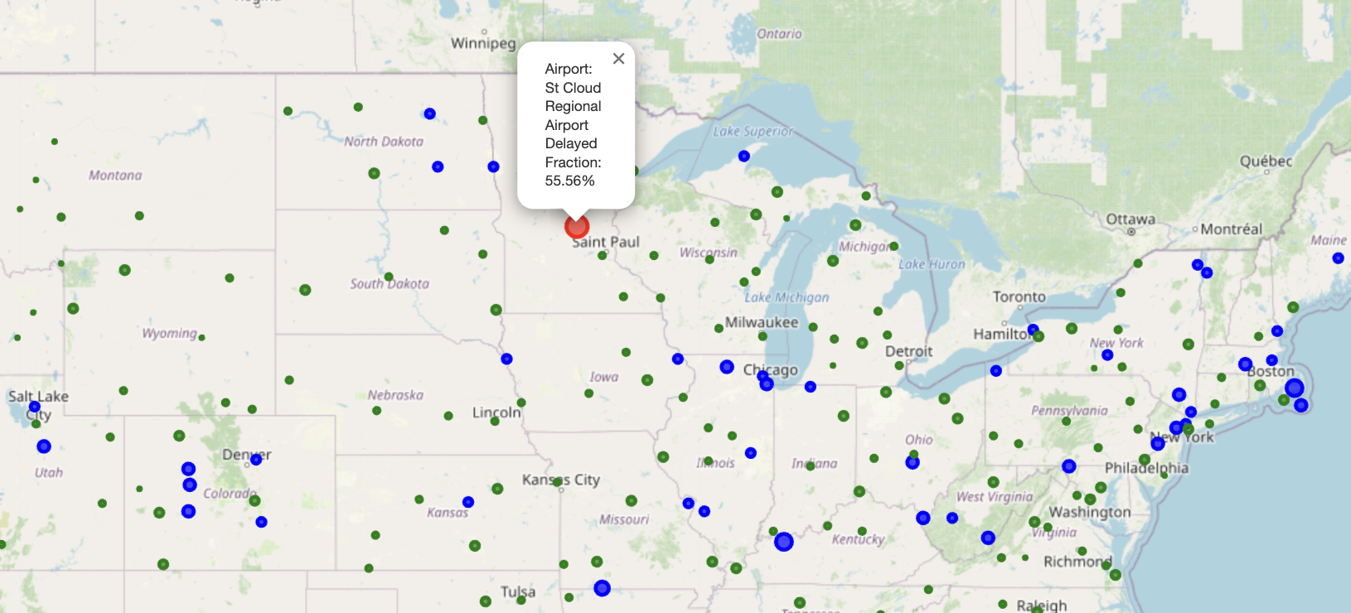
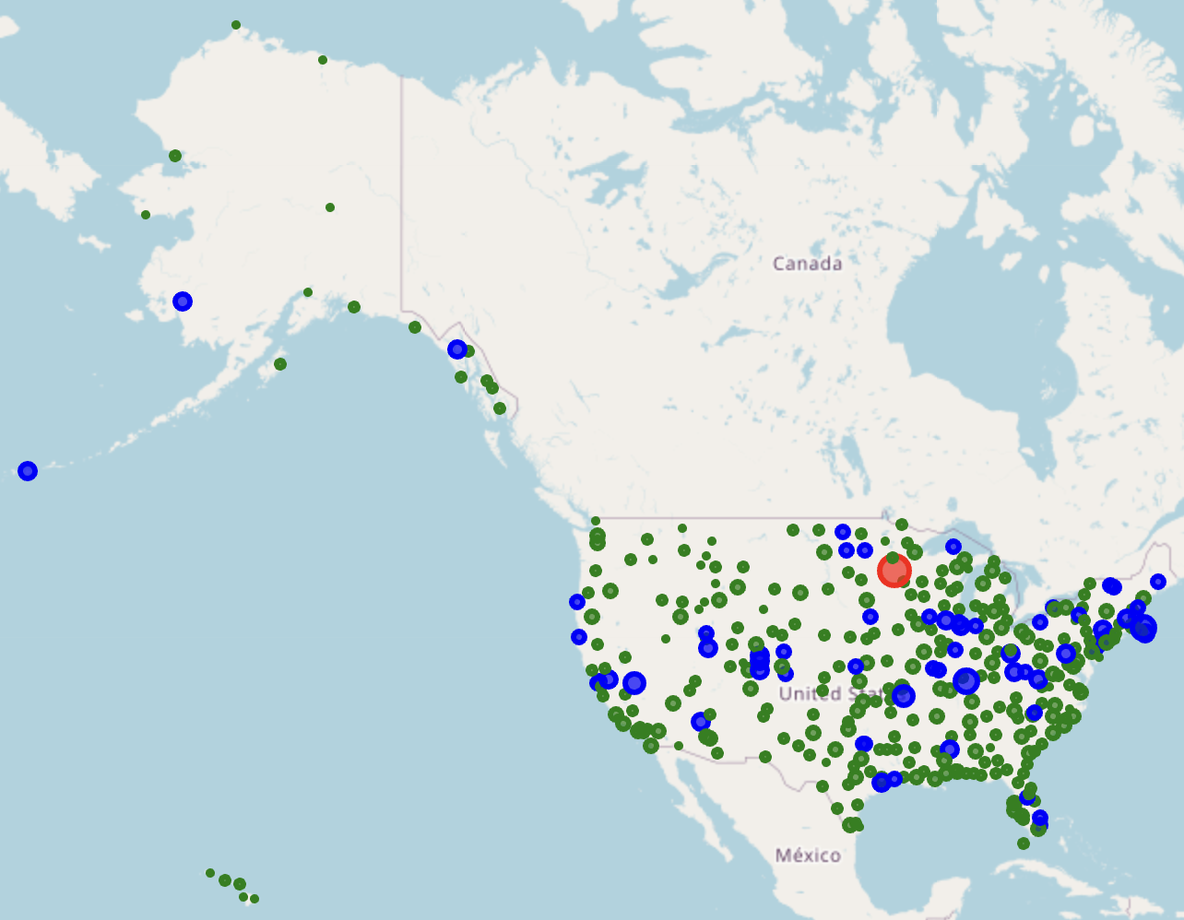

Slide 4
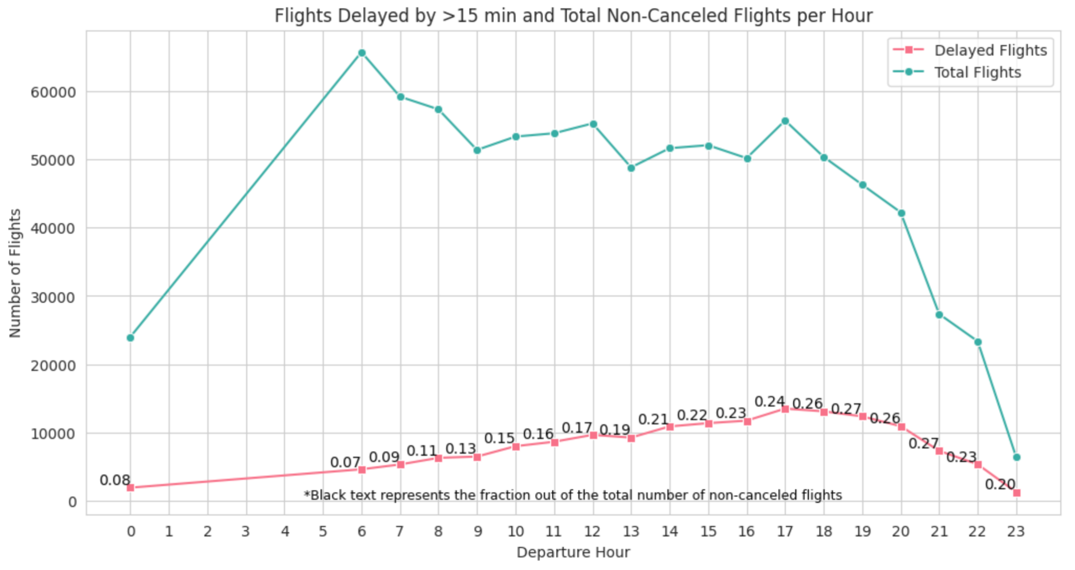

Slide 5
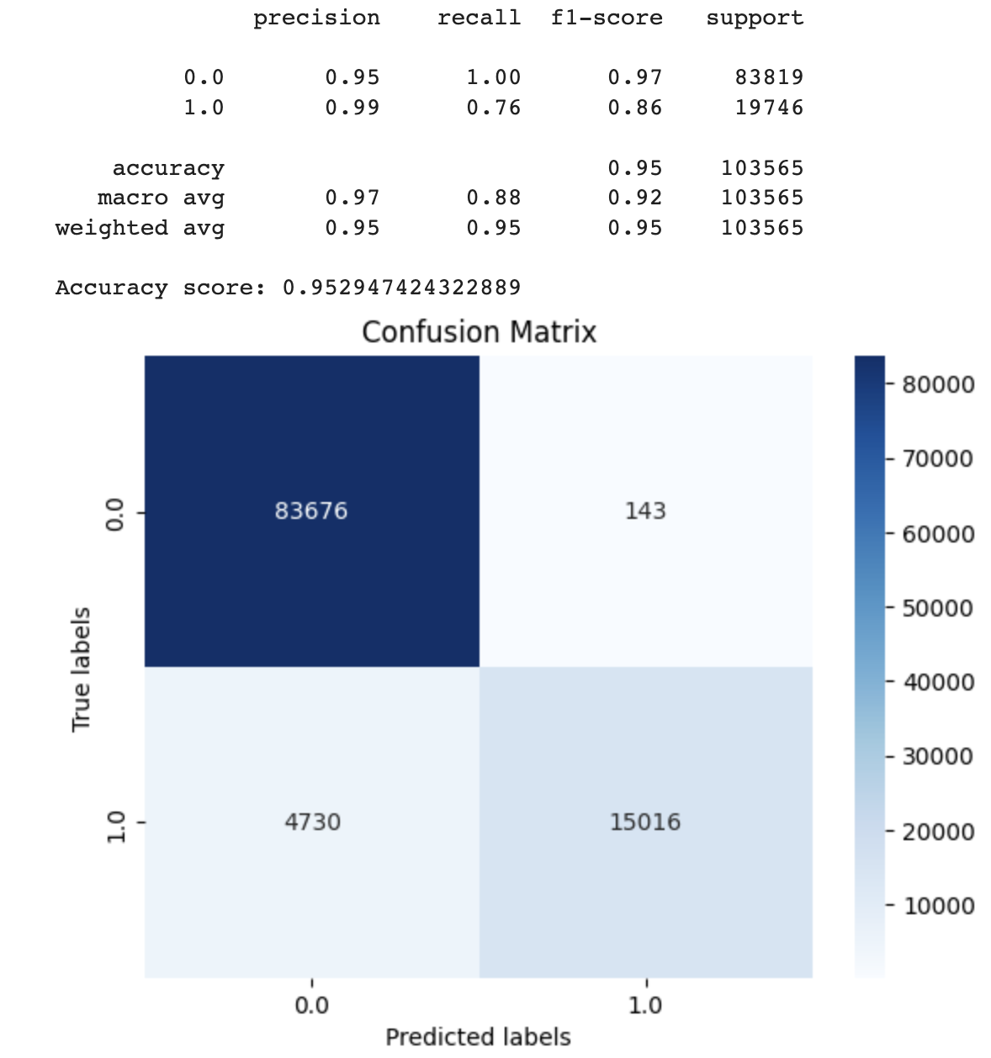
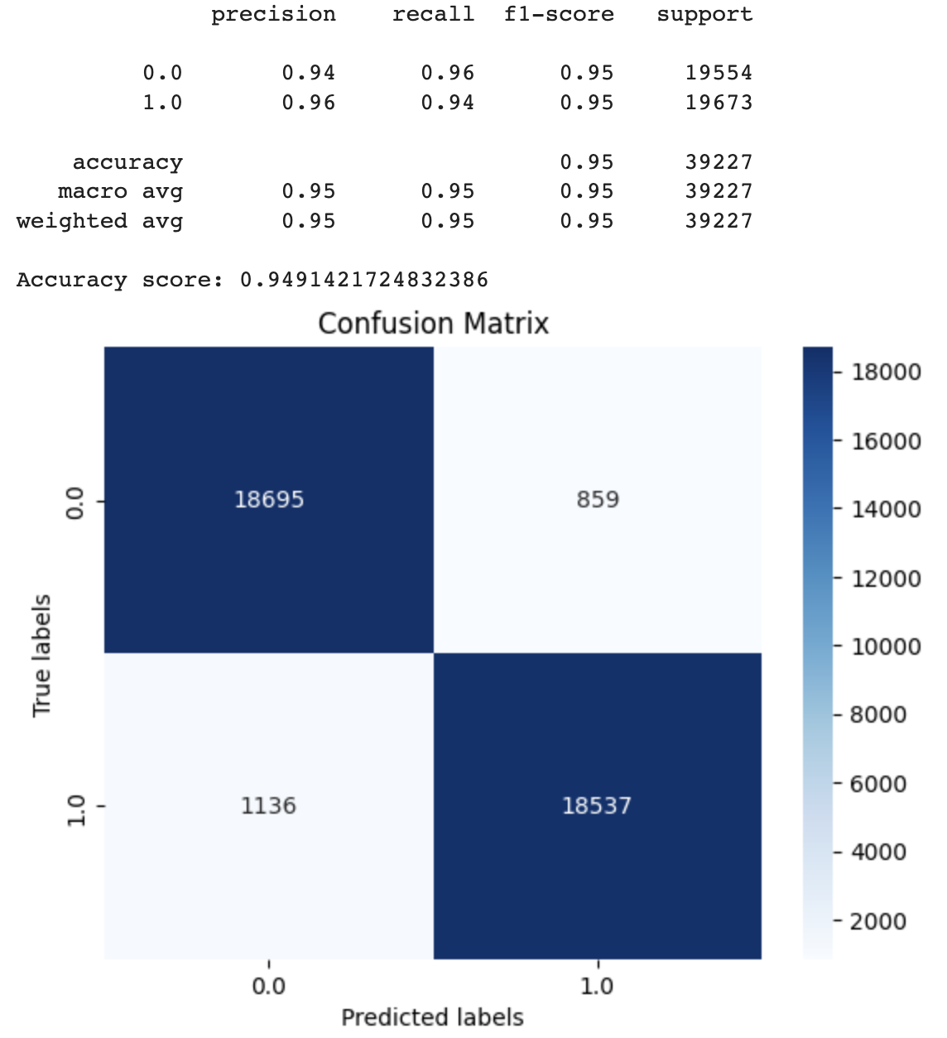
Random Forest Classifier
No Undersampling
With Undersampling

Slide 6
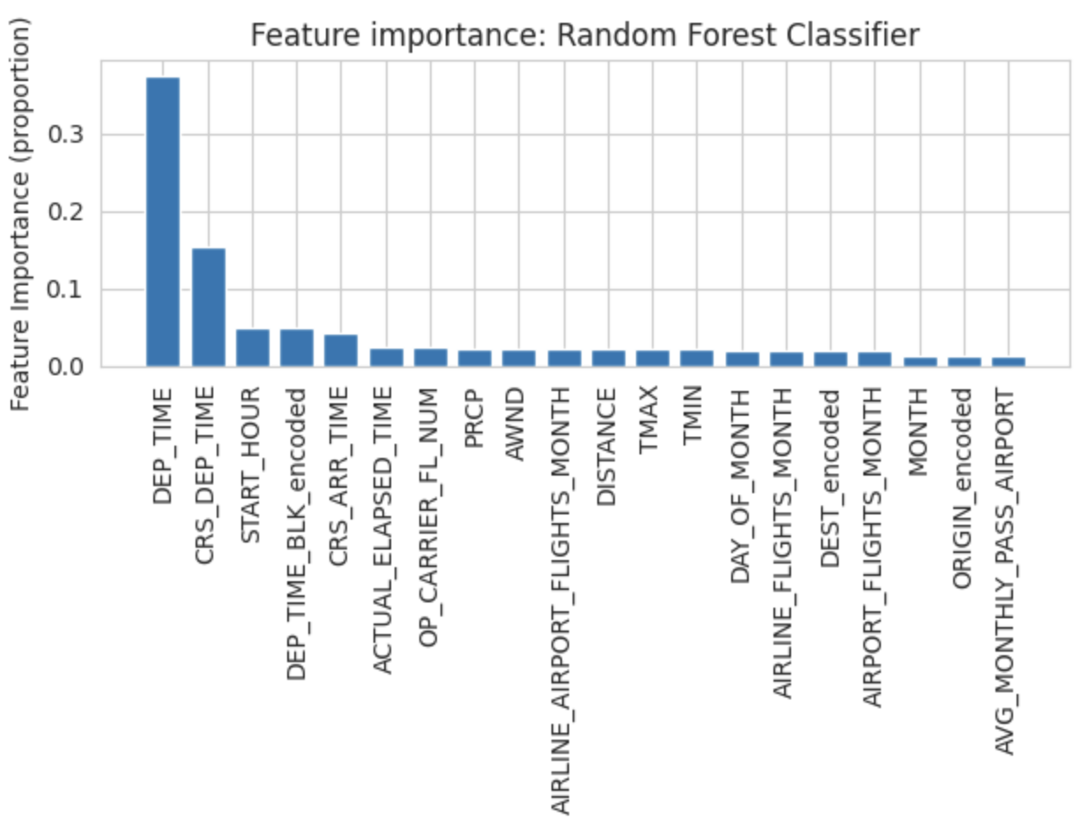
Insights
Random Forest Classifier found ‘Departure Time’ to be most significant
Highest delay rates: 5-9 pm
Late Arrivals + More Flights = More Delays?
Decreased Efficiency later in day?
High Delay Airports (>20%) vs. Low Delay (<20)
~100 miles longer
80% more snow/precip. on average
51% more flights per month
43% more passengers per month
Important to have balanced training data
Complex models may not necessarily perform better than simpler models
Trade-off between time/simplicity
RF vs. MLP

