Slide 1
Adaptive Chemistry Game
Vivian Vriezekolk
Supervised by George Kachergis
Frank Leoné

Slide 2
Video games and education
Growing video industry
Not evidence based educational games.
Demand to integrate intrinsically motivating aspects to educational games.

Slide 3
Research question
“Will a game teaching chemistry (molecular structures and names) with an adaptive algorithm improve learning compared to the same game without an adaptive learning algorithm?”

Slide 4
Educational game
The four pillars
  Active learning
  Engagement (Intrinsically motivating)
  Meaningful learning
  Social Interaction

Slide 5
Immediate feedback

Slide 6
Spacing effect

Slide 7
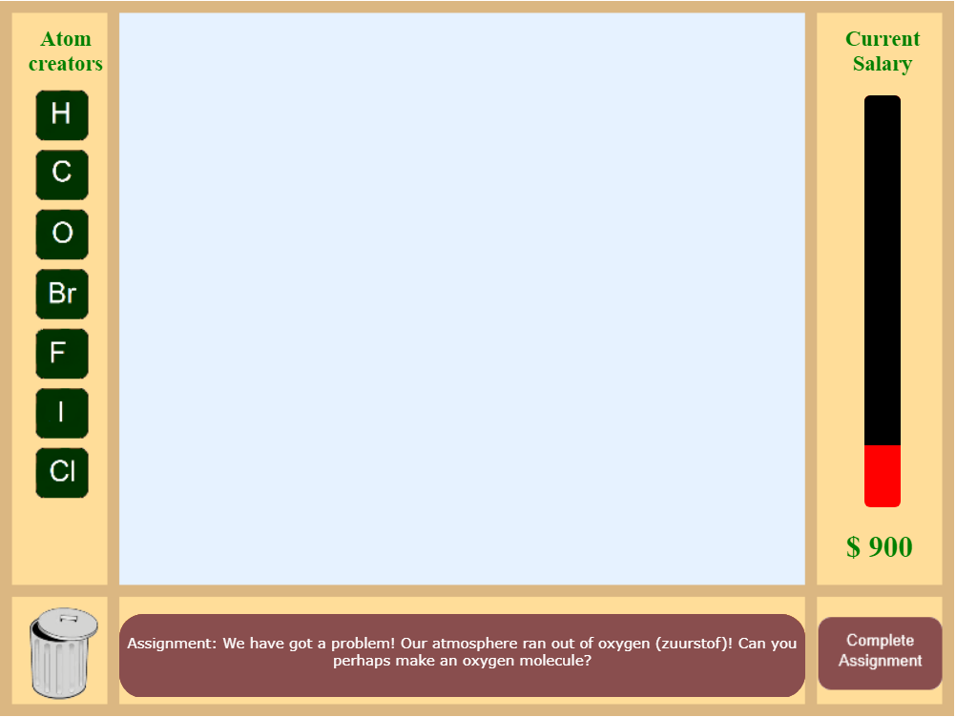
Game Demo
chemistrygame-eca18.firebaseapp.com

Slide 8
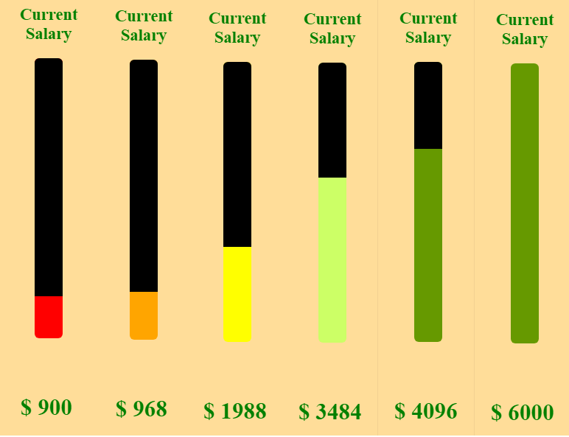
Progress bar
Based on difficulty and score

Slide 9
Adaptive vs Random version
Order is important Order is not important
Spacing questions Massing questions
Assistant’s aid Only feedback

Slide 10
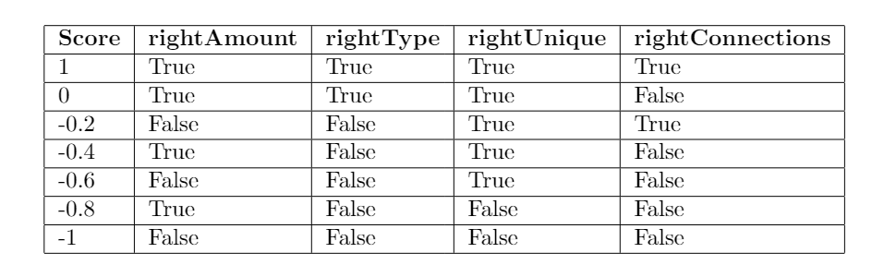
Evaluating answers
Not right or wrong

Slide 11
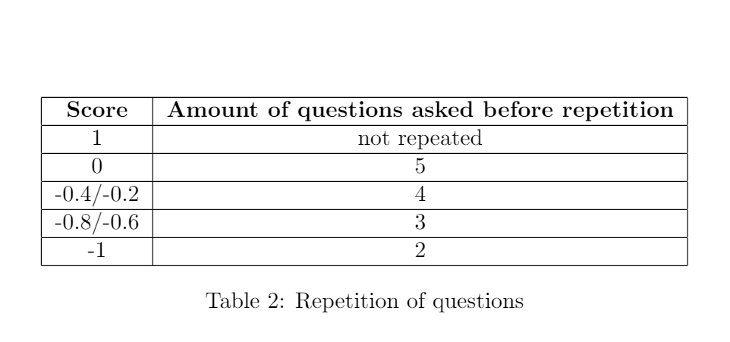
Repetition based on score

Slide 12
Research participants
31 participants (14 random, 17 adaptive)
Average age 23.9
Randomly assigned to version

Slide 13
Research procedure
Play game
Questionnaire

Slide 14
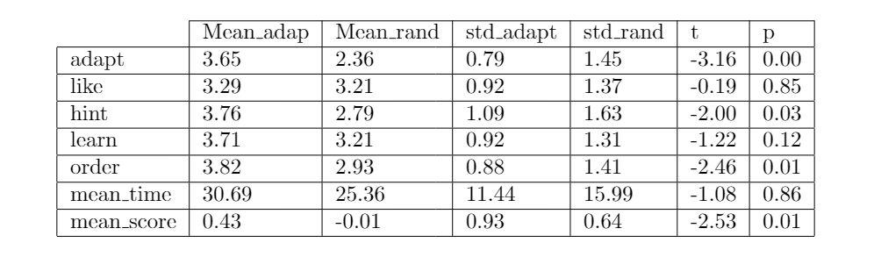
Results

Slide 15
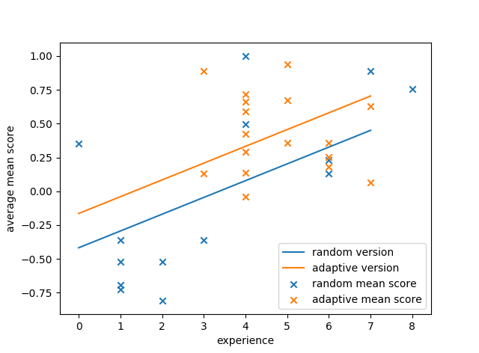

Slide 16
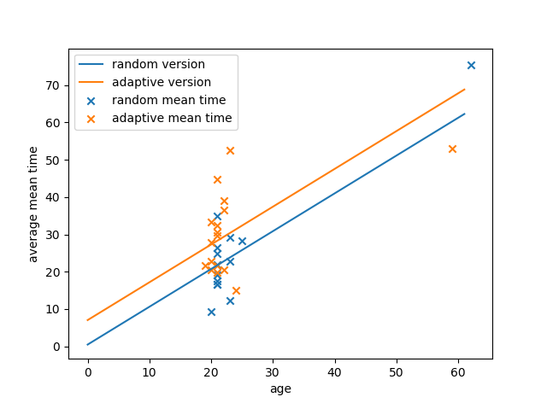

Slide 17
Conclusion

Slide 18
Discussion

Slide 19
Take home message
Meer onderzoek moet nog gedaan worden.

Slide 20
References

