Slide 1
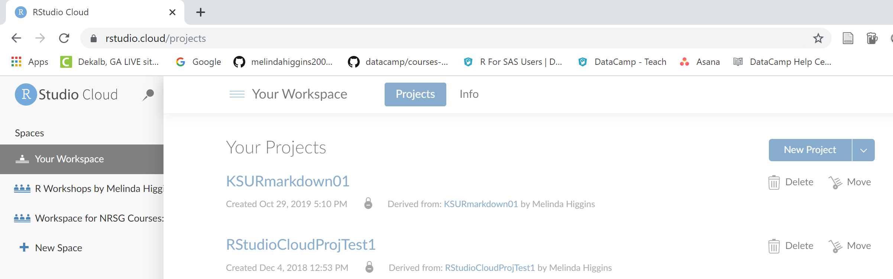
Click “R Workshops by Melinda Higgins” Workspace

Slide 2
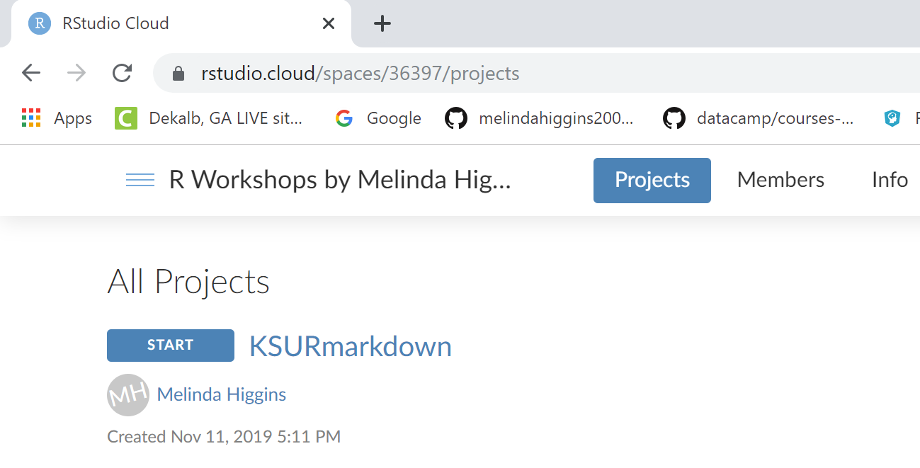
Click “START”

Slide 3
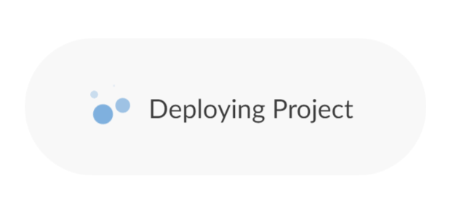
Be patient, project deploying …

Slide 4
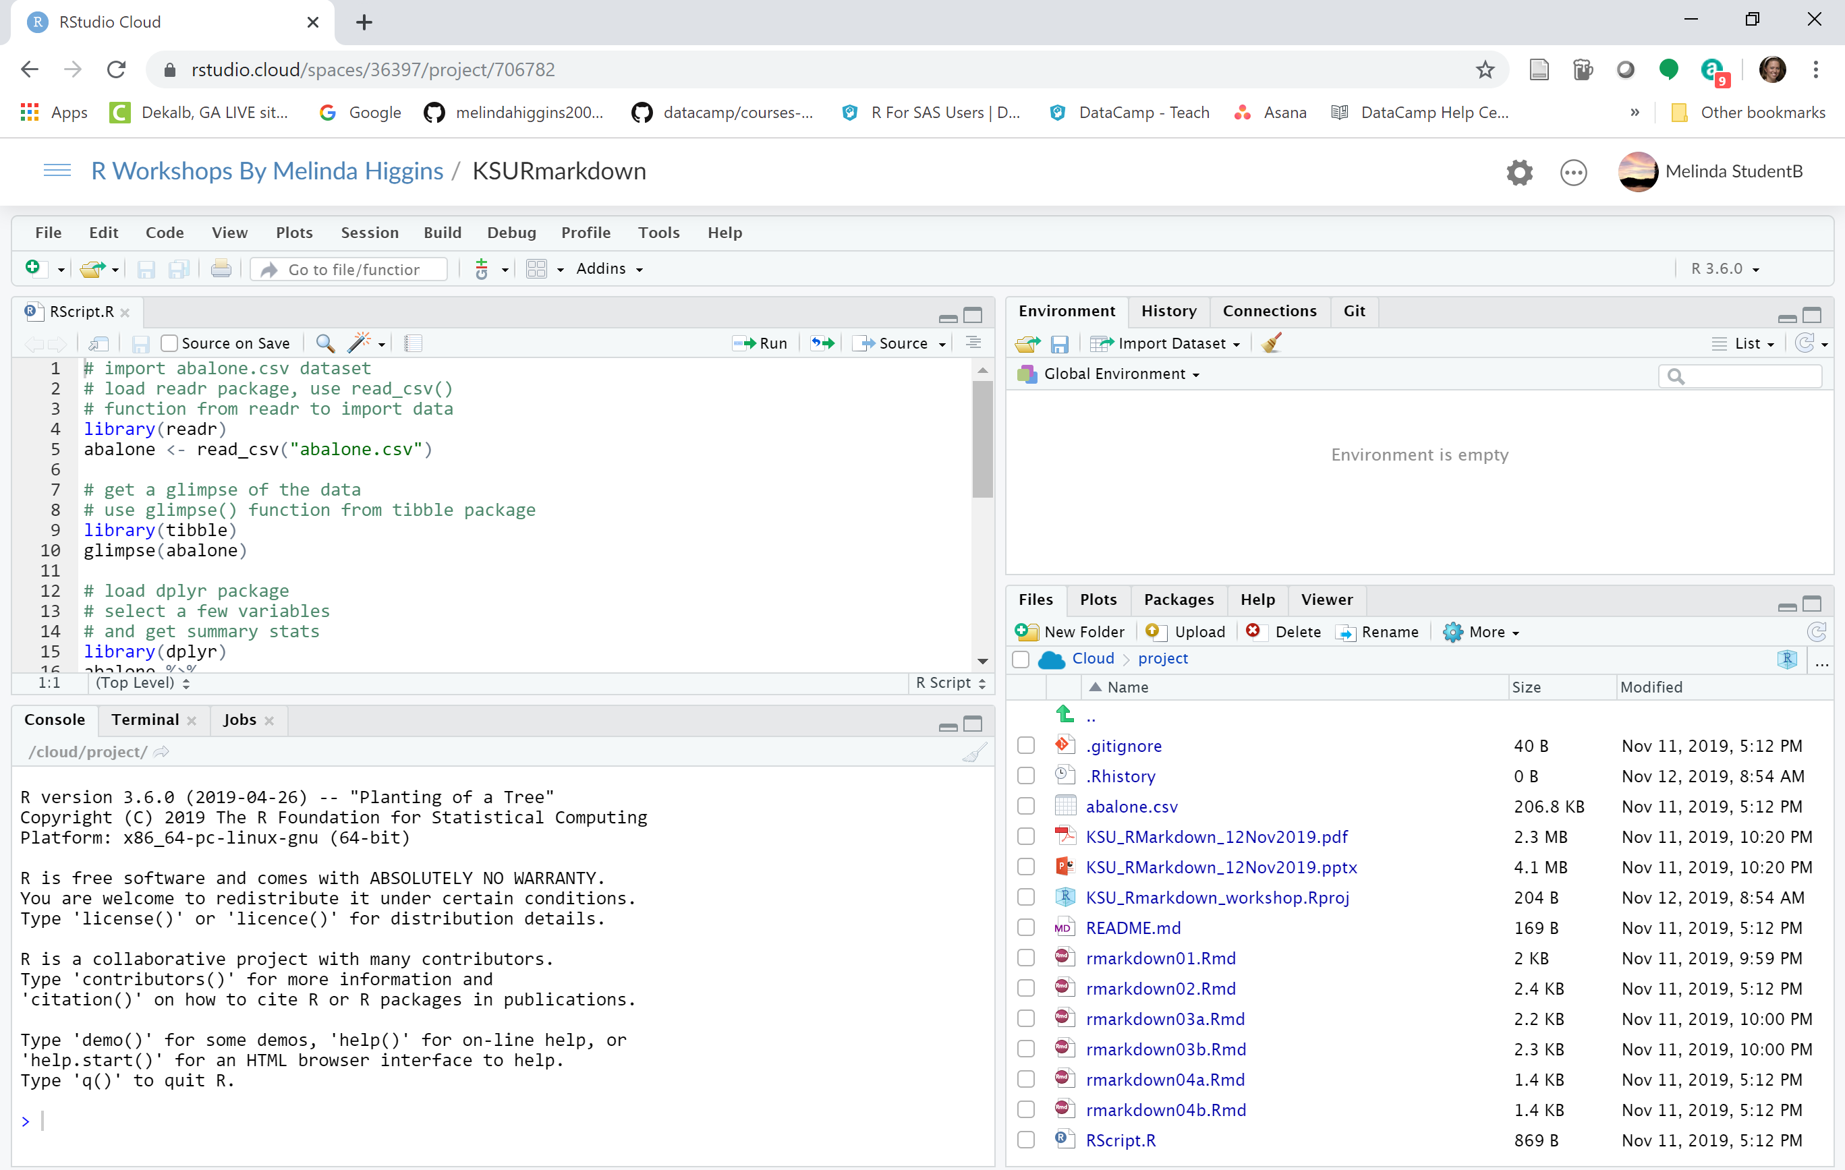
Code, documents,
view data
Environment, etc
Console – run code interactively, view output
View files, packages, plots, help, viewer

