Slide 1
Secure Data Hiding In Images Using Steganography
CAPSTONE PROJECT
Presented By: Jadiya Om AbhishekBhai
Student Name: Jadiya Om AbhishekBhai
College Name: Chandubhai S. Patel Institute of Technology
Department : Computer Science and Engineering

Slide 2
OUTLINE
Problem Statement
Technology used
Wow factor
End users
Result
Conclusion
Git-hub Link
Future scope

Slide 3
Problem Statement
It is crucial to keep the cover image unchanged while safeguarding the hidden data.
A secure approach is needed to conceal sensitive messages within images without detection.
Traditional encryption methods are easily recognizable, which may attract unnecessary scrutiny.
Creating an intuitive interface for seamless encryption and decryption, even for users without technical expertise

Slide 4
Technology used
Programming Language: Python
Image Processing Library: OpenCV
Graphical User Interface (GUI): Tkinter
File Handling & Security: Used Encryption logic for password Privacy
Platform: Windows 11
Additional Libraries: tkinter(For GUI) , cv2(OpenCV) , os .

Slide 5
Wow factors
Utilizes a method to discreetly Embed text into images without noticeable changes.
Features a simple and accessible interface for encoding and retrieving hidden content.
Adopts a lossless approach by subtly altering image data rather than employing standard encryption.
Compatible with widely used image formats, with a preference for PNG to maintain high fidelity.

Slide 6
End users
Military & Defense Operations – Securely embedding classified messages within digital images to prevent enemy interception.
Corporate Data Protection – Concealing sensitive business data within multimedia files to avoid cyber espionage.
Journalism & Whistleblowing – Safeguarding confidential sources by hiding messages in shared images.
Cybersecurity & Malware – Attackers using steganography to embed malicious code inside images, bypassing detection systems.

Slide 7
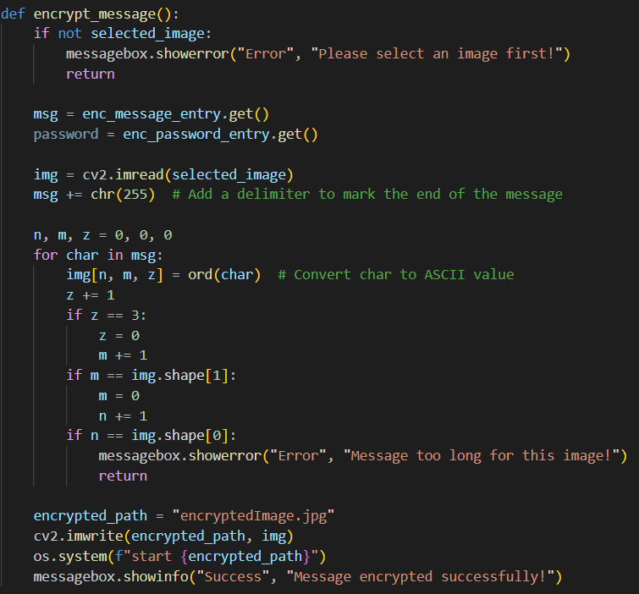
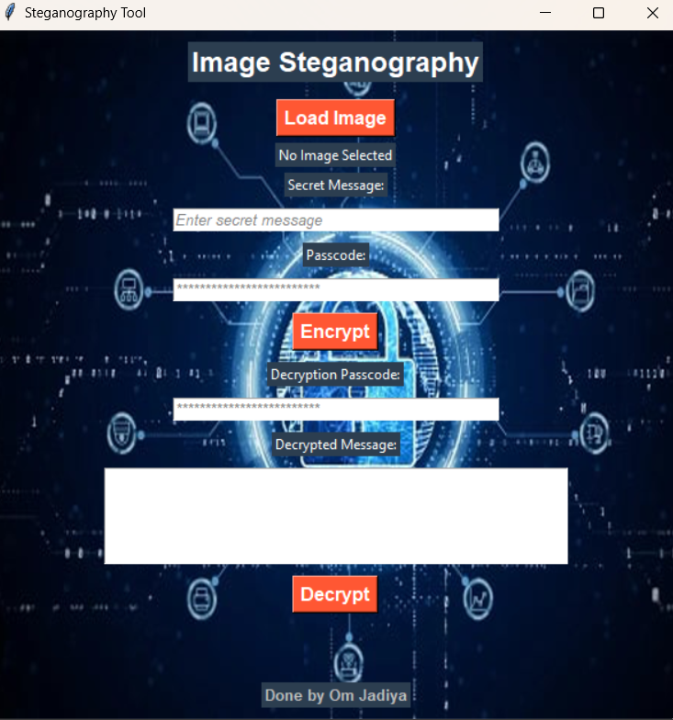
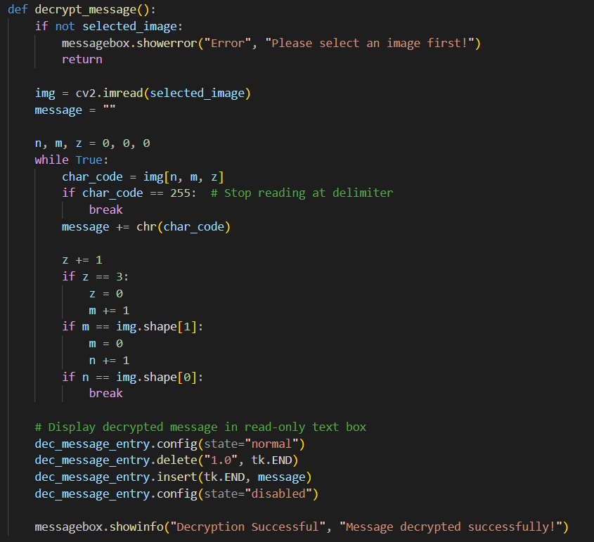


Results
GUI:
Encryption Code:
Decryption Code:
Input Image File:
Output Image File:

Slide 8
Conclusion
Steganography allows for the covert transmission of sensitive data.
This project presents an effective method for Embedding messages within images.
A simple and intuitive interface makes encryption and decryption accessible to all.
Future improvements can enhance security, efficiency, and scalability.

Slide 9
GitHub Link
https://github.com/Vivid3226/AICTE_Intern

Slide 10
Future scope
Advanced Encryption Techniques – Integrate AES encryption before embedding text in images.
Support for Audio & Video Steganography – Expanding beyond images.
AI-based Detection Prevention – Ensuring messages stay undetectable from modern forensic tools.
Mobile App & Web Version – Expanding accessibility beyond desktops.
Multi-Layer Security – Combining steganography with blockchain for ultra-secure communication.

Slide 11
THANK YOU

