Slide 1
Cuba
Liwen Yin

Slide 2

Cuba Overview
Cuba, officially the Republic of Cuba, is an island country, comprising the island of Cuba (largest island), Isla de la Juventud, and 4,195 islands, islets and cays surrounding the main island. It is located where the northern Caribbean Sea, Gulf of Mexico, and Atlantic Ocean meet.

Slide 3
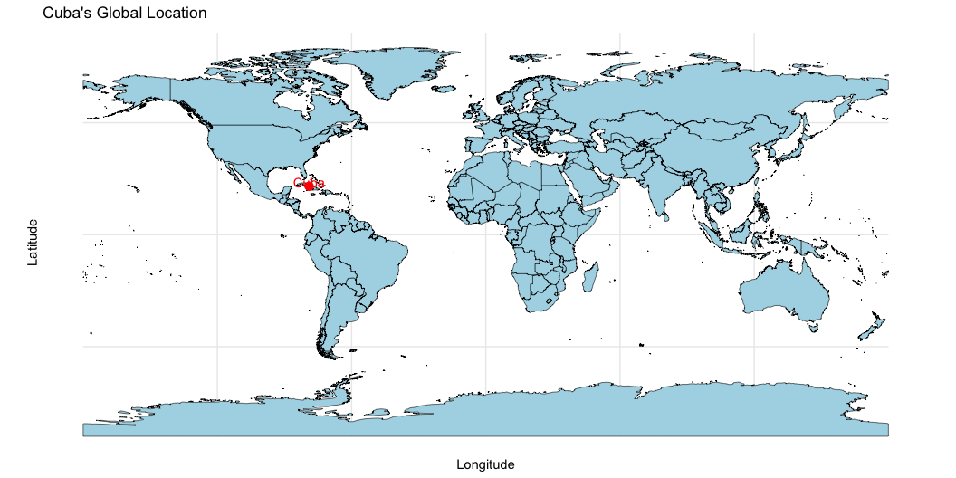
Cuba’s Global Location

Slide 4
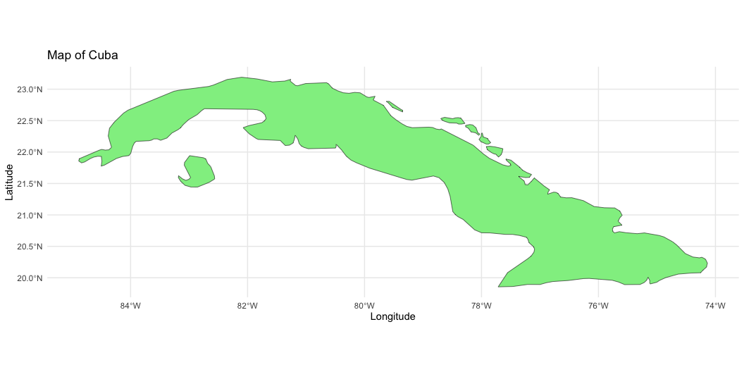
Cuba is a socialist republic governed by the Communist Party of Cuba, with a one-party system and leadership centralized under the President and Prime Minister. Its economy is a mixed socialist model, dominated by state-controlled industries such as tourism, agriculture, and biotechnology, while facing challenges like the U.S. embargo and inefficiencies in state-run sectors. The population, approximately 11 million, reflects a mix of Afro-Cuban, European, and Mestizo heritage, with Spanish as the official language. Cuba boasts high literacy rates and universal healthcare, contributing to one of the highest life expectancies in the region. Geographically, it is the largest island in the Caribbean, featuring tropical climates and diverse ecosystems, though it is vulnerable to hurricanes and coastal erosion.

Slide 5
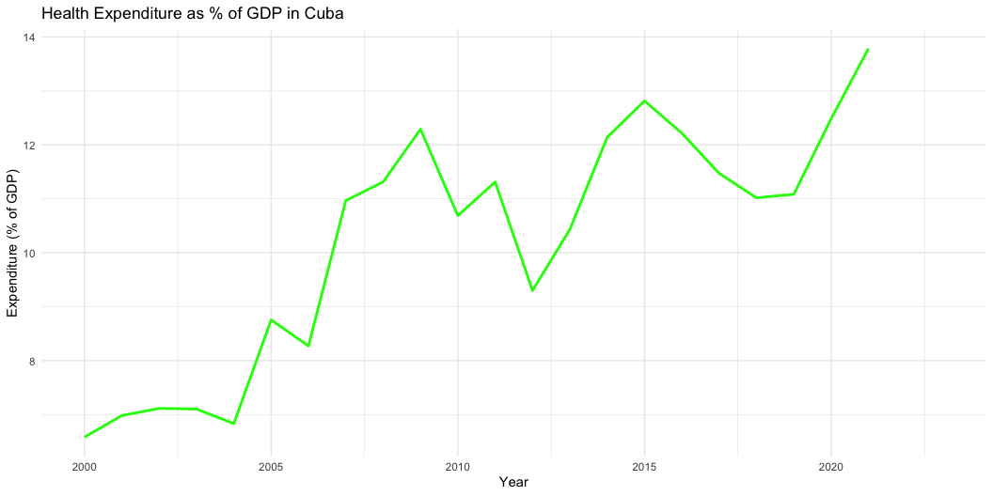
Description of the government
Leadership Structure: 1. President of the Republic: 2. Prime Minister: 3. National Assembly of People’s Power: 4. Council of State: 5. Communist Party of Cuba: The graph shows the trend of Cuba’s health expenditure as a percentage of GDP from 2000 to 2023. Overall, the percentage has demonstrated a general upward trend with some fluctuations.
Cuba operates under a socialist system where the government places a strong emphasis on public services, especially healthcare and education. Universal Healthcare: The Cuban government guarantees free and universal healthcare for all citizens. Preventive Healthcare: Investments are directed toward preventive care, such as vaccination programs, community health services, and routine medical checkups. These policies necessitate consistent government investment, leading to an overall increase in health expenditure as a share of GDP.

Slide 6
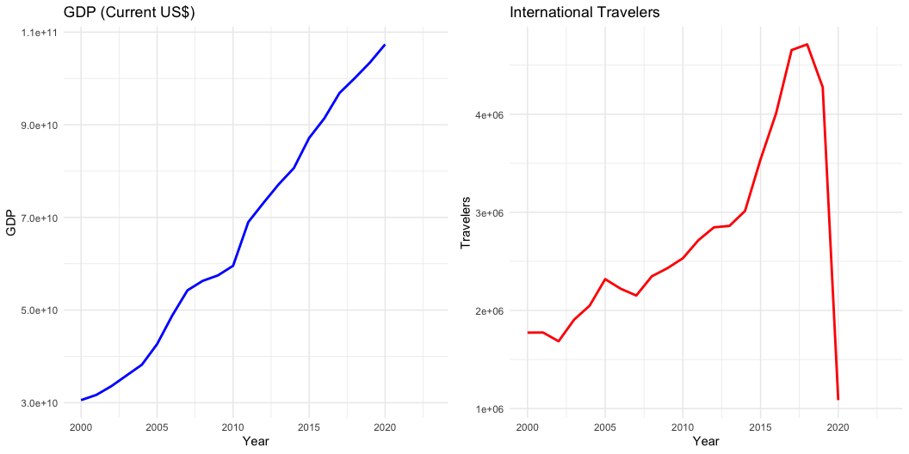
GDP & International Travelers
GDP (Current US$) Trend: Cuba’s GDP increased significantly from approximately 3 × 10¹⁰ in 2000 to over 1.1 × 10¹¹ by 2020. Insight: This upward trend suggests steady economic growth despite external sanctions and economic challenges.
International Travelers Trend: The number of international travelers increased steadily, peaking in 2018, but dropped sharply in 2020. Insight: The sharp decline in 2020 is likely due to the global COVID-19 pandemic, which disrupted international travel and highlighted the vulnerability of Cuba’s tourism sector.

Slide 7
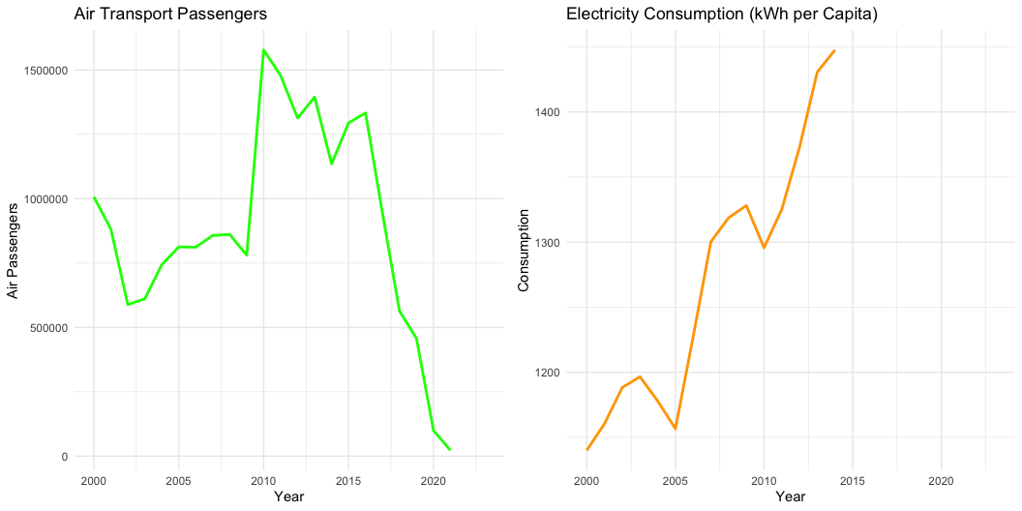
Air Transport Passengers Trend & Electricity Consumption
Air Transport Passengers Trend: The number of air passengers rose sharply around 2010, followed by a notable decline in subsequent years. Insight: Early growth reflects increased tourism and improved policies, whereas the decline may stem from economic pressures and shifting global conditions.
Electricity Consumption (kWh per Capita) Trend: Per capita electricity consumption grew steadily, particularly after 2010. Insight: This trend indicates improvements in Cuba’s energy infrastructure and growing socioeconomic activity.

Slide 8
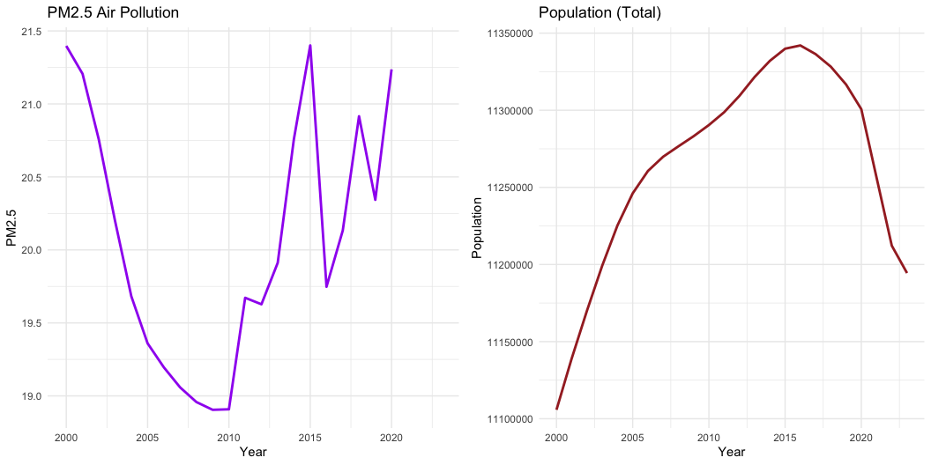
PM2.5 Air Pollution & Population
PM2.5 Air Pollution Trend: PM2.5 concentrations were high in 2000 but showed a gradual decline, with some fluctuations after 2015. Insight: The overall improvement reflects efforts to address air quality; however, the fluctuations suggest continued challenges related to industrial and transport emissions.
Population (Total) Trend: The population steadily increased until 2015, after which it leveled off and began to decline slightly. Insight: The recent decline may be driven by lower birth rates, increased emigration, and changes in demographic dynamics.

Slide 9
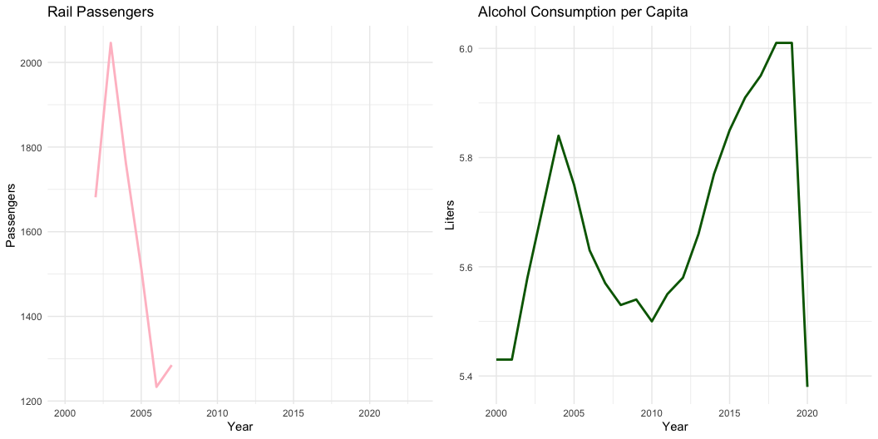
Rail Passengers & Alcohol Consumption per Capita
Rail Passengers Trend: The number of rail passengers peaked around 2005 but declined sharply thereafter. Insight: The decline suggests issues with aging infrastructure, reduced investment, and competition from alternative transportation systems.
Alcohol Consumption per Capita Trend: Alcohol consumption per capita rose until 2015 before dropping significantly. Insight: This decline may reflect changes in health policies, economic conditions, or cultural shifts.

