Slide 1
SiM Lift
——GA2

Slide 2
Sim Lift
Timeline
Some Deliveries
Further Plan

Slide 3
Timeline
Research
Sharing information
Requirement
Design simulation
Code
Test
Modify

Slide 4
Progress made
Research
Sharing information
Requirement
Design simulation
Code
Test
Modify

Slide 5
Research
Simulation Method //Done
traffic statistics of building //Done
Simulation Time //Still researching

Slide 6
Delivery
Research:
Simulation method
---By vivien

Slide 7
Research-simulation method
----VIVIEN
Simulation is the real thing or a virtual process.
Simulation to demonstrate the key features of selected physical
or abstract system of systems.
Simulation of key issues including effective access to
information,
key features and
performance of selected applications approximation to simplify and assumptions, as well as the reproducibility and effectiveness Simulation.
The simulation can be considered an external manifestation of
the system to reproduce the special Simulation.

Slide 8
Research-simulation method
----VIVIEN
Simulation step:
Problem Definition
Project Planning
System Definition
Model Formulation
Input Data Collection & Analysis
Model Translation
Verification & Validation
Experimentation & Analysis
Documentation & Implementation
Decisions for Simulating

Slide 9
Thought of our simulation
----VIVIEN
1. input data
total demand number of use lift
2. generate random data (arrive time,
floor, destination floor) includes:
-normal data
-traffic data

Slide 10
Thought of our simulation
----VIVIEN
3. simulate use these random data and some specific setting. for example,
-simulation1: 2 lifts, capacity 10 people, these random number
-simulation2: 3 lifts, capacity 12 people, these random number
our simulate system, lift control, is similar to the realworld's lift running

Slide 11
Thought of our simulation
----VIVIEN
4. get the useful data and show to user data includes:
average wait time, busy % , occupancy, wait queue length
(this is for user to judgement which setting is better. The setting are lift number, lift capacity )

Slide 12
Thought of our simulation
----VIVIEN
for example:
2lifts, capacity 10 3lifts, capacity 12
average wait time: 20s 10s
busy %: 80% 65%
occupancy: 9 7
wait queue length: 12 7
----According to the feedbacks and discussion of group member

Slide 13
Delivery
Research:
Traffic Pattern
---By fidel

Slide 14
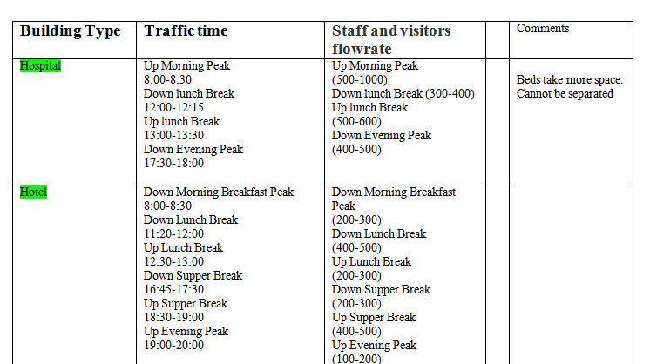
Research-Traffic Pattern
Building type research:
----FIDEL

Slide 15
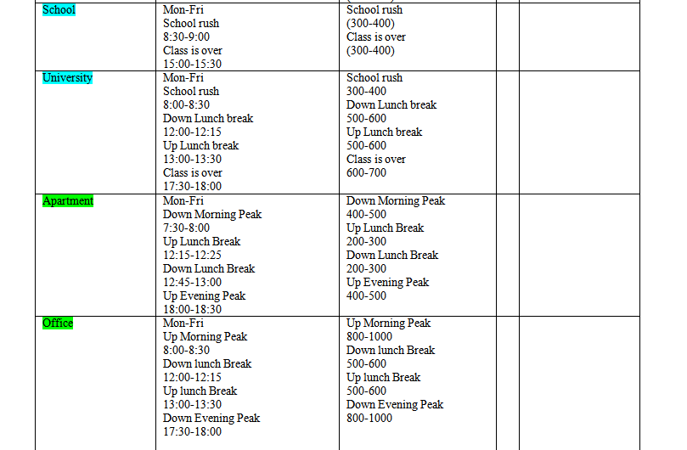
Research-Traffic Pattern
----FIDEL

Slide 16
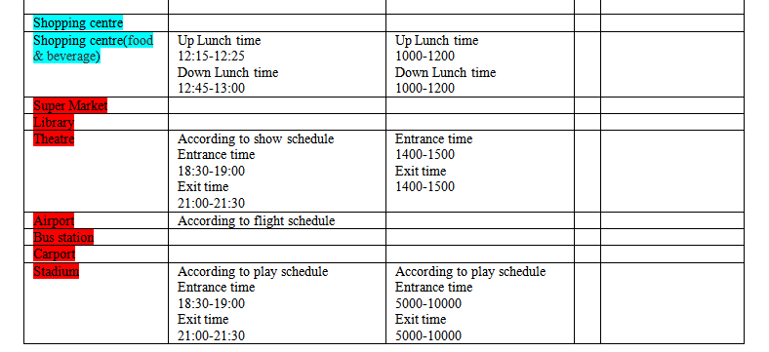
Research-Traffic Pattern
----FIDEL
-green shade must have
-blue shade important
-red shade option

Slide 17
Sharing information
Github
Two of us will go back to China
Q:Meeting?
A: QQ group with Gene twice a week

Slide 18
Progress made
Research (vivien, fidel)
Sharing information (all)
Requirement (luke)
due to 23/12/2013
Design simulation
due to 27/12/2013
Code
Test
Modify

Slide 19
Requirement
List basic requirements
Adding some extra requests(option)
---Luke

Slide 20
Design Simulation
UML diagram jeff Due to 22/12/2013
Naming luke Due to 27/12/2013
-The structure of whole code will base on naming.
Interface design vivien Due to 27/12/2013

Slide 21
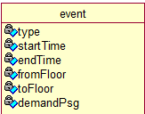
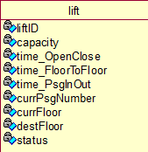




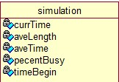
Draft of Naming
This draft is done by vivien.
The whole naming will be done by luke due to 27/12/2013

Slide 22
Code
Three important classes:
-TRAFFIC random(fidel) Due to 30/12/2013
-CONTROLLER/SIMULATION lift (fidel) Due to 06/01/2014
-INTERFACE/INPUT/RULES simulation(luke) Due to 08/01/2014
STATS/RESULTS/VISULISATION
The other codes will be assgined to each of us after naming already done.
The other classes may includes: passenger, event,
building, floor, etc.

Slide 23
Test & Modify
Test and modify will be done several times
During coding.
Final test & modify for first demonstration
Due to 12/01/2014
Preliminary demonstration
14/01/2014

Slide 24
The Rest
Meeting time:
Twice a week with GENE.
Check the data in github.
The action table will be updated at github each week.
https://github.com/VivienGA2/TimeLine/issues?state=open

Slide 25
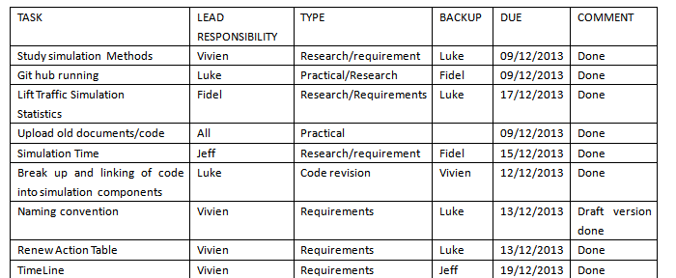
Action Table

Slide 26
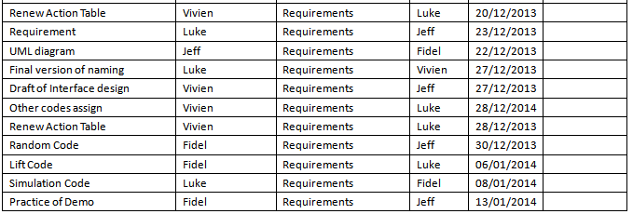
Action Table

