Slide 1
A Digital Humanities Approach to Characterizing Murderers in Agatha Christie’s Detective Novels
Masterarbeit-Verteidigung
Mengjiao Li
Matrikelnummer 3392731
Institut für Literaturwissenschaft | Universität Stuttgart
Betreuer: Dr. Anselm Küsters | Dr. Nora Ketschik

Slide 2
1. Research Question
Objective of the Study A quantitative and qualitative analysis of murderer characterizations in eight of Christie novels using digital methods.
Research Question How can digital methods analyze the portrayal of murderers in Agatha Christie’s novels, thereby revealing her conception of murderers and her moderate feminism?
Theoretical Frame
Unreadability of Christie’s Texts (Ina Hark 1997)
New Woman Concept (late 19th Century)
Agatha Christie transcends simple repetition through inventive variation (Verbogen 2008)

Slide 3
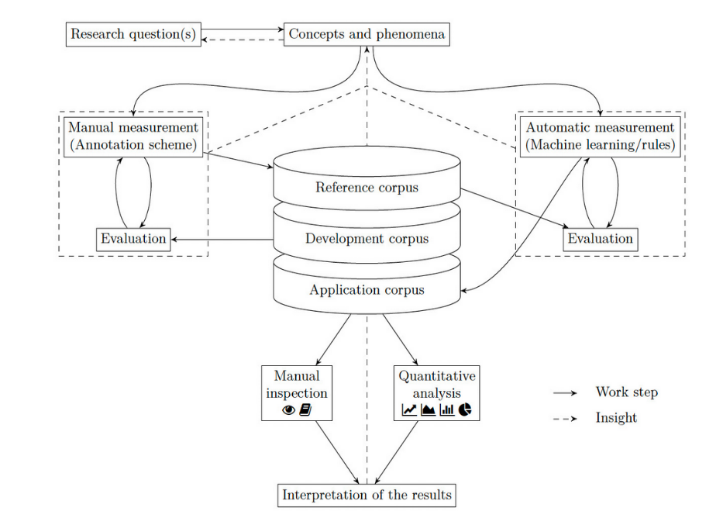
2. Operationalization
Workflow for Reflected Text Analysis, Pichler & Reiter (2022)

Slide 4
Concept and Definition
murderers’ characterizations
Agatha Christie’s conception of the murderers
Agatha Christie’s moderate feminism
Notes:
murderers’ relationships with other characters, their talkativeness (reflected through speech/appearance rate), contextualization of murderers (semantic fields), sentiment of murderers’ modifiers (whether they portrayed as positive, neutral or negative), and differentiation of modifiers for male and female murderers. These characterizations are investigated by employing social network analysis, bar plot visualization, Word2Vec analysis, sentiment analysis and linguistic representation. Theoretical Concept
Unreadability (Ina Rae Hark)
“human guilt and innocence are thoroughly intermixed, rather than being in mutually exclusive binary positions. If we attempt to read people like books to separate the murderous from the non-murderous, we must fail, because in Christie’s view, no such creature as a person incapable of murder exists.” (Ina Hark 1997, 2)
Verbogen (2008)’s argument that, while Christie employs formulaic structures, her works transcend simple repetition through inventive variations
The New Woman (moderate Feminism)
The “New Woman” is “a woman who represented women seeking greater independence, education and involvement in public life, challenging traditional gender roles and societal expectations.” (Dolski 2024, 33)

Slide 5
Corpus and Methods
Corpus (total tokens 805,967):
The Murder of Roger Ackroyd (1926)
The A.B.C. Murders (1936)
And Then There Were None (1939)
Lord Edgware Dies (1933)
A Murder is Announced (1950)
The Mirror Cracked from Side to Side (1962)
The Mystery of the Blue Train (1928)
Evil Under the Sun (1941)
Resource: https://www.gutenberg.org & https://detective.gumer.info
featuring male solo murderers, 31.9% of total tokens
featuring female solo murderers,37.6% of total
tokens
featuring co-murderers, 30.9% of total tokens
Notes:
the novels analyzed offer a cross-section of Agatha Christie’s writing across different periods: from the 1920s to the 1960s.

Slide 6
Methods and Tools:
Social Network Analysis (Gephi)
Speech/Appearance Rate (R, ggplot2)
Word2Vec(t-SNE Visualization)
Sentiment Analysis (R, Lexicoder Sentiment Dictionary)
Linguistic Representation (Gephi)

Slide 7
3. Quantitative Analyses
3.1 Social Network Analysis (SNA)
Process
Co-occurrence relationships are manually recorded.
Addtional attributes of murderers are manually annotated with CATMA: quoted speeches (tagged with name) & mention (tagged with mention_(name)).
Ezlinavis: initial networks based on co-occurrence
Gephi: final networks with attributes

Slide 8
Metrics
Quoted Speeches
Mention
Degree Centrality
Closeness Centrality
Betweenness Centrality
Eigenvector Centrality
Notes:
the number of it is a sign whether the character is active throughout the novels; A mention indicates significant attention or suspicion directed toward a character; A node with a high Degree Centrality is considered important because it has many direct connections to other nodes. a node with a high Closeness Centrality is closely related to other nodes and can spread information very fast. A node with high Betweenness Centrality acts as a bridge in the network. It controls information flow between other nodes; a node with high eigenvector centrality is related to resourceful nodes.

Slide 9
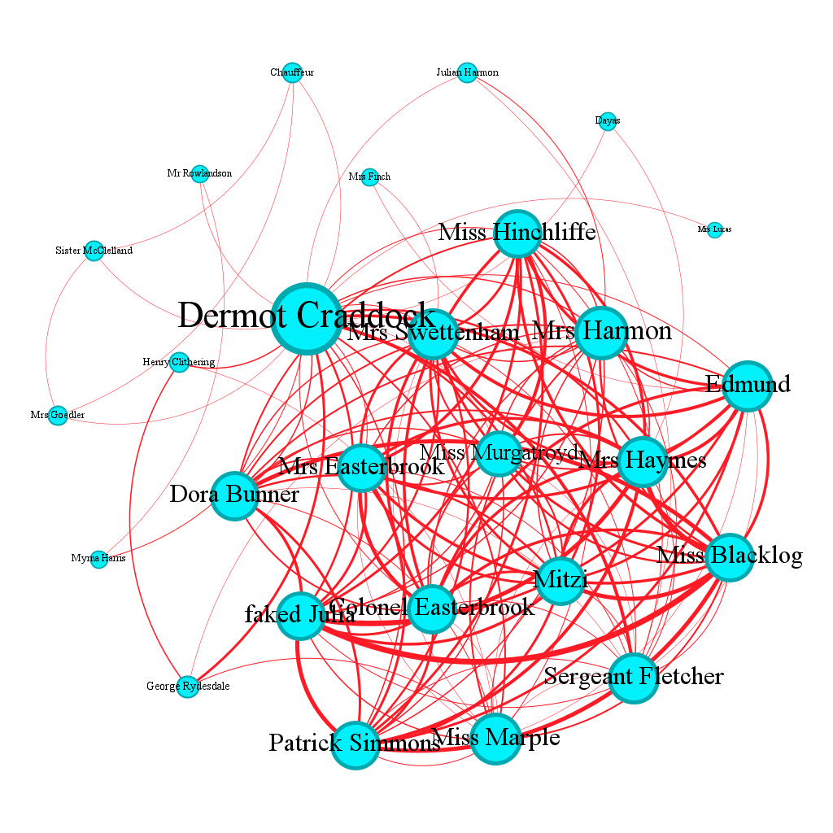
Visualization
Visualization of Character Relationships in A Murder is Announced with Nodes Ranked by Degree, Layout: Yifan Hu
Notes:
The result of SNA is presented below, with three distinct networks corresponding to three different rankings for each novel: Degree, Quoted Speeches, and Mention

Slide 10
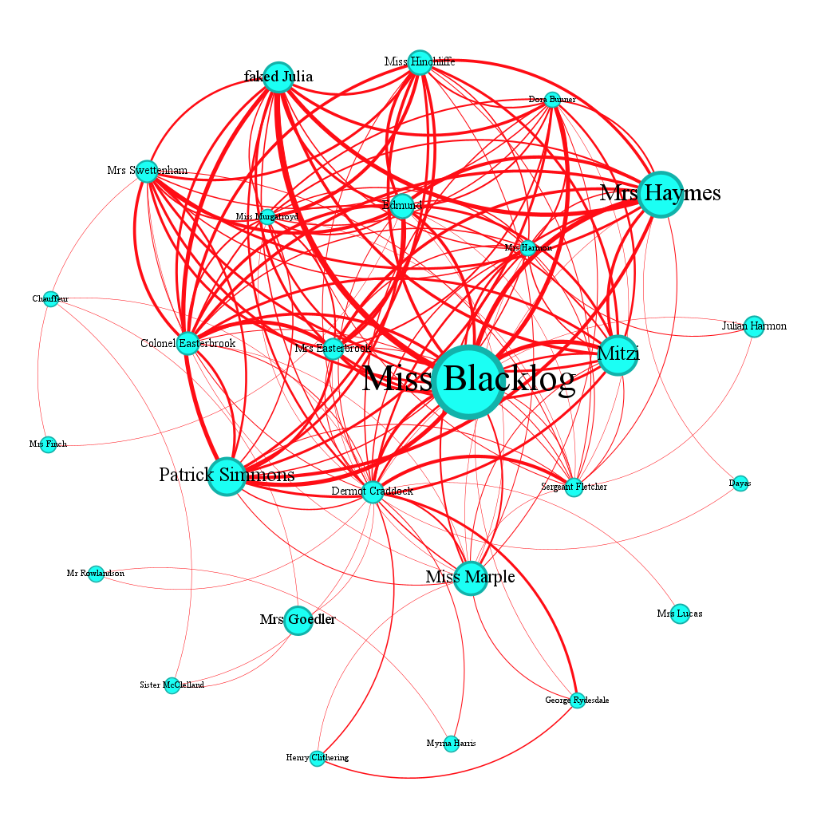
Visualization of Character Relationships in A Murder is Announced with Nodes Ranked by Mention, Layout: Yifan Hu

Slide 11
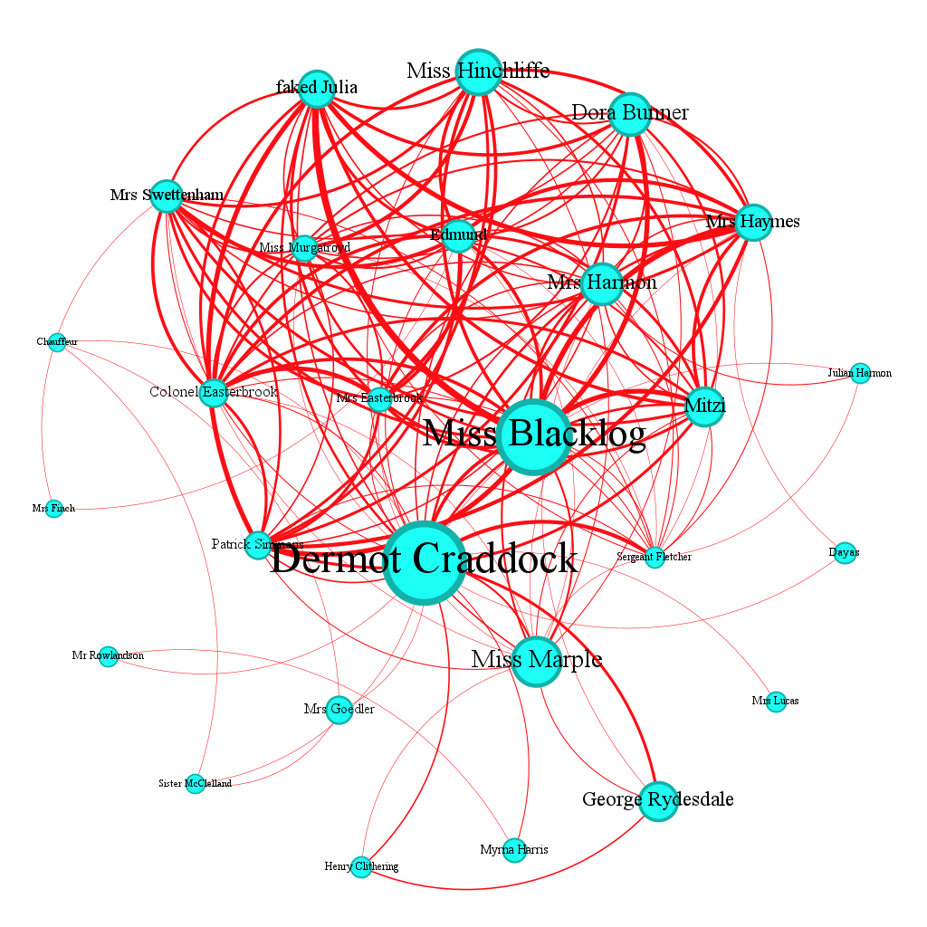
Visualization of Character Relationships in A Murder is Announced with Nodes Ranked by Quoted Speeches, Layout: Yifan Hu

Slide 12
Synthesis of SNA Results
Murderer | Gender | Degree/Ave.Degree/Max | QS/Ave.QS /Max | Men/Ave.Men /Max | CC/Ave.CC /Max | BC/Ave.BC /Max | EC/AVE.EC /Max
Sheppard | male | 21/11 /21 | 699/193 /1361(Poi.) | 0/49 /285(R. Paton) | 1/0.69 /1 | 48.69/5.23 /48.69 | 1/0.63 /1
F. Clarke | male | 11/8 /37 (P, H) | 229/81 /1557(P) | 20/11 /178 (Cust) | 0.54/0.51 /0.81 (P, H) | 4.57/24.63 /319.39 (P, H) | 0.47/0.3 /1(P, H)
Wargrave | male | 13/10 /14 (Lom.) | 349/181 /599 (Lom.) | 23/23 /77 (Arms.) | 0.96/0.91 /1 (Lomb.) | 3.3/2.21 /16.3(Lomb.) | 0.99/0.85 /1 (Lomb.)
Jane Wilkinson | female | 14/8 /25 (P, H) | 272/186 /2047 (P, H) | 418/37 /418 | 0.69/0.62 /1(P, H) | 9.4/8.35 /88.83(P, H) | 0.75/0.47 /1(P, H)
Miss Blacklog | female | 15/11 /25 (Crad.) | 647/175 /742 (Crad.) | 198/30 /198 | 0.7/0.63 /0.96 (Crad.) | 0.07/8.11 /160.4 (Crad.) | 0.92/0.59 /1 (Crad.)
Marina Gregg | female | 11/8 /19 (Crad.) | 251/143 /884 (Crad.) | 628/35 /628 | 0.52/0.48 /0.69 (Crad.) | 1.9/19.6 /149.3 (Crad.) | 0.75/0.42 /1.0 (Preston)
Knighton | male | 18/8 /23(Kath.) | 152/119 /947 (P) | 45/23 /209 (Derek) | 0.68/0.54 /0.76 (Kath.) | 47.42/15.34 /171 (Kath.) | 0.88/0.44 /1(P)
Mason | female | 10/8 /23 (Kath.) | 73/110 /947 (P) | 43/23 /209 (Derek) | 0.59/0.54 /0.76 (Kath.) | 3.59/15.34 /171 (Kath.) | 0.61/0.44 /1 (P)
P. Redfern | male | 16/12 /18 (P) | 224/220 /1009 (P) | 117/48 /181 (Kenn.) | 0.9/0.76 /1 (P) | 4.97/3.1 /15.21 (P) | 0.95/0.7 /1 (P)
C. Redfern | female | 16/12 /18 (P) | 229/220 /1009 (P) | 136/48.1 /181 (Kenn.) | 0.9/0.76 /1 (P) | 4.97/3.1 /15.21 (P) | 0.96/0.7 /1 (P)

Slide 13
Patterns in Female Solo Murderers:
above average Quoted Speeches and Degree → active, talkative
higher Mention values → stronger narrative attention /suspicion
high Closeness Centrality → well-connected
high Eigenvector Centrality → connected with resourceful characters
low Betweenness Centrality → act within groups
Patterns in Male Solo Murderers:
above average Quoted Speeches and Degree → active, talkative
often lower Mention values
high Closeness Centrality → well-connected
high Eigenvector Centrality → connected with resourceful characters
low Betweenness Centrality → act within groups

Slide 14
Patterns in Co-murderers:
The centrality values of male murderers are equal to or greater than those of female murderers.
Female murderers are frequently characterized in a supporting capacity.
Since the female accomplices do not directly involve in the murder, their comparable Mention values suggest that they are not peripheral figures at all within the narrative.

Slide 15
3.2 Bar Plot of Speech/Appearance Rate
ggplot2 package in R is employed.
The bar plot analysis serves as a method to complement SNA, making it easier to identify patterns in narrative engagement, such as how murderers’ presence varies across the novels.

Slide 16
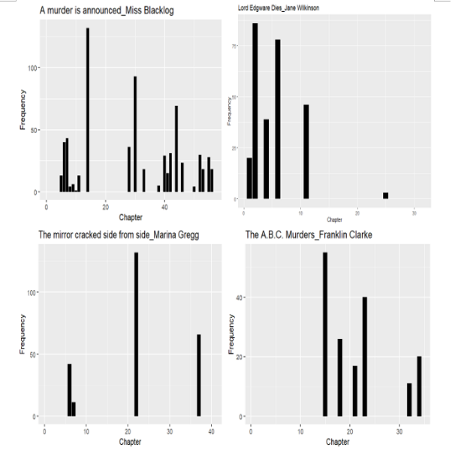
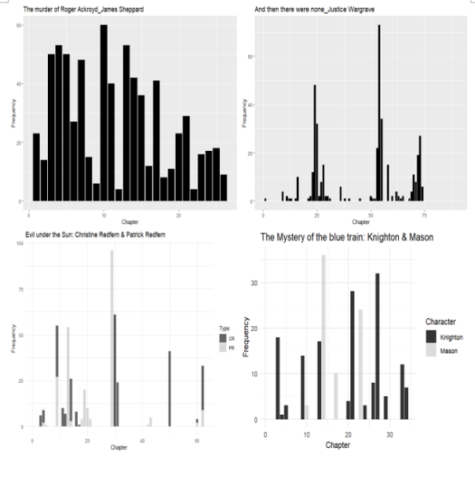
Barplots
Bar Plot of Speech/Appearance Rate of Murderers

Slide 17
Talkativeness is classified using distribution quartiles: the 75th percentile is 35.75 speeches per chapter, the 50th is 22.5, and the 25th is 16.5.
Characters are classified as “highly talkative” if their average number of speeches per chapter exceeds the 75%. Characters whose averages fall between the 25% and 75% are categorized as “moderately talkative,” while those below the 25% are considered “rarely talkative.”

Slide 18
Murderer | Number of Chapters in which she/he appears/Chapters of Novel | Average number of speeches in each chapter | Level of Talkativeness
Jane Wilkinson | 6 | 45 | highly
Miss Blacklog | 22 | 29 | moderate
Marina Gregg | 4 | 63 | highly
Sheppard | 26 | 27 | moderate
F. Clarke | 6 | 38 | highly
Wargrave | 41 | 9 | rare
Knighton | 13 | 12 | rare
Mason | 4 | 18 | moderate
P. Redfern | 14 | 16 | moderate
C. Redfern | 13 | 18 | moderate
Murderers’ Average Number of Speeches per Chapter of Appearance

Slide 19
3.3 Word2Vec
Corpus Preparation and Model Training
Contextualization of non-murderers is represented as comparison. Non-murderers in this study refer to detectives and the most suspicious characters (who are with the highest score of Mention) in each novel.
Eight novels are combined.
All character names are standardized.
Training procedure follows methodological guidelines outlined in the forTEXT learning unit Word2Vec with Gensim (Schumacher, 2023b).

Slide 20
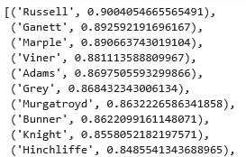
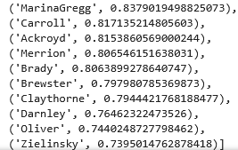
Semantic Field of Target Character
Semantic Filed of Miss Blacklog with Top 20 Most Similar Words

Slide 21
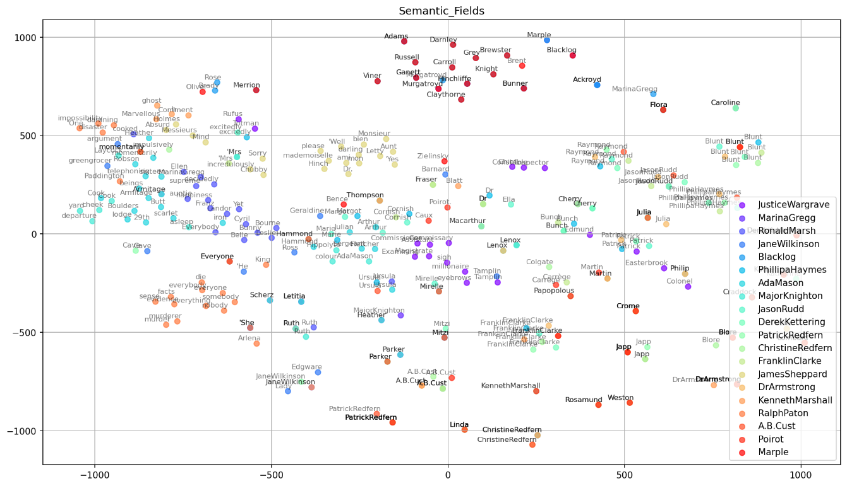
t-SNE Visualization (1)
t-SNE Representation of Semantic Fields of Murders and Non-Murderers individually

Slide 22
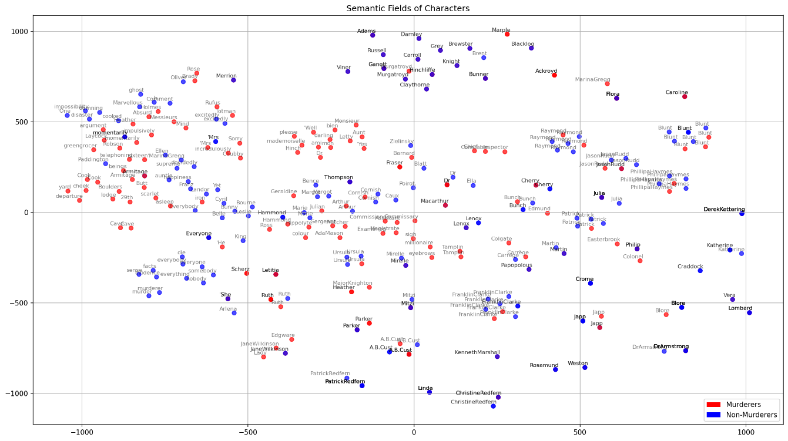
t-SNE Visualization (2)
t-SNE Representation of Semantic Fields of Murders and Non-Murderers in Group

Slide 23
T-test
Why T-test?
the data consists of two independent groups (murderers and non-murderers)
a numerical measure for each character (the mean of the Word2Vec embeddings)
robust against violation of normal distribution
Result:
p-value is 0.426: murderers do not differ statistically from non-murderers in terms of the semantic content of their language.

Slide 24
3.4 Sentiment Analysis
To investigate how sentiment is linguistically constructed around the murderers
This study applies lexicon-based computational sentiment analysis to the linguistic modifiers surrounding the murderers in the selected novels
Both murderers and detectives’ sentiment scores are to be considered.

Slide 25
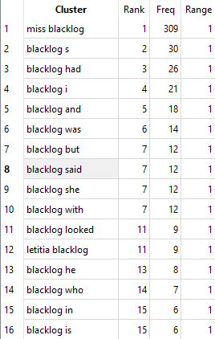
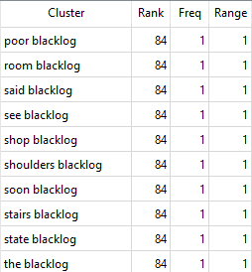
Identification of Modifiers
search tool: AntConc , Cluster function, search range is set to include one word before and after the term

Slide 26
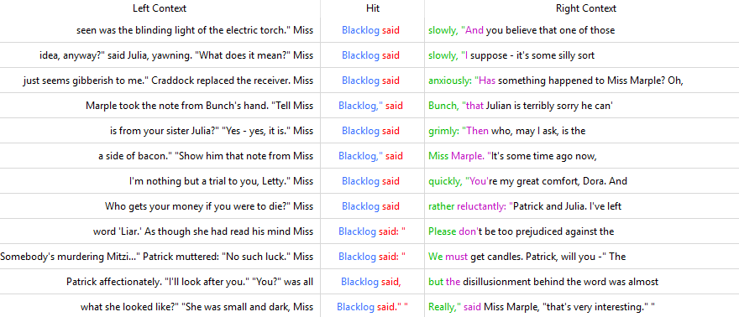
Key Word in Context (KWIC)
A Screenshot of KWIC Result for the Word Sequence Blacklog said in AntConc

Slide 27
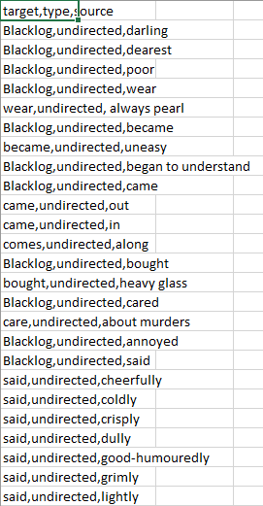
Search results are manually recorded and a csv file is created for every target character.
A Screenshot of Blacklog’s Modifiers in CSV Format

Slide 28
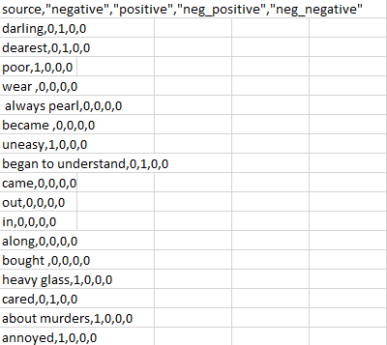
Sentiment analysis in this study is implemented in R
The Lexicoder Sentiment Dictionary (LSD) developed by Young & Soroka is employed for this purpose.
A Screenshot of Sentiment Analysis for the Modifiers of Miss Blacklog

Slide 29
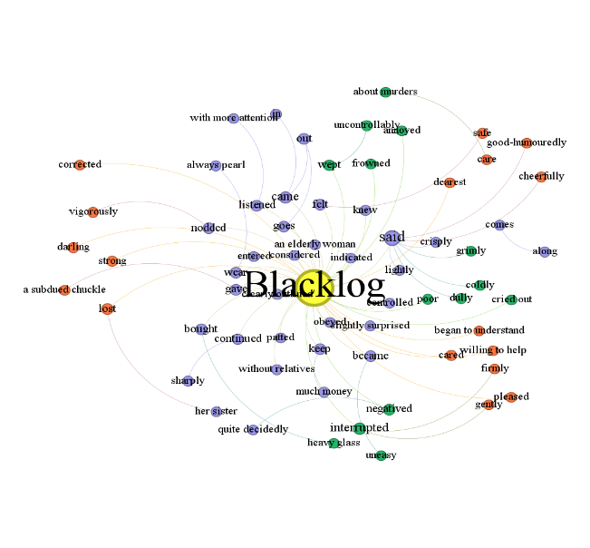
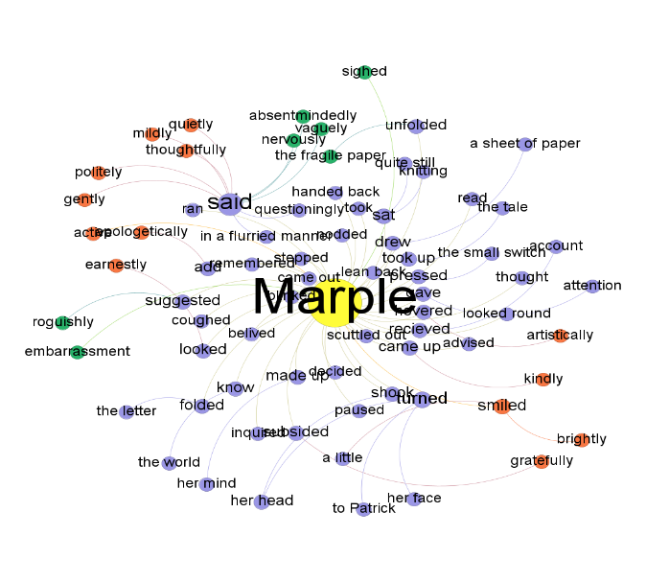
CSV files created for the modifiers of each target character are imported into Gephi
sentiment is then added as an attribute in Gephi labor, and the sentiment scores are then as values imported.
the score of negative sentiment is changed to -1
positive sentiment remains as 1
neutral sentiment is represented by a score of 0
Sentiment Network Visualizations for Miss Blacklog and Miss Marple in Gephi, Layout: Yifan Hu

Slide 30
 | Neutral (%) | Positive (%) | Negative (%) | Total Score
The Murder of Roger Ackroy
Sheppard | 40 | 30 | 30 | 0
Poirot | 63 | 26 | 11 | 15
The A.B.C. Murders
F. Clarke | 68.89 | 13.33 | 17.78 | -4.45
Poirot | 77.78 | 14.29 | 7.94 | 6.35
And Then There were None
Wargrave | 80.43 | 11.96 | 7.61 | 4.35
Lord Edgware Dies
Jane Wilkinson | 70.59 | 8.82 | 20.59 | -11.77
Poirot | 61.33 | 26.67 | 12 | 14.67
A Murder is Announced
Miss Blacklog | 53.03 | 25.76 | 21.21 | 4.55
Miss Marple | 72.97 | 17.57 | 9.46 | 8.11
The Mirror Cracked Side from Side
Marina Gregg | 59.18 | 22.45 | 18.37 | 4.08
Miss Marple | 60 | 24 | 16 | 8
The Mystery of the Blue Train
Knighton | 54.95 | 29.67 | 15.88 | 13.79
Mason | 68.75 | 9.38 | 21.88 | -12.5
Poirot | 64.21 | 27.37 | 8.42 | 18.95
Evil under the Sun
C. Redfern | 76.67 | 5 | 18.33 | -13.33
P. Redfern | 60.78 | 21.57 | 17.65 | 3.92
Poirot | 67.59 | 23.15 | 9.26 | 13.89
Sentiment Scores of Murderers and Detectives in Selected Novels

Slide 31
While the sentiment scores of the detectives are always above zero, the sentiment scores of the murderers vary a lot.
These findings lend empirical support to Verbogen (2008)’s argument that Agatha Chritie transcends simple repetition through inventive variations: the murderers can be portrayed not only as negative, but also as positive and neutral. And precisely these variations of conception of characters reflect Ina Hark’s theory of the unreadability of Agatha Christie’s texts, which posits that “human guilt and innocence are thoroughly intermixed, rather than being in mutually exclusive binary positions. If we attempt to read people like books to separate the murderous from the non-murderous, we must fail, because in Christie’s view, no such creature as a person incapable of murder exists” (Hark 1997, 2).

Slide 32
3.5 Linguistic Representation
Linguistic representation refers to the way linguistic elements, such as words, phrases, certain syntax, are used to represent ideas, concepts, experiences, and social realities, thereby shaping how we understand and interpret the world.
Two main research questions guide the analysis: (1) Which words with negative sentiment scores does Agatha Christie most frequently associate with evil, and which words with positive sentiment scores does she associate with good? (2) Does her use of these words differ between female and male murderers?
Linguistic elements in this study are words identified in the previous section as carrying negative or positive sentiment scores

Slide 33
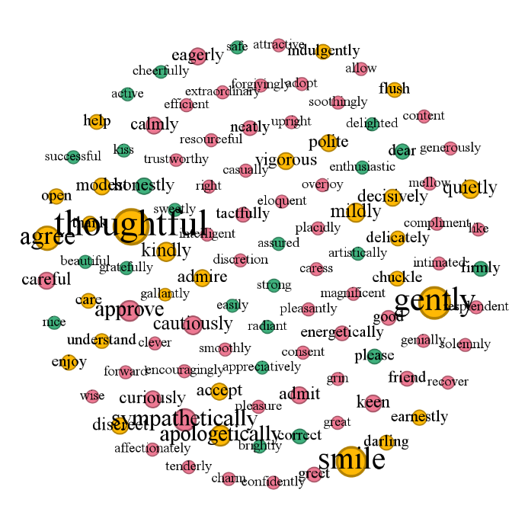
orange: female and male characters,
red: exclusively for male characters,
green: exclusively for female characters.
Of all the 109 positive modifiers, 71.6% are used for male characters
and 28.4% are used for female characters.
41.28% of all positive modifiers are exclusively used for detectives,
33.94 % are used exclusively for murderers
24.77% are used both for detectives and murderers
Linguistic Representation of Positive Modifiers in Gephi, Layout: Fruchterman Reingold

Slide 34
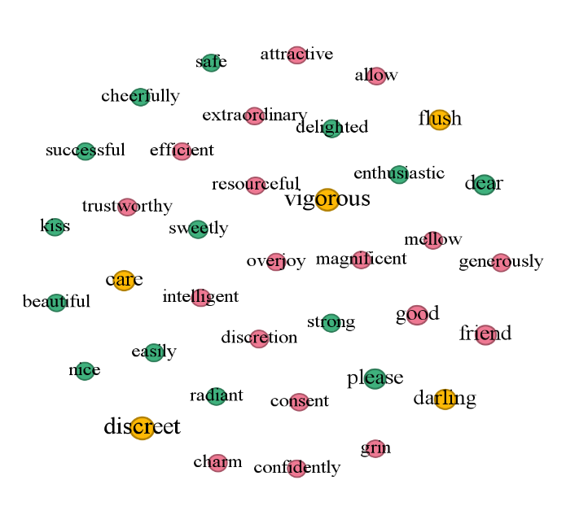
Linguistic Representation of Positive Modifiers Exclusively Used for Murderers in Gephi, Layout: Fruchterman Reingold

Slide 35
Male | Frequency | Female | Frequency | Both | Frequency
good | 2 | dear | 2 | discreet | 3
friend | 2 | please | 2 | vigorous | 3
attractive | 1 | safe | 1 | flush | 2
allow | 1 | cheerfully | 1
efficient | 1 | kiss | 1
resourceful | 1 | beautiful | 1
trustworthy | 1 | nice | 1
overjoy | 1 | easily | 1
intelligent | 1 | sweetly | 1
discretion | 1 | delighted | 1
charm | 1 | radiant | 1
consent | 1 | enthusiastic | 1
confidently | 1 | strong | 1
grin | 1 | successful | 1
magnificent | 1
mellow | 1
generously | 1
extraordinary | 1
Positive Modifiers Exclusively Used for Murderers

Slide 36
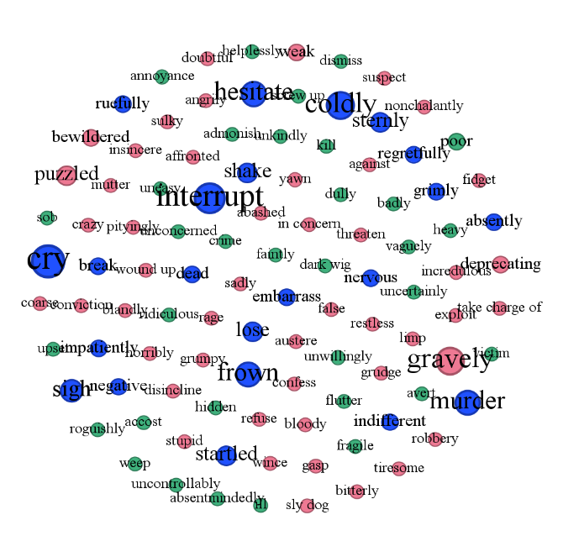
blue :both genders
red : exclusively for male characters
green : exclusively for female characters
Of all the 103 negative modifiers, 59.26% are used for male characters and 40.74% are used for female characters
30.1% of all negative modifiers are exclusively used for detectives, 52.43 % are used only for murderers, 17.48% are used both for detectives and murderers. Within the domain of negative descriptors, murderers are clearly the primary targets.
Linguistic Representation of Negative Modifiers in Gephi, Layout: Fruchterman Reingold

Slide 37
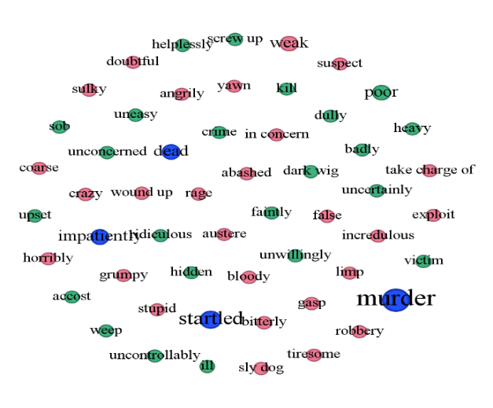
Linguistic Representation of Negative Modifiers Exclusively Used for Murderers in Gephi, Layout: Fruchterman Reingold

Slide 38
Male | Frequency | Female | Frequency | Both | Frequency
weak | 2 | accost | 1 | murder | 5
yawn | 1 | badly | 1 | startled | 3
wound up | 1 | crime | 1 | dead | 2
tiresome | 1 | dark wig | 1 | impatiently | 2
take charge of | 1 | dully | 1
suspect | 1 | faintly | 1
sulky | 1 | heavy | 1
stupid | 1 | helplessly | 1
sly dog | 1 | hidden | 1
robbery | 1 | ill | 1
rage | 1 | kill | 1
limp | 1 | ridiculous | 1
incredulous | 1 | screw up | 1
in concern | 1 | sob | 1
horribly | 1 | uncertainly | 1
grumpy | 1 | unconcerned | 1
gasp | 1 | uncontrollably | 1
false | 1 | uneasy | 1
exploit | 1 | unwillingly | 1
doubtful | 1 | upset | 1
crazy | 1 | victim | 1
coarse | 1 | weep | 1
bloody | 1 | poor | 1
bitterly | 1
austere | 1
angrily | 1
abashed | 1
Negative Modifiers Exclusively Used for Murderers

Slide 39
Regarding positive modifiers, male murderers are described more in terms of strength and intellect, with words like resourceful, trustworthy, intelligent, and efficient, while female murderers are more associated with emotional warmth, beauty, and charm, such as safe, beautiful, kiss, radiant, and sweetly.
Some modifiers typically associated with men in the author’s era, like strong and successful, are also used to describe female murderers.
Shared modifiers like discreet and vigorous suggest that murderers of both genders are seen as effective, energetic, or calculating
With respect to negative modifiers, male murderers are more described by a range of negative or problematic traits, such as emotional instability like rage, grumpy, weak, poor decision-making like stupid, sly dog, or immoral behavior like robbery, exploit. The terms used for female murderers often convey a sense of passivity, emotional distress, or vulnerability, such as sob, weep, helplessly, faintly, ill, poor, and upset.
Modifiers exclusively used for female murderers like dark wig, hidden, and victim suggest that these female murderers adopt a facade of weakness to divert attention away from themselves during the investigative process

Slide 40
4. A Comprehensive Overview of the Murderers
Results of quantitative analyses are combined with additional information to the murderers to get a comprehensive profile for each murderer.

Slide 41
 | Gender | Age | Occupation/Identity | Motive | Methods of Killing | Number of Victims | Fate
Sheppard | male | middle-aged | Doctor | fear of exposure | stabbing | 1 | suicide
F. Clarke | male | young | a wealthy man’s younger brother | greed | strangling, blunt force, stabbing | 4 | arrested
Wargrave | male | old | retired judge | twisted sense of justice | poison, blunt force, shooting and indirect | 10 | suicide
Knighton | male | young | secretary | greed | blunt force | 1 | arrested
P. Redfern | male | young | con artist | greed | blunt force | 1 | arrested
Jane Wilkinson | female | young | actress, Lord Edgare’ wife | greed | stabbing, poison | 3 | arrested
Miss Blacklog | female | old | owner of a house | greed, fear of exposure | shooting, poison,strangling | 3 | arrested
Marina Gregg | female | young | actress | revenge, fear of exposure | poison, shooting | 3 | suicide
Ada Mason | female | young | house maid | greed | providing falsified testimony | 1 | arrested
C. Redferm | female | young | teacher of Latin | greed | providing falsified testimony | 1 | arrested
Additional Information about the Murderers

Slide 42
5. Conclusion
Agatha Christie’s murderers are complex and multifaceted, reflecting the inherent unreadability of her texts.
Unreadability, Inventive Variation
Female murderers are active and communicative, often maintaining close relationships with other characters.
While they are frequently depicted as emotionally vulnerable, poor, harmless, and lacking in intelligence, these portrayals serve as disguises to carry out their murder schemes and divert police investigations.
These women employ the same violent methods as their male counterparts, such as stabbing and strangling, and are depicted with similar traits of discretion and vigor.
Female accomplices also play a crucial role, offering strategic false testimonies to support the male perpetrators.
New Woman

Slide 43
References
Anthony, Laurence. AntConc (Version 3.2.1). Tokyo, Japan, Waseda University, 2023. http://www.antlab.sci.waseda.ac.jp/
Bastian, M., S. Heymann, and M. Jacomy. Gephi: an open-source software for exploring and manipulating networks. Third international AAAI conference on weblogs and social media,2009. https://gephi.org/
Dolski, Dora. “The portrayal of male and female murderers in selected novels of Agatha Christie.” University of Zadar, 2024. URN: nbn:hr:162:247069
Gius, Evelyn, Jan Christoph Meister, Malte Meister, Marco Petris, Dominik Gerstorfer, and Mari Akazawa. CATMA 7 (Version 7.1), 2024. https://catma.de/
Hark, Ina Rae. “Impossible Murderers: Agatha Christie and the Community of Readers.” Delamater, Jerome H. and Ruth Prigozy (eds), Theory and Practice of Classic Detective Fiction, Bloomsbury Publishing USA,1997, pp. 111-118.
Pichler, Axel, and Nils Reiter. “From Concepts to Texts and Back: Operationalization as a Core Activity of Digital Humanities.” Journal of Cultural Analytics, vol. 7, no. 4, Dec.2022. https:/​/​doi.org/​10.22148/​001c.57195
R Core Team. R: A Language and Environment for Statistical Computing. R Foundation for Statistical Computing, 2023. https://www.r-project.org/
Schumacher, Mareike. “Netzwerkanalyse.” forTEXT: Literatur digital erforschen, 2018, https://fortext.net/routinen/methoden/netzwerkanalyse.
Verbogen, Aagje. “Agatha Christie and Her Murderers: A Case Study of the Miss Marple Novels.” University of Gent, 2008. https://libstore.ugent.be/fulltxt/RUG01/001/414/024/RUG01-001414024_2010_0001_AC.pdf
Young, Lori and Stuart Soroka. Lexicoder Sentiment Dictionary. 2012. https://www.snsoroka.com/data-lexicoder/

Slide 44
Mengjiao Li
E-Mail:
st183118@stud.uni-stuttgart.de
Universität Stuttgart
Institut für Literaturwissenschaft

