Slide 1

Société Chéroise d'Elevage de Poulet
Where should our French chicken be exported?
Vivien Pichon
03.2025

Slide 2
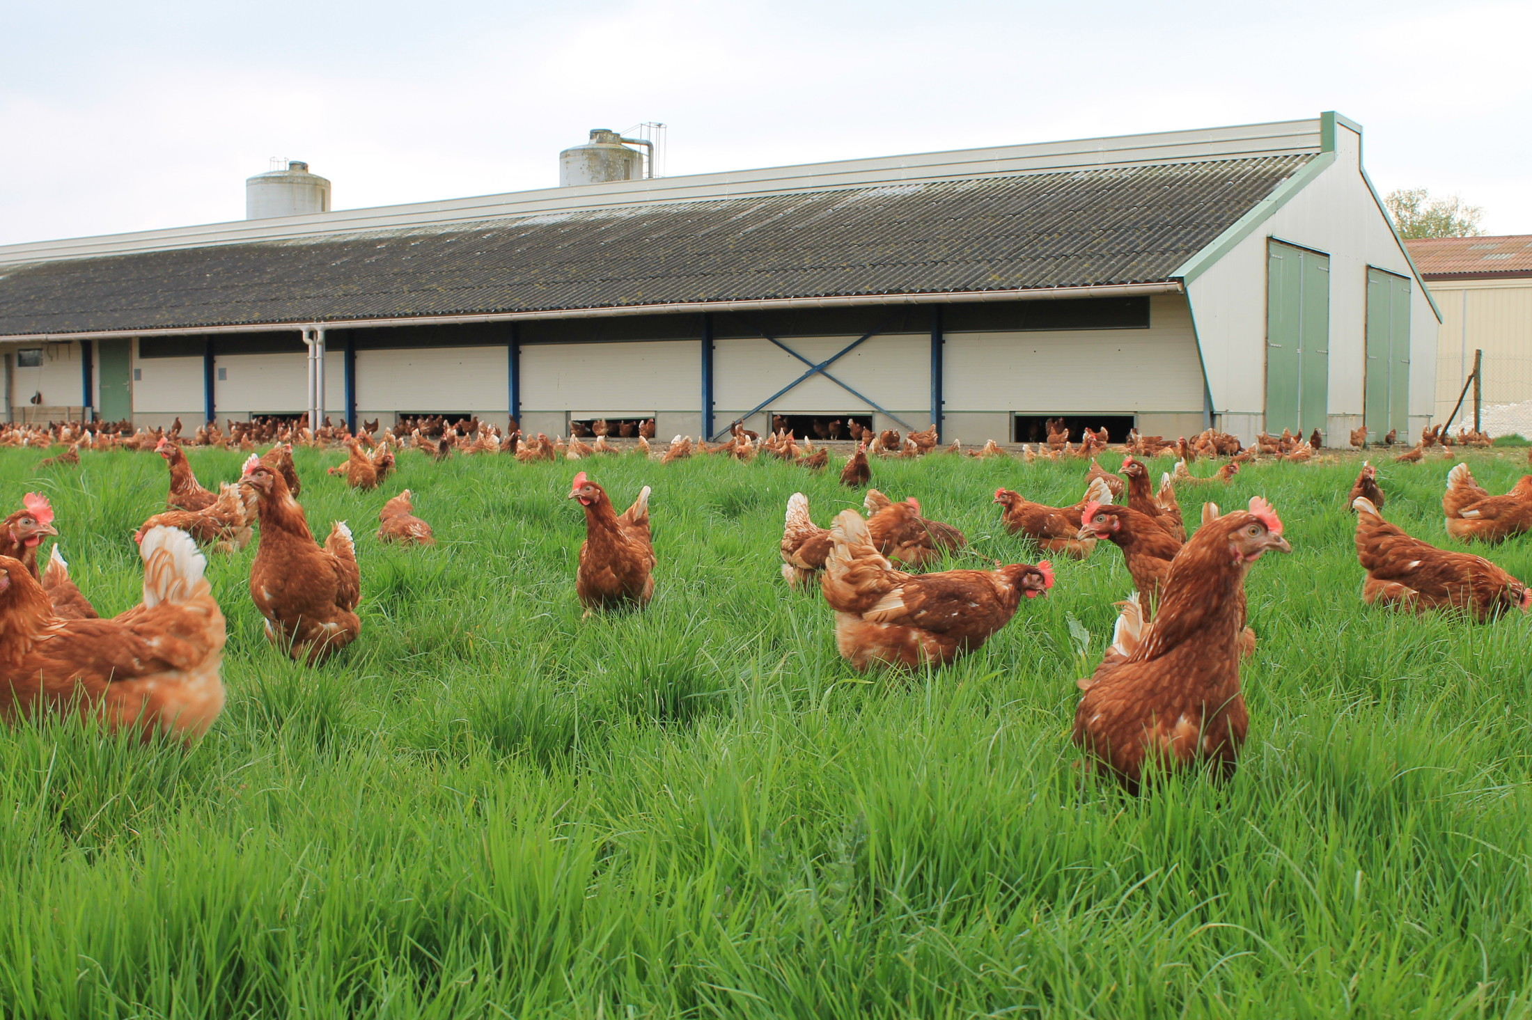
Choice of exportation country
Characteristics of French chicken
France / EU
US / World
Presence of animal welfare regulations
No animal welfare rules
Ban on animal bonemeal and growth promoters
Bonemeal and growth promoters allowed in most countries
Strict waste management
liberal waste disposal
High environmental value
High meat quality
High price
Notes:
5 freedoms of animals: freedom from hunger and thirst, discomfort, pain, injury and disease, and the freedom to express normal behavior.

Slide 3





Choice of exportation country
Indicators of interest
- GDP in dollars
- Index of ease of business (2019)
- Logistics performance index (2018)
- Political stability index
- Population
- Consumer price index
- Chicken consumption
- Chicken import quantity
- Chicken import value
Year 2021
Last year before geopolitical mess
- Share of customer expenditure spent on food
- Corruption Perception index

Slide 4



Data cleaning and completion
The final table has 181 rows and 13 columns
Calculate new indicators
GDP per capita
Chicken import price
Chicken consumption per capita
Indicator removal
Share of customer expenditure spent on food
Rows removal
67 with more than 2 NAs
Raw values table
Scaled table
Fill missing values
Random Forest predictor

Slide 5
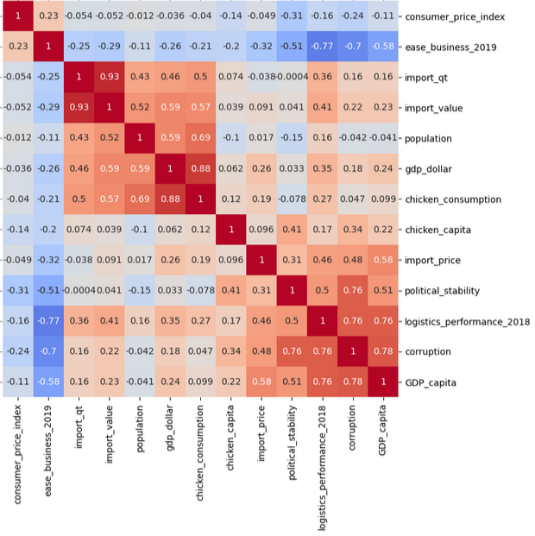
Correlations between variables
Two main groups of variables are clearly visible
B
Country population size
A
Country economic organization and efficiency

Slide 6
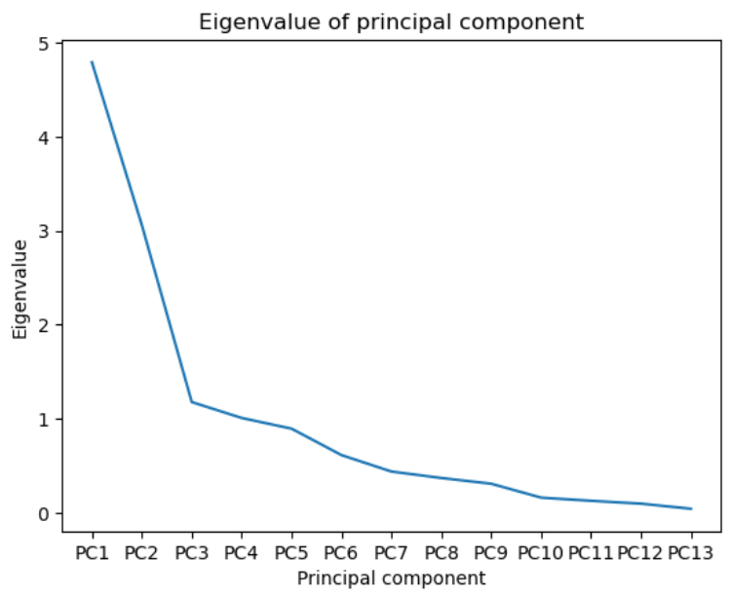
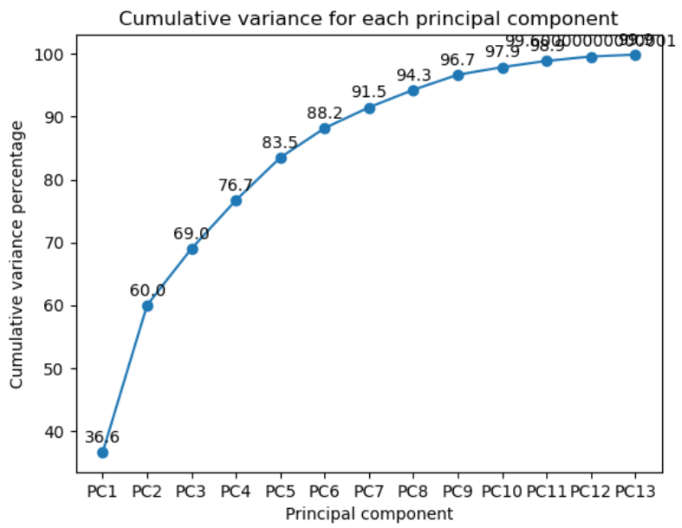
Number of components of the PCA
5 PC explain 80%+ of the variability
Elbow at PC3
We want more than 80% of variability, so we go until PC5.

Slide 7
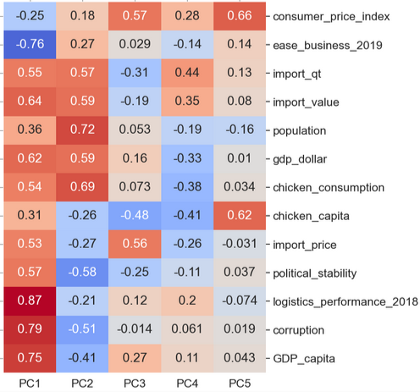
Understand the PC
Concrete (and imperfect) equivalents
A
B
PC1: Performance and organization of the economy.
PC2: Country population size.
PC3: Price of imported goods in general.
PC4: Low chicken production (low consumption despite higher imports).
PC5: Countries with high overall prices and chicken consumption.

Slide 8
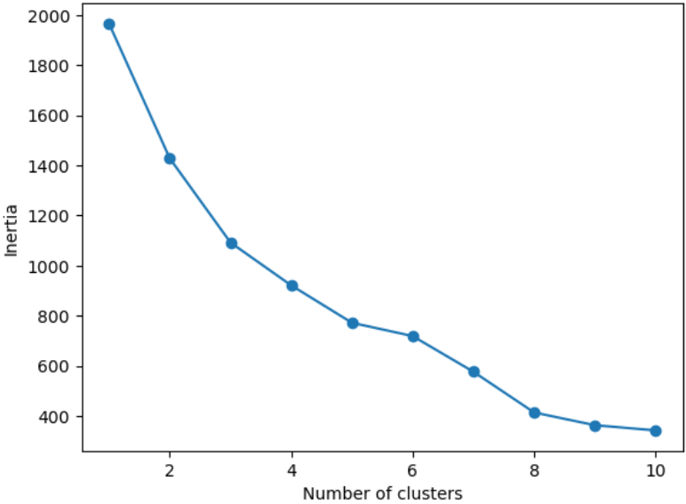
Cluster the countries
Adding extra clusters puts the ouliers aside
We will look for 8 clusters, we expect 2 or 3 to be very small, outlier groups.

Slide 9
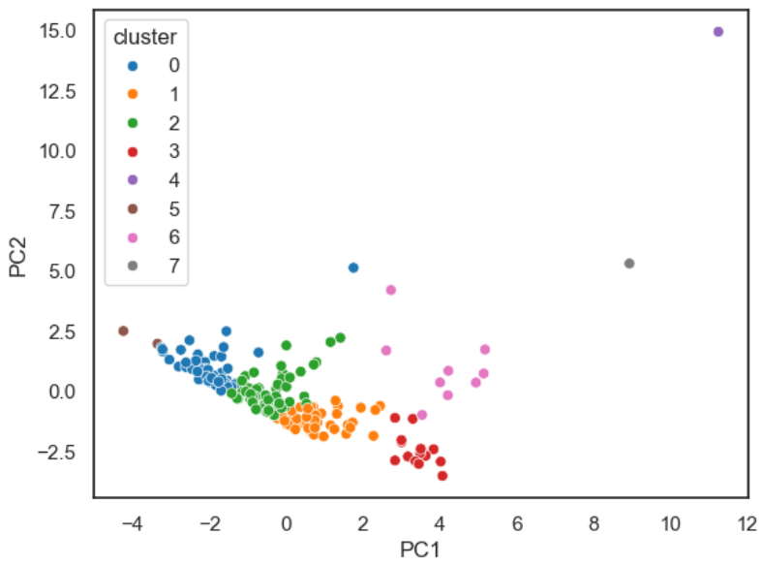
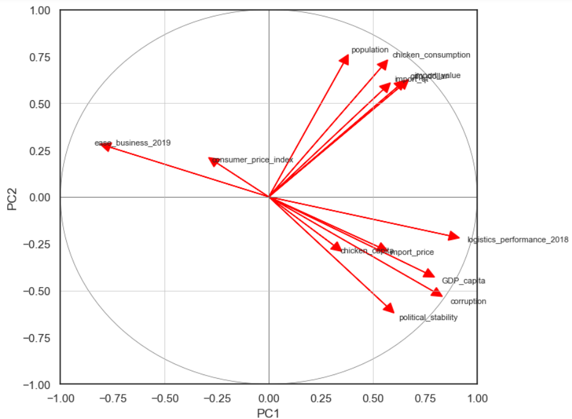
Cluster the countries
The clusters are very close to each other
China
B
USA
Wealthiest countries
A
The clusters 3 and 6 are the wealthiest countries.
The clusters 4, 5 and 7 are the outliers.

Slide 10
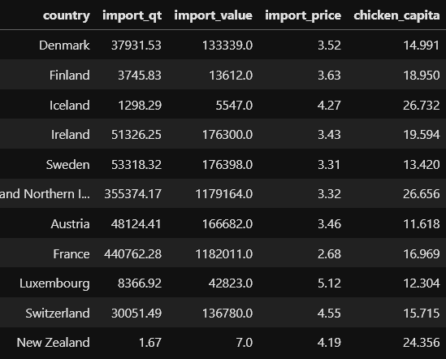
Choice of target countries
List of countries with higher import prices than France
Aim at countries with:
High import prices
French-speaking
No boat-shipping involved
UK

Slide 11
Thank you for your attention

