Slide 1
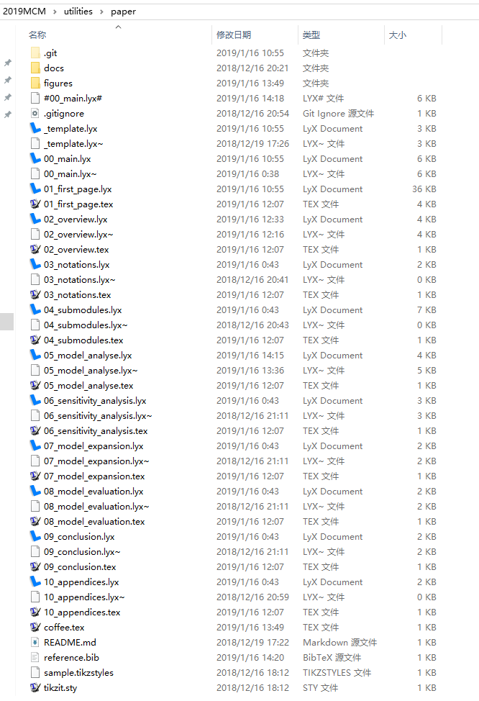
Demo
GitHub repository: https://github.com/ZPinjun/paper

Slide 2
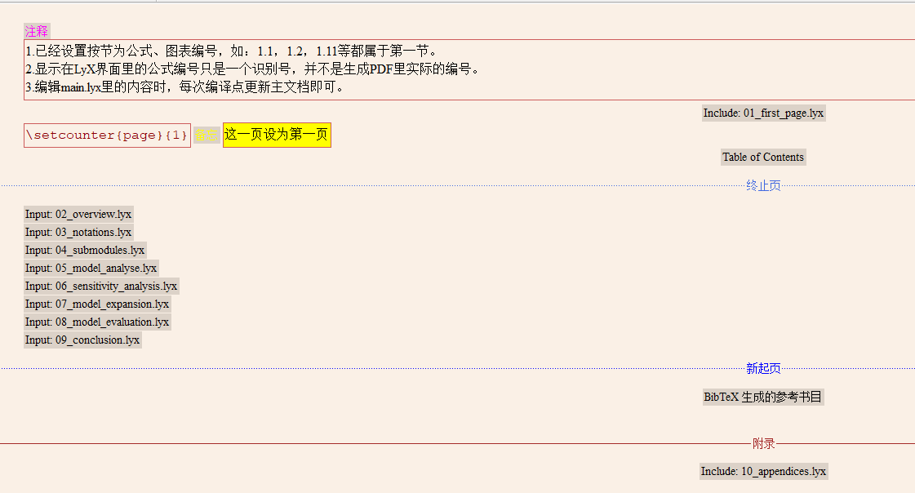
Structure
View document（Ctrl + R）
View master document
Tips:
If you are editing main.lyx and click 『View document』, the main.lyx will be saved and compiled automatically.
However, if you are editing another .lyx file, you have to manually save that file and click 『View document』here to see the effect.

Slide 3
Premable
\usepackage{xeCJK} %支持中、日、韩语言
\setCJKmainfont{SimSun} %宋体
\usepackage{tikzit} %支持tikzit工具
\input{sample.tikzstyles} %导入tikzit样式
\usepackage{lastpage}
\usepackage{fancyhdr}
\pagestyle{fancy}
\lhead{Team \# 77824}
\chead{}
\rhead{page \thepage\ of \pageref{LastPage}}
\cfoot{}
\rfoot{}
\lfoot{}
\usepackage{tocbibind}
Check them for every document you write, and every document you create

Slide 4

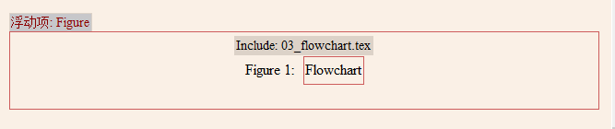
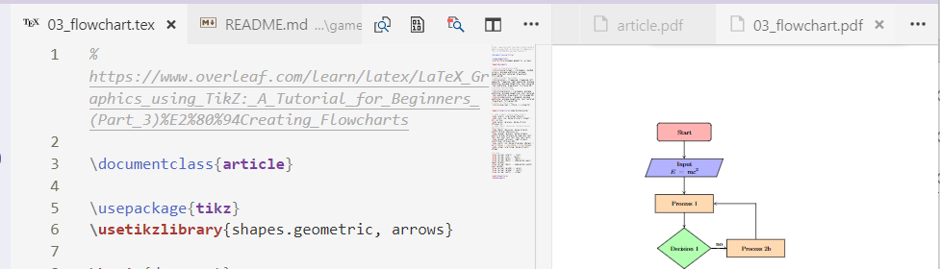
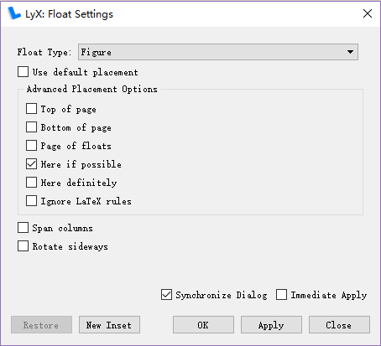
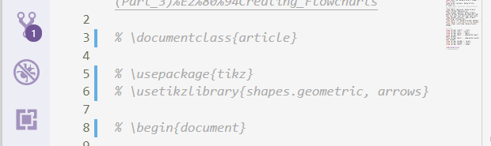
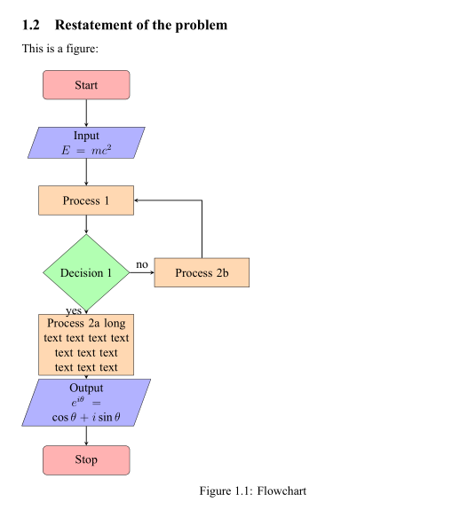


Figure - Flowchart
Insert figure float
Include file
Code on vs code,
Include on LyX.
Very important
Comment these because you want to include them in a LyX document, this is just a component, so it doesn’t need premable
Also remember to center the figure~
Right click ->
Text style -> customized
This is powerful plugin name 『LaTeX Wrokshop』 for vs code, which can preview you tex files as pdf in real time.

Slide 5
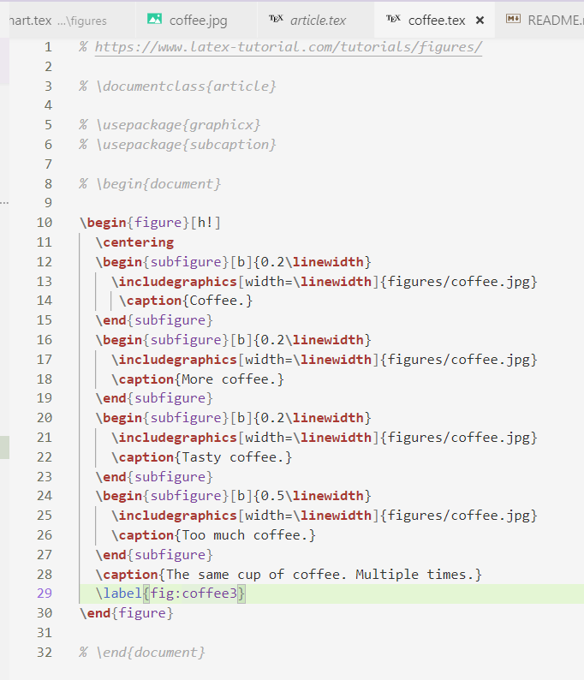
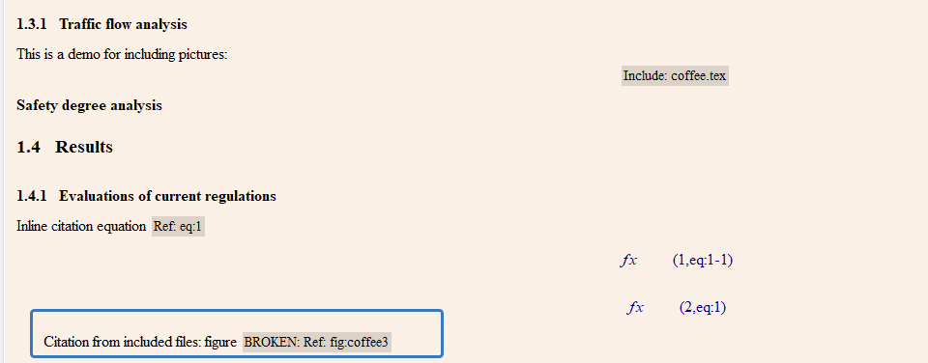
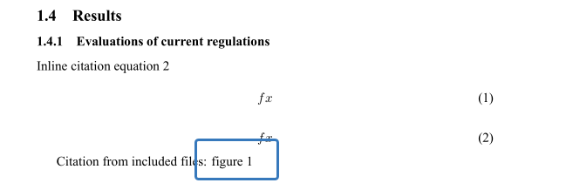
Figure - Picture
Insert graphics
Insert label, for figures, tables, fomulas
Insert cross reference
Insert graphics is fast for insert pictures~
For subfigures, just include another .tex files is ok, a tip is that keeping the .tex files included under the same folder as the LyX file, otherwise the relative path will get messy.(I have tested the bug exists)
Although 『\label{fig:coffee3}』is not in the LyX file, you can still cite it using 『Insert cross reference』

Slide 6
Table, formula, etc.
Just the same as figure!

Slide 7
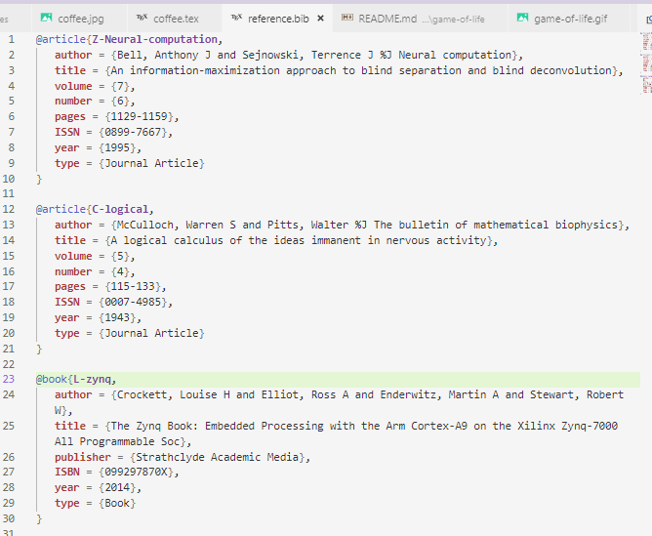
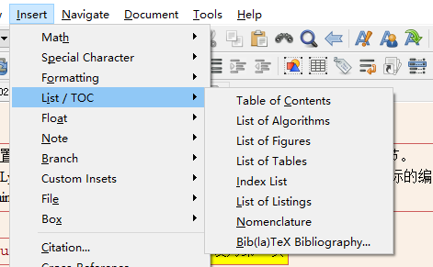
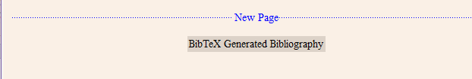
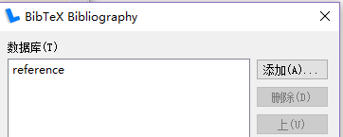
Reference - BibTeX
Insert -> List/TOC -> BibTeX Bibliography
A `.bib` demo
Conduct of label fomat:
Z-xxx: Zheng Pinjun
C-xxx: Chen Tanci
L-xxx: Li Yiming
Click it, add reference files

Slide 8
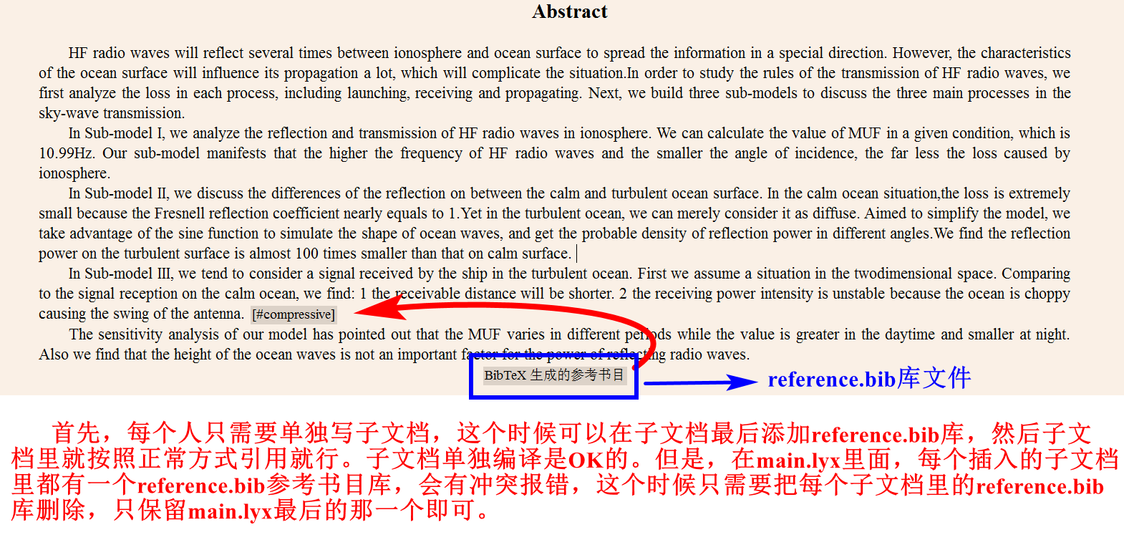
Reference - BibTeX
Reference in sub-files.

