Slide 1
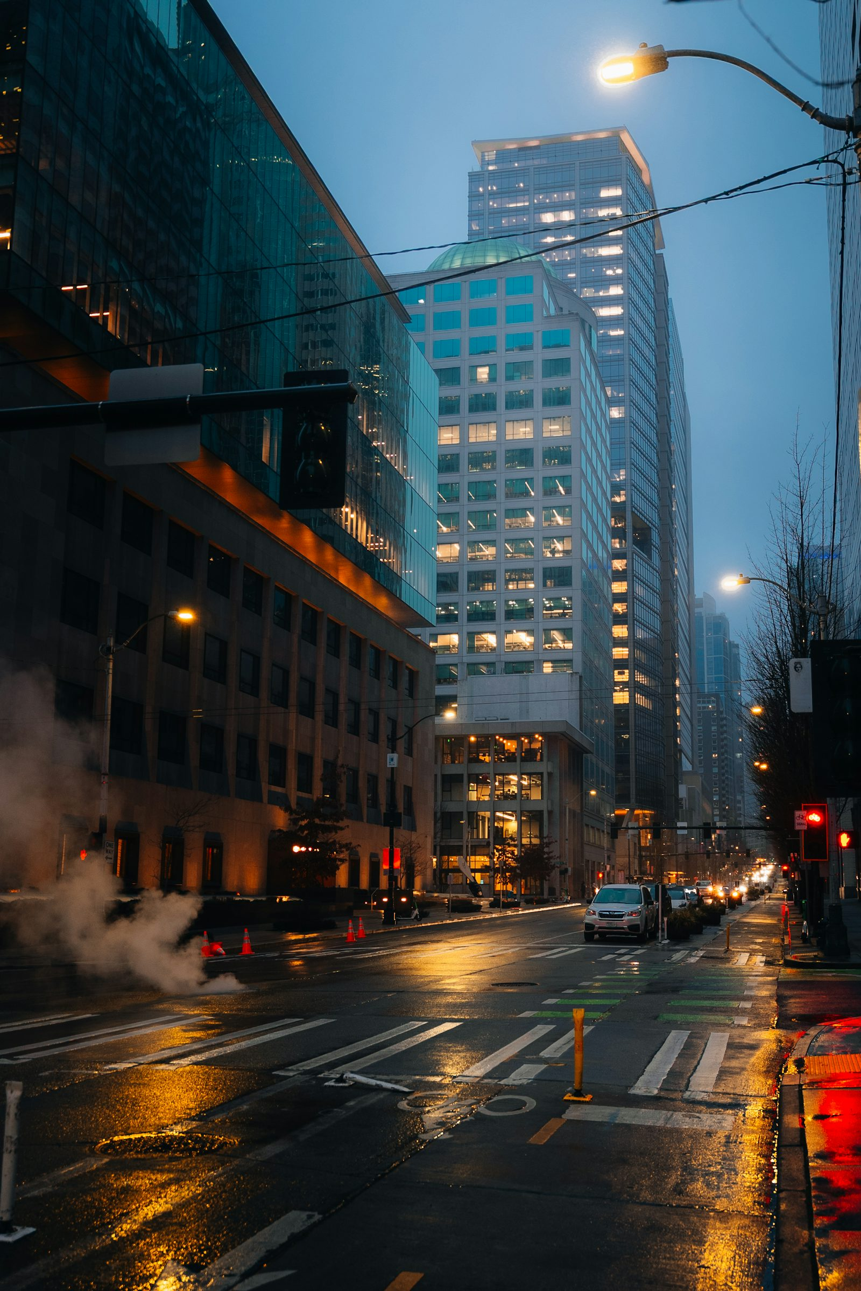
JourneyFrame
AI-Powered Relationship-Aware Trip Planner
Plan unforgettable outings — through iMessage.
🏆 HackWithSeattle 2026

Slide 2
The Problem
😩
🤖
🌧
Decision Fatigue
No Relationship Context
Ignores Reality
"Where should we go?" is exhausting. Most planners give generic lists, not real plans.
Apps don't know if it's a first date, a reunion with a college friend, or a family day.
Weather, time of day, local vibe — existing tools miss what actually matters.

Slide 3

Our Solution
Just text the AI like a friend.
"My friend Sarah is visiting Seattle tomorrow. Plan a cozy rainy-day afternoon for us."
✦ Understands relationship type & occasion
✦ Adapts to weather, time of day & local vibe
✦ Creates a 3–5 stop itinerary with emotional purpose
✦ Sends the plan + scene images via iMessage

Slide 4
How It Works
A 6-stage RocketRide AI pipeline — triggered by one iMessage
1
2
3
4
5
6
Intent Parser
Context Enrich
Itinerary Planner
Experience Narrator
Image Prompt Gen
Response Composer
Location · Occasion Mood · Time · Constraints
→
Weather · Preferences Relationship · Local Recs
→
3–5 stops · Duration Emotional Purpose
→
Warm conversational message per stop
→
Cinematic prompts per major stop
→
iMessage-ready multi-message output

Slide 5
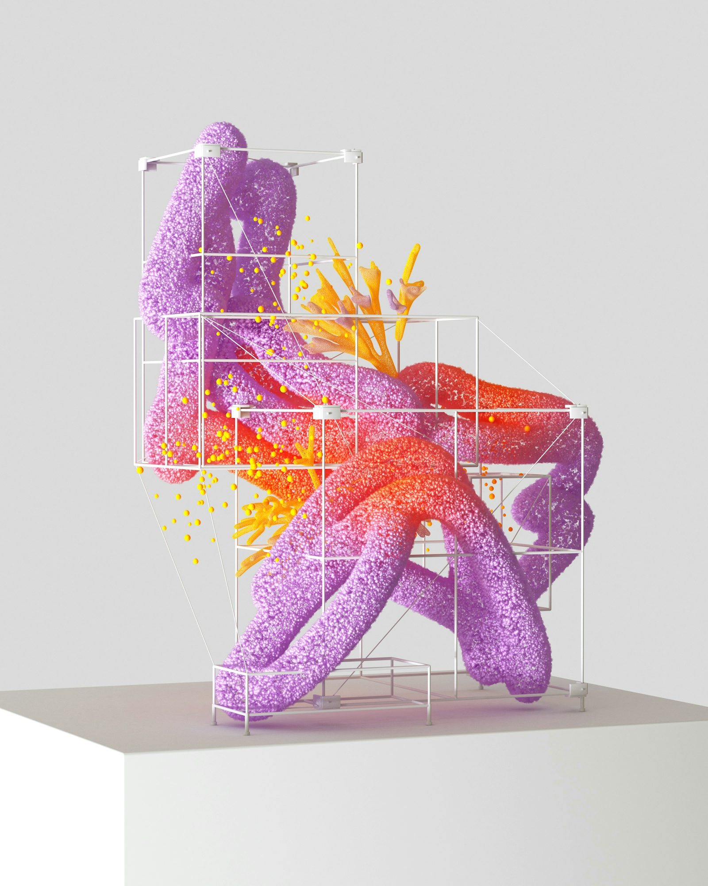
Tech Stack
🚀 RocketRide
🧠 Claude Sonnet 4.6
Core AI orchestration — 6-stage wave pipeline with parallel LLM calls
LLM powering all 6 pipeline stages via RocketRide wave agent
📡 Photon Spectrum
🖼 gpt-image-2
iMessage delivery layer — inbound/outbound message routing
Cinematic travel poster generation — one image per full itinerary
⚡ FastAPI Backend
📦 spectrum-ts
Python webhook server connecting Photon → RocketRide pipeline
TypeScript SDK for Photon — persistent Socket.IO iMessage connection

Slide 6
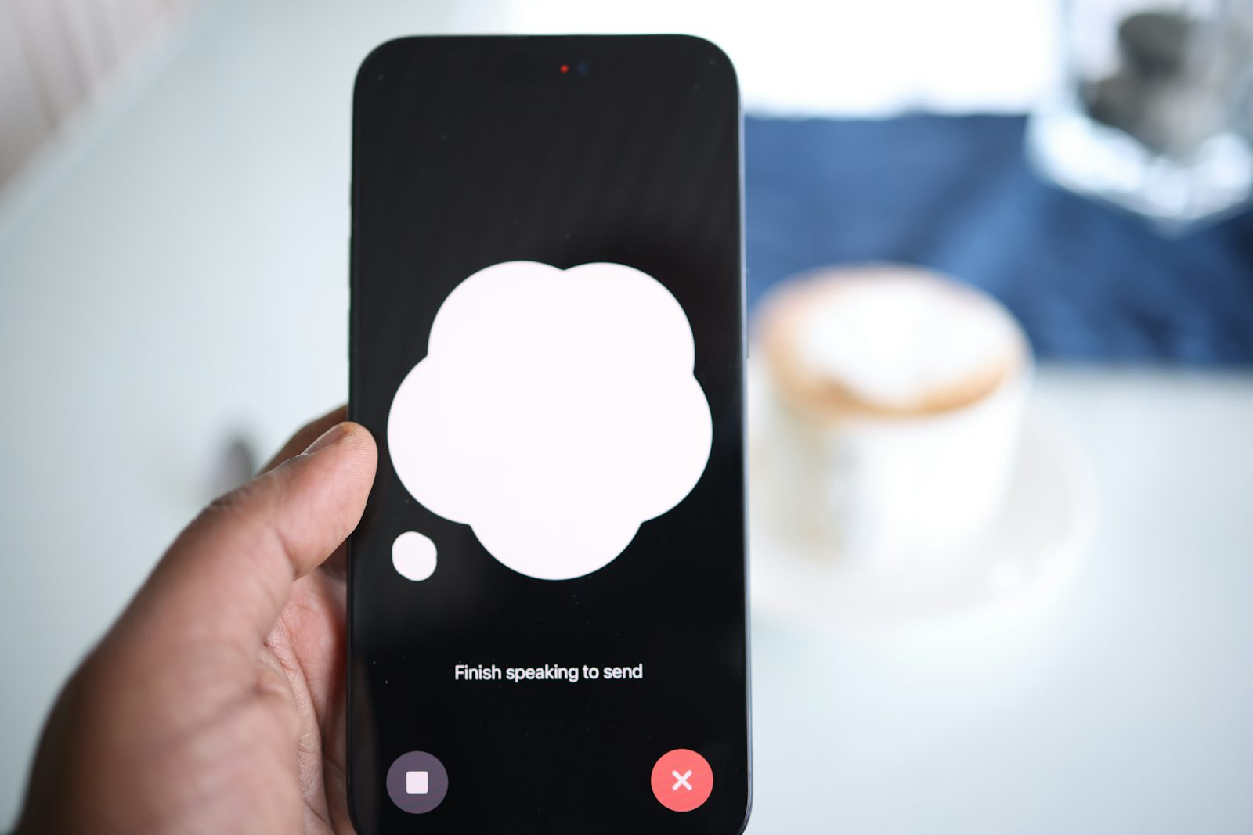
Example Journey
"My friend Sarah is visiting Seattle tomorrow. Plan a cozy rainy-day afternoon."
2:00 PM
Victrola Coffee Roasters
Warm up with a perfect pour-over. A local institution — perfect for reconnecting.
3:15 PM
Elliott Bay Book Company
Browse rain-soaked shelves. Find one book to gift each other.
4:30 PM
Pike Place Market
Watch the fish throwers, grab flowers, feel Seattle's heartbeat.
5:45 PM
The Pink Door
Hidden gem with Puget Sound view. Share small plates & a bottle of Rosé.
7:30 PM
Waterfront Walk
End the night with the city lights reflecting on the water. No agenda needed.

Slide 7
Architecture
📱 User iMessage
📡 Photon Spectrum
⚡ FastAPI Webhook
🚀 RocketRide Pipeline
🧠 LLM + External APIs
→
→
→
→
← iMessage response with text + images
RocketRide stages:
Intent Parser
Context Enrichment
Itinerary Planner
Experience Narrator
Image Prompt Gen
Response Composer

Slide 8
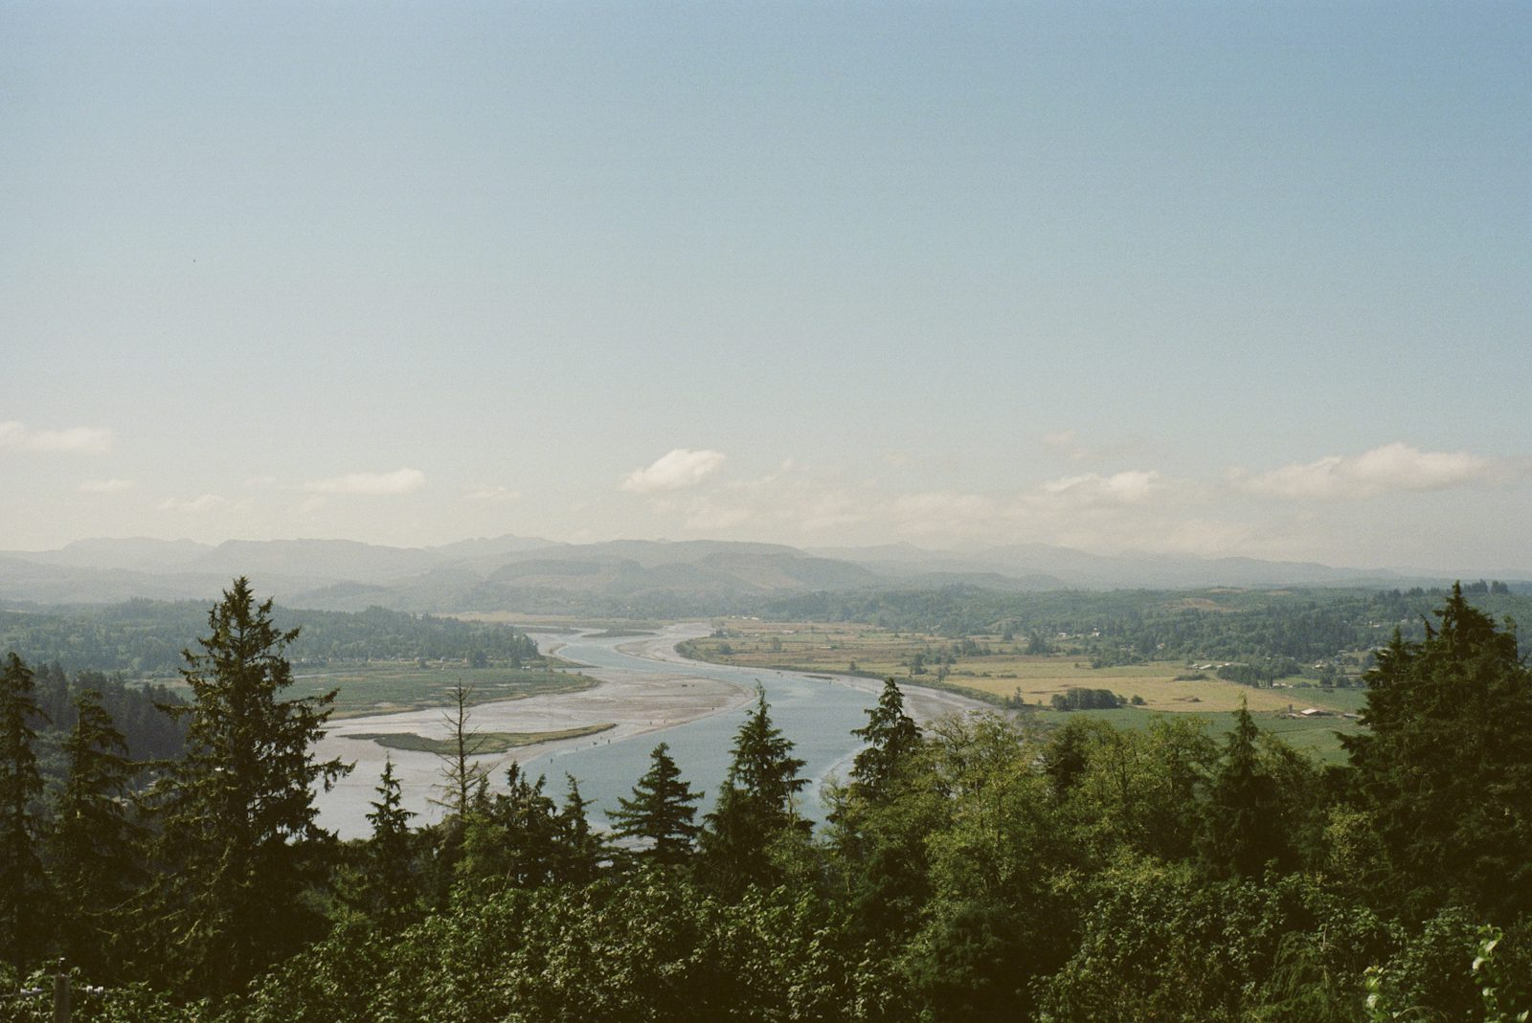
Why JourneyFrame Wins
🎯 Relationship-First
💬 Zero Friction UX
The only planner that knows WHO you're going with, not just WHERE.
No app to download. No sign-up. Just text an iMessage.
🔁 Deeply Technical
🌍 Infinitely Scalable
Real RocketRide multi-stage pipeline. Real Photon iMessage delivery.
Works for any city, any occasion, any relationship.

Slide 9
Frame your next journey.
Just send a text.
Built with 🚀 RocketRide · 📡 Photon Spectrum · ⚡ FastAPI · 🧠 Claude
🏆 HackWithSeattle 2026

