Slide 1
PERU
CONSUMER & REWARDS
Executive learnings for Product — Growth & loyalty tracks only.
Sources: Aug 31 context + store visits · Sep 2 workshop · Sep 3 Consumer vision · Club TaDa launch week.
Scope: not Service Level (Seller/Courier/Admin/CX) — see companion deck.
Headline: reliability and data foundations before scale — map, MMP/Braze, wallet UX, then tiers/omnichannel.

Slide 2
FIELD MEETINGS
Aug 31 · Context meeting (Lima office)
• Peru Growth/Commercial (Ulises, Eloy, Alex, acquisition & retention leads) + visiting product — same morning as POC visits.
• Growth engine: 102k new customers target; healthy acquisition (no new-user coupon); TikTok ~40% of paid, Meta ~30%; homemade creative in Lima.
• Retention gap: RGB M1→M2 31.3% vs Marketplace-only 20.7%; only 27 of 100 new users buy returnables — education + price, not awareness alone.
• Club TaDa launch that week — points ladder (~2% effective), 10% Loyalty Rate year target; short term coupons, mid term Backus experiences (football, concerts).
• Awareness Kantar: TaDa 9% vs Rappi 41% / PedidosYa 37%; moats = returnables + cold drinks vs aggregators.
• Portfolio: monetary coupons steered 100% to beer so Marketplace + Take Rate does not go negative for POCs; brand pages ready locally but create-in-admin still engineering-only.
• Product levers on table: copy Brazil location UX (config); checkout address-review modal just launched; ZD Libri + Consumer Room for quant/qual research.
Aug 31 · Store visits — La Marina, Merino, San Pedro
• 3/3 POCs: consumer map pin stuck (WhatsApp is real-time layer) — same theme as workshop #1 and Sep 3 P1.
• Search misses brand/format; deposit-bottle (“tengo/no tengo”) disputes; clients cancel repeatedly to route to preferred POC (store name visible).
• Consumer promo in app without BIS alert — stores cannot pre-stock for campaigns; hurts fill rate and campaign ROI.
Sep 2 · Growth workshop (BeerHub) — summary
• 3h One Year Plan 2027; Consumer + Rewards shared board, separate top-4 votes (detail + photos on next slide).
• Consumer: map, MMP/data, payment gateways, wallet UX. Rewards: Braze enrichment, flash coupons, BEES admin, anti-fraud.
• Future vision + El Momento Inesperado hospitality (kits, birthdays, first Club order).
Sep 3 · Consumer vision with Growth
• Victoria’s squad walked 12+ 2026 features (multishowcases, Buy Again 61% conversion, address flow, Live Activities Sep 1, brand pages, Turbo pilot).
• Eloy’s team listed 18 prioritized pains — 6 P1 consumer-centric (RGB education, map, partial order/stock, CX bot, search, wrong address / no-answer).
• Explicit bridges to Rewards: coupon wallet lifecycle (P2), Club TaDa ordering in admin, Braze cache (kill app), Fish Promo personalization (+6% GMV MX reference).
• Next steps captured: feature prioritization for Peru (not all at once), Braze event audit with Bruno, lifecycle deck for Club migration, returnables brand page for next campaign.

Slide 3
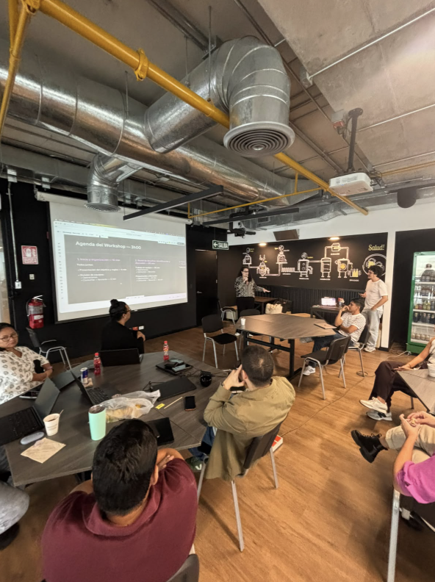
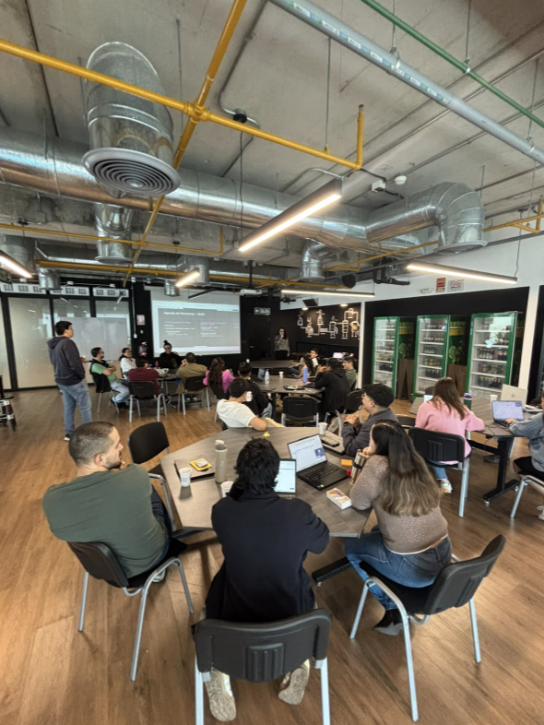
GROWTH
WORKSHOP
How it ran
• Same day as OPS workshop — 3h One Year Plan 2027 with Product visit (Brazil/Mexico).
• Consumer and Rewards ideated on a shared board; each track presented priorities and voted top 4.
• Part 2: future vision (personalization, omnichannel loyalty, football occasion, social commerce).
• Closing: El Momento Inesperado — hospitality surprises (football kits, birthdays, Club first order).
Peru context
• National awareness ~9% (Kantar) — growth and loyalty must earn trust, not only promos.
• Club TaDa launched during visit week; RGB ~44% of orders but low education on returnables.
• Consumer reliability gaps (map, address) overlap Service Level — same fixes unlock both.

Slide 4
CONSUMER
Workshop Sep 2 + Vision Sep 3 · 18 Growth pains prioritized with commercial team
What we learned
• Live courier map is #1 ask — pin rarely moves; ETA reduced to ranges; overlaps seller map failure (3/3 stores).
• Data stack not homologated: AppsFlyer/Segment gaps block attribution, Braze triggers, and paid media optimization.
• Payments ~3% online — single gateway (Niubiz) blocks BIN/bank campaigns like Mercado Pago.
• Returnables/RGB (~44% orders): consumers don't understand exchange rules; inter-brand swap unclear.
• P1 gaps: search/discovery limits, CX bot not tropicalized (~45% deflection but stale AI), partial order blocked without seller stock quantity, consumer no-answer (#2 cancel driver), wrong address ~18%.
• Wallet/coupons: manual lifecycle clusters; Club TaDa ordering helps but flash UX and Braze cache (kill app) hurt campaigns.
Workshop top 4 votes
• #1 Real-time courier tracking on map.
• #2 SDK + MMP integration & data homologation (close AppsFlyer order gap).
• #3 Payment gateways — BIN / bank partnerships (BBVA, BCP).
• #4 Coupon wallet UX & ordering (Club TaDa without burying other coupons).
Shipping / near term (Sep 3)
• Multishowcases (Sep 15 target) · Buy Again 61% order conversion · new address flow (CO live).
• Live Activities on lock screen (Sep 1) · search typo fallback · brand pages for returnables education.

Slide 5
REWARDS
Workshop Sep 2 + Club TaDa launch week · dependency-heavy stack before tiers
What we learned
• Club TaDa launched during visit — ~85% active users enrolled, mostly B tier; tiers not live yet.
• Heavy reliance on monetary coupons; want Braze enrichment — points for surveys, channels, data (vote #1).
• Flash burn coupons with countdown not built; wallet visuals and coupon images lag competitors.
• Rewards admin outside BEES — CAO list downloads, manual anti-fraud for bodegueros, raffle winners manual.
• SessionM ↔ Bees One catalog sync friction; batch points and custom events need hardening.
• Future vision voted: football occasion earn/burn + API, omnichannel redeem (Tambo/OXXO test), tiers 3–4 yr horizon.
• National awareness 9% — loyalty must pair with reliability (Consumer map/address) and CRM data quality.
Workshop top 4 votes
• #1 Club TaDa × Braze — points for enrichment, surveys, channel opt-in.
• #2 Flash coupon (burn) with time-boxed countdown in wallet.
• #3 Rewards admin inside BEES — coupons, missions, rules in one place.
• #4 Automated anti-fraud — bodeguero patterns, abnormal earn/burn.
Now vs later
• Now: wallet UX + flash mechanics with Club admin · Braze triggers · BEES admin centralization.
• Gate: homologate events before scaling personalized earn/burn.
• Later: tiers, omnichannel redemption, football API, premium hospitality experiences.

