Slide 1
PERU
SERVICE LEVEL
Executive learnings for Product — Seller · Courier · Admin · CX
Sources: Aug 31 store visits (3 Lima POCs) · Sep 1 Service Level with OPS + Product · Sep 2 OPS workshop (BeerHub).
Scope: operations & service level only — not Consumer or Rewards tracks.
Peru context: +36% orders Jan–Jul YoY, ~96% SLA, ~18% cancellations from wrong address.
Shared product bets: Ecosystem Communication (weeks) · real-time inventory (strategic) · Brace for supervisor→store comms.

Slide 2
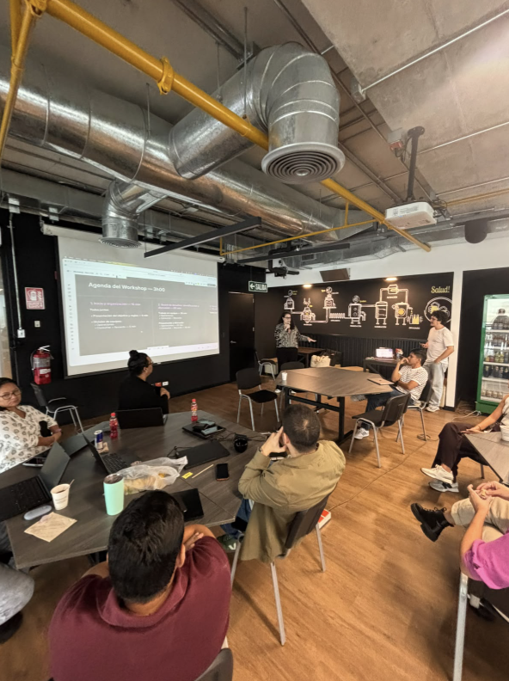
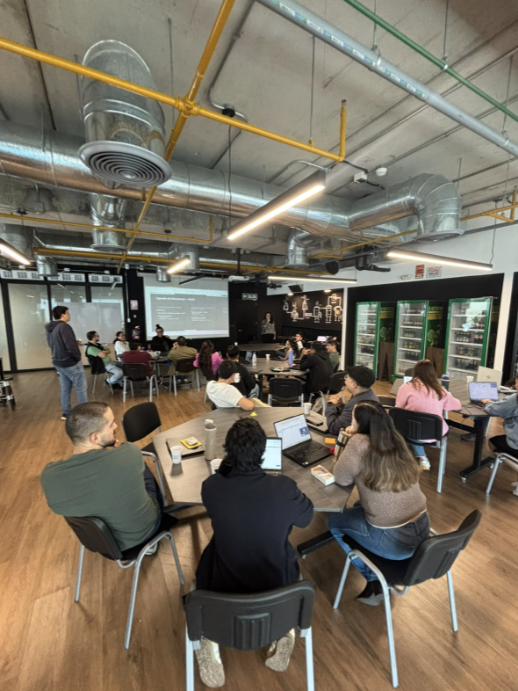
OPS WORKSHOP
How it ran
• Kick-off → challenge board (real ops examples) → group prioritization vote → future vision for 2027.
• Dedicated Operations board — stores, couriers, CX, admin (27.CX.ADMI).
• Part 1: 25+ operational pains on stickies. Part 2: co-created bets (scheduled orders, copilot, BIS→TADA, vending).
Who participated
• Peru OPS: supervisors, stores, couriers, CIEX/CX, commercial admin.
• Visiting Product & Design (Brazil/Mexico); Consumer and Rewards on a parallel board the same day.
Top 4 votes — Operations
• #1 Real-time KPI visibility — stock, SLA, availability, hot CRM SKUs; alerts before SLA breaks.
• #2 Automation + AI copilot for POC admin — coverage, polygons, grouping with SLA guardrails.
• #3 Claims resolution — CX, store & consumer on one path; fast credit like market leaders, not parallel email.
• #4 SKU restrictions on coupons — fewer promo errors, cancellations, and unfair seller KPI penalties.
Sep 2, 2026 · BeerHub, Lima · One Year Plan 2027

Slide 3
SELLER
TaDa Seller app + Web Tiendas (WebPO) · validated in 3/3 Lima POCs
What we learned
• Map does not update: courier pin stays at the store; on peak only 1–2 of 15 riders visible — stores track via WhatsApp (La Marina ~5–10% visibility).
• Inventory is on/off only (no quantity). Combos stay active when one SKU is off; search misses brands/formats; orders still arrive on disabled SKUs.
• Order alert sound fails or plays on the wrong device (shared login: office PC vs shop floor) → missed and expired orders.
• No in-app chat with the customer; deposit-bottle disputes hurt ratings; cannot assign a 2nd order to a courier already en route (La Marina #2 ask).
• WebPO is valued (demand by hour, courier planning, weekly payments) but consumer promos often do not alert the store to pre-stock.
Priorities for Product
• Stock quantity + partial order when one SKU is out (today: full cancel).
• Ecosystem Communication (seller ↔ consumer ↔ courier) — shipping in weeks.
• Actionable KPIs in-app; Top Tiendas off Monday Excel/WhatsApp.
• Reliable push + sound + session on shared store accounts.

Slide 4
COURIER
Fleet & last mile · driven by address quality, wait time, and proof of delivery
What we learned
• Wrong address drives ~18% of cancellations (saved addresses + checkout UX); INAP review launched before the visit.
• Customer no-answer at the door: no standard wait time → courier/seller cancel; major ticket and rating driver.
• Sellers dispatch blind when the map freezes; WhatsApp is the real-time layer (no audit trail).
• Returnable / heavy promos create unsafe stacking on bikes; store phone sometimes exposed to couriers.
• “Delivered but not received” is low volume but painful; delivery PIN exists globally — Peru store-level pilot.
Priorities for Product
• Address UX (checkout review + location patterns from CO/BR tests).
• Timed courier ↔ consumer messages (5-min window; MX pilot −30% courier cancels).
• Live map shared with seller (and CX) — same layer, one fix.
• Roll out delivery confirmation code per POC.

Slide 5
ADMIN / OPS
What we learned
• No real-time network cockpit: at rush, supervisors cannot see offline stores, expired orders, or new CRM SKUs not activated — Power BI T+1 + WhatsApp.
• Promo/discount ops: 4 discount types × DDC sheets → 8+ templates updated twice weekly; flash promos require delete/re-upload; shelf order fixed manually each time.
• Polygons edited street-by-street; no neighbor POC view; dangerous zones not excludable (BIS has this, TaDa does not).
• Brace (notification center) planned to replace supervisor WhatsApp blasts; Admin squad capacity blocks the ops dashboard.
• ~20% of new POCs close within 3–4 months — gold/silver/bronze ranking still lives outside the product.
Priorities for Product
• KPI cockpit per POC (resume OPS Power BI inside the platform; weekend on-call).
• Brace: targeted store comms with read metrics.
• Promo admin: change one campaign without full spreadsheet re-upload.
• WebPO: keep weekly VLC/credit notes; close gap on per-order export or stores stay on legacy tools.

Slide 6
CX
CIEX · Zendesk · triangle between store, consumer, and support
What we learned
• Claims path is slow: Zendesk → email to store → days for evidence; CX, store, and consumer are not on one thread.
• Support cannot cancel after the courier has the order — parallel email/Teams.
• Small-claim coupons deflect ~40% of tickets (working); large cases (full case damage) still need the store.
• CX has no live courier map — same blind spot as consumers; drives “where is my order?” volume.
• Tax docs: customer puts RUC in delivery notes; store does not see it → ticket days later; checkout checkbox missing.
• OPS workshop vote #3: resolve claims like market leaders (fast credit), not parallel email.
Priorities for Product
• Faster claims triangle + clearer roles (when store vs automated coupon).
• cx-courier-map-visibility — align with seller map fix.
• Ecosystem Communication reduces issues that become tickets.
• Checkout invoice type + RUC; delivery PIN for dispute closure.

