Slide 1
Competitive
programming questions
and logic
Avinash

Slide 2
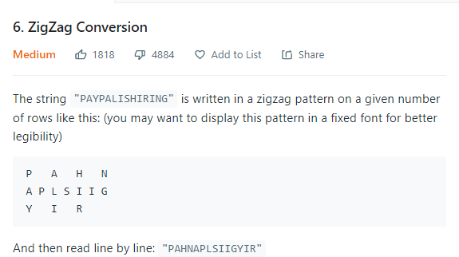
Source : leetcode
Explaination:
Fill column wise , for columns complete with letters just traverse and fill, otherwise define 'a' with n-1 and assign m[a][i] = s.pop(0)
Question -
Code-
class Solution:
def convert(self, s: str, numRows: int) -> str:
if numRows == 1:
return(s)
t = len(s)
m = [[0 for i in range(t)] for i in range(numRows)]
s = list(s)
x=""
for i in range(t):
if i%(numRows-1) == 0:
a = numRows-1
for j in range(numRows):
if len(s) == 0:
break
m[j][i] = s.pop(0)
else:
if len(s) == 0:
break
a = a-1
m[a][i]=s.pop(0)
for i in range(numRows):
for j in range(t):
if m[i][j] != 0:
x += m[i][j]
return(x)

Slide 3
Source : leetcode
Explaination:
https://medium.com/@acinom/zigzag-conversion-c6827126e941
Question - same alternative
Code-

Slide 4
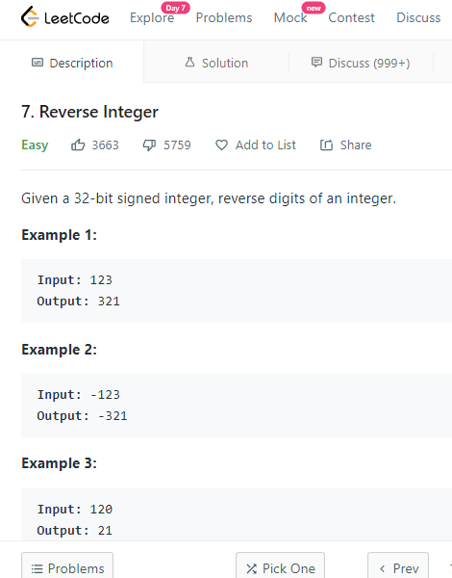
Source : leetcode
Explaination:
convert to string, reverse and lstrip 0s. keep flag for negative value and append '-'. For keeping overflow check the final value to be within range of int.
Question -
Code-
class Solution:
def reverse(self, x: int) -> int:
high = int(math.pow(2,31))
if x == 0:
return(0)
f=0
if x<0:
f=1
x = str(abs(x))
x = x[::-1]
x = x.lstrip('0')
if f==1:
x = "-" + x
x = int(x)
if x> (high-1) or x < (-1*high):
return(0)
return(x)

Slide 5
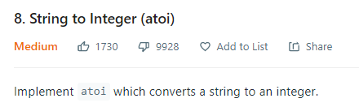

Source : leetcode
Explaination:
strip left spaces. if first element comes - or + add it to result str, then loop remaining strip and add elements of str till non digit found, convert it to int.
Question -
Code-
class Solution:
def myAtoi(self, str: str) -> int:
str = str.lstrip(" ")
ans = ""
f=0
# if not(str[0].isdigit() or str[0]=="-"):
# return(0)
if len(str)!=0:
if str[0]=='-':
ans+='-'
str = str[1:]
elif str[0]=='+':
ans+='+'
str = str[1:]
for i in range(len(str)):
if (str[i].isdigit()):
ans+= str[i]
else:
break
print(ans)
if ans == "-" or ans == "" or ans == "+":
return(0)
ans = int(ans)
m = math.pow(2,31)
if ans < m*(-1):
return(int(m*(-1)))
if ans> m-1:
return(int(m-1))
print(ord(1))
return(ans)

Slide 6
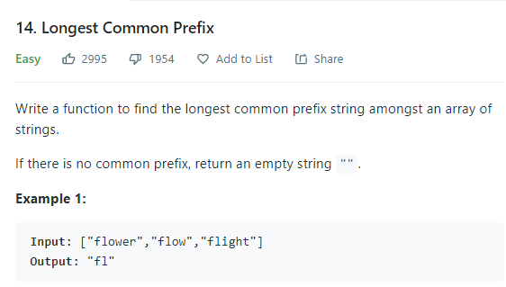
Source : leetcode
Explaination:
1. Brute force
2. Take min and max strings and return common part(best)
3. Build a trie and return biggest path.
Question -
Code-
Not required

Slide 7
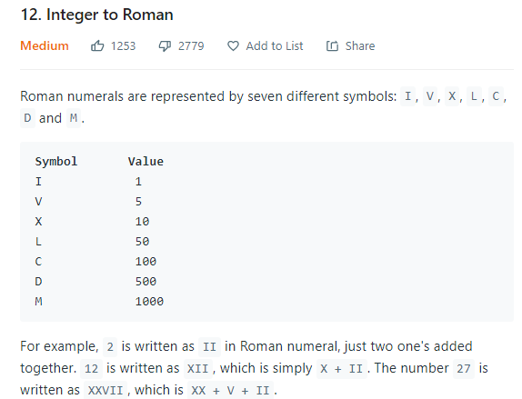
Source : leetcode
Explaination:
Find the logic in such questions. A pattern repeated. For example here in code given below, the in ref tuple, z+=2 gives same logic for 4 and 40 and 400.
Question -
Code-
class Solution:
def intToRoman(self, num: int) -> str:
n = num
num = str(num)[::-1]
ref = ("I","V","X","L","C","D","M")
ans =""
z=0
for i in range(len(str(num))):
if i>=3:
t = ref[-1]*int(num[i]) #for more than 1000
ans = t+ans
continue
#everything from here generalized from I to X logic
if int(num[i]) >=5:
t = ref[z+1] + (ref[z])*(int(num[i])-5)
if int(num[i]) == 9:
t = ref[z]+ref[z+2]
else:
t = ref[z]*int(num[i])
if int(num[i]) ==4:
t = ref[z] +ref[z+1]
ans=t+ans
if z+4 <len(ref):
z+=2 # here z we are talking about
return(ans)

Slide 8
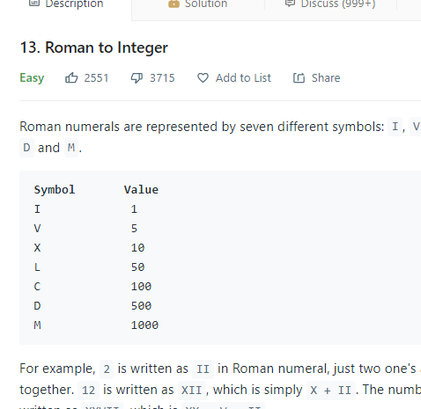
Source : leetcode
Explaination:
Just add everything one by one except if the value of a[i]<a[i+1] then add a[i+1]-a[i].
Question -
Code-
class Solution:
def romanToInt(self, s: str) -> int:
ref = {"I":1,"V":5,"X":10,"L":50,"C":100,"D":500,"M":1000}
i=0
ans = 0
while(i<len(s)-1):
if ref[s[i]]<ref[s[i+1]]:
ans+=ref[s[i+1]]-ref[s[i]]
i+=2
else:
ans+=ref[s[i]]
i+=1
if i==len(s)-1:
ans+=ref[s[-1]]
return(ans)

Slide 9
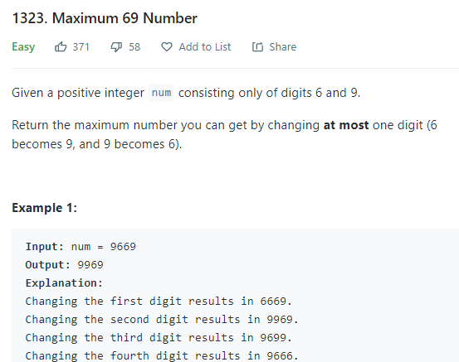
Source : leetcode
Explaination:
Mine - Just flip first 6 from right
Question -
Code-
class Solution:
def maximum69Number (self, num: int) -> int:
num = str(num)
ans = ""
for i in range(len(num)):
if num[i] == "6":
ans+="9"
break
ans+=num[i]
ans+=num[i+1:]
return(int(ans))

Slide 10
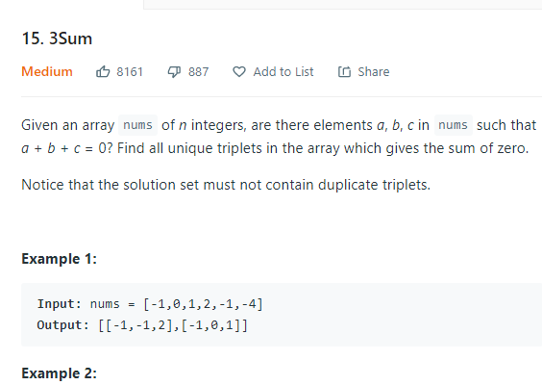
Source : leetcode
Explaination:
Sort the array, fix a (if some a already used skip)and find b and c using two pointers running from both sides.
Question -
Code-
class Solution:
def threeSum(self, nums: List[int]) -> List[List[int]]:
ans= []
nums.sort()
la = len(nums)
for i in range(la):
if i>0 and nums[i]==nums[i-1]: #cond to avoid same a again
continue
l,r = i+1,la-1
while l<r:
if nums[l] + nums[r] + nums[i] == 0:
ans.append([nums[l],nums[r],nums[i]])
l+=1
#below one imp to skip same elements again and again.
while l<r and nums[l] == nums[l-1]:
l+=1
if nums[l] + nums[r] + nums[i] < 0:
l+=1
if nums[l] + nums[r] + nums[i] >0:
r-=1
return(ans)

Slide 11
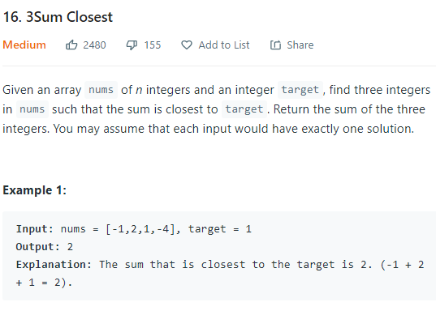
Source : leetcode
Explaination:
Two pointer solution traverse in same manner as 3 sum question and check and store the lowest distance triplet.
Question -
Code-
class Solution:
def threeSumClosest(self, nums: List[int], target: int) -> int:
nums.sort()
xyz=sys.maxsize
for i in range(len(nums)):
l,r=i+1,len(nums)-1
while l<r:
if abs(target - (nums[i]+nums[l]+nums[r]))<xyz:
xyzs = nums[i]+nums[l]+nums[r]
xyz = abs(target - xyzs)
print(xyz,xyzs)
if nums[i]+nums[l]+nums[r]<target:
l+=1
elif nums[i]+nums[l]+nums[r]>target:
r-=1
elif nums[i]+nums[l]+nums[r]==target:
return(nums[i]+nums[l]+nums[r])
return(xyzs)

Slide 12
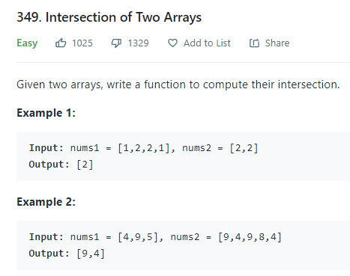
Source : leetcode
Explaination:
1. Brute force (m*n complexity), for each element check and keep a set.
2. sort arrays, compare upfront elements, if match add and push indexes to next unique value else which ever is small push that one to next unique.
3. Use a hashmap from nums1 and turn its value back to 0, once found in nums2(dont 0 if duplicacy not required)
Question -
Code-
class Solution:
def intersection(self, nums1: List[int], nums2: List[int]) -> List[int]:
i,j = 0,0
ans = []
if len(nums1)== 0 or len(nums2) == 0:
return(ans)
nums1.sort()
nums2.sort()
while(True):
temp = nums1[i]
temp2 = nums2[j]
if nums1[i]<nums2[j]:
while(i<len(nums1) and nums1[i]==temp):
i+=1
if i>len(nums1)-1:
break
elif nums1[i]>nums2[j]:
while(j<len(nums2) and temp2==nums2[j]):
j+=1
if j>len(nums2)-1:
break
else:
ans.append(temp)
while(i<len(nums1) and nums1[i]==temp ):
i+=1
while(j<len(nums2) and temp2==nums2[j]):
j+=1
if i>len(nums1)-1 or j>len(nums2)-1:
break
return(ans)

Slide 13
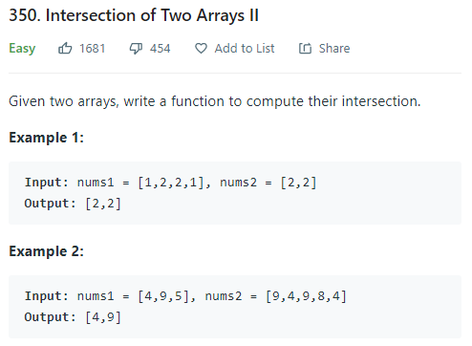
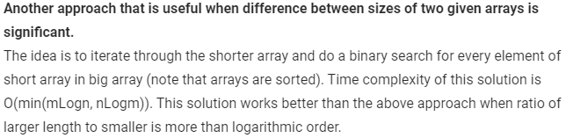
Source : leetcode
Explaination:
Now same solution just instead of looping to next unique, just increment index for whichever is smaller among head elements. For same inc both.
=>read yellow box, binary search elements of shorter array for two sorted arrays with big ratio of elements.
Question -
Code-
class Solution:
def intersect(self, nums1: List[int], nums2: List[int]) -> List[int]:
i,j = 0,0
ans = []
if len(nums1)== 0 or len(nums2) == 0:
return(ans)
nums1.sort()
nums2.sort()
while(True):
if nums1[i]<nums2[j]:
i+=1
if i>len(nums1)-1:
break
elif nums1[i]>nums2[j]:
j+=1
if j>len(nums2)-1:
break
else:
ans.append(nums1[i])
i+=1
j+=1
if i>len(nums1)-1 or j>len(nums2)-1:
break
return(ans)

Slide 14

Source : GeeksforGeeks
Explaination:
same solution except add only once if head elements are same, otherwise add smaller one. Finally flush out remaining elements from larger array.
Question -
Code-
Not required

Slide 15
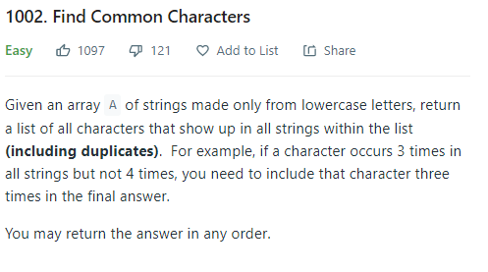
Source : leetcode
Explaination:
1. create same prev code as function and feed return value from first two with third... and so on thill end of array.
2. same alternative (hashmap ) for function (FASTER)
Question -
Code-
class Solution:
def commonChars(self, A: List[str]) -> List[str]:
def use(nums1,nums2):
i,j = 0,0
ans = []
if len(nums1)== 0 or len(nums2) == 0:
return(ans)
nums1.sort()
nums2.sort()
while(True):
if nums1[i]<nums2[j]:
i+=1
if i>len(nums1)-1:
break
elif nums1[i]>nums2[j]:
j+=1
if j>len(nums2)-1:
break
else:
ans.append(nums1[i])
i+=1
j+=1
if i>len(nums1)-1 or j>len(nums2)-1:
break
ans = "".join(ans)
return(ans)
//main code start
cw = A[0]
for k in range(1,len(A)):
nums1 = list(A[k])
nums2 = list(cw)
cw = use(nums1,nums2)
return(cw)

Slide 16
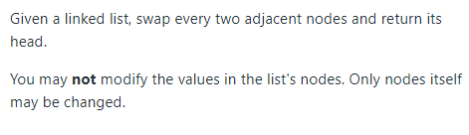
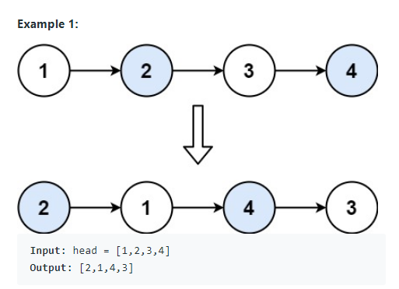
Source : leetcode
Explaination:
Looks simple, logic is simple but there are many corner cases to be aware of
1. For for length less than 2 handle yourself.
2. for odd take care of last value.
3. Now main course - appoint a pointer at next head to work then do shifting using logic. eg. here 3
while entering loop head.next.next ==None then do the basic shift and break. [Note - keep the head.next for returning at end]
Question -
Code-
# Definition for singly-linked list.
# class ListNode:
# def __init__(self, val=0, next=None):
# self.val = val
# self.next = next
class Solution:
def swapPairs(self, head: ListNode) -> ListNode:
if head == None or head.next == None: #for 1 and 0 len
return(head)
temp2 = ListNode()
temp0 = ListNode()
temp0 = head.next
if head.next.next == None: #for 2 length
head.next.next = head
head.next = None
return(temp0)
while(True):
if head.next == None: #for odd cases last element
temp2 = temp0
while(temp2.next!=None):
temp2 = temp2.next
temp2.next = head
head.next = None
break
if head.next.next==None: #for last two elements even cases
head.next.next = head
head.next = None
break
temp2 = head.next.next
head.next.next = head
head.next = temp2.next
head = temp2
return(temp0)

Slide 17
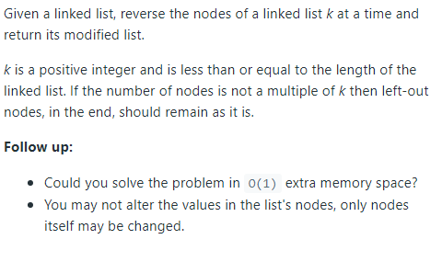
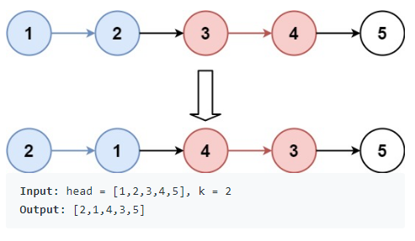
Source : leetcode
Explaination:
List of k size to append items and flush out in reverse. For every segment. Handle pointers well.
Follow up - use reversing linked list logic.
Question -
Code-
# Definition for singly-linked list.
# class ListNode:
# def __init__(self, val=0, next=None):
# self.val = val
# self.next = next
class Solution:
def reverseKGroup(self, head: ListNode, k: int) -> ListNode:
x = []
nhead = ListNode()
newhead = ListNode()
nhead = head
flag = 0
while(True):
newhead = head
for i in range(k):
if head == None: // if <k remaining
flag = 1
break
x.append(head.val)
head = head.next
if flag == 1: // flag because nested loop
break
head = newhead
for i in range(k):
head.val = x.pop(-1)
head = head.next
return(nhead)

Slide 18
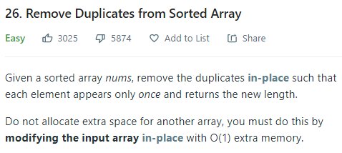

Source : leetcode
Explaination:
Set a cur element, if successively get cur pop them, then shift cur to next unique value. (for popping can use pointers to shift rather than pop, more faster).
Question -
Code-
class Solution:
def removeDuplicates(self, nums: List[int]) -> int:
if len(nums) == 0:
return(0)
cur = nums[0]
i=1
while(True):
while(i<len(nums) and nums[i]==cur):
nums.pop(i)
if i>len(nums)-1:
break
cur = nums[i]
i+=1
return(len(nums))

Slide 19
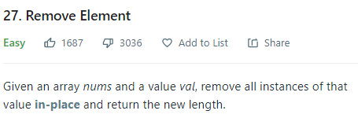
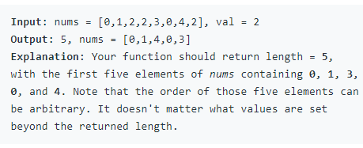
Source : leetcode
Explaination:
Two pointer solution, one runs itertively over nums, other on finding val, finds next *not val and replaces both positions. Keep note for loop ends var with (l-1) value for range(l). SO return i+1, and reduce value for regular case before returning to nullify.
Question -
Code-
class Solution:
def removeElement(self, nums: List[int], val: int) -> int:
if len(nums) == 0: //for len1
return(0)
if len(nums) == 1: // for len2
if val == nums[0]:
return(0)
else:
return(1)
l = len(nums)
for i in range(l):
if nums[i] == val:
j = i+1
while(j < l and nums[j] == nums[i]):
j+=1
if j == l:
i-=1 // imp because returning+1
break
nums[i],nums[j] = nums[j],nums[i]
return(i+1) // for case where loop doesn't runs at all.

Slide 20
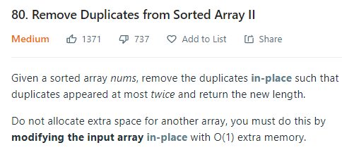
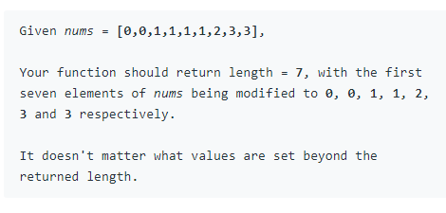
Source : leetcode
Explaination:
Two pointer solution doesn't applicable (observe).
Use pop method to remove if count goes beyond 2.
Question -
Code-
class Solution:
def removeDuplicates(self, nums: List[int]) -> int:
l = len(nums)
if l == 0 or l == 1:
return(l)
count = 1
cur = nums[0]
i=1
while(True):
if nums[i] == cur:
if count>=2:
nums.pop(i)
i-=1
else:
count += 1
else:
cur = nums[i]
count = 1
i+=1
if i >len(nums)-1:
i-=1
break
return(i+1) //note i+1

Slide 21
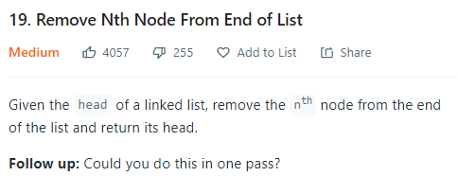
Source : leetcode
Explaination:
1.cal length(l) in first traverse and remove l-n th node
2. Run second pointer n-1 places behind head.
handle following:
Note : intialize t(seond pointer) with None (as in case of removal of front element it should not be first element but one less i.e. none when head reaches the end)
Question -
Code-
# Definition for singly-linked list.
# class ListNode:
# def __init__(self, val=0, next=None):
# self.val = val
# self.next = next
class Solution:
def removeNthFromEnd(self, head: ListNode, n: int) -> ListNode:
if head==None:
return(None)
temp = ListNode()
temp = head
t = None
n = n-1
while(head.next!=None):
head = head.next
if(n<1):
if t == None:
t = temp
else:
t = t.next
n-=1
if t == None:
return(temp.next)
t.next = t.next.next
return(temp)
Learnings
Never try to mould the code to satisfy particular test case, avoid if else as much as possible. Also keep everything general to pass every test case.

Slide 22

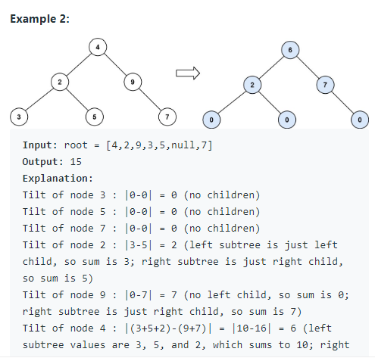
Source : leetcode
Explaination:
recursiveF(node):
in recursive function return tilt of the node's right and left and sum of left and right subtree.
Question -
Code-
class Solution:
def findTilt(self, root: TreeNode) -> int:
def calctilts(root):
if not root:
return 0, 0
ltilt, lsum = calctilts(root.left)
rtilt, rsum = calctilts(root.right)
return ltilt + rtilt + abs(lsum-rsum), lsum + rsum + root.val
return calctilts(root)[0]
Learnings
First completely be sure that an algo(even an idea) doesnt works and then discard it.

Slide 23
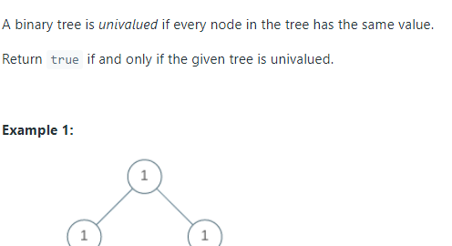
Source : leetcode
Explaination:
1. if left and right subtrees are equal and node value also same.
2. pass root.val as second arg, visit all nodes using lateral search and see if any other node value is present.
Question -
Code-
class Solution(object):
def isUnivalTree(self, root):
left_correct = (not root.left or root.val == root.left.val
and self.isUnivalTree(root.left))
right_correct = (not root.right or root.val == root.right.val
and self.isUnivalTree(root.right))
return left_correct and right_correct
Learnings

Slide 24
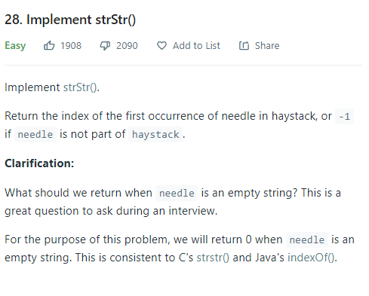
Source : leetcode
Explaination:
first loop for each element but limit haystack-needle+1 length because last all elements will fell short(improvement in learnings). then again run a loop for needle.
Question -
Code-
int strStr(std::string haystack, std::string needle) {
int n = needle.length();
int h = haystack.length();
if(n==0)
return 0;
int j;
int ans = -1;
int temp;
for(int i=0;i<h-n+1;i++) //see limit not h
{
if(haystack[i] == needle[0])
{ j=1;
temp = i+1;
while(j<n and temp< h)
{
if(haystack[temp]!=needle[j])
break;
j++;
temp++;
}
if(j == n)
return i;
}
}
return ans;
}
Learnings
small differences make a big impact. Never ignore small improvements you can make in code.

Slide 25
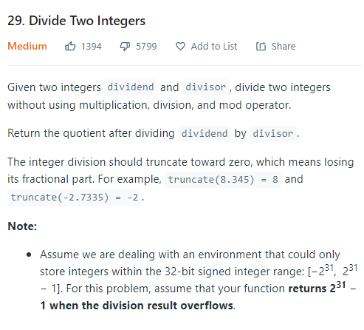
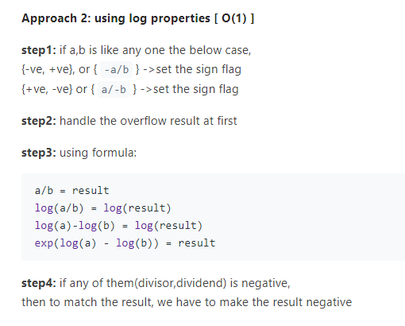

Source : leetcode
Explaination:
fig.1 using maths
fig.2 a function for abs without multiplication, doesnt work for overflow tho.
Question -
Code-
Learnings
use maths in cases like this first , usually helpful. Keep overflow in mind while forming your solution.

Slide 26
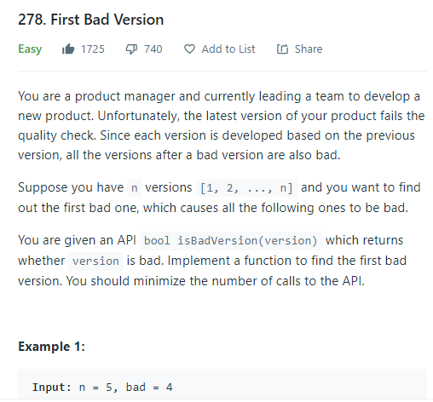
Source : leetcode
Explaination:
eg. TTTTFFFFF here find the first F. Use binary search for max speed. Also for mid use l + (h-l)/2 to avoid overflow. Finally when you come out of loop it may not be at exact position to rectify that.
Question -
Code-
class Solution {
public:
int firstBadVersion(int n) {
int l = 0;
int h = n;
long unsigned int mid;
while(l<h)
{
mid = l + (h-l)/2; // to avoid overflow don't write(l+h)/2
if(isBadVersion(mid))
{
h = mid;
}
else
l = mid+1;
}
if(!isBadVersion(mid))//imp as loop is not exiting on isbad condn
{
mid++;
}
return mid;
}
};
Learnings
Study exp of this, and see how to debug. Don't give up, think logically for solutions.

Slide 27
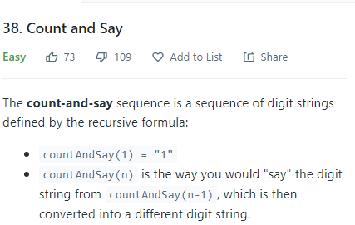
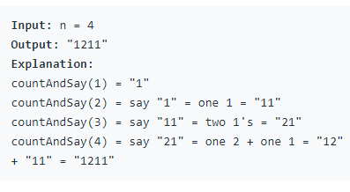
Source : leetcode
Explaination:
Just make a function to solve for a particular string and in recursive function call that function, it will go down to base case which will return “1” and then that will be arg to function in successive calls.
Question -
Code-
class Solution {
string eval(string s){
char current= s[0];
int count = 0;
string ans ="";
for(int i = 0; i<s.length() ;i++){
if(current == s[i] ){
count++;
continue;
}
else{
ans += std::to_string(count) + current ;
current = s[i];
count = 1;
}
}
ans += std::to_string(count) + current;
return ans;
}
public:
string countAndSay(int n) {
if(n==1)
return "1";
return eval(countAndSay(n-1));
}
};
Learnings
std::to_string(count) conversion to string in c++

Slide 28
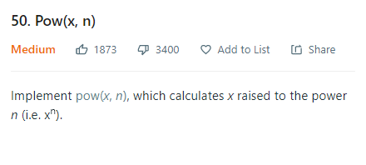
Source : leetcode
Explaination:
1. brute force
2. x*x if n%2 == 0 log(n)
3. log and then anti log ( take care of negative x as log doesn't accept it)
Question -
Code-
class Solution:
def myPow(self, x: float, n: int) -> float:
if x<0:
if n%2!=0: #handling -x
return(-1*math.exp(n*math.log(abs(x))))
return(math.exp(n*math.log(abs(x))))
Learnings
Again saying, look for maths workaround, for O(1)

Slide 29
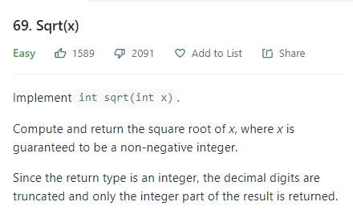
Source : leetcode
Explaination:
1. brute force
2. binary search condn - > a*a <=x and (1+a)^2>x
3. use maths (but beware of small non definite errors due to logarithm)
Question -
Code-
class Solution:
def mySqrt(self, x: int) -> int:
if x == 0:
return 0
num = math.exp(math.log(x)/2)
# for cases when log is approx but less
if math.ceil(num) - num < 10e-7:
return math.ceil(num)
else:
return math.floor(num)
Learnings
See problems dealing with natural numbers are always sorted array types, cause natural numbers are sorted, so can use “binary search”

Slide 30
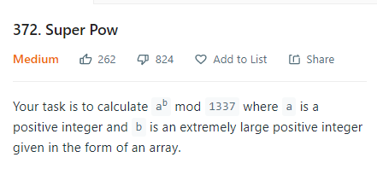
Source : leetcode
Explaination:
euler's modular exponentiation used...
*can be done by converting into b into binary (explore)
Question -
Code-
a = a % 1337
s=''
for i in range(len(b)):
s+=str(b[i])
b = int(s)
b = b%1140 # totient(a) = 1140
return(a**b%1337)
Learnings
pow(a,a_s,1337) third argument is modulo

Slide 31
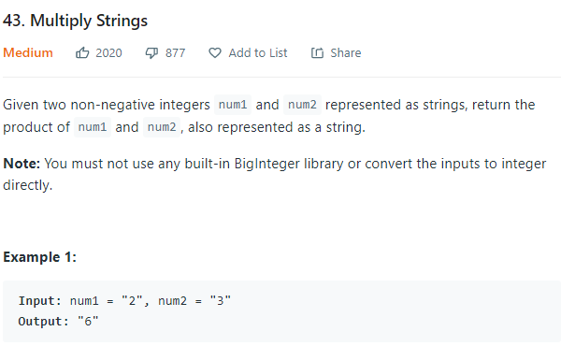
Source : leetcode
Explaination:
1. Conventional multiplication in code below. (production but not faster)
2. usehashmap faster.
3. use own int() function.
Question -
Code-
class Solution:
def multiply(self, num1: str, num2: str) -> str:
def val(x):
return(ord(x)-48)
num1 = num1[::-1]
num2 = num2[::-1]
tab = []
l1,l2 = len(num1),len(num2)
carry = 0
for i in range(l1):
t = []
carry = 0
for _ in range(i):
t.append(0)
for j in range(l2):
v = val(num2[j])*val(num1[i]) + carry
t.append(v%10)
carry = v//10
if carry!=0:
t.append(carry)
tab.append(t)
ans = ""
maxi = max(tab,key=len)
carry = 0
for i in range(len(maxi)):
s = carry
for j in range(l1):
if i < len(tab[j]):
s += tab[j][i]
ans += str(s%10)
carry = s//10
if carry!=0:
ans += str(carry)
if ans[-1] == '0':
return '0'
return(ans[::-1])
Learnings
verify each step working and then proceed further.

Slide 32
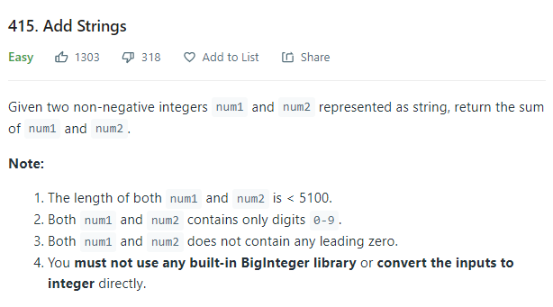
Source : leetcode
Explaination:
used hashmap to map keys. Then basic loops to add both strings and store result in ans string.
part 1 for till num1
part 2 remaining num2 elements if so
part 3 leftover carry
Question -
Code-
class Solution:
def addStrings(self, num1: str, num2: str) -> str:
num1 = num1[::-1]
num2 = num2[::-1]
hmap = {str(i):i for i in range(0,10)} # ninja tech
l1,l2 = len(num1),len(num2)
carry = 0
ans = ""
for i in range(l1):
v = hmap[num1[i]] + carry
if i<l2:
v += hmap[num2[i]]
carry = v//10
ans = str(v%10) + ans
print(ans,carry)
i+=1
while(i<l2):
v = hmap[num2[i]] + carry
carry = v//10
ans = str(v%10) + ans
i+=1
print(ans)
if carry!=0:
ans = str(carry) + ans
return(ans)
Learnings
for loop ends i value at last position and not +1 of that.

Slide 33
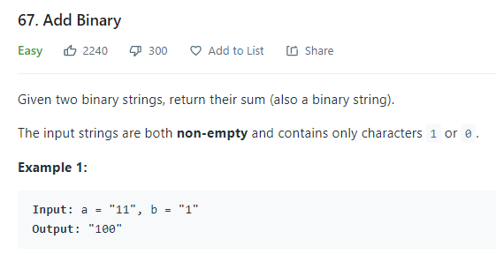
Source : leetcode
Explaination:
same as last slide just change carry update and ans assignment.
Question -
Code-
class Solution:
def addBinary(self, num1: str, num2: str) -> str:
num1 = num1[::-1]
num2 = num2[::-1]
hmap = {str(i):i for i in range(0,2)} # ninja tech
l1,l2 = len(num1),len(num2)
carry = 0
ans = ""
for i in range(l1):
v = hmap[num1[i]] + carry
if i<l2:
v += hmap[num2[i]]
if v>=2:
carry = 1
else:
carry = 0
if v in [0,2]:
ans = '0' + ans
else:
ans = '1' + ans
i+=1
while(i<l2):
v = hmap[num2[i]] + carry
if v>=2:
carry = 1
else:
carry = 0
if v in [0,2]:
ans = '0' + ans
else:
ans = '1' + ans
i+=1
if carry!=0:
ans = str(carry) + ans
return(ans)
Learnings

Slide 34
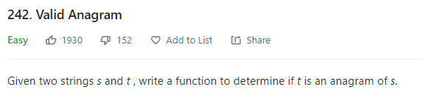
Source : leetcode
Explaination:
1. hashmap to store values and +1 for s1 thne subtract for s2 , if all values 0 -> true; (optimization: run only for string 1 and update - and+ together, for this return 0 if strings len is unequal.)
2. sort both strings and check if they are equal.
Question -
Code-
bool isAnagram(string s, string t) {
string temp;
unordered_map<char,signed int> m;
if(t.length()<s.length()){
temp = t;
t = s;
s = temp;
}
for(auto i=0; i<s.length();i++){
m[s[i]] +=1;
}
for(int i=0; i<t.length();i++){
m[t[i]] -= 1;
}
for(auto k : m){
if(k.second != 0){
return 0;
}
}
return 1;
}
Learnings
Don't forget sorting! Especially in hard string problems.

Slide 35
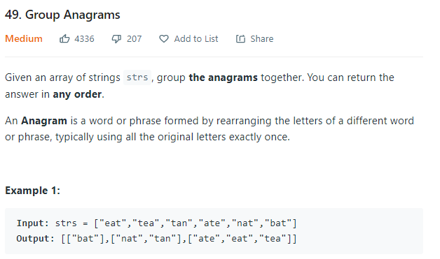
Source : leetcode
Explaination:
create a map and store m[sorted]: vec(unsorted1, unsorted2...)
push all values of map into ans and return.
Question -
Code-
vector<vector<string>> groupAnagrams(vector<string>& strs) {
vector<vector<string>> ans;
map<string,vector<string>> m;
string temp;
for(auto x:strs){
temp = x;
sort(x.begin(),x.end());
m[x].push_back(temp);
}
for(auto x:m){
ans.push_back(x.second);
}
return ans;
}
Learnings
think of different data structure if stuck.

Slide 36
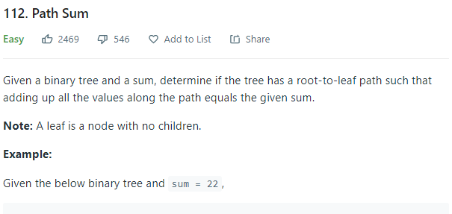
Source : leetcode
Explaination:
use 'or' between right and left trees recursively. If reaching leaf sum becomes 0 then return true.
Question -
Code-
class Solution:
def hasPathSum(self, root: TreeNode, sum: int) -> bool:
if root == None:
return 0
def hasPathSu(root,sum):
if root == None:
return 0
# imp as specified leaf node so check in this and not root == none part
if root.left == None and root.right == None:
if sum == root.val:
return 1
return 0
return(hasPathSu(root.left,sum-root.val) or hasPathSu(root.right,sum-root.val))
return(hasPathSu(root,sum))
Learnings
base condition is not always root == None for recursion in trees, it depends on question

Slide 37
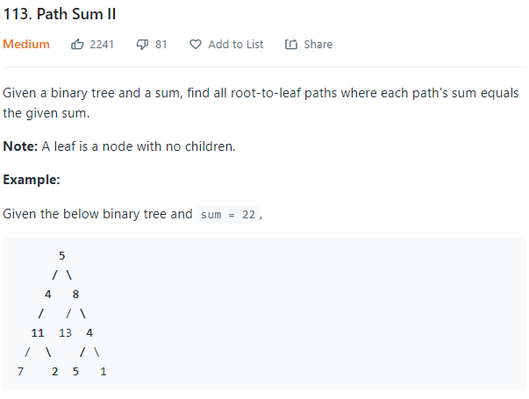
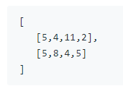
Source : leetcode
Explaination:
maintain a vector that contains element root - >.... ->current element. if sum becomes 0 at a leaf node then add it to another vector maintained by reference. (s in this case)
Question -
Code-
class Solution {
void recur(TreeNode* root, int sum,vector<int> k, vector<vector< int >> &s){
if(root == nullptr){
return;
}
if(root->left == nullptr && root->right == nullptr){
if(sum - root->val == 0){
k.push_back(root->val);
s.push_back(k);
k.pop_back();
}
return;
}
k.push_back(root->val);
recur(root->right,sum - root->val,k,s);
recur(root->left,sum - root->val,k,s);
k.pop_back();
return;
}
public:
vector<vector<int>> pathSum(TreeNode* root, int sum) {
vector< vector<int> > s;
vector<int> k;
recur(root,sum,k,s);
return s;
}
};
Learnings
push to begin with do operations and pop later - > way of maintaining a vector that contains elements from root -> ... -> current element.
dont't have to pop if passing by value the vector and not reference.

Slide 38
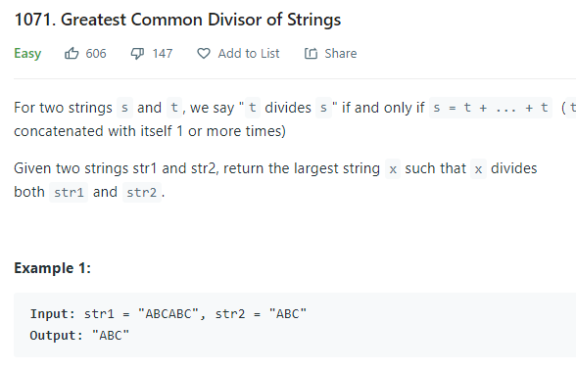
Source : leetcode
Explaination:
if such string exists, then it should be of length gcd of str2 and str1. (mind blown) so make a function to check substr of any string of gcd length with both.
More optimal: s1+s2 == s2+s1 if solution exists ... means from above we can directly return gcd len one if so.
Question -
Code-
class Solution {
bool check(string s, string t){
int sl = s.length();
string temp = t;
while(t.length()<sl){
t += temp;
}
if(t == s){
return true;
}
return false;
}
int gcd(int a, int b)
{
if (b == 0)
return a;
return gcd(b, a % b);
}
public:
string gcdOfStrings(string str1, string str2) {
if(str1[0] != str2[0]){
return "";
}
string t = str2.substr(0,gcd(str1.length(),str2.length()));
if(check(str1,t) && check(str2,t)){
return t;
}
return "";
}
};
Learnings
for greedy problems first test your hypothesis then start out coding.

Slide 39
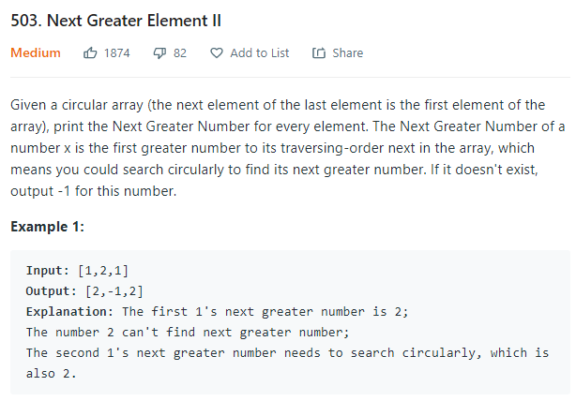
Source : leetcode
Explaination:
1. j%n to wrap around and use brute force.
[best and optimal]
2. i: 0 ->2n: [as wrap around won't work]
traverse and push index in stack if a[top] is greater. if greater element found then assigne output array[top] = a[i];
pop top.
Question -
Code-
//for ist one
https://leetcode.com/submissions/detail/419733306/
//for second (not my code)
vector<int> nextGreaterElements(vector<int>& nums) {
int n = nums.size();
vector <int> res(n, - 1);
stack <int> st;
for(int i = 0; i < 2 * n; i++){
int idx = i % n;
int x = nums[idx];
while(!st.empty() && nums[st.top()] < x){
res[st.top()] = x;
st.pop();
}
st.push(idx);
}
return res;
}
};
Learnings
If a problem requires you, to trace back in some way, stack can be used. Eg. if you keep pushing i in stack while traversing ... at i+1 stack will contain i. Pop and push based on required algo.

Slide 40
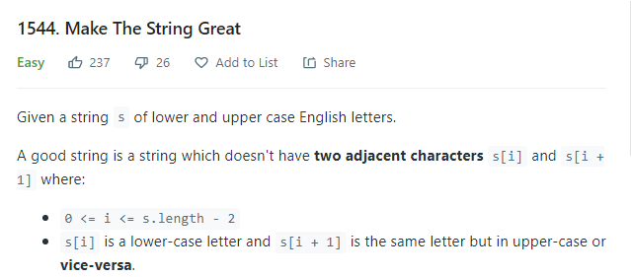
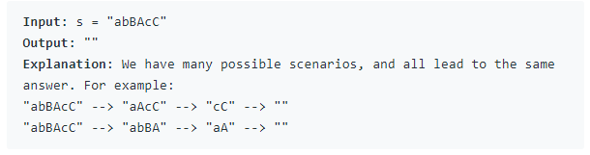
Source : leetcode
Explaination:
Apply learning from last question, use stack to edit the same string and not construct by brute force.
Question -
Code-
class Solution {
public:
string makeGood(string se) {
stack<char> s;
for(int i=0;i<se.size();i++){
if(!s.empty() && (abs((int)s.top() - (int)se[i]) == 32)){
s.pop();
}
else{
s.push(se[i]);
}
}
se = "";
while(!s.empty()){
se += s.top();
s.pop();
}
reverse(se.begin(),se.end());
return se;
}
};
Learnings

Slide 41
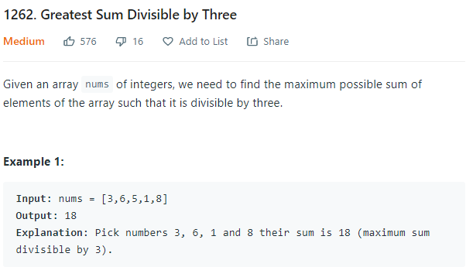
Source : leetcode
Explaination:
recursive solution to get all sum and return max divisilbe by 3.
Question -
Code-
class Solution {
void recur(vector<int> nums,int sum,int i,int &m){
if(i == nums.size()){
if( sum%3 == 0 && m< sum){
m = sum;
}
return;
}
recur(nums,sum,i+1,m);
recur(nums,sum+nums[i],i+1,m);
}
public:
int maxSumDivThree(vector<int>& nums) {
int m = 0;
recur(nums,0,0,m);
return m;
}
};
Learnings
Time limit exceeded. O(2^n)

Slide 42
Source : leetcode
Explaination:
Question -
Code-
Learnings

Slide 43
Source : leetcode
Explaination:
Question -
Code-
Learnings

Slide 44
Source : leetcode
Explaination:
Question -
Code-
Learnings

Slide 45
Source : leetcode
Explaination:
Question -
Code-
Learnings

Slide 46
Source : leetcode
Explaination:
Question -
Code-
Learnings

Slide 47
Source : leetcode
Explaination:
Question -
Code-
Learnings

Slide 48
Source : leetcode
Explaination:
Question -
Code-
Learnings

Slide 49
Source : leetcode
Explaination:
Question -
Code-
Learnings

Slide 50
Source : leetcode
Explaination:
Question -
Code-
Learnings

