Slide 1

Stylometric Analysis
Classic Techniques and Novel Approaches

Slide 2
Objective
Translator Profiling
Translator Identification
Challenges
Handling Texts of Unequal Length
Isolating Translator Style from Authorial Voice
Small Corpus Limitations

Slide 3
Classic Analysis Techniques
Novel Approaches
Complex Network Analysis
TTR Entropy
Network Motif Analysis
Centrality Rankings
Modularity Community Detection
Spectral Embedding
Word Frequencies
N-Gram Frequencies
Parts-of-Speech Tag Frequencies
Function Word Frequencies
Sentence Lengths
Punctuation Usage
Type Token Ratio

Slide 4

Complex Network Analysis
Step 1
Source Text
Step 2
Extraction
Step 3
Network Construction
ви́деть
знать
идти́
де́лать
ви́деть
ду́мать
знать
идти́
де́лать
ду́мать

Slide 5
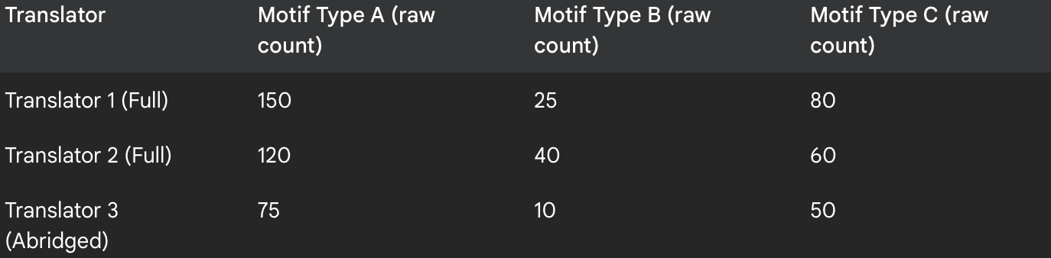
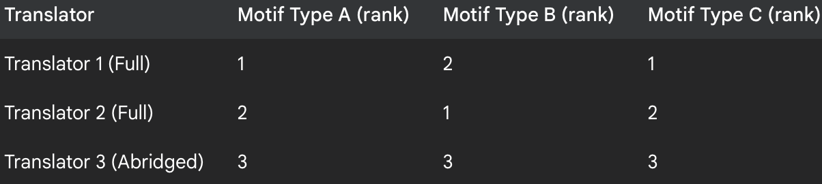
Bigram Adjacency Matrix
Network Motif Extraction
Counts vs Ranked Scaling
 | знать | идти́ | де́лать | ви́деть | ду́мать
знать | 0 | 3 | 1 | 1 | 2
идти́ | 3 | 0 | 2 | 6 | 12
де́лать | 1 | 2 | 0 | 0 | 1
ви́деть | 1 | 6 | 0 | 0 | 3
ду́мать | 2 | 12 | 1 | 3 | 0

Slide 6
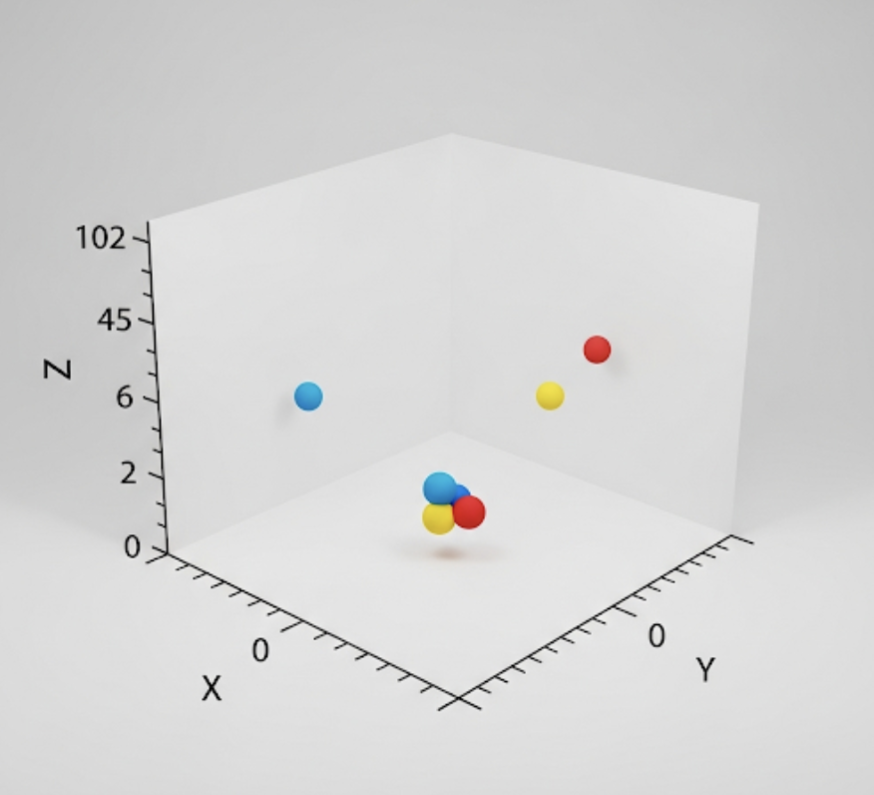
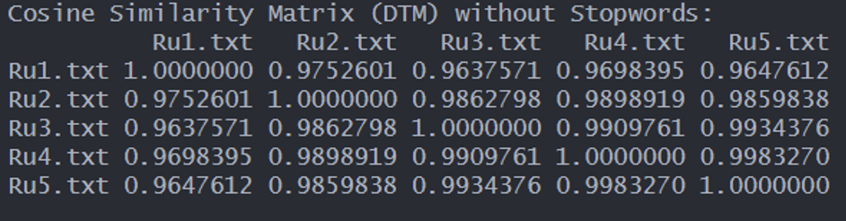
Spectral Embedding
L = D − W
L = Laplacian Matrix
D = Diagonal Degree matrix . Each diagonal entry D_{ii} is the sum of weights of the edges connected to node i.
W = weighted adjacency matrix, where W_{ij} represents the similarity or weight between nodes i and j.

Slide 7
Recommendations
Use Spectral Embedding for Visualization: This advanced technique is superior to PCA for our small corpus. It will create a more accurate map of the translators' stylistic clusters by better preserving local network structures.
Normalize for Text Length to Address Abridgement: Use "chunking" or split the corpus before applying classic tools. This is critical because these tools are highly sensitive to text length and will produce invalid results otherwise.
Employ Rank-Based Scaling for Network Analysis: For novel methods like network motifs and centrality, we will use ranks instead of raw counts. This minimizes length bias and is proven to be more effective at capturing the subtle, structural "thumb-print" of a translator's style.

Slide 8
Citations
Cooper, D. L., Ogoltsev, D., & Ondrejcek, M. (2023). Type-token ratio and entropy as measures to characterize a forgery of oral-formulaic epics. Oral Tradition, 36(1), 37–62.
Eder, M. (2017). Visualization in stylometry: Cluster analysis using networks. Digital Scholarship in the Humanities, 32(1), 50–64. https://doi.org/10.1093/llc/fqv061
El-Fiqi, H., Petraki, E., & Abbass, H. A. (2019). Network motifs for translator stylometry identification. PLoS One, 14(2), e0211809. https://doi.org/10.1371/journal.pone.0211809
Zenker, F., & Kyle, K. (2021). Investigating minimum text lengths for lexical diversity indices. Assessing Writing, 47(2), 100505. https://doi.org/10.1016/j.asw.2020.100505

