Slide 1

The Enigma Machine
BECQUET Victor

Slide 2
Table of contents
01
02
What is the Enigma machine
DECIPHERING
03
04
German Nazis’ Enigma
Breaking the Code

Slide 3
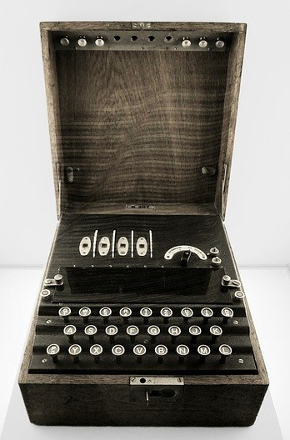
What is the Enigma machine ?
Cipher device
Invented in the early 1920s by the German engineer,Arthur Scherbius
Initially sold for commercial use

Slide 4
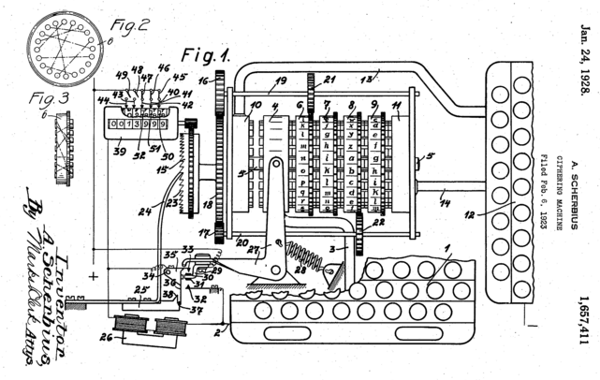
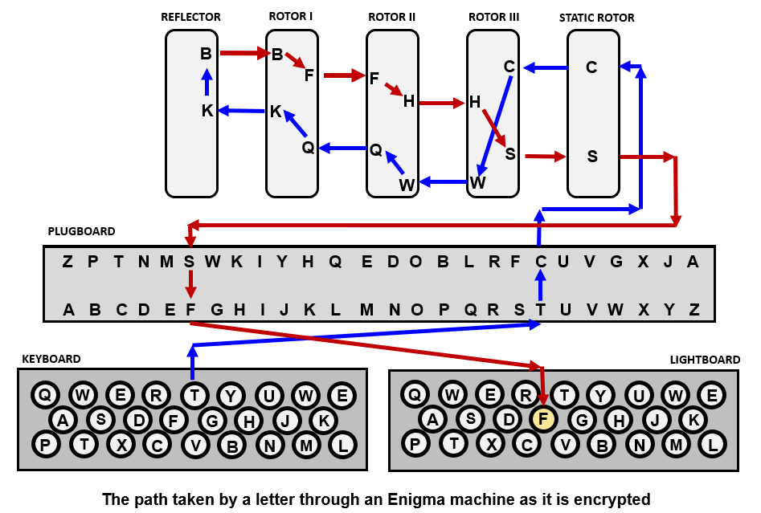

Slide 5
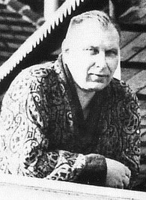
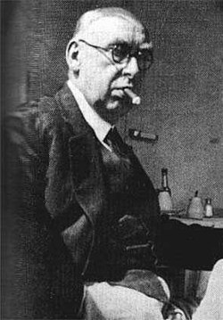
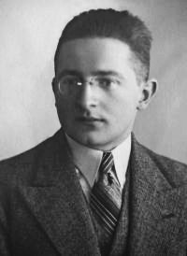
DECIPHERING
Hans-Thilo Schmidt
Rudolph Lemoine
Marian rejewski

Slide 6
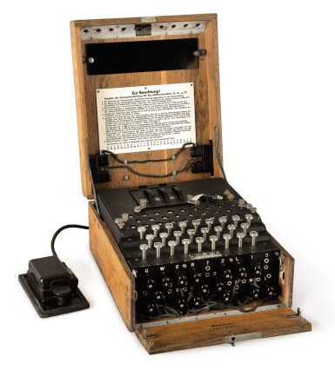
German Nazis’ Enigma

Slide 7
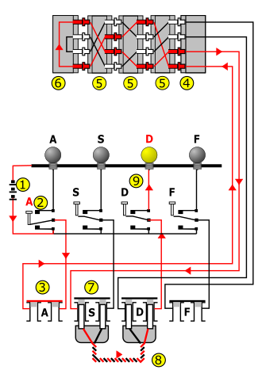
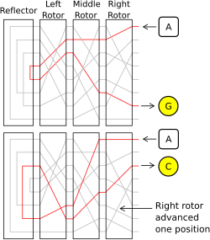

Slide 8
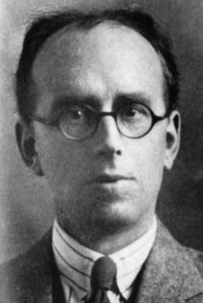
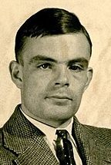

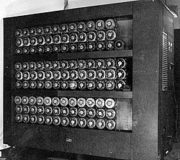
BREAKING THE CODE
DILLY KNOX
ALAN TURING
Bombe at Bletchley Park
HAROLD ‘DOC’
KEEN

Slide 9
Thank you for listening
Do you have any questions?

