Slide 1
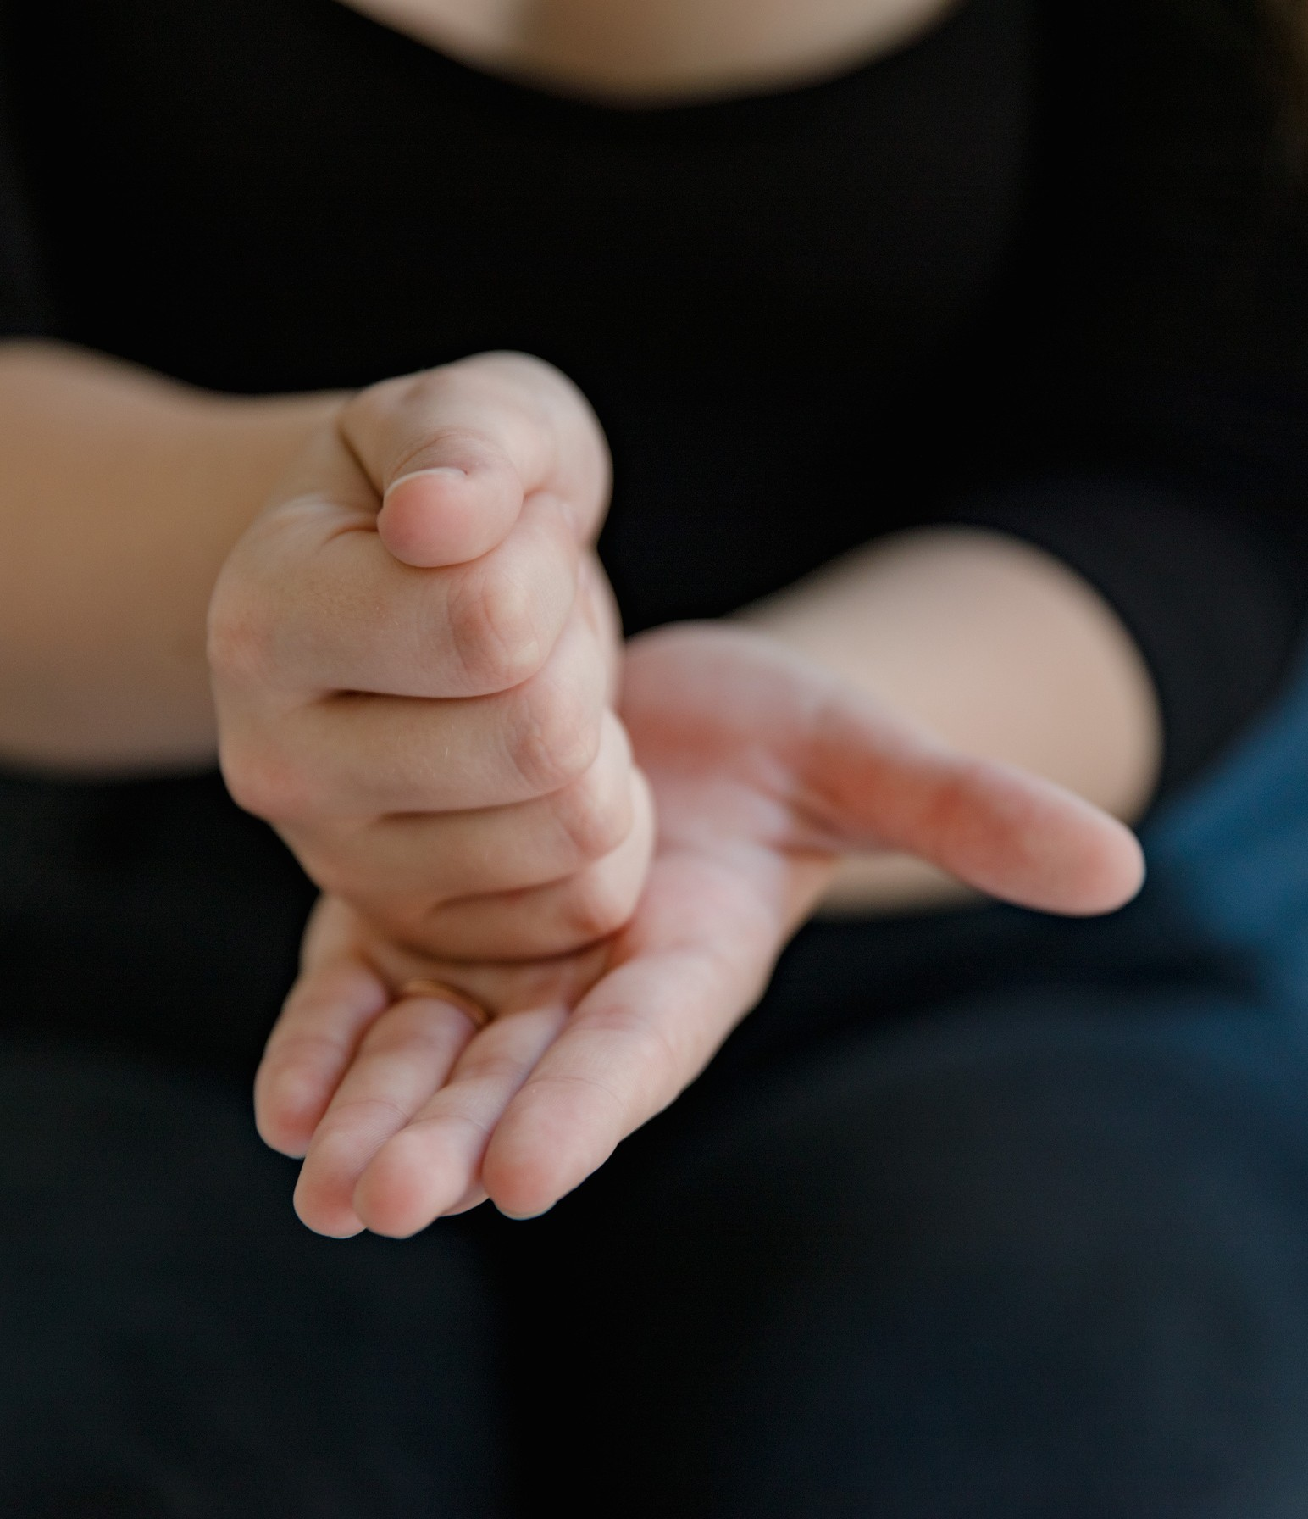
HARPOCRATES
SIGN LANGUAGE INTERPRETOR
Sai Vindhya Tennti 120106008
Elugam Rithvik 120106028
Kandi Arjun Redd0y 120106048

Slide 2
CONTENTS
1
Introduction
2
Problem Statement
3
Objective and Scope of project
4
Training and Testing method
5
Methods and Modules Used
6
Code and Output

Slide 3
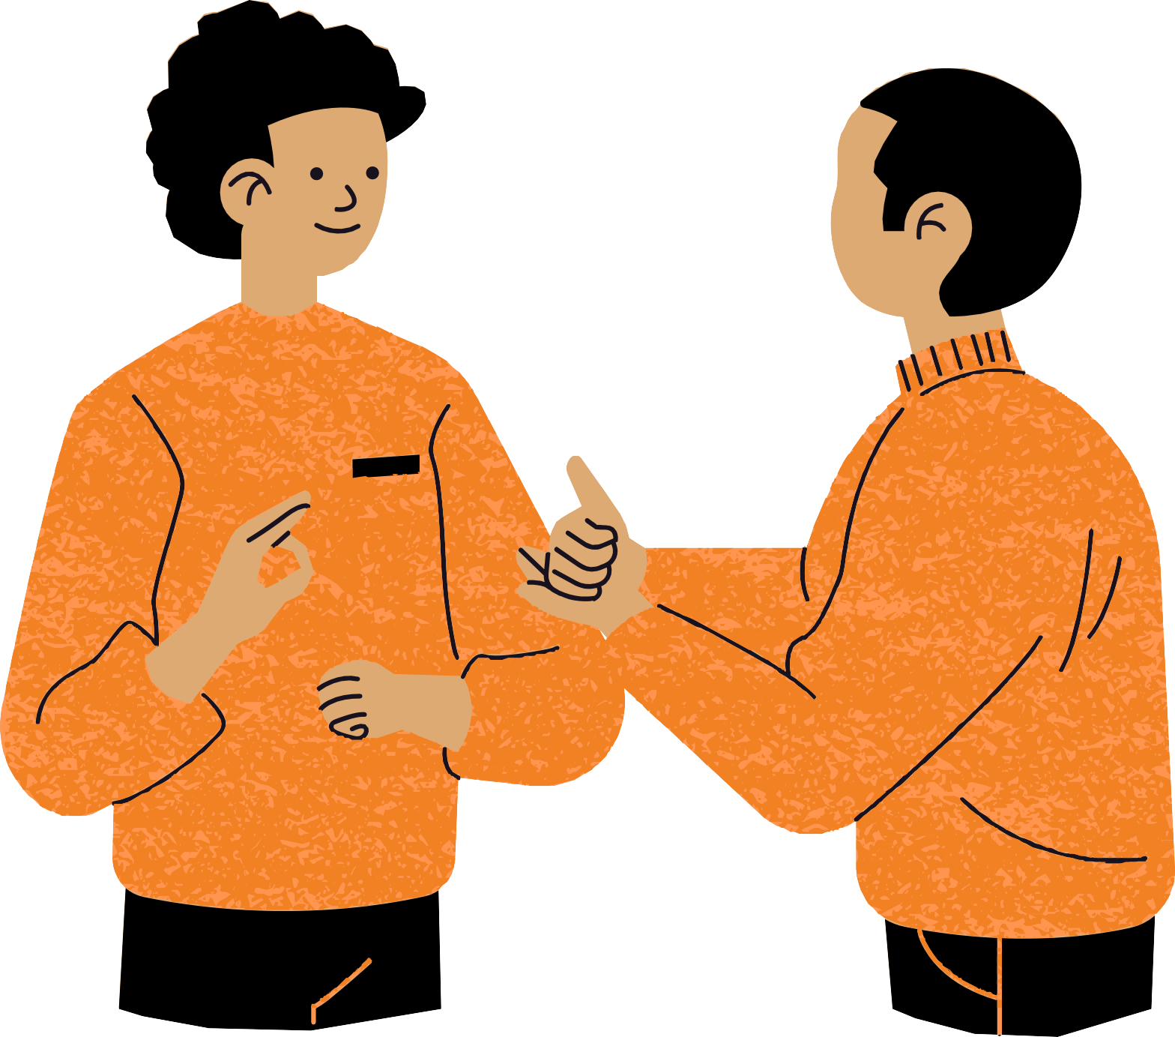
INTRODUCTION
Sign language is a form of communication that does not rely on acoustic sounds. Instead, sign language relies on sign patterns, such as body language, orientation, and arm movements, to facilitate communication between people. There are probably around two hundred sign languages in use today. It is estimated that there are between 9 and 14 million hearing impaired people in India, and that "one in every five people who are deaf in the world lives in India," making it the country with the most Deaf and possibly the most sign language users.

Slide 4
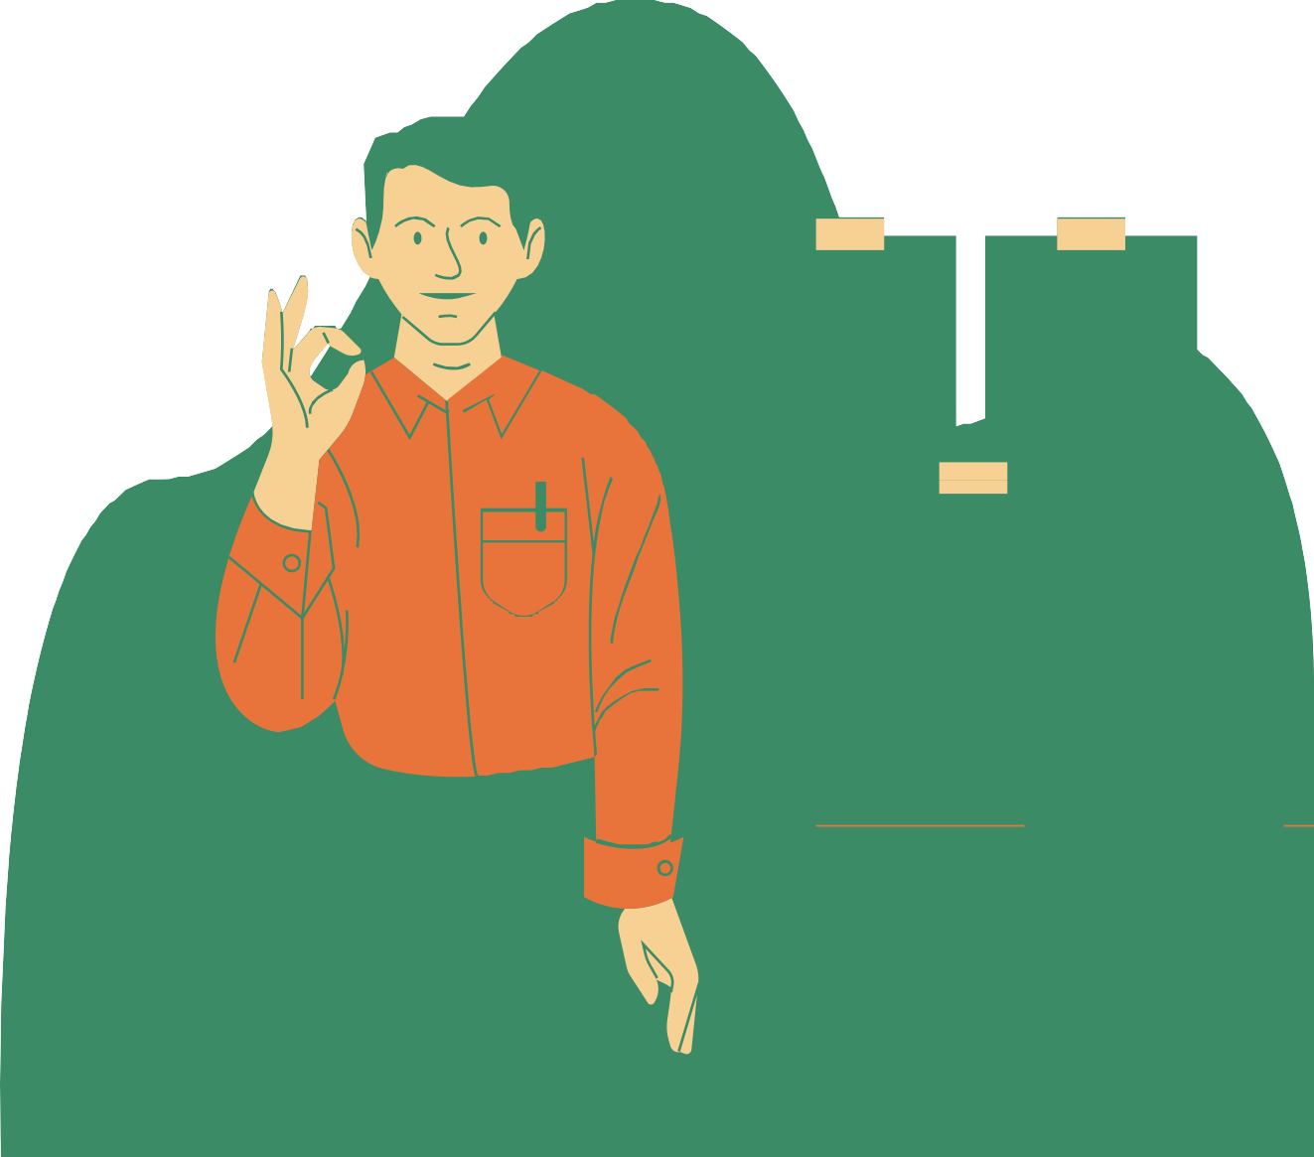

PROBLEM STATEMENT
Comunication with specially abled people.
Learning the sign language. Understanding the language. Having resources to learn them.

Slide 5






OBJECTIVE
Predicting the sign langauge through camera
Giving the result in sentence form for better understanding
Also can be used for letters with moment.

Slide 6
SCOPE OF THE PROJECT
Facilitating meaningful communication
Support education and awareness
Enhance accessibility

Slide 7
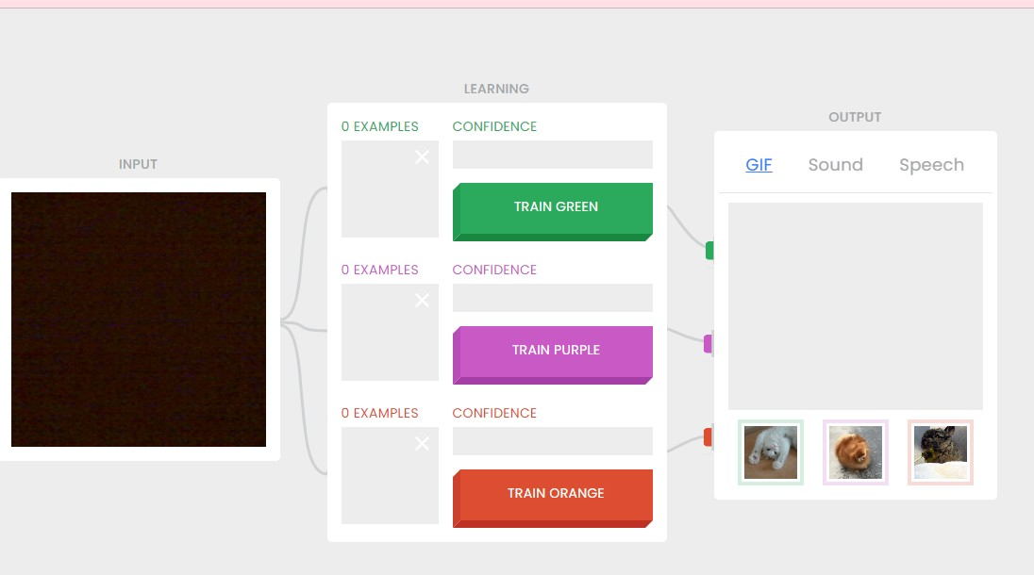
TRAINING AND
TESTING
We take the gif data and train it using a predefined training module called teachable machine, which uses keras and tensorflow models and neural network methods to generate a h5 file that we save and use in other code.

Slide 8
METHODS AND MODULES USED
PYTHON
NEURAL NETWORKS
TENSORFLOW
KERAS

Slide 9
METHODS AND MODULES USED
PIL
OPENCV
NUMPY
TKINTER

Slide 10
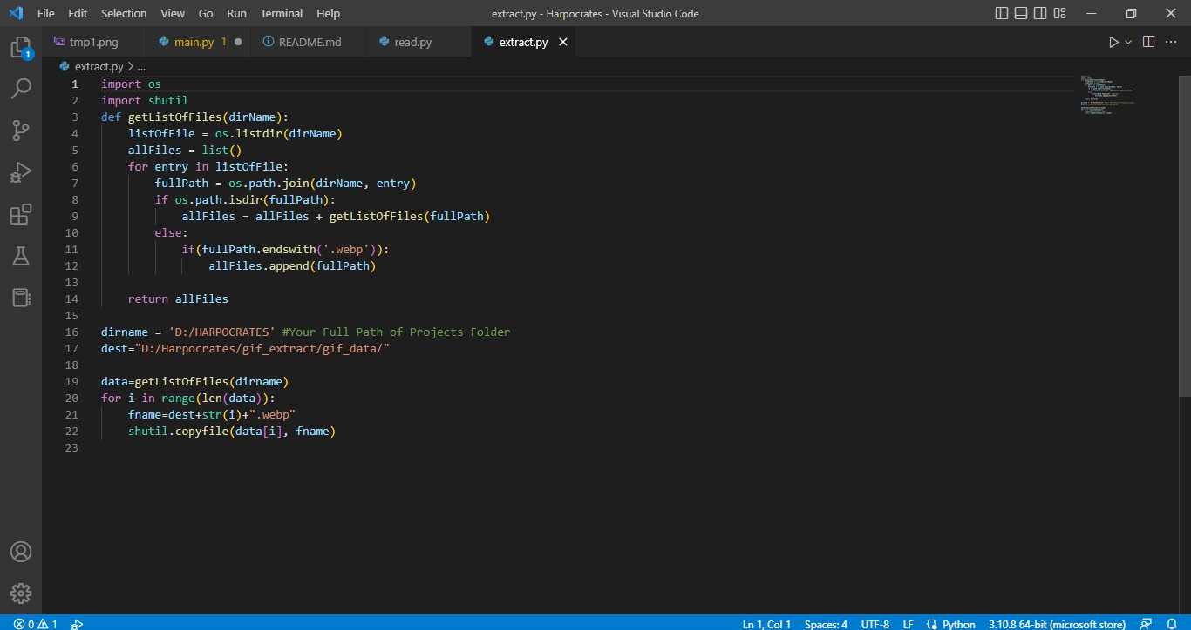

Slide 11
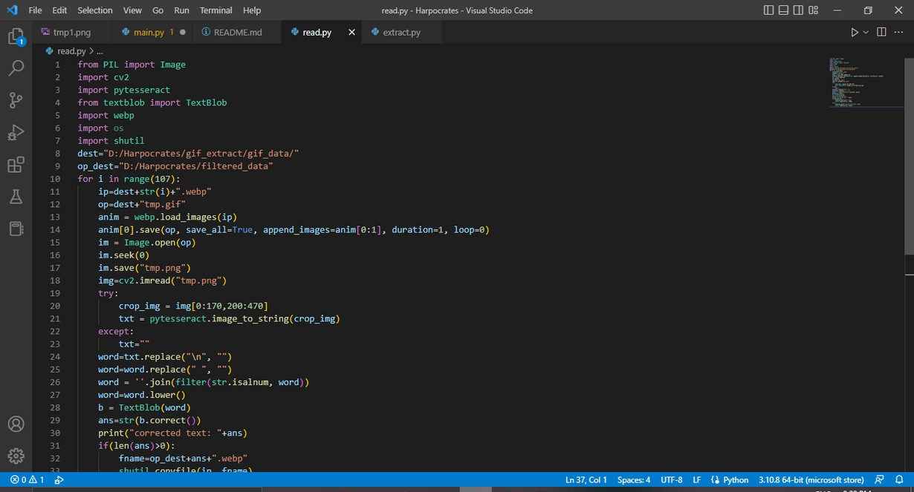
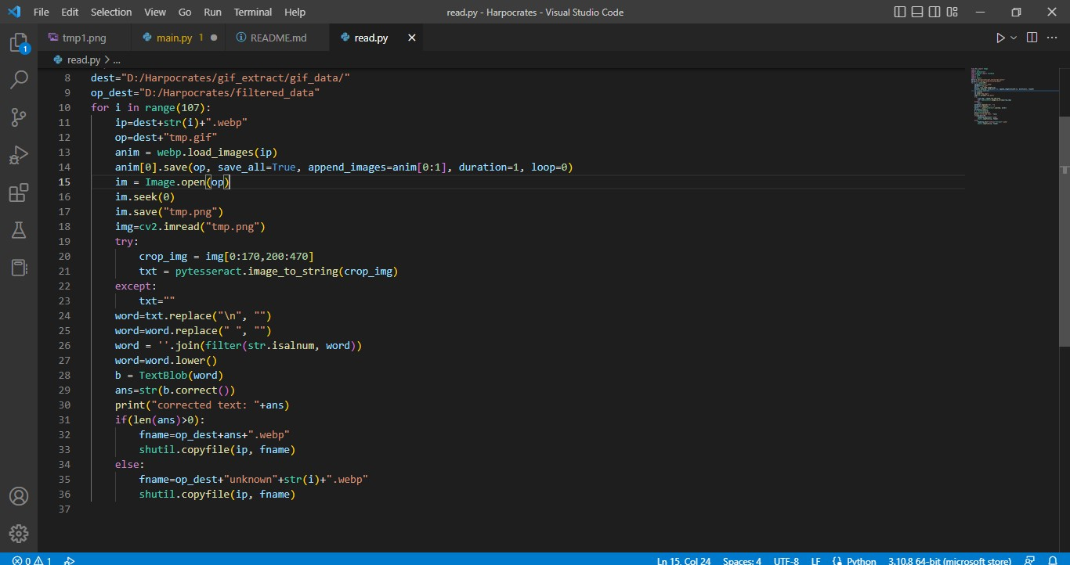
2

Slide 12
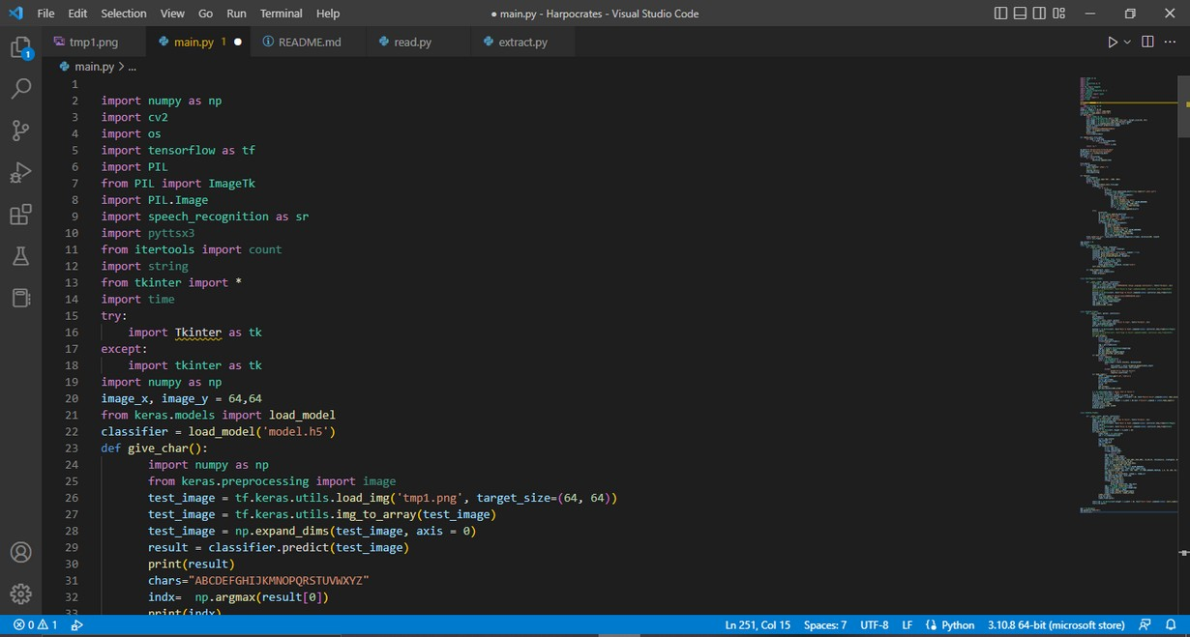
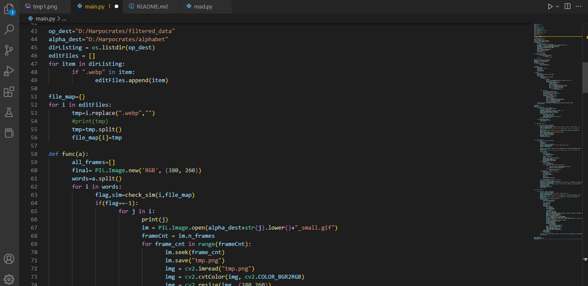
3.1

Slide 13
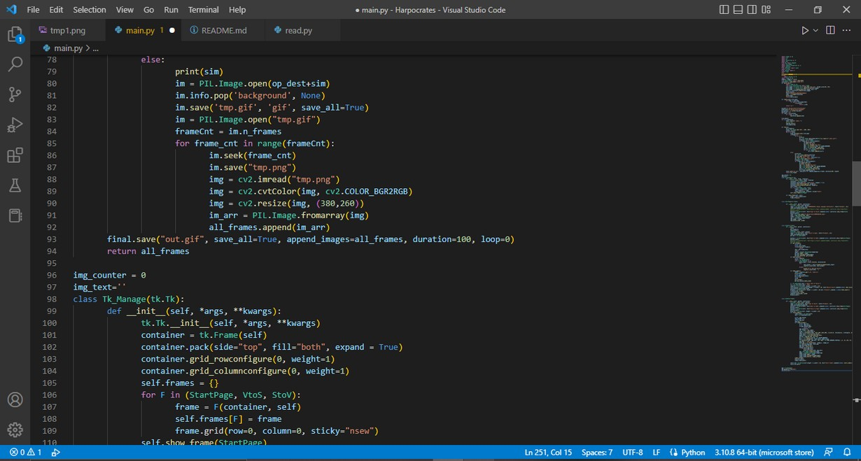
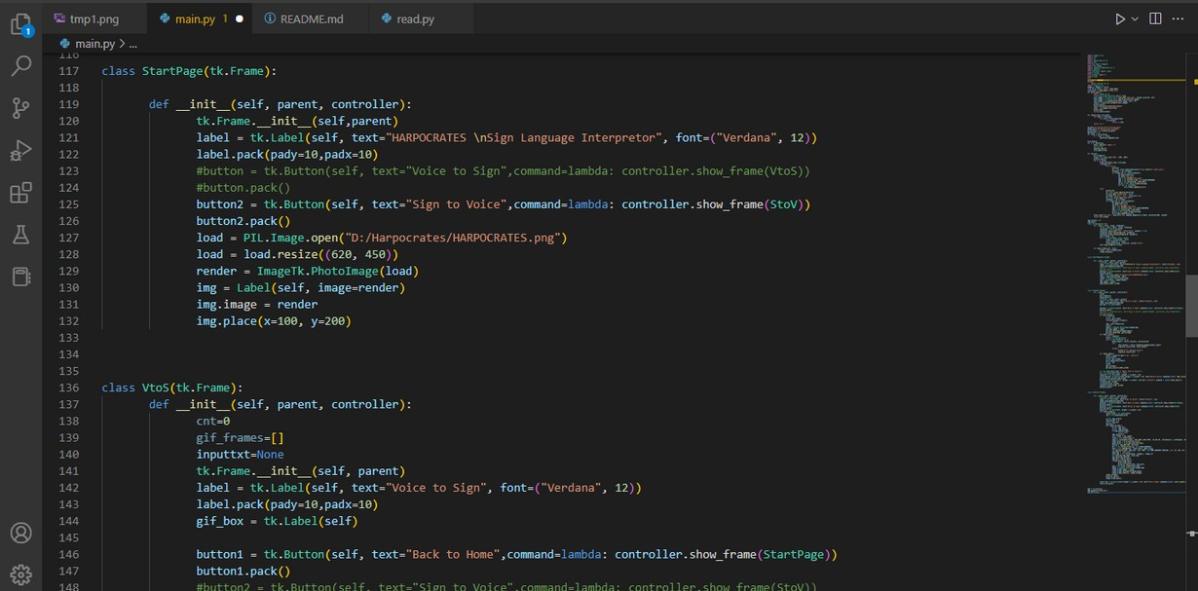
3.2

Slide 14
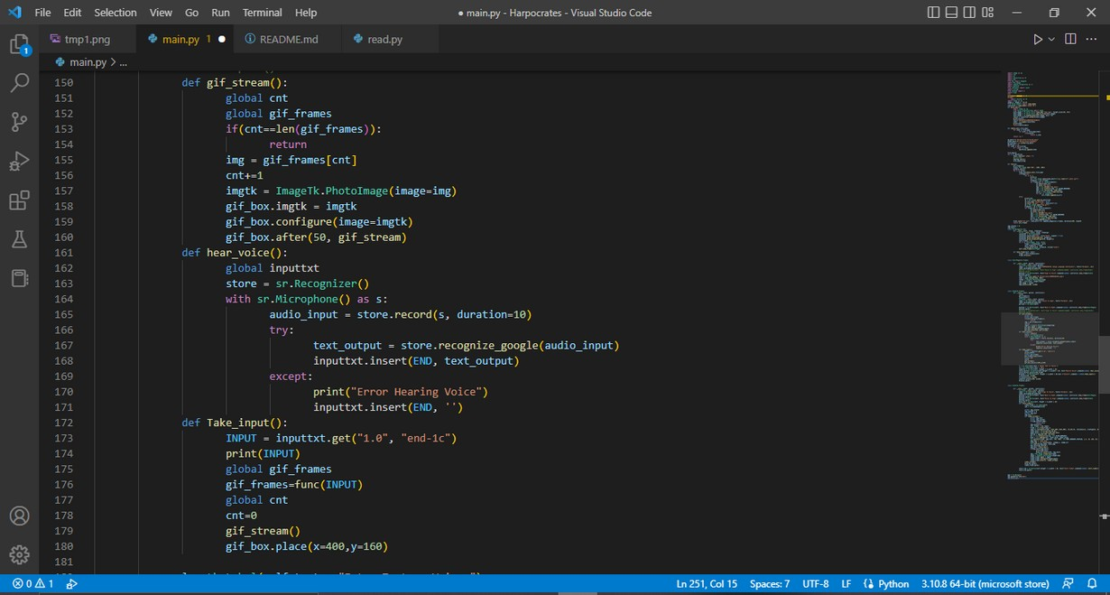
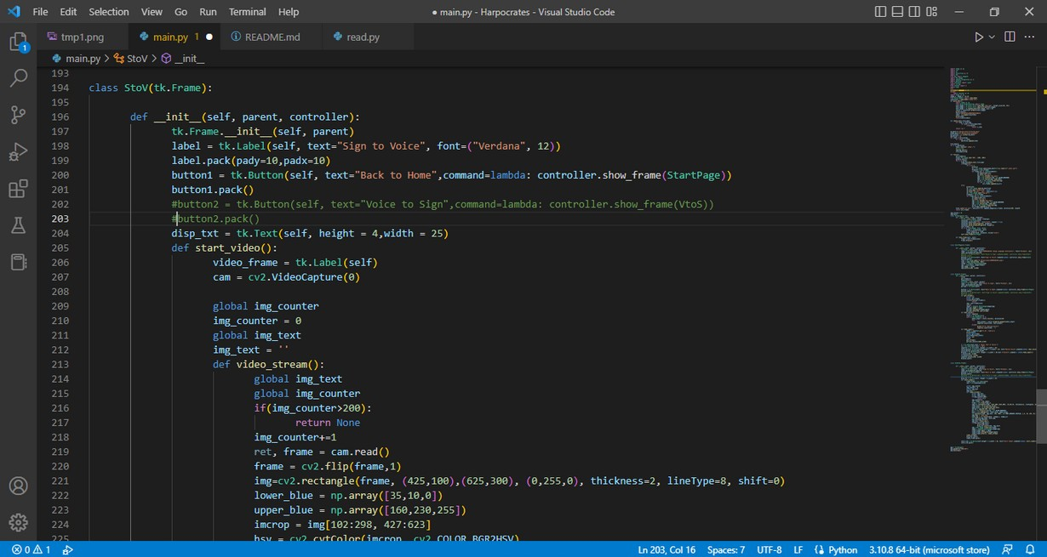
3.3

Slide 15
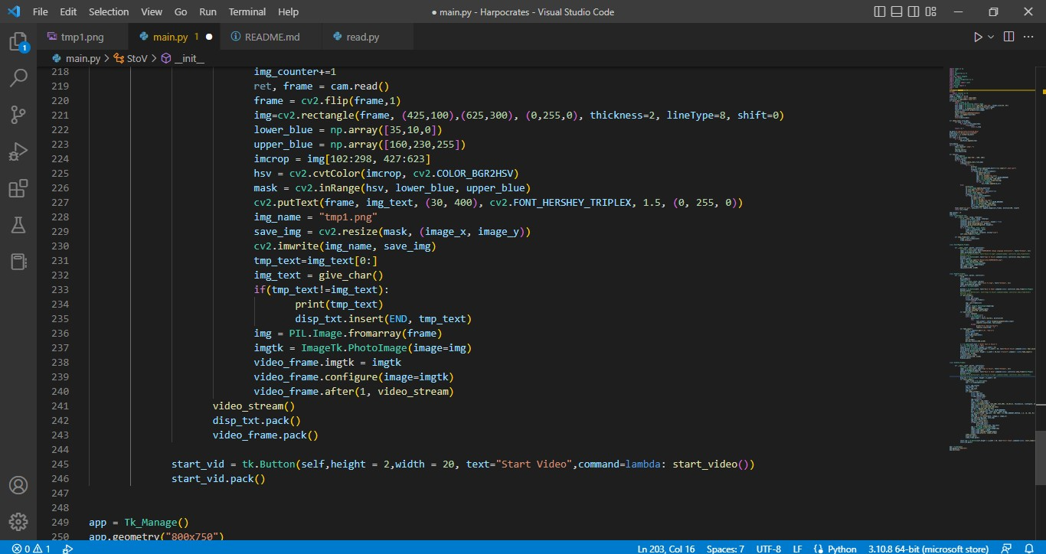
3.4

Slide 16
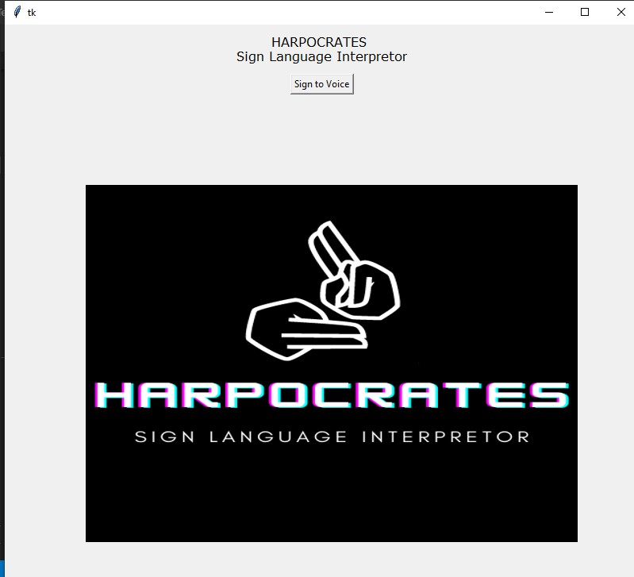
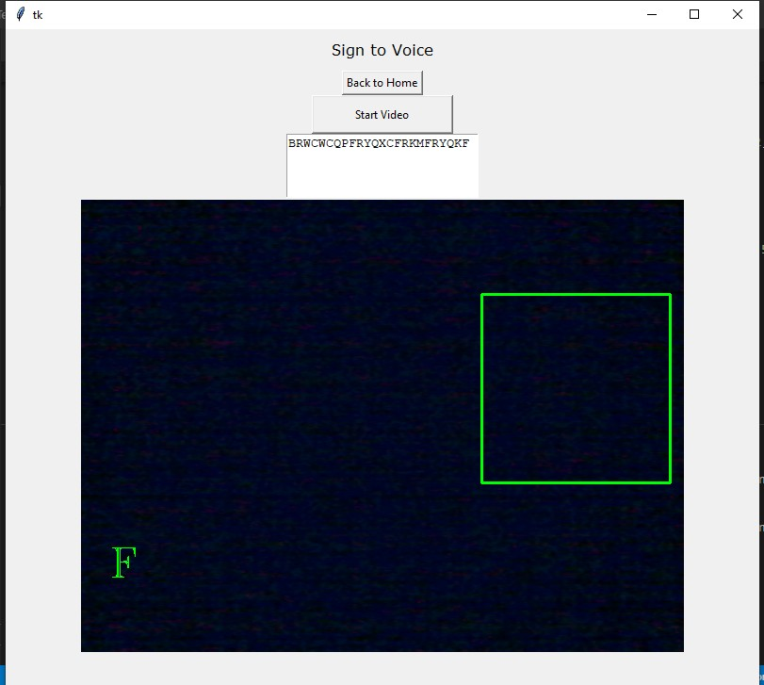
OUTPUT

