Slide 1

Assembly Unit Control System
PLC S7-300 Implementation & 3D Digital Twin Simulation in TIA Portal V20 and Factory I/O

Slide 2
System Overview & Goals
Designing and validating an end-to-end automated assembly line using digital twin technology before hardware deployment.

Slide 3

Key Software & Hardware
Siemens TIA Portal V20
Serves as the engineering software framework. Houses the CPU S7-300 logic, hardware conﬁguration, and S7-PLCSIM engine for real-time PLC execution without physical hardware.
Factory I/O Environment
Provides a realistic 3D industrial simulation scene for the Assembly Unit. Features realistic physics, sensors, pneumatic actuators, and discrete I/O communication drivers.

Slide 4
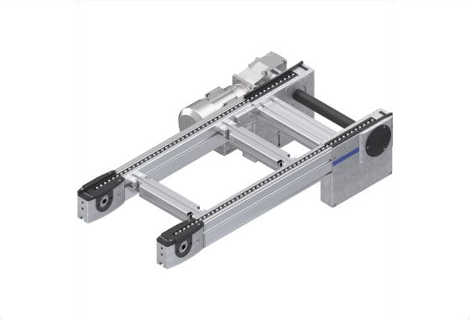
Factory I/O Assembly Cell
Part Conveyors: Transport base components and lid elements into the station.
Pneumatic Clamps: Securely hold base parts during press ﬁt operations.
Two-Axis Robot / Pusher: Picks or transfers assembled units onto the exit conveyor.
Optical Sensors: Detect part arrival, orientation, and clamping completion status.

Slide 5
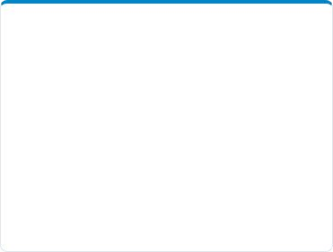
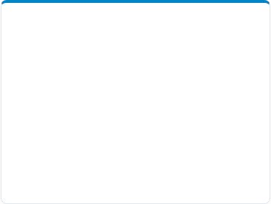
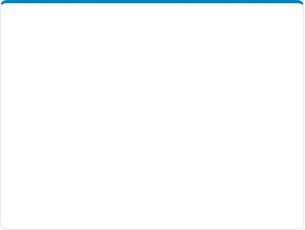



Core System Architecture
1. 3D Scene
Factory I/O simulates actuators, photoelectric sensors, and mechanical physical behaviors.
2. PLCSIM Driver
Bidirectional memory tag mapping connects S7-PLCSIM virtual registers to 3D I/O nodes.
3. PLC Program
TIA Portal S7-300 executes OB1 cyclic control, safety interlocks, and state machine FCs.

Slide 6

I/O Signal Mapping
Address | Signal Name | Type | Function Description
I 0.0 | Start_PB | BOOL (Input) | Main control panel system start button
I 0.1 | At_Place_Sensor | BOOL (Input) | Optical sensor detecting part positioned in clamp
Q 0.0 | Conveyor_Entry | BOOL (Output) | Drives motor for incoming raw component feed
Q 0.1 | Pneumatic_Clamp | BOOL (Output) | Extends cylinder to hold component during assembly

Slide 7






Sequence of Operations
Step 2: Clamp
Conveyor stops and pneumatic cylinder clamps part tightly in place.
Step 4: Exit
Clamp releases and exit conveyor transports ﬁnished product out.
Step 1: Feed
Raw part moves down entry conveyor until optical sensor detects position.
Step 3: Press
Vertical assembly arm lowers lid onto base to complete pressing sequence.

Slide 8
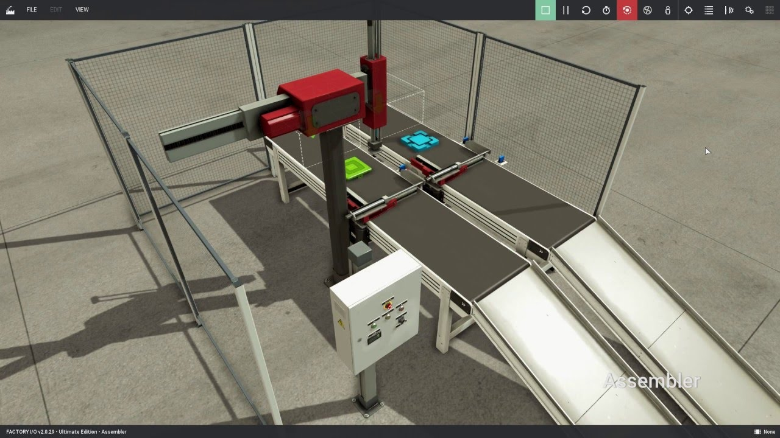
PLC Logic in TIA Portal
Structured Ladder Logic (LAD)
Main control execution runs inside OB1, calling modular Function Blocks (FC) for auto and manual modes.
Safety interlocks ensure cylinders cannot extend unless parts are conﬁrmed in position, preventing mechanical collisions in Factory I/O.

Slide 9
Performance & Precision
100%
Zero Hardware Downtime
By conducting full software-in-the-loop (SIL) testing with S7-PLCSIM and Factory I/O, control logic bugs and edge cases are resolved prior to physical implementation on site.
Virtual Validation

Slide 10
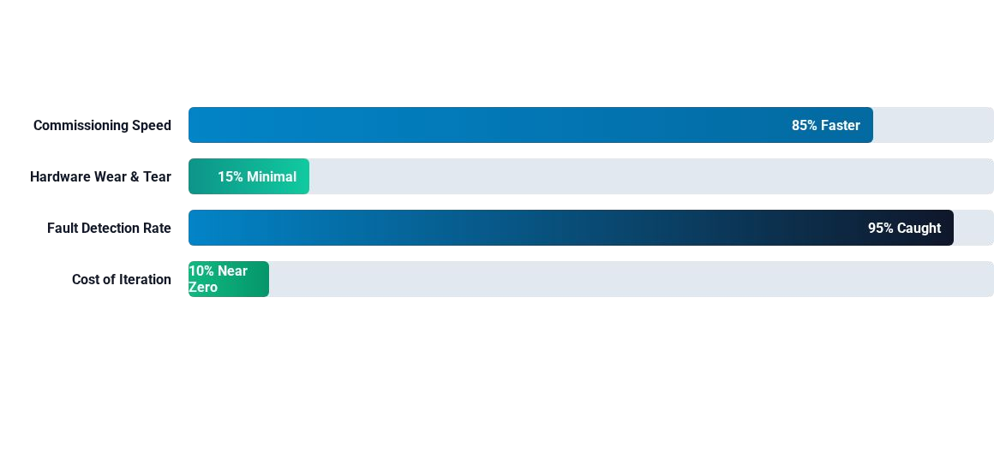
Virtual vs Physical Setup
Virtual commissioning
ith Factory I/O dramatically lo
ers deployment risk and dramatically speeds up code veriﬁcation cycles.

Slide 11
"Digital twin simulation turns complex PLC programming into
Engineering Impact
_{a safe, visual, and hig}—
hly deterministic engineering process.
— Industrial Automation Engineering Best Practice

Slide 12
Questions & Discussion
Thank you for attention!

Slide 13



GitHub и материалы проекта
github.com/ViyeiraAlmaz/Gantry-Robot
https://assets.rexroth.mam.bosch.tech/assets/api/acbcfafd-4781-4241-ad24-6decaab9b398/dc_ecommerce_big_j
^{p}S^{g}ource: www.boschrexroth.com
https://cdn.automationforum.co/uploads/2023/08/tia-portal-21-scaled.jpg
Source: automationforum.com
https://factoryio.com/

