Slide 1
Who are you?
Arthur Howard
  2nd semester Computer Science Major
  Made at least 4 games
  Plays Beatsaber and Smash
  Likes clever naming conditions

Slide 2
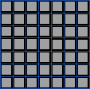
Peace by Piece
A ChessLike RTS game
*Concept Art
*Concept Art

Slide 3
Game at a Glance.
The game is like chess.
You start the game with a number of points.
You buy your starting pieces with the points.
Whenever you capture opponents you gain points which you can then spend on more pieces.
The goal of the game itself is to capture the enemy king, or gain a certain amount of points.

Slide 4
More Explanation.
7x7 Gameboard.
Extra points spawn in the middle of the board.
The economy ramps up over time, because the pieces
are worth more than they cost.
Placing a new piece takes your turn.
When placing a piece you must set it adjacent to
your king.
*Concept Art

Slide 5
Production Map
Setup tools, asses strengths, decide on general direction
Sprites that don’t look like garbage
A dynamic board of tiles
Pieces that can navigate board, and take other pieces
Giving the pieces individual rules to play by
Points system with piece placing
Begin Balancing
Good looking gui
Menus
Stretch Goals
  Custom boards, Sprite themes, online multiplayer?

Slide 6
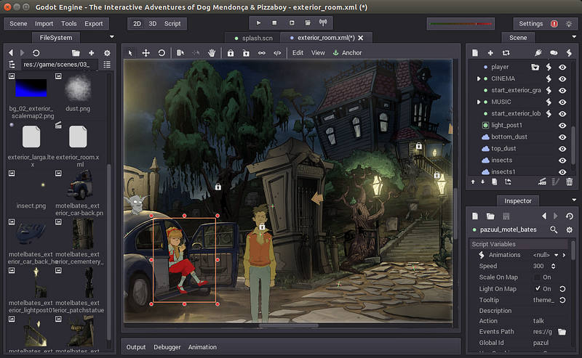
Tools we will be using.
Github
Godot
Slack

