Slide 1
Traffic Management system using IoT Phase: III
TEAM MEMBERS
Sri Arvind Neel raj Naraayanan Rajesh Arindran

Slide 2
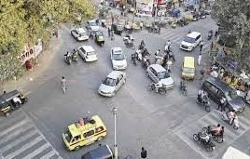
Introduction
Welcome to the presentation on Revolutionizing Trafﬁc Management System. This project utilizes IoT sensors to create an advanced IoT solution. By leveraging these technologies, we aim to optimize trafﬁc ﬂow, reduce congestion, and enhance overall road safety. Join us as we explore the potential of this groundbreaking project.

Slide 3

Table of contents
Design of our idea
Sensors Used Code
Sample output
Conclusion

Slide 4
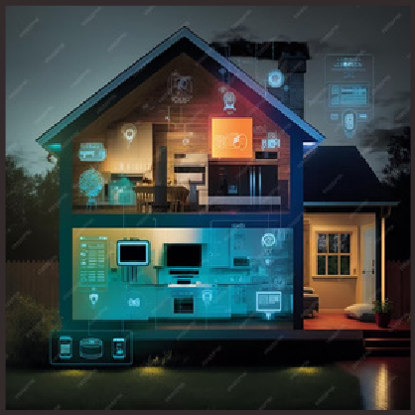
Design of thinking:
Smart Traffic Control
Enhance traffic flow by implementing sensor- based technology. When congestion surpasses a set threshold, traffic signal timers dynamically extend green light durations. This intelligent solution reduces wait times and eases congestion, optimizing traffic management at intersections. A forward- thinking approach to combat gridlock.

Slide 5
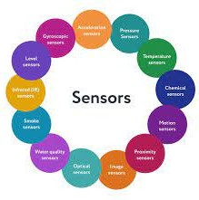
Sensors Used
Ultrasonic Distance Sensor - HC-SR04 (5V)
DHT22 AKA AM2302 ESP-32
Neo Ring light wires

Slide 6
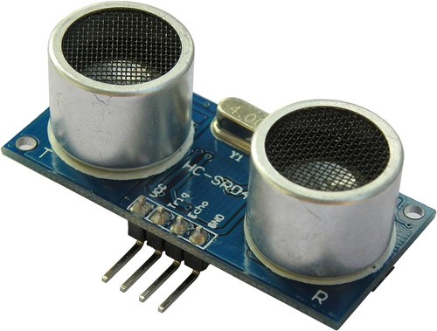
Ultrasonic Distance Sensor - HC-SR04 (5V)
The HC-SR04 Ultrasonic Distance Sensor is a popular and affordable sensor used for measuring distances. Operating at 5V, it works on the principle of sending ultrasonic waves and calculating the time it takes for them to bounce back after hitting an object. This data allows you to accurately measure distances, making it a valuable component in various applications like robotics, obstacle detection, and proximity sensing. Its simplicity and reliability make it a go-to choice for many electronics enthusiasts and engineers.

Slide 7
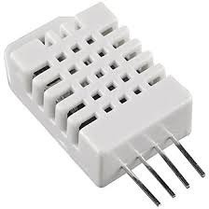
Digital-output relative humidity & temperature sensor (DHT- 22)
The DHT22 is a digital-output relative humidity and temperature sensor/module that provides accurate readings for both parameters. Also known as the AM2302, it offers a wide operating voltage range and communicates through a single-wire digital interface, making it relatively easy to integrate into projects. With its precision and compatibility, the DHT22 is a favored choice for weather stations, home automation, and IoT applications, enabling you to monitor and control indoor environments effectively.

Slide 8
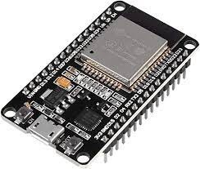
ESP-32
The ESP32 is a highly versatile microcontroller and wireless communication module developed by Espressif Systems. It features dual-core processors, Wi-Fi, and Bluetooth capabilities, making it a powerful and popular choice for IoT and embedded systems. With its extensive GPIO pins, low power modes, and compatibility with the Arduino IDE, the ESP32 is a go-to platform for a wide range of projects, from connected devices to robotics and automation, owing to its flexibility, connectivity options, and developer- friendly ecosystem

Slide 9
NEO Ring Light
TThe NEO Ring Light in IoT is a smart and versatile lighting solution designed for various applications. It integrates Internet of Things (IoT) technology to offer advanced control and automation features. Users can remotely adjust brightness, color temperature, and even schedule lighting through a mobile app or voice commands
Wires
Wires are conductive pathways that transmit electrical signals or power in electrical and electronic systems.

Slide 10
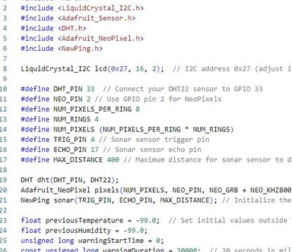
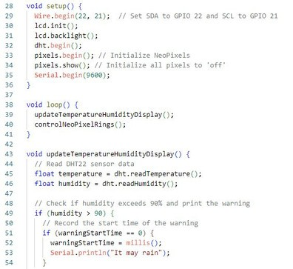
CODE

Slide 11
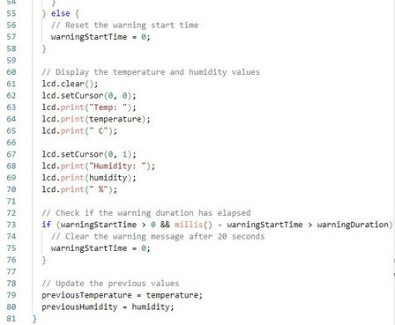
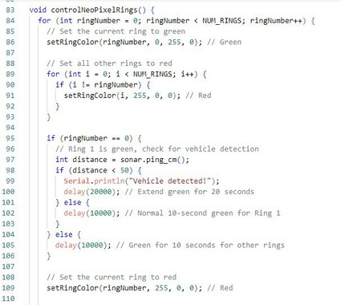
CODE

Slide 12
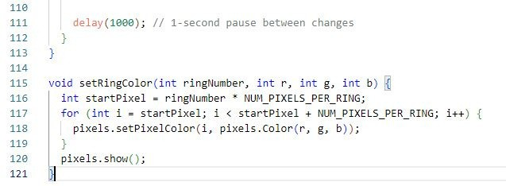
CODE

Slide 13
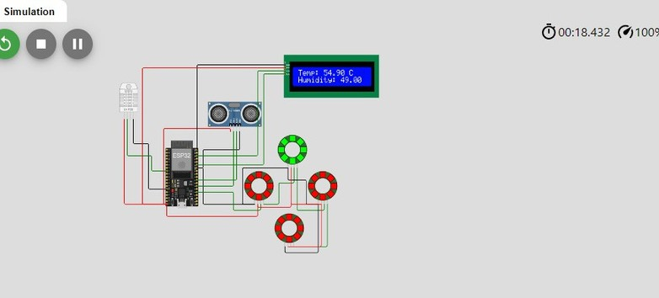
Sample Output

Slide 14
Conclusion:
In conclusion, this project demonstrates the successful implementation of smart traffic management using ultrasonic sensors and the HC-SR04 sensor module. By dynamically adjusting traffic signal timings based on congestion, we've shown a promising solution to reduce waiting times and alleviate traffic congestion at junctions. Moving forward, we plan to enhance and expand this project using Raspberry Pi technology, which will provide more computational power and connectivity options to further optimize traffic control and explore additional smart city applications
Thanks

