Slide 1
Group 4
Members:
Aman Khandelwal(U101116FCS007)
Sagnik Mitra(U101116FCS188)
Shashwat M. Shah(U101116FCS112)

Slide 2
Multi Source Multi Class Fake News Detection
Hamid Karimi
Proteek Chandan Roy
Sari Saba-Sadiya
Jiliang Tang

Slide 3
Description of Problem
Fake news is a term that has been used to describe very different issues, from satirical articles to completely fabricated news and plain government propaganda in some outlets. Fake news, information bubbles, news manipulation and the lack of trust in the media are growing problems with huge ramifications in our society. However, in order to start addressing this problem, we need to have an understanding on what Fake News is. These multiple sources provide rich contextual information about fake news and offer unprecedented opportunities for advanced fake news detection.

Slide 4
Our Work
Initially we collected necessary datasets
Divided them into training and test sets
Applied TF-IDF to evaluate how important is a word in a document
We use Multinomial Naive Bayes method to plot confusion matrix for our test data
When we take alpha = 0.01 then we get 89.8% accuracy.

Slide 5
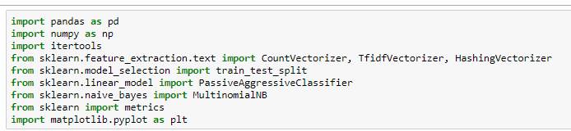
Libraries Used

Slide 6
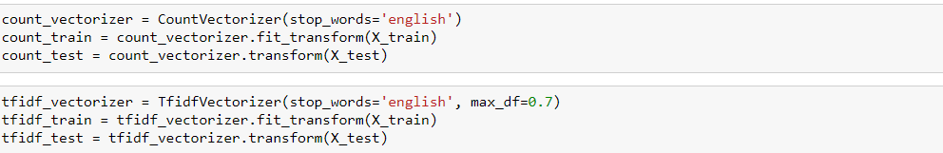
Building Vectorizer Classifiers

Slide 7
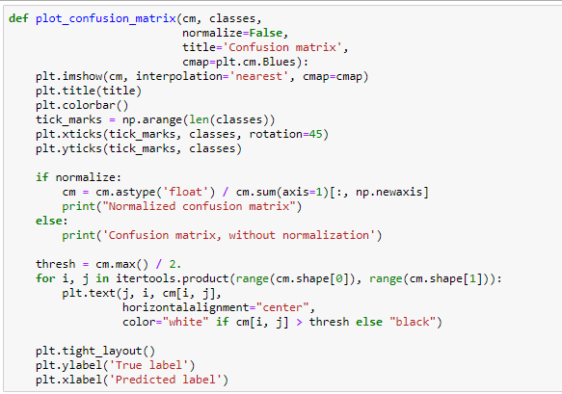
Confusion Matrix

Slide 8
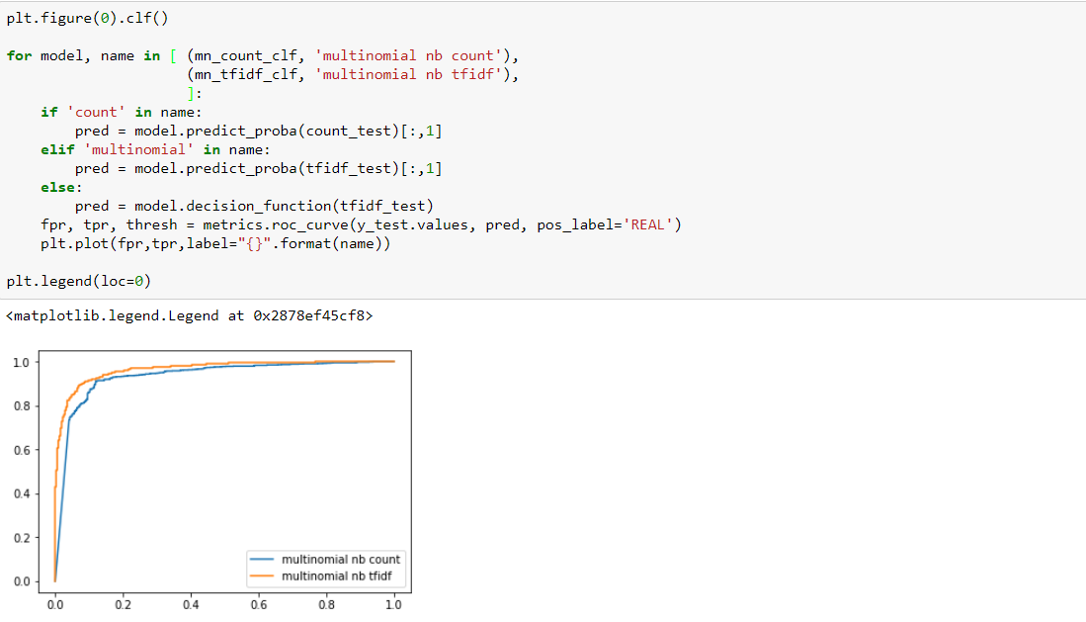
Comparing Models using graph

Slide 9
Which group member has done what?
Aman Khandelwal - Multinomial NB Tf-IDF
Sagnik Mitra - DataSet loading and comparison
Shashwat Shah - Multinomial NB Count

Slide 10
Dataset Used
https://www.kaggle.com/rchitic17/real-or-fake#fake_or_real_news.csv
In this CSV file, we have 4 columns: ID, Title, Text, Label

Slide 11
Conclusion
The fake news detection faces several challenges – how to incorporate multiple sources and how to discriminate degrees of fakeness. We applies Multinomial NB TF-IDF(89.8) and Multinomial NB count(89.3) on our dataset and compare their results. On comparison we get Multinomial NB TF-IDF has more accuracy.

Slide 12
THANK YOU

