Slide 1
TEAM XCHANGE VISHNU MR(E22CSEU0125)

Slide 2
FOREIGN EXCHANGE RATE ANALYSIS INR(₹) V/S USD($ )

Slide 3
Table of contents
01
Introduction
02
Abstract
03
Method
04
Results
05
Conclusion

Slide 4
—J. Paul Getty
“Buy when everyone else is selling and hold until everyone else is buying. That’s not just a catchy slogan. It’s the very essence of successful investing.”

Slide 5
01
Introduction
Why we started

Slide 6
Introduction
In the fast-paced world of finance, the ability to accurately predict the future prices of assets is of paramount importance.

Slide 7
Introduction
However, as markets become increasingly complex and dynamic, the question arises: can we improve the efficiency of these predictive models by incorporating more comprehensive data?

Slide 8
02
Abstract
What are we doing?

Slide 9
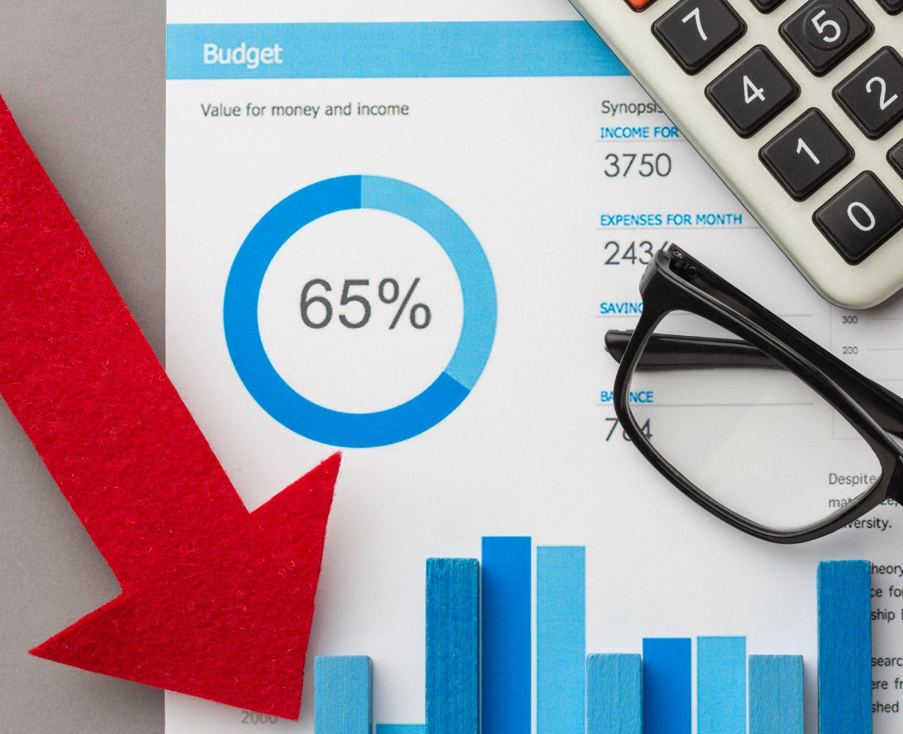
What Are We Doing?
This study investigates the efficiency of predicting the close values of financial instruments, such as stocks one using the Open, High, Low, and Close (OHLC) data and the other relying solely on historical price values.

Slide 10
What is OHLC?

Slide 11
What is OHLC?
Open(O)
High(H)
Low(L)
Close(C)
Price at which a financial instrument started trading at the beginning of a specific time period.
Price at which a financial instrument ended trading at the end of a specific time period.
Lowest Price the financial instrument reaches during specific time period
Highest Price the financial instrument reaches during specific time period

Slide 12
03
Methods
How are we doing it?

Slide 13
Methods
We are trying to compare close value when open,high and low values are given and when historical data is given utilizing Linear Regression and graph plotting.

Slide 14
Methods
And anazlyzing the error that occurs from both the observations and observing the Bear and Bull Period over time.

Slide 15
Bear?...Bull?
What are these animals referring to?

Slide 16

Bull Analogy
In a financial context, a "bull market" is a period when prices of stocks, currencies, or other assets are generally rising or expected to rise.

Slide 17

Bear Analogy
In a "bear market," prices of assets are generally falling or expected to fall.

Slide 18
04
Results
What did we find?

Slide 19
Things to know before results?
We are predicting the close value data for 3rd November 2023, according to the real world statistics the close value on that day was ₹83.1745 and our data extends form December 2003-August 2023

Slide 20
Initiative prioritization matrix: impact & effort
Historical Data Analysis
OHLC
Using Historical data analysis the predicted value was found to be ₹81.065
Using Open , High and Low data analysis the predicted value was found to be ₹83.258

Slide 21
Where is Bear and Bull?

Slide 22
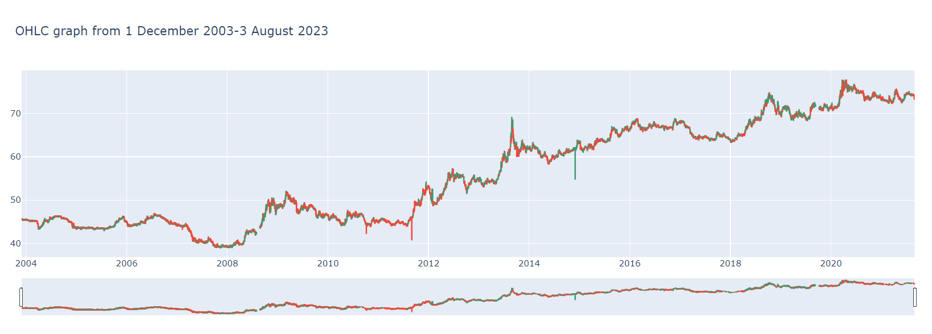
Bear and Bull Graph

Slide 23
05
Conclusion
What did we observe?

Slide 24
Conclusion
We Observed that for predicting the closing values for a certain day or date we would require more than just historical data for a good guess of the price for an upcoming financial season.

Slide 25
Thank You!

